Slide 1
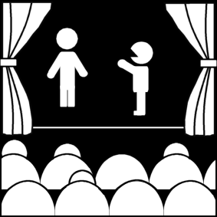
Elements of Theatre Audience and Theatre
Week 2
Introduction to Theatre
College of the Desert

Slide 2
Special Qualities of Theatre
Theatre is lifelike and familiar – it is an imitation of humans in action.
Theatre is also exotic – characters are different from us.
Verisimilitude – lifelikeness
"Eros" – the fact that humans are before us on stage is inherently "erotic."
Fleeting – not recoverable – one performance cannot ever be like the rest.
Objective: the audience gets only what the characters do or say – does not have vantage point of prose fiction, where the author can comment on action / characters.
Complex: -- uses complex means – all art forms – to convey.
Theatre is Immediate: happens to us now and never again the same way.

Slide 3
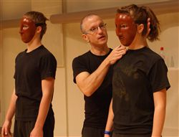
Special Qualities of Theatre
Audience:
We bring our own experiences with us and help dictate the kinds of theatre done
We participate – our presence affects the event
Performers:
Have different training, experiences, talents, perceptions, and imaginations
What is performed:
Usually a script (play) – but not always written down
Improvisation -- “action “ embodied by performers and seen by audience
Simplified definition of a theatrical event:
A does to B with C watching
Structure of plays and acting styles will influence
Performance:
All elements together – performers, sets, costumes, lights, makeup, sound, audience, what is performed, environment
Environment:
Physical environment
Social – can affect attitudes
Can make a non-political play or non-socially-significant play political or significant

Slide 4
How does theatre appeal to audiences?
1. Sensory stimulation (light and sound):
Eros – the live performer a powerful appeal to our senses
Theatre critic Walter Kerr -- ("We are contenders, making the play and the evening and the emotion together. We are playmates, building a structure.")
Theatron – seeing place – Greek
Auditorium – hearing place – Roman
Drama comes from the Greek verb "dran" – to do or to act = action
Vision is most powerful
Sound is another strong sense

Slide 5
How does theatre appeal to audiences?
2. Human Values – story and character inherent in the text of any play:
Stories are compelling – a framework for other values. Response comes from suspense, surprise, revelations, unfolding of events, reversals discoveries. Audience can anticipate if prepared for.
Character – the representation of a human being in a theatrical performance (or in the literary work) – as much as the audience needs to know....
We identify – that character is like me.
Subconscious references (like nightmares).
Association – historical people, people from our pasts.

Slide 6
How does theatre appeal to audiences?
3. Artistic Excellence
4. Intellectual Value
The idea, or theme ("the me") usually takes care of itself, if presented well – becomes more acute over time
Performance values must succeed to communicate idea
All four of these work together... reading a play is only part of its potential.

Slide 7
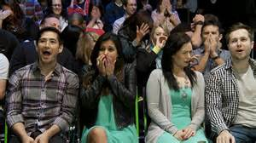
How does theatre appeal to audiences?
Audience sees:
Innovation
Style
Historical period
Level of abstraction
Social class
Given circumstances
A danger:
The "Affective fallacy" – responding to our own perceptions only
For instance, someone undergoing a divorce / separation might react to the play, Kramer versus Kramer in a different way from someone else; similarly, one who has had the experience of suicide in their lives might react quite differently to the play Ordinary People than someone else).

Slide 8
Realistic vs. Non-Realistic Elements
Realistic
Story
Non-Realistic
Story
Events which the audience knows have happened or might happen in everyday life.
For example:
Blanche DuBois in the play, A Streetcar Named Desire, goes to New Orleans to visit her sister and brother-in-law.
Events which do not take place in real life but occur only in the imagination.
For example:
Emily in Thornton Wilder’s Our Town, after she has died, appears alive and returns to visit the Earth for one day.

Slide 9
Realistic vs. Non-Realistic Elements
Realistic
Structure
Non-Realistic
Structure
Action is confined to real places; time passes normally as it does in everyday life.
For example:
In the play ‘Night, Mother, the clock on the stage is the same time as it is in real life and plays out as such.
Random use of time and place.
For example:
In August Strindberg’s The Dream Play, walls dissolve and characters are transformed, as in a dream.

Slide 10
Realistic vs. Non-Realistic Elements
Realistic
Characters
Non-Realistic
Characters
Recognizable human beings – such as a family.
For example:
In Eugene O’Neil’s Long Day’s Journey into Night, there are clear characters in the play such as the mother, father, and two sons.
Unreal figures like a ghost.
For example:
In William Shakespeare’s Hamlet, the character of Hamlet’s father is a ghost, or in his play Macbeth, the three witches are non-realistic characters.

Slide 11
Realistic vs. Non-Realistic Elements
Realistic
Acting
Non-Realistic
Acting
Performers portray people as they behave in daily life.
For example:
The character of Nora Helmer in Henrik Ibsen’s A Doll’s House leaves her husband and an unsatisfactory marriage in a believable, forthright manner.
Performers enact ghosts and animals; they also engage in singing, dancing, acrobatics, and gymnastics in musical comedy or performance art.
For example:
Any Cirque du Soleil performance.

Slide 12
Realistic vs. Non-Realistic Elements
Realistic
Language
Non-Realistic
Language
Ordinary dialogue or conversation.
For example:
The gentleman caller in Tennessee Williams’ The Glass Menagerie tells Laura about his future in the language of an optimistic young salesman.
Poetry.
For example:
In most of William Shakespeare’s play, some see his language as poetry, or in the musical West Side Story, the song “Tonight” sung to Maria is seen as poetic.

Slide 13
Realistic vs. Non-Realistic Elements
Realistic
Scenery
Non-Realistic
Scenery
Rooms of a real house.
For example:
The play You Can’t Take It With You, uses a realistic set, and Chekhov’s play The Cherry Orchard uses a realistic set.
Abstract forms and shapes on a bare stage.
For example:
In most Greek plays such as Sophocles’ Electra.

Slide 14
Realistic vs. Non-Realistic Elements
Realistic
Lighting
Non-Realistic
Lighting
Lights onstage appears to come from natural sources – a lamp in the room or sunlight.
For example:
In Ibsen’s Ghosts, the sun is supposed to rise through the window and the lighting designer will try to accurately portray that.
Shafts of light fall at odd angles, also colors in light are used randomly.
For example:
A single blue spotlight used on a singer in a musical comedy.

Slide 15
Realistic vs. Non-Realistic Elements
Realistic
Costumes
Non-Realistic
Costumes
Ordinary street clothes.
For example:
All the characters in August Wilson’s play Fences wear everyday clothes from the 1950s.
The bright costumes of a chorus in a musical comedy.
For example:
The strange costume that is usually worn by Caliban, the half-man, half beast in William Shakespeare’s play The Tempest.

Slide 16
Realistic vs. Non-Realistic Elements
Realistic
Makeup
Non-Realistic
Makeup
The natural look of characters in a domestic play.
For example:
All the characters in Lorraine Hansberry’s play A Raisin In the Sun.
Masks worn by characters.
For example:
Masks were used frequently in Greek tragedies.

Slide 17
Drawbacks
Theatre is:
A minority art
Only one audience, a few people at a time, can see a performance. Compare that to a film showing in 3,500 theatres.
An expensive art
There are weekly salaries and ongoing expenses.
An obscure art
There is less chance of fame for its artists.

Slide 18
The Basic Elements of Theatre
Script/Text, Scenario, Plan:
This is the starting point of the theatrical performance. The element most often considered as the domain of the playwright in theatre. The playwright’s script is the text by which theatre is created. It can be simplistic, as in the 16th century, with the scenarios used by the acting troupes of the Commedia dell’ Arte, or it can be elaborate, such as the works of William Shakespeare. The script, scenario, or plan is what the director uses as a blueprint to build a production from.

Slide 19
The Basic Elements of Theatre
The Process:
This is the coordination of the creative efforts usually headed up in theatre by the director. It is the pure process by which the playwright’s work is brought to realization by the director, actors, designers, technicians, dancers, musicians, and any other collaborators that come together on the script, scenario, or plan. This is the works in progress stage.

Slide 20
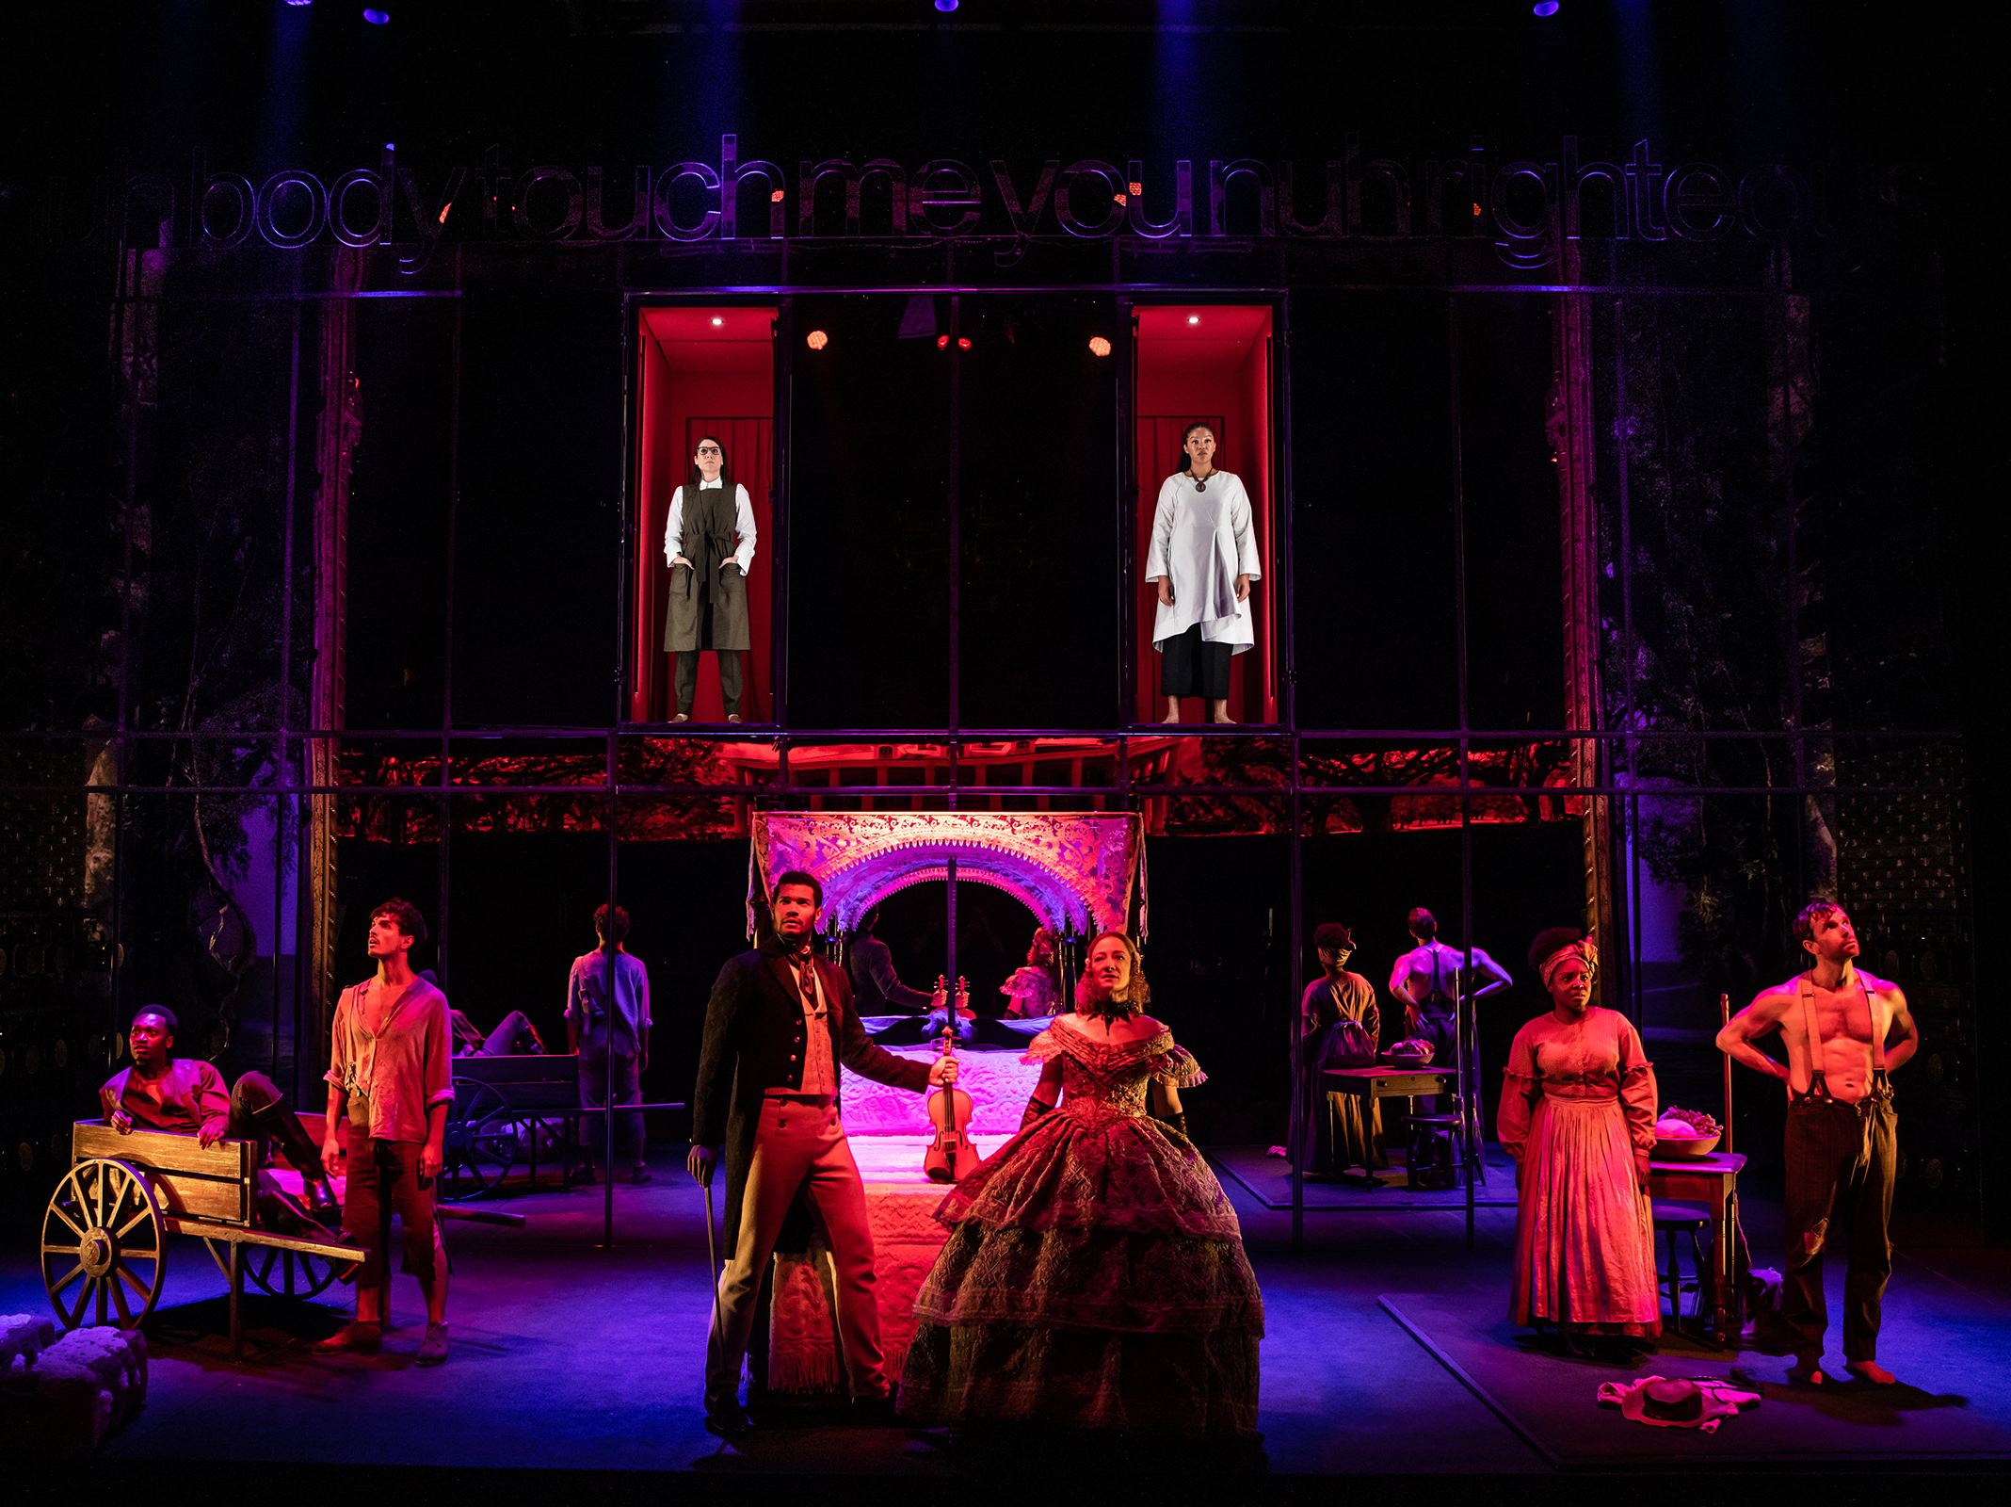
The Basic Elements of Theatre
The Product:
This is the end result of the process of work involved. The final product that results from all of the labors coming together to complete the finished work of script, scenario, and plan, in union with all of the collaborators in the process to create the final product. This is what the audience will witness as they sit in the theatre and view the work.

Slide 21
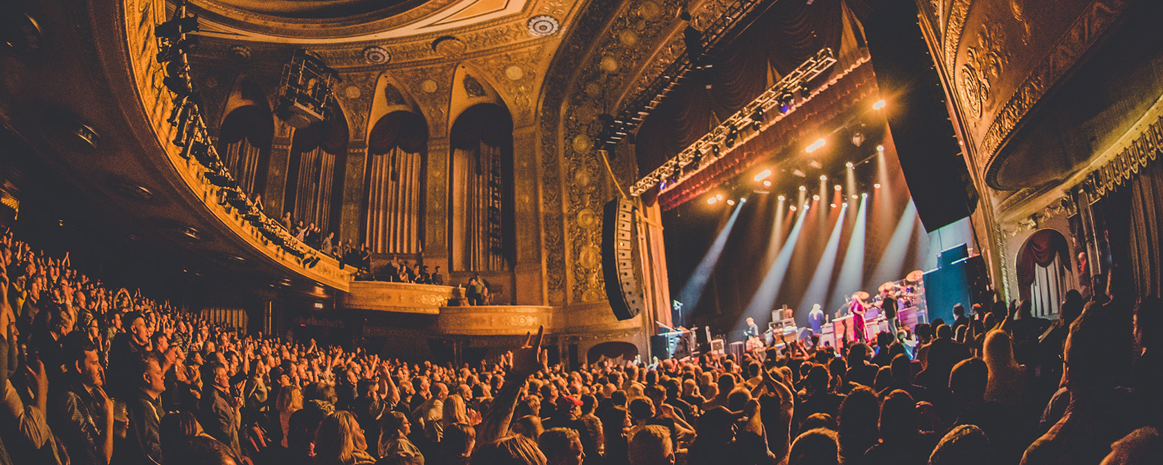
The Basic Elements of Theatre
The Audience:
Theatre requires an audience. For all of the arts public is essential. The physical presence of an audience can change a performance, inspire actors, and create expectations. Theatre is a living breathing art form. The presence of live actors on the stage in front of live audiences sets it apart from modern day films and television.

Slide 22
3 Reasons a Theater Degree Is Important
According to Backstage.com,
Theater is a business
As Derrick Sanders, cofounder of Congo Square Theatre Company in Chicago, once said, “It should be called a Business Show because the Business comes first.” Although people may pretend that professional theater is a bunch of people putting on a play just for fun, the reality is that virtually every production is an accurately planned and coordinated business activity.
Theater companies typically are not-for-profit or nonprofit entities with a board of directors and compensated employees, who appear both onstage and in the conference room. They feature marketing and public relations, education, and grant-writing departments (or people).
A theater degree prepares a person to enter the business of making art.

Slide 23
3 Reasons a Theater Degree Is Important
According to Backstage.com,
The business of theater is good preparation for other careers.
Rahm Emanuel, the current mayor of Chicago and formerly Chief of Staff to President Obama as well as a Congressman, majored in the Humanities in college with a specialization in dance. “Value” studies would look at Emanuel and identify him as not being successful because he neither works as a professional dancer nor earns income in the field of dance. Instead of adopting this flawed logic, it is important for us to acknowledge that the skills gained through theater apply to other jobs and careers outside of the performing arts.
Theater majors frequently become makers and producers of theater but they also (and probably in equal or greater numbers) become lawyers, politicians, management consultants, marketing executives, and community educators to name just a few of the many career paths open to them.

Slide 24
3 Reasons a Theater Degree Is Important
According to Backstage.com,
Social importance and salary do not always correlate.
According to Payscale.com, the majors with the least “salary potential” are Theology, Child and Family Services, Special Education, and Elementary Education. What unites these majors is their focus on the most vulnerable and sometimes the least fortunate members of society. To be clear, their real value to society far exceeds whatever number appears on a paycheck.
Theater serves a key function in our society.
The value of theater remains. It entertains. It educates. It creates community. It can take a significant amount of capital to create. It requires a lot of work to make. Artists labor to create art. That art may be ephemeral, a production that runs for only a hour or more, but the power of that creation is not only worthwhile but also invaluable.

