Slide 1
Greek and Roman Theatre
Week 9
[Part 3]
Introduction to Theatre
College of the Desert

Slide 2
Brief Roman History
Rome – in 753 B.C. was a town dominated by Etruria, North of Rome.
In 509 B.C., the Etruscan (from Etruria) ruler was expelled, and Rome became a republic (just as Athens became a democracy).
In the 4th Century B.C., Rome expanded, and by 265 B.C. controlled the Italian peninsula, then Sicily, then several Greek territories.
By 240 B.C., Greek Theatre was familiar to Romans, translated into Latin, and brought to Rome.
The beginnings of Roman theatre recorded: the first record of drama at the Ludi Romani (Roman Festival or Roman Games).
Rome became an empire after Julius Caesar, 27 B.C.
They were a Republic – from 509-27 B.C.
They were an Empire – from 27 B.C.-476 A.D.
By 345 A.D., there were 175 festivals a year, 101 devoted to theatre.
In 55 B.C., the first stone theatre was built in Rome (by Julius Caesar).

Slide 3
Rome and Theatre
To the Romans we owe much of our culture, our words, our government, our very being—Roman blood is in the veins of almost everyone who comes from European descent—so much so it's fair to say we are all Romans in one way or another.
Over half of English vocabulary is derived from Latin, the Romans' native tongue. In more ways than one, we speak their language.
The stage is no different. The Romans' taste in entertainment was also remarkably "modern"—or, better put, ours is remarkably Roman—in short, amusement trumped drama at almost every turn.
Terms like "theatre," "drama," "tragedy," "critic," "program," "theory" and "comedy" come from Greek.
"Spectacle," "circus," "perform," "impersonation" and "actor" are originally Roman words, not to mention "operatic histrionics," "sports personality," "nudity," "violence" and "stupid farce."
The Romans liked their shows lavish, something that appealed to both eye and ear—and heart and mind.
For a people who adopted and realized a vision of world conquest, it was natural to think lavishly, a perspective they did not apply only to the theatre.

Slide 4
Rome and Theatre
Roman architecture is still quite impressive today, as is the statuary and city-planning of ancient Italy.
Largely content with re-creating Greek statues, drama and the like, the Romans on their own invented surprisingly little in the arts, especially when one considers the money and manpower at their command.
This reluctance to perform radical experiments in culture is in part their general attitude toward creative pursuits as fundamentally a source of recreation.
Only when business was done, did most Romans make room for pleasure and art.
Negotium, their very word for "business," means literally "no free time," a verbal reminder not to waste time and energy on idle pursuits.
So, where the Greeks took their theatre seriously, the Romans on the whole saw it as a pastime, a way to stop being serious for a little while.

Slide 5
Rome and Theatre
To them, the theatre brought an opportunity, if only momentary, not to rehearse real-world problems, an attitude which makes perfect sense when one backs up and looks at the larger scheme of things.
In studying Roman theatre, then, we are really investigating one aspect of the merger of Greek and Roman culture in the third and second centuries BC.
First came the Latin translation of Homeric epic, soon followed by tragedy and comedy—adapted, of course, to the Roman heart and tongue—and later other genres of poetry, culminating eventually in some of the finest literature ever produced by Western civilization.
In many ways, what the Romans are to us now, the Greeks were to them back then, that is, models for how to build a culture.
While theatre in Rome evolved into its own distinct species, the Romans in the long run failed to escape the strong gravitational pull of Greek drama, a situation consistent with their cultural dependence on Greece in general.
The Roman dramatist Plautus, for instance, invented masterful, effective comedies, still fully playable on the modern stage.
His successor Terence—who was really more Menander's "stepson" than a native Italian—came as close to composing effective character study for the stage as anyone ever did in ancient Rome. Nevertheless, Terence's drama never surpassed the Greek classics he emulated.
Lastly, Seneca's tragedies may be brilliant if understood to be meta-tragic parody—if not, they are simply too tragic to work effectively on stage—but in either case they make a sad and fitting finale for the histrionic genre of classical tragedy.

Slide 6
An Overview of Roman Drama
Traditionally, there are three major phases of development:
1) An early period (pre-240 BC) when native Italian drama, such as Atellan farces dominated the Roman stage
2) The period of literary drama (240 BC - 100 BC), when the Romans primarily adapted classical and post-classical Greek plays
3) The renaissance of popular entertainment (100 BC - 476 AD), when traditional Roman fare like circuses, spectacles and mime returned to the forefront of the entertainment scene

Slide 7
An Overview of Roman Drama
At first glance, Roman theatre history presents a fundamental problem:
The evidence for theatre does not coincide with that for drama. That is, the majority of texts we have today derive from the second phase (the age of literary drama in the second and third centuries BC), whereas all existing Roman theatres date significantly later and may not even have been constructed for dramatic performances at all. With that, it is hard to reconstruct the dynamics of Roman stagecraft. While much the same might be said of ancient Greece, it is certain that Greek post-classical theatres were designed for the performance of plays, at least to some extent.
Literary drama was aimed, for the most part, at the upper classes.
Plautus' comedy, as low-brow as it may look to us, was directed toward an audience willing to listen to words and follow a plot, as opposed to watching acrobats, tightrope-walkers and gladiators.
Terence's plays go further yet and invite actual contemplation of the human condition, what, no doubt, the Roman tragedies written during the late Republic also did, many of which were based on Greek myth and drama.
Unfortunately not a single play of this sort has been preserved intact.
Rome’s entertainment was divided between "readers" and "viewers," that is, a literate nobility and the unwashed mob.
Unlike in the Greek world, however, serious drama was able to hang onto the hearts and minds of the Roman public for only a century or so.

Slide 8
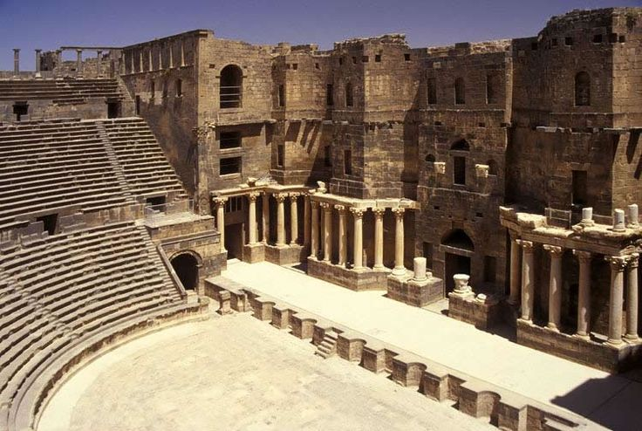
Roman Theatre
Borrowed Greek ideas and improved them
Less philosophical
Encompassed more than drama :
Acrobatics
Gladiators
Jugglers
Athletics
Chariots races
Boxing
Venationes (animal fights)
Entertainment tended to be lavish, sentimental, distracting
Actors / performers were called "histriones"

Slide 9
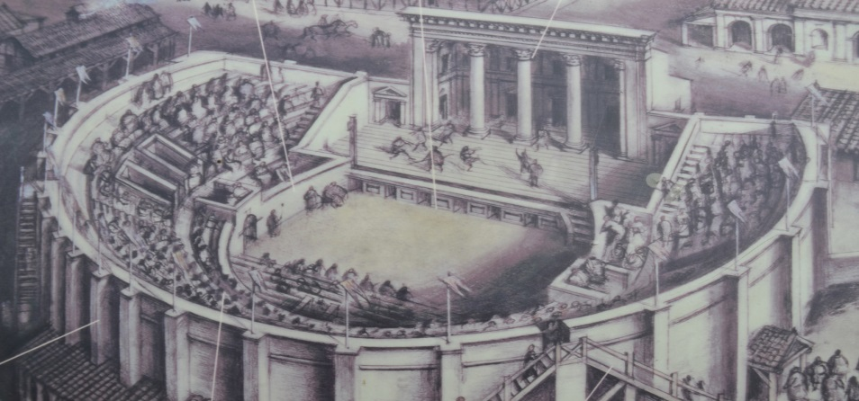
Three major influences on Roman theatre:
Greek Drama
Etruscan influences – emphasized circus-like elements
Fabula Atellana – Atellan farces (Atella was near Naples)
Short improvised farces, with stock characters, similar costumes and masks – based on domestic life or mythology – burlesqued, imitated – during the 1st century B.C., then declined
May have influenced commedia dell ‘Arte
Stock characters in Roman farces:
Bucco: showoff, rowdy
Pappas: foolish old man
Dossenus: swindler, drunk, hunchback
Drama flourished under the republic but declined into variety entertainment under the empire

Slide 10
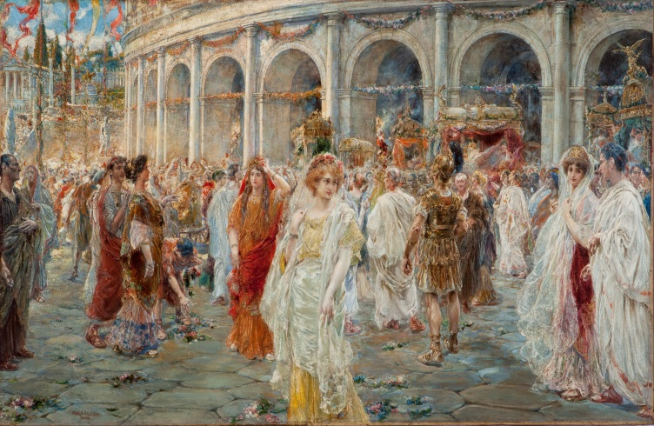
Roman Festivals:
Held in honor of the gods, but much less religious than in Greece.
First Roman Festival – Ludi Romani – 6th century B.C.
The annual games honoring Jupiter
Festivals and public games (ludi) played a large part in Roman society of old. Roman games varied from peaceful theatre to the violent gladiator combats. All played a part in getting citizens together to enjoy a spectacle and experience the culture of Rome.
Roman Festivals became theatrical in 364 B.C.
They were held in September (the autumn) and honored Jupiter
By 240 B.C., both comedy and tragedy were performed.
Five other festivals followed:
Ludi Florales (April)
Plebeii (November)
Apollinares (July)
Megalenses (April)
Cereales (no particular season)
Under the empire, these festivals afforded "bread and circuses" to the masses – many performances.
Performances at festivals probably paid for by the state a wealthy citizen, had free admission, were lengthy—including a series of plays or events, and probably had prizes awarded to those who put extra money in
Acting troupes (perhaps several a day) put on theatre events

Slide 11
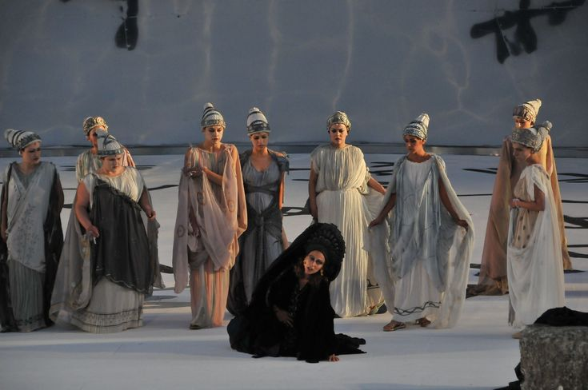
Forms of Roman Theatre
Roman Drama – there are only about 200 years that are important:
Livius Andronicus – 240-204 B.C.
Wrote, translated, or adapted comedies and tragedies, the first important works in Latin.
Little is known, but he seems to have been best at tragedy.
Gnaeus Naevius – 270-201 B.C. excelled at comedy, but wrote both
Both helped to "Romanize" the drama by introducing Roman allusions into the Greek originals and using Roman stories
Comedy and Tragedy followed different paths
Other forms of Roman Theatre:
Pantomime: solo dance, with music (lutes, pipes, cymbals) and a chorus.
Used masks, story-telling, mythology or historical stories, usually serious but sometimes comic
Mime: overtook after 2nd century A.D.
Spoken
Usually short
Sometimes elaborate casts and spectacle
Serious or comic (satiric)
No masks
Had women
Violence and sex depicted literally (Heliogabalus, ruled 218-222 A.D., ordered realistic sex)
Scoffed at Christianity
Needless to say, the Church did not look kindly at Mime.

Slide 12
Who is Livius Andronicus?
According to Britannica.com:
Lucius Livius Andronicus, (born c. 284 B.C., died c. 204 B.C.) was the founder of Roman epic poetry and drama.
He was a Greek slave, freed by a member of the Livian family; he may have been captured as a boy when Tarentum surrendered to Rome in 272 B.C..
A freedman, he earned his living teaching Latin and Greek in Rome.
In 240 BC, as part of the Ludi Romani (the annual games honouring Jupiter), Livius produced a translation of a Greek play, probably a tragedy, and perhaps also a comedy.
After this, the first dramatic performance ever given in Rome, he continued to write, stage, and sometimes perform in both tragedies and comedies, after 235 BC in rivalry with Gnaeus Naevius.
Only one fragment is known from each of his three remaining comedies; fewer than 40 lines of the 10 tragedies have survived.
Their titles show that he translated mainly the three great tragedians, Aeschylus, Sophocles, and Euripides.

Slide 13
Who is Gnaeus Naevius?
According to Britannica.com:
Gnaeus Naevius, (born 270 BC — died 200 BC) was the second of a triad of early Latin epic poets and dramatists, between Livius Andronicus and Ennius.
He was the originator of historical plays that were based on Roman historical or legendary figures and events.
The titles of two of his historical plays are known, Romulus and Clastidium, the latter celebrating the victory of Marcus Claudius Marcellus in 222 BC and probably produced at his funeral games in 208 BC.
During 30 years of competition with Livius, Naevius produced half a dozen tragedies and more than 30 comedies, many of which are known only by their titles.
Some were translated from Greek plays, and, in adapting them, he created the Latin fabula palliata (from pallium, a type of Greek cloak), perhaps being the first to introduce song and narrative, transferring elements from one play into another, and adding variety to the metre.
He incorporated his own critical remarks on Roman daily life and politics, the latter leading to his imprisonment and perhaps exile.
Many of the comedies used the stereotypes of character and plot and the apt and colorful language that would later be characteristic of Plautus.
Tarentilla, one of his most famous plays, clearly foreshadows the Plautine formula with its vivid portrayal of Roman lowlife, intrigue, and love relationships.

Slide 14
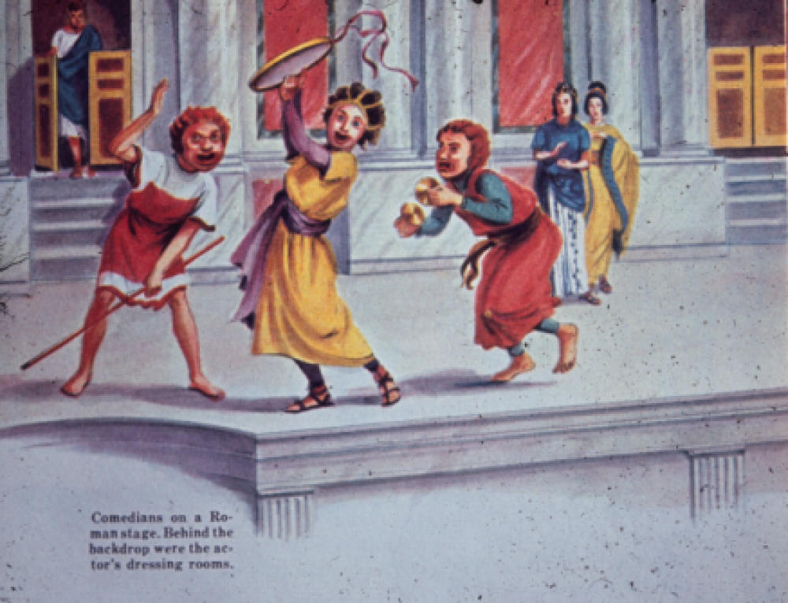
Roman Comedy
Comedy was most popular
Only two playwrights' material survives
Titus Maccius Plautus (c. 254-184 B.C.)
21 existing plays, 130 + total
Very popular
Pot of Gold, The Menaechmi, Braggart Warrior -- probably written between 205-184 B.C.
All based on Greek New Comedies, probably, none of which has survived
Added Roman allusions, Latin dialogue, varied poetic meters, witty jokes
Some techniques:
Stychomythia – dialogue with short lines, like a tennis match
Slapstick
Songs

Slide 15
Roman Comedy
Publius Terenius Afer [Terence] (195 or 185-159 B.C.)
Born in Carthage, came to Rome as a boy slave, educated and freed
Six plays, all of which survive
The Brothers, Mother-in-Law, etc.
More complex plots – combined stories from Greek originals.
Character and double-plots were his forte – contrasts in human behavior
Less energetic than Plautus, less episodic, more elegant language
Used Greek characters
Less popular than Plautus

Slide 16
Roman Comedy
Plautus was the practical playwright; Terence, the elegant literary craftsmen.
Plautus was the playwright of the masses; Terence, of the classes.
Characteristics of Roman Comedy:
Chorus was abandoned
No act or scene divisions
Songs
Plautus – average of three songs, 2/3 of the lines with music
Terence – no songs, but music with half of the dialogue
Everyday domestic affairs
Action placed in the street

Slide 17
Who was Titus Maccius Plautus?
According to Britannica.com:
Plautus, (born 254 BC — died 184 BC), was a great Roman comic dramatist, whose works, loosely adapted from Greek plays, established a truly Roman drama in the Latin language.
The Roman predecessors of Plautus in both tragedy and comedy borrowed most of their plots and all of their dramatic techniques from Greece.
Even when handling themes taken from Roman life or legend, they presented these in Greek forms, setting, and dress.
Plautus, like them, took the bulk of his plots, if not all of them, from plays written by Greek authors of the late 4th and early 3rd centuries BC (who represented the “New Comedy,” as it was called), notably Menander.
He referred to towns in Italy; to the gates, streets, and markets of Rome; to Roman laws and the business of the Roman law courts; to Roman magistrates and their duties; and to such Roman institutions as the Senate.
His action was lively and slapstick, and he was able to marry the action to the word. In his hands, Latin became racy and conversational, verse varied and choral.
Plautus’ plays read like originals rather than adaptations, such is his witty command of the Latin tongue.
It has often been said that Plautus’s Latin is crude and “vulgar,” but it is in fact a literary saying based upon the language of the Romans in his day.
Plautus

Slide 18
Who was Titus Maccius Plautus?
According to Britannica.com:
The plots of Plautus’s plays are sometimes well organized and interestingly developed, but more often they simply provide a frame for scenes of pure farce, relying heavily on intrigue, mistaken identity, and similar devices.
Plautus is a truly popular dramatist, whose comic effect springs from exaggeration, burlesque and often coarse humor, rapid action, and a deliberately upside-down portrayal of life, in which slaves give orders to their masters, parents are hoodwinked to the advantage of sons who need money for girls, and the buyer or soldier is outwitted and fails to secure the seduction or possession of the desired girls.
Plautus, however, did also recognize the virtue of honesty (as in Bacchides), of loyalty (as in Captivi), and of nobility of character (as in Amphitruo).
Plautus’s plays, almost the earliest literary works in Latin that have survived, are written in verse, as were the Greek originals.
Although Plautus’s original texts did not survive, some version of 21 of them did. These had been adapted, modified, cut, expanded, and generally brought up-to-date for production purposes.
There was renewed scholarly and literary interest in Plautus during the 2nd century, but it is unlikely that this was accompanied by a stage revival, though a performance of Casina is reported to have been given in the early 4th century.

Slide 19
Who was Titus Maccius Plautus?
According to Britannica.com:
During the Middle Ages, Plautus was little read if at all—in contrast to the popular Terence.
By the mid-14th century, Plautus began to influence European domestic comedy after the Renaissance poet Ariosto made the first imitations of Plautine comedy in the Italian vernacular.
His influence was perhaps to be seen at its most sophisticated in the comedies of Molière, and it can be traced up to the 20th century in such adaptations as Cole Porter’s musical Out of This World (1950), and the musical and motion picture A Funny Thing Happened on the Way to the Forum (1963).
Plautus, in adapting Greek New Comedy to Roman conditions and taste, also significantly affected the course of the European theatre.

Slide 20
Plautine Comedy
Plautus' comedies revolve mostly around daily life and average people, superficially the stuff of Greek New Comedy as opposed to the politically oriented Old Comedy of the Classical Age or the spoofs of tragedy popular in post-classical Middle Comedy.
Plautus, however, generates humor in a different way from Menandrean comedy.
Often extreme personality types set in outlandish situations, Plautine characters as a group recall Aristophanes' creations more than Menander's.
Indeed, devious pimps, greedy prostitutes, lustful young men, lustful old men, tortured mothers and torturing wives and, most of all, crafty slaves who delight in deception populate Plautus' plays.
Plautus's sense of comic timing, exactly how far to take a joke or run a scene, is unsurpassed in Western drama, even by Shakespeare, all of which presupposes a shrewd understanding of his audience's needs, intelligence and the reason they are sitting in the theatre at all.
As a result, Plautus' plays may not always be great art, nor do they strive at every moment to educate or improve the audience or advance the technology of theatre, but Plautus' comedies are invariably and without exception entertaining.
His comedies continue to be performed with great success today—they were among the first ancient plays produced on stage in the Renaissance, the dawn of the modern age.
While many viewers announce in public that they want to learn from plays or see goodness and morality triumph, all too often what they actually pay for are flashy, vapid, sensual, amoral spectacles.
His plays represent an inspired blend of native Italian drama and Hellenistic comedy, the product of lathering a bawdy slapstick tone over the well-oiled machinery of Menandrean plots.

Slide 21
Who is Publius Terenius Afer? A.K.A. Terence
Born, Carthage, Africa, 190 B.C.
Died, 158 B.C.
Roman dramatist simply known as Terence
"While there's life, there's hope." Probably every English-speaking person has used or at least heard that expression at some time.
The Roman comedy writer, Terence, was of African descent.
He was brought to Rome as a slave by the Roman Senator, Terentius Lucanus, who gave him a good education and finally freed him.
The success of his first play, staged in 166 B.C. gave him the opportunity of introduction into the most refined society in Rome.
Here his engaging manners and accomplishments made him a prime favorite.
Terence's dramatic work was of two kinds: fairly close translations of the later Greek comedy writers, especially Menander; and "contaminations" which is the term used in referring to an unification of all or parts of two or more Greek dramas into a Romanized whole.
By some happy chance six of Terence's comedies were preserved through the Dark Ages and later were studied by some of the greatest playwrights, particularly by Molière.
The existing plays are: Andria, Hecyra, Heautontimoroumenos, Eunuchus, Phormio, and Adelphi.

Slide 22
Terence's Drama
His work is uniquely well-documented, and the reason must be, at least in part, the high regard in which he was held from his own time on.
So, for instance, the Romans living in the next century (100-1 BC) saw Terence's writing style as the model of their own—Julius Caesar himself composed an essay on Terence's sermo purus ("clean dialogue")—and well over a millennium later professors in the Renaissance used his drama as a teaching tool.
As a result, we have over six-hundred Terence manuscripts, dating from many different periods of the Middle Ages and Renaissance.
Compared to Plautus whose plays survived medieval times on the slenderest of threads, the existence of so many copies of Terence's work is a remarkable tribute to his endurance as an artist.
All in all, it is hard to find any age in which Terence's work has not been praised and imitated and his name not widely known.
But most remarkable of all—and, without doubt, the best evidence for Terence's drama and its theatrical context—is information which comes from his own hand, the prologues added to the front of his dramas.
Except for Aristophanes', the text of every ancient play existing is expressed not with its author himself as the spokesman outright but through the persona of a stage character. This makes it hard, often impossible, to unravel the dramatist from the drama.
Terence’s prologues, however, address the audience directly and discuss, not the plot of the upcoming play the way Greek dramatists often did, but details of the play's production and the workings of Roman theatre.
Thus, unique documents attesting to the nature of Roman Comedy—and Republican drama and society in general—these prologues open our eyes to the world beyond, behind and beneath the play, hinting, for instance, at what rehearsals were like, how productions were funded and the jealousy that could rage between rival playwrights. But, best of all, we hear what Terence has to say about his work and his life in his own words.
And as expected, his truth is clearly not the truth, the whole truth, that is. Like any public figure who feels compelled to defend his actions and choices, Terence dodges questions, skirts issues, flatters his producers, kisses up to the public, points to his own genius and, generally, acts like a politician at a press conference, not a patient on truth serum.

Slide 23
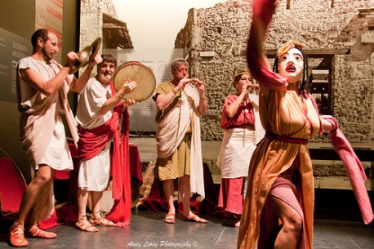
Roman Tragedy
None of the plays survived from the early period, and only one playwright’s work survived from the later period:
Lucius Annaeus Seneca (5 or 4 B.C. – 65 A.D.)
Nine existing tragedies, five adapted from Euripides
His popularity declined
Committed suicide in 65 A.D
Though considered to be inferior, Seneca had a strong effect on later dramatists
Probably closet dramas—never presented, or even expected to be
Characteristics of Roman Tragedy:
Five episodes / acts divided by choral odes
Elaborate speeches – forensic influence
Interest in morality – expressed in sententiae (short pithy generalizations about the human condition)
Violence and horror onstage, unlike Greek
Characters dominated by a single passion – obsessive (such as revenge) – drives them to doom
Technical devices:
Soliloquies, asides, confidants
Interest in supernatural and human connections – was an interest in the Renaissance

Slide 24
Who was Lucius Annaeus Seneca?
According to Britannica.com:
Seneca, in full Lucius Annaeus Seneca, by name “Seneca the Younger” (born 4 BC, in Spain —died 65 AD in Rome [Italy]),
He was a Roman philosopher, statesman, orator, and tragedian.
He was Rome’s leading intellectual figure in the mid-1st century and was a ruler with his friends of the Roman world between 54 and 62 AD, during the first phase of the emperor Nero’s reign.
The Apocolocyntosis divi Claudii (Pumpkinification of the Divine Claudius) stands apart from the rest of Seneca’s surviving works. A political skit, witty and corrupt, it has as its theme the deification—or “pumpkinification”—of the emperor.
The rest of his works divide into philosophical works and the tragedies.
Of the 10 “Senecan” tragedies they are intended for play readings rather than public presentation, the pitch of the speech is a high monotone, emphasizing the lurid and the supernatural. There are impressive set speeches and choral passages, but the characters are static, and they rant.
In the 16th to 18th century, Senecan prose, in content and style, served the vernacular literatures as a model for essays, sermons, and moralizing.
As the first of “Spanish” thinkers, he had an influence in Spain that was always powerful.

Slide 25
Roman Dramatic Theory:
Horace – (65-8 B.C.)
A theoretician
Wrote Ars Poetica (The Art of Poetry)
Had little influence in his time (interest at the time was in theatre not drama), but much influence in the Renaissance
Interpreted Aristotle’s Poetics, but less theoretical and more practice-oriented
Mentions unities (of time, place, and action), genre separation, language use in tragedy and comedy
Horace was the major lyric Latin poet of the era of the Roman Emperor Augustus (Octavian).
He is famed for his Odes as well as his corrosive satires
Horace became the voice of the new Roman Empire

Slide 26
Roman Theatre Design – Buildings
First permanent Roman theatre built 54 A.D. (100 years after the last surviving comedy)
So permanent structures, like Greece, came from periods after significant writing
More that 100 permanent theatre structures by 550 A.D.
General characteristics:
Built on level ground with stadium-style seating (audience raised)
Skene becomes scaena – joined with audience to form one architectural unit
Paradoi become vomitorium into orchestra and audience
Orchestra becomes half-circle
Stage raised to five feet
Stages were large – 20-40 feet deep, 100-300 feet long, could seat 10-15,000 people
3-5 doors in rear wall and at least one in the wings
Scaena frons – façade of the stage house – had columns and statues – painted
Stage was covered with a roof
Dressing rooms in side wings
Trap doors were common
Awning over the audience to protect them from the sun
During the empire around 78 B.C, a cooling system was used – air blowing over streams of water
Area in from of the scaena called the proskene (proscenium)
125 permanent theatres built during the empire

Slide 27
Roman Theatre Design – Buildings
No permanent theatre structure stood in the city of Rome until 55 BC.
Before that, many wooden theatres had risen and subsequently come down in quick succession.
This stands in marked contrast to the rest of the Roman world where there were numerous permanent arenas, amphitheaters, and playhouses constructed of stone and concrete, but none inside the city of Rome itself.
The typically conservative and tradition-minded Romans of Republican times were suspicious of theatre's corrupting influence.
Theatre, as it turned out, was one of the major weapons used by the emperors of Rome to appease, calm and distract the mob and thus maintain a firm grip on the state.
Temporary theatres, as all Republican ones were, must have been variable in style: built, no doubt, for special occasions in accordance with changing tastes and the specific venue of performance, and thereafter readily demolished.
Roman playwrights had as many as five different ways for his characters to enter the stage, comparable to the three doors and two parodoi available to later Greek dramatists.
Because no known early Latin drama calls for so many different entrances, the Republican theatre probably had fewer.
While the Roman theatre had an orchestra below and in front of the stage, it was not regularly used by the performers but served as a seating area for dignitaries. Since the chorus had ceased to be a force in the theatre long before the dawn of literary drama in Rome—there were no longer choristers who needed room to dance, not in drama at least.

Slide 28
Roman Theatre Design – Buildings
It is always possible other types of entertainment called for using the orchestra as a performance space, so we cannot say with certainty it was always used for seating.
Except for the dignitaries seated in the orchestra, the viewers sat in a large round auditorium called the cavea ("hollow").
In accordance with Roman custom, the seating there was segregated into social classes, sometimes gender, too.
Early on, these seats were made of wood—only later did stone seating come into fashion—much the way Greek theatres evolved.
But unlike their Greek counterparts, Roman theatres were not necessarily built into hillsides, rather in open, public spaces, usually in well-populated areas, such as city centers, where a great number of people had ready access to the entertainments presented there.
The Colosseum, for example, in downtown Rome could house more than fifty thousand spectators, three times what the Theatre of Dionysus in Athens held.
No wonder, then, Roman dignitaries wanted to sit in the orchestra where such a large slice of the public could watch them as they watched the play—it is hard to imagine better publicity—so by its location in the heart of the city Roman theatre evolved into a regular feature of civic life in the Roman Empire. Depending on one's political sentiments, that was or was not a good thing.
What is certain is that outdoor theatres not constructed of stone would require at least some degree of rebuilding, if for no other reason than simple wear-and-tear. And because during this age theatre was also a growing enterprise in Rome, it seems all the more likely that the structures themselves underwent constant refurbishment.

Slide 29
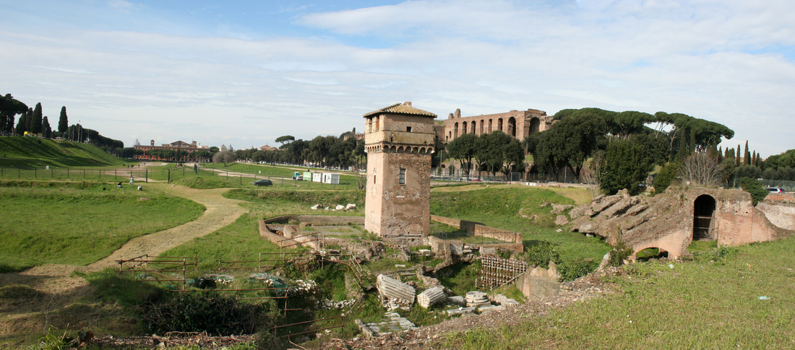
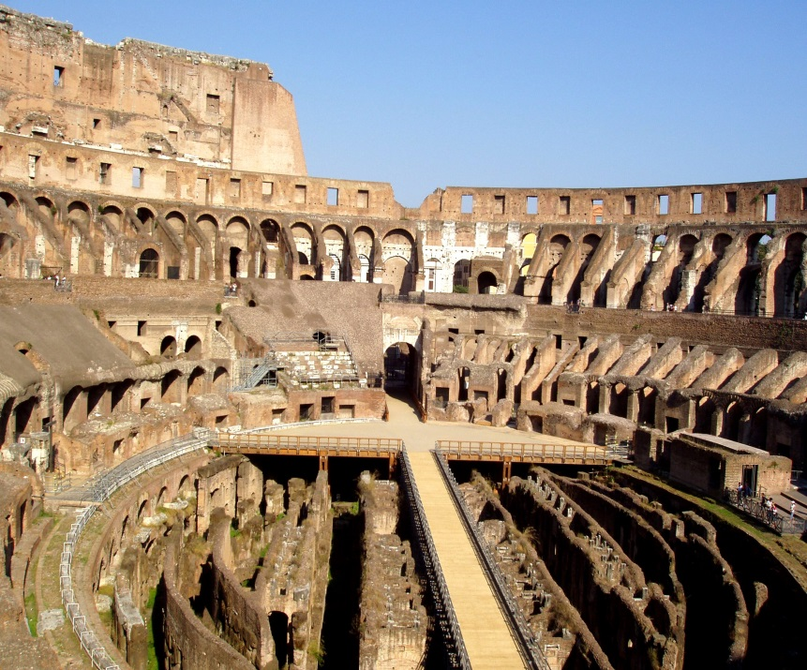
Other Roman Structures:
Circus Maximus:
For chariot races
600 B.C.2000 feet long
650 feet wide
60,000 spectators
Track to race 12 chariots at a time
Also housed circus games, horse racing, prize fighting, wrestling, etc.
Amphitheaters
For gladiatorial contests and wild animal fights
First permanent one in 46 B.C.
The Colosseum – 80 A.D.
Three stories, then 4
157 feet tall
620 feet long
513 feet wide
50,000 people
Had space with elevators below to bring up animals, etc.
Perhaps used curtains – back and foreground
Spectacular effects:
Many performers (Cicero tell us: 600 mules, 3000 bulls)
Mechanical lifts for animals
Traps
Some realistic, three-dimensional scenery

Slide 30
Staging Roman Theatre and Drama
As called for in the dramas which have been preserved, the staging itself hints at certain features which must have been present in Republican theatre.
For instance, there are relatively few props necessary in producing any early Roman drama and all but no application of scenery to plot, which argues for minimal sets and stage decor.
Moreover, the dramatic texts invariably dictate when to bring props on and off the stage argues that there was no curtain or the like whereby the stage could be set or cleared out of the audience's sight.
Furthermore, when the Romans began adapting Greek drama, they naturally carried over with it those features peculiar to Greek theatre, particularly post-classical practices.
For instance, as in Menandrean comedy, the Roman comic playwrights Plautus and Terence often envisioned the stage as depicting a city street and the entrances as doors to private homes or public shrines.
The wing exits frequently represented the way to town and the harbor, or to the market and the country, with some notable variations called for in particular plays.

Slide 31
Staging Roman Theatre and Drama
Although it is unclear how realistic these depictions were meant to be envisioned in terms of scenery and set pieces, it is notable that the plays themselves often carefully lay out in their language all extraordinary features of the landscape.
The scene was not represented on stage, rather the audience relied on the spoken word to imagine the setting.
On much the same sort of minimal stage and relying on the power of language in much the same way, Shakespeare produced his dramas, to considerable effect.
Characters in Roman Comedy sometimes use—and sometimes abuse—an altar during the course of a play.
At the end of Plautus' Mostellaria ("The Haunted House"), for example, the dishonest slave Tranio flees to an altar as a refuge from his enraged master Theopropides who is threatening to beat him.
There, the altar functions as a sort of asylum saving the slave from punishment and, given the high emotions of the scene, we must assume it was a real, not imaginary structure on the stage.

Slide 32
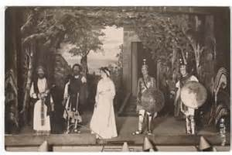
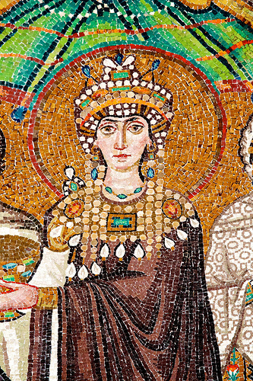
Roman Actors
Referred to as histriones and mimes – later primarily histriones
Mostly male – women were in mimes
Mimes, however, were considered inferior; perhaps they were slaves
We know little about the size of troupes
In the 1st century B.C., a "star" performer seems to have been emphasized
6th century A.D.
Theodora – a star actress – married Emperor Justinian of the Eastern Empire – but had to renounce her profession
Style of acting:
Mostly Greek traditions – masks, doubling of roles
Tragedy – slow, stately, formal delivery
Comedy—more rapid and conversational
Movements likely enlarged
Actors probably specialized in one type of drama, but did others
Encores if favorite speeches given (no attempt at "realism")
Mimes – no masks
Greek or roman costumes
Much music

Slide 33
Producers, Directors and Actors
With little evidence for realistic set design or ample props, the scripts of Roman Comedy seem to suggest that there was little expense incurred in Republican theatrical productions.
As early as 186 BC, the Roman Senate imposed measures on producers to curb their spending on ludi ("games, plays"), by which it is always possible that the senators did not mean the types of Roman Comedy preserved today but some other sort of entertainment.
Nevertheless, ludi must refer to something presented on the stage.
Moreover, expensive spectacles were a way for an ambitious Roman politician to win over poor voters and thus gain high office. Thus, the Senate's legislation attempting to limit theatre-related expenditures may not be so much an attempt to rein in theatre itself but to counteract the consequences of such extravagance.
Historical data shows that theatrical productions continued to escalate in both expense and grandeur. In 99 BCE, for instance, one Claudius Pulcher displayed a memorable scaenae frons that had been elaborately painted.
Theatrical activity was closely connected with three interlocking facets of Roman life:
Worship of Gods
The honoring of the dead
Individual self-glorification, or, put another way, with religious ceremonial, eulogy of the family and vote-winning

Slide 34
Producers, Directors and Actors
While there is some evidence that amateurs performed in early Atellan farces, the performance of plays in Rome was left largely to specialists, at least some of whom were slaves.
These thespians often traveled in a troupe called a grex (literally, "a flock," i.e. of sheep), with a leader who was called a dominus ("master").
Some Roman stars of the stage were widely known and well-respected, a few even belonging to the middle class.
In Greek comedy masks are essential in role-changing because they allow performers, in accordance with the three-actor rule, to play multiple characters within a single drama. But there is clearly no such restriction in Roman Comedy where as many as six speaking characters—though that many is very rare—appear on stage at once.
Masks are, furthermore, useful in helping men play women's roles—just as on the Greek stage, there were no female performers in Roman Comedy—and aid also in distinguishing character-types for the sizeable crowds playwrights like Plautus are said to have drawn.
Given all this and the tradition of mask-wearing in Atellan farce, logic dictates that the Roman stage did indeed call for masks in performance, though admittedly the evidence is far from conclusive.

Slide 35
Theatre at the End of the Empire
Fall of the Roman Empire
6th Century A.D. – Christianity rising
Emperor Constantine (324-337 A.D.) – made Christianity legal
Emperor Theodosius – made any other worship illegal
By 400 A.D., many festivals decreased, diminished – no gladiators by 404 A.D., and no ventiones (animal fights) by 523, but others continued
Church opposition to Theatre:
1. Association with pagan gods
2. Wastefulness
3. Ridicule of church by mimes (sacrament and baptism)
533 A.D. is the last record we have of a performance in the Roman Empire – mentioned in a letter

Slide 36
Works Cited
Dudley, Donald Reynolds. “Seneca.” Encyclopædia Britannica, Encyclopædia Britannica, inc., 26 May 2017, www.britannica.com/biography/Lucius-Annaeus-Seneca-Roman-philosopher-and-statesman.
Fort A. & Kates H.“Minute History of the Drama.” New York: Grosset & Dunlap, 1935. p. 24.
The Editors of Encyclopædia Britannica. “Lucius Livius Andronicus.” Encyclopædia Britannica, Encyclopædia Britannica, inc., 23 Apr. 2009, www.britannica.com/biography/Lucius-Livius-Andronicus.
The Editors of Encyclopædia Britannica. “Plautus.” Encyclopædia Britannica, Encyclopædia Britannica, inc., 2 Jan. 2017, www.britannica.com/biography/Plautus.

