Slide 1
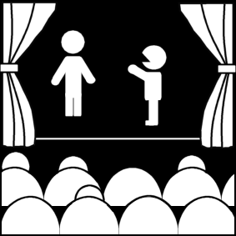
Medieval, Chinese, Hindu, and Japanese Theatre
Week 10
[Part 2]
Introduction to Theatre
College of the Desert

Slide 2
Medieval History
Before the fall of the Roman Empire, imperial leadership had converted to Christianity, which ultimately dominated both religion and government in Europe after 500 A.D.
After the fall of Rome the 600’s A.D., came a period known to us as the "dark ages."
Much political turmoil – no reliable political structure
The Church was the only stable "government"
The church exerted increasing influence.
The Church started attacking theatre, acting, spectacle, and any kind of secular, imaginative literature such as plays.
In the 4th Century, the Bishop of Rome, claiming to be the successor to St. Peter, established supremacy in church matters and in worldly concerns
Feudalism – the manor was the chief non-church political entity
Feudalism is the dominant social system in medieval Europe, in which the nobility held lands from the Crown in exchange for military service, and vassals were in turn tenants of the nobles, while the peasants (villains or serfs) were obliged to live on their lord's land and give him homage, labor, and a share of the produce, theoretically in exchange for military protection.
The manor (large estate), headed by a nobleman, had absolute authority over the serfs, (peasants) who worked the land.
Lords of manors were vassals, or subjects, of a king. The king’s knights protected the lords and their land.
Serfs (servants) owed allegiance to their lord.
There is no evidence of any theatre during the Dark Ages (500-900) until the tenth century.

Slide 3
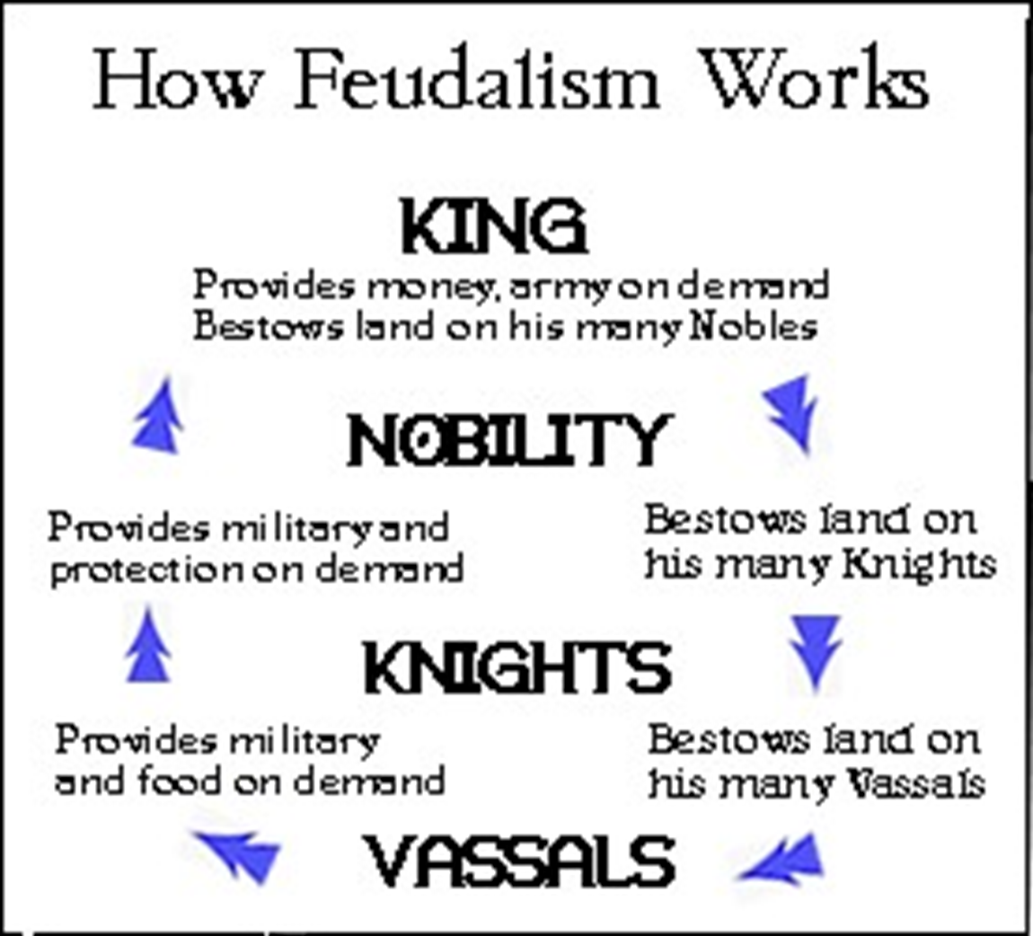

Slide 5
Medieval History
Little is known about the theatre between 600-1000 A.D.
There are references to actors (histriones), jugglers, rope dances in traveling tribes, remnants of Roman mimes, popular pagan festivals and rites
But there was little written drama; none that survives, and almost no other surviving references to it.
Hrosvitha of Gandersheim, a nun, wrote religious plays based on Terence's plays, but they were probably "closet dramas."
Also Christian ceremonies, where the theatre seems to have been "reborn." Between 925 and 975, drama becomes re-introduced into the church services
Theatre was "reborn" within the very institution that helped to shut it down – The Church
Perhaps the church had little choice – it couldn't stop the pagan rites – too popular – so many aspects of pagan rites found their way into Christian ceremonies.
Christmas the birth of Christ, not celebrated in December till the 4th century, to take advantage of the winter festivals
Easter replaced the spring festivals

Slide 6
Medieval History
In the 12th century, the Crusades helped bring other cultures to Europe (or, to be more accurate, Europeans took from other cultures and brought them to Europe).
Other religious dramas extended outside the church, in the vernacular [native language].
At first, the church had control of the drama outside of the church, but then it gradually became more controlled by nonspiritual groups
The Guilds (tradesmen) took over in some cities, and it was common for certain Guilds to retain control over certain plays / stories, all of which were based in some way on the Bible or religious teachings
For instance, the Bakers’ Guild would control the play about the Last Supper, and Shipwrights’ Guild would get plays about Noah, etc.
The church still needed to approve the scripts, even when its role diminished.

Slide 7
Drama Inside the Church
Before 1200 AD, most plays were still being done inside the church as part of the liturgy.
Most were probably still in Latin, the language of the Church.
Liturgy is the customary public worship performed by a religious group, according to its beliefs, customs and traditions. Technically speaking, liturgy is a subset of ritual. When ritual is undertaken to participate in a divine act or assist a divine action, it is liturgy. If the ritual does not have this purpose it is not liturgy but only ritual. Thus, the word, sometimes rendered by its English translation "Service or Divine Service", refers to a formal ritual, which may or may not be elaborate, enacted by those who understand themselves to be participating in a divine action, such as the Eastern Orthodox Divine Liturgy (Greek: Θεία Λειτουργία), Catholic Mass, the Eucharist or Mass (Anglican Communion). A daily activity such as the Muslim salah and Jewish synagogue services would be ritual but not liturgy. If the Temple were re-established, the ritual undertaken by the Judaic priesthood within the Temple would be liturgy.
Staging:
There were two main areas for the performances to take place:
Mansions – small scenic structures for indicating location
In more complex plays, there were many mansions
Platea – general acting area, adjacent to the mansion
The church structure usually served as the mansions (the choir loft, for instance, could serve as heaven; the altar might be the tomb of Christ).
Machinery was also used:
To fly Christ up to heaven
To have angels come down
Costumes were probably ordinary church garments

Slide 8
Drama Inside the Church
By 1200 AD, some of these plays were being performed outdoors.
By 1350, plays were in the vernacular, rather than Latin.
Laymen were the actors (male members of the community, unpaid—though there were some women on stage in France), no longer clerics and priests.
The stories began to range even further than when they were part of the liturgical services.
The church seemed to support these dramas
Why did they begin to move outdoors?
Probably because of the expanding needs of the plays.

Slide 9
Theatre in the Church

Slide 10
Medieval Drama outside of the Church:
With diminishing church control, secularization led to some changes.
Secularization is the transformation of a society from close identification with religious values and institutions toward nonreligious values and secular institutions
Sometimes the plays were very complex – in cycles – that someone was hired to oversee
The master copy of the script was called the Register
Sometimes the producing company / guild could monopolize or censor it or ban it
The “Keeper of the Register” was an important position and had much control
The Master of Secrets – was in charge of the machines (secrets) – the special effects
Often very intricate (need 17 people to operate Hell machinery in Belgium in 1501)
Flying was a major technique
Quite common – almost all the scenes had Heaven on the right, Hell on the left, and Earth on the middle. Therefore, angels, resurrection – had to use flying.
Platforms covered with cotton (the "glories") held angels
Trap doors – appearances and disappearances
Fire – the hell mouth – a fire-breathing monster representing hell

Slide 11
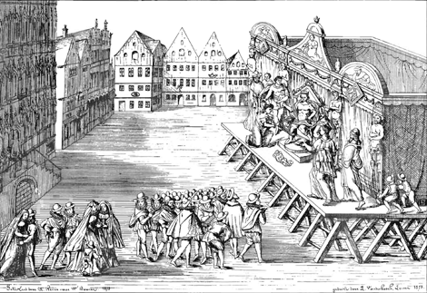
Medieval Staging
Two major kinds of stages in the medieval theatre:
Fixed
Moveable
Technical tricks would be more extensive on fixed stages
The mansion (background) and platea (open space to perform) were borrowed from the church services
Plays were performed outdoors and were not confined to cathedrals and monasteries
Simultaneous display of several locations also borrowed from liturgical drama
Simultaneous staging was a distinctive characteristic of medieval theatre
Fixed Staging / Platform Stages
Mansions set up in available spaces (courtyards, town squares, etc.), usually arranged in straight lines or rectangles or circles, depending on the space
Heaven and Hell were at opposite ends, if possible
Moveable Stages
Pageant wagons moved through the streets while the audience stayed in one place – like parade floats
The term "pageant" is used to refer to the stage, the play itself, and the spectacle
Plays were performed in sequence – thus each play was performed several times
There are few reliable descriptions of pageant wagons
One claims that the wagons must be over 12 feet tall—it would seem impossible to fit through the streets (many medieval streets had overhanging buildings), and would be flimsy

Slide 12
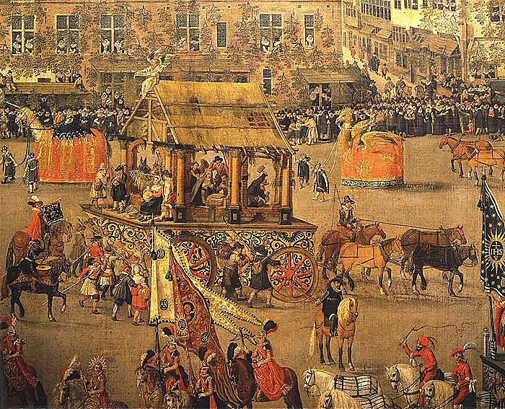
Pageant Wagons

Slide 13
The Medieval Drama
Medieval drama seems naïve if we don’t understand the period
Plays were performed in the local language rather than in Latin
They have little sense of history – reflecting the limited knowledge of the people
Anachronisms (meaning a thing belonging to a period other than that in which it exists, especially a thing that is noticeably old-fashioned) were quite common (In The Second Shepherds’ Play, for instance, the stolen lamb becomes the baby Jesus, and the Shepherds had been using Christian references even before this "baby Jesus" arrived).
This mixed-tone play ends with a solemn presentation of the nativity in the Christ child, but most of the play is given over to comic action about shepherds trying to outwit a sheep thief. The action is full of ironic parallels between a fake birth (using a lamb) and the birth of the “lamb of God.”
Comic elements appeared in plays that were otherwise quite serious, and had as their purpose to teach Biblical stories and principles to the people
The medieval mind looked at the temporal world (Earth) as transitory; Heaven and Hell were the eternal realities

Slide 14
The Medieval Drama
The Religious Plays:
Three kinds of religious plays:
Mystery plays – about Christ or from the Old Testament
Miracle plays /Saint’s plays – lives of saints, historical and legendary
Most famous play – Mary Magdalene (1500) – recounted the rale lives of saints
Morality plays – didactic allegories, often of common man’s struggle for salvation
Everyman – only his good deeds accompany him in death
Humanity’s struggle with good and evil
Filled with good deeds, Pride, and Gluttony – giving human characteristics to abstract ideas

Slide 15
The Medieval Drama
Characteristics in common:
Aimed to teach or reinforce Church doctrine
Melodramatic: good rewarded, evil punished
God and his plan were the driving forces, not the characters
To us, these plays seem to be episodic, confusing sequences of time, and an odd mixture of comic and serious – unnerving
The “director” of plays was known as a play master
Most playwrights and actors of medieval Europe remain anonymous to us, but we know much about staging practices because of many detailed accounts and promptbooks
Promptbooks are books containing scripts, detailed stage directions, and production practices
Medieval Europe had produced no tragedies
The mixed tone in these medieval plays seems to have influenced Renaissance theatre in England and Spain.

Slide 16
Medieval Secular Plays
Secular plays are non-religious dramas
They began to be written and performed again by the 1200s
Latin comedies and tragedies were studied in schools and universities
Farce – very popular
Particularly in France, where it was well-developed
Pierre Patelin – 15th century France – clever knaves outwitting each other
A fifteenth-century anonymous medieval farce written originally in French. It was extraordinarily popular in its day, and held an influence on popular theatre for over a century.
Moralities
Secularized
Allegories based on classical gods and heroes, often with some political content
Interludes and Masques
Between courses at a banquet, masques were allegorical compliments to the guests – with intricate dances and spectacle
The Interlude and the Morality play were often performed by professional acting companies – a European return to institutional theatre outside religious drama
Aspects of the interlude are often evident in Shakespeare’s plays written for professional companies
Towns staged pageants
The plays were often put in celebrations in honor of dignitaries
Secular plays were most often performed by professional actors attached to noble houses

Slide 17
The Decline of Medieval Theatre
There was an increased interest in classical learning – affected staging and playwriting
Social structure was changing – destroyed feudalism and "corporate" nature of communities
Disagreement within the church led to prohibition of religious plays in Europe (Queen Elizabeth, the Council of Trent, from 1545-1563 – religious plays were outlawed).
By late 16th century, drama of medieval period lost its force.
Results of the decline:
Professional actors still needed, but not amateurs
Professional theatre rose, became commercial (no longer a community venture)
No longer religious plays – returned to the classics for new ideas for stories

Slide 18
India Theatre History
Sanskrit plays appeared in India
The Natyasastra (Doctrine of Dramatic Arts) outlines the principles of performance, staging, and dramatic form as practiced in India and applied to Sanskrit plays.
Performances were very presentational and included colorful costumes, music, dance, and complicated emblematic system of hand gestures.
The type of theatre space varied, but it was very decorative and symbolic rather than scenic.
Actors performed mostly on open stages.
Unlike Greek and Roman theatre, women often participated as actors in Sanskrit plays and performed prominent roles.
Most of the stories of Sanskrit drama are based on epic Indian literature such as the Mahabharata and the Ramayana, which features heroic adventures of gods and mortals.
The dramas are structurally organized around rasa (moods) rather than action and event as we see in typical Western plays.
All the plays end happily after a nearly free-form journey through time and space.

Slide 19
India Theatre History
Most of the surviving plays are dated from the 4th and 5th century.
The most famous plays are Shakuntala by Kalidasa and The Little Clay Cart.
Like Roman comedy, Sanskrit now exists primarily on paper.
India had two related forms to Sanskrit plays:
Kutiyattum – A religious theatrical form based on ancient epics performed in temples
Kathakali – 1700s – dance drama – dominate classical theatre of India
Kutiyattum combines elements of the Natyasastra with folk traditions and they included actresses
They used early Indian practice, using music, open space, and colorful costumes
Kathakali is an all-male epic theatre where the signing provides the narrative
It incorporates incredible makeup and costumes and its complex system of gestures bears resemblance to the performance descriptions of Natyasatra.
The actor-dancers sometimes enact violent scenes, which were supposedly absent from the Sanskrit plays.

Slide 20
Indian Performances
Kutiyattum Performance
Kathakali Performer

Slide 21
Video of a Kutiyattum Performance
Kutiyattam, Sanskrit Theatre
https://youtu.be/sHGfu-wdVfw
Eye Dancing and India’s Ancient Art of Kathakali
Kathakali is a traditional Indian dance native to the southern state of Kerala. To perform it, artists deck out in elaborate costumes and colorful makeup to tell stories from Hindu epics. It takes students nearly 12 years of training to learn the choreography and gestures necessary to Kathakali. But the real trick? Mastering the eyes. Dancers must learn to constrict and move their eyes to express a whole range of emotions.
https://youtu.be/_4WmgIyg6rY
https://youtu.be/nwiLwsgicno

Slide 22
Chinese Theatre History
There is no evidence of professional theatre before the 10th century
It wasn’t until after the 10th century did we see differing forms of plays and theatrical styles developed in both northern and southern China.
By the 13th Century Yüan plays appeared and they were written during the Yüan Dynasty from 1280-1368.
Most of the surviving plays remain anonymous or are credited to playwrights about whom we know little or nothing.
The Orphan of Chao – an episodic adventure keyed to family revenge was made into a French adaptation by the mid-18th century.
The Romance of the Western Chamber by Wang Shifu is a lightly erotic tale of two secret loves and features a host of songs.
The Circle of Chalk by Li Xiandou is about a battle for custody of a child was the inspiration for Bertolt Brecht’s The Caucasian Chalk Circle (1944).
The Chinese culture produced no tragedies for the stage.
Most of the Chinese plays featured a mixed tone like Sanskrit and would end either happily or sadly but with a sense of poetic justice – vertue is rewarded, evil is punished.

Slide 23
Chinese Theatre History
Instrumental music of strings, flute, and percussion was important and many Chinese plays included solo singing.
Like Greece and Rome, none of the original music survived.
Plays from northern China were traditionally organized into four parts or acts and had an additional scene called a wedge as either a prologue or an epilogue.
Southern China produces plays with many acts – up to fifty in some cases – and were more often comic or melodramatic.
Chinese theatre is highly stylized with movement, dance, chant, and music.
Different Chinese regions developed their own style.
In the 1800s Chinese artists developed Chinese music drama – also known as Beijing Opera.

Slide 24
Chinese Staging
The earliest known stages were nearly bare thrust stages, except for a carpet, a table, and two chairs.
This configuration remains traditional for music drama.
It had only two doorways upstage
One for entrances
The other for exits
A performance could be indoors or out, but the stage was sometimes roofed.
The musicians and stage attendance remained onstage with the actors throughout the performance.

Slide 25
Chinese Music Drama
Music drama tells epic and domestic stories
Because the literary qualities of the earlier work are substantially diminished they have been replaced by remarkable acrobatics and various kinds of spectacle created by the actors themselves or through their ornate and colorful costumes and mask-like makeup.
Although both men and women performed in early years of Chinese theatre, by the 18th century women were banished from the stage.
Women did not return to the stage until 1912.
Before the banishment, actresses often cross-dressed as males and sometime led the acting troupes.
Once women were removed, male cross-dressing featuring a falsetto voice was established as a convention when music drama was being defined.
Video of a Cultural performance:
Highlights of Chinese Theater - Flowers of all Colors
https://youtu.be/cqeqZ6d8GaQ
Chinese Opera
https://youtu.be/wzBDB-u1pRg

Slide 26
Japanese Theatre History
Toward the end of the Yüan Dynasty in China, the first great classical theatre of Japan – Noh theatre – developed in the court of shogun in the feudal samurai system of the late 14th century.
Noh theatre has always maintained music and dance as part of the dramatic presentation.
There were two master actor-playwrights that created and perfected the Noh theatre:
Kan’ami
Kan’ami’s son Zeami
Kan’ami is credited with defining Noh’s essential form, and his most famous play is Sotoba Komachi – a play about an aging woman who is possessed by the spirit of her dead lover.
Zeami is considered the most important figure of Noh theatre, not only because he wrote hundreds of plays, many of which are still performed, but he was also known for his writings in the theory of performance and composition.

Slide 27
Noh Theatre Staging
All Noh theater was performed on a temple-like stage, open, and had a semi-thrust with a highly polished floor.
The audience was seated on two sides (downstage and stage right).
On the upstage wall has a large painted pine tree and the main square of the stage is outlined by four pillars supporting a roof.

Slide 28
Performing Japanese Theatre
The leading character in a Noh play is called a Shite – the Shite is masked
Most other characters are not masked
The actors perform in front of the onstage musicians playing flute and percussion, and a chorus, which often speaks for the Shite, although we also hear the Shite’s voice.
Actors are traditionally male (even though some of the Shite roles are female)
The gestures of actors are highly stylized and often accentuated by remarkable uses of fans.
Playwrights are not considered nearly as important as the actors in Kabuki are.

Slide 29
Kabuki Theatre
The most popular classical Japanese form of theatre is Kabuki
Kabuki began in 1603 through the dancing performances of the priestess Okuni.
Although Kabuki was begun by a woman and the form was dominated by female performers for over 25 years, the government banned women from Kabuki in 1629.
It has traditionally been performed by men ever since, with female roles (onnagata) performed by men who specialize in this form of cross-dressing.
Kabuki features original plays as well as many adapted from Noh and puppet theatre (Bunraku).
Chikamatsu (1683-1725) wrote for both Kabuki and Bunraku and has been widely translated. His most famous play is Love Suicides at Sonezaki (1703) which explores social and domestic problems.
Two lovers kill themselves because they are unable to realize the marriage they desire.
Kabuki actors do not wear masks, but the makeup is intricate and mask-like.
Kabuki performance is spectacular, using a revolving stage (the first in the world – created in 1758), huge elevator traps, and special effects that delight audiences with a mixture of realism and stylization.
In the play Masakado (The Demon Princess), the princess creates a magical dance that causes an earthquake and the play ends with all the scenery collapsing.

Slide 30
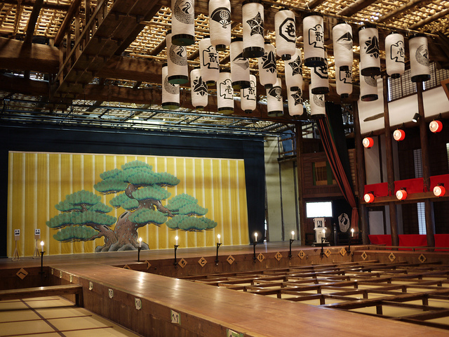
Kabuki Theatre
Kabuki is a great borrower and added the proscenium arch after encountering it in the late 19th century.
The most dynamic element of the Kabuki Stage is the hanamichi – a stage-level ramp that passes directly from the stage apron down right center to the back of the house.
Video of Japanese Theatre
Kabuki Theatre
https://youtu.be/67-bgSFJiKc

Slide 31
Butoh Theatre
Butoh (舞踏 Butō) is a form of Japanese dance theatre that encompasses a diverse range of activities, techniques and motivations for dance, performance, or movement.
Following World War II, Butoh arose in 1959 through collaborations between its two key founders Hijikata Tatsumi and Ohno Kazuo.
The art form is difficult to define; notably, founder Hijikata Tatsumi viewed the formalization of Butoh with "distress".
Common features of the art form include playful and grotesque imagery, taboo topics, extreme or absurd environments, and it is traditionally performed in white body makeup with slow hyper-controlled motion.
However, with time Butoh groups are increasingly being formed around the world, with their various aesthetic ideals and intentions.
Video of Butoh
Butoh - an expressive and obscure form of dance theatre
https://youtu.be/j7l3ToKPDBQ

