Slide 1
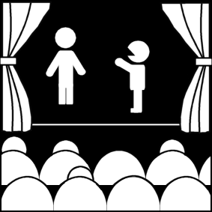
The Actor and the Theatre
Week 6
[Part 2]
Introduction to Theatre
College of the Desert

Slide 2
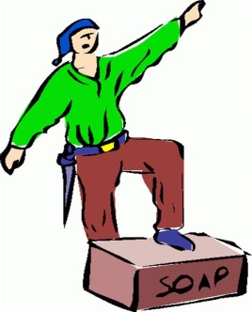
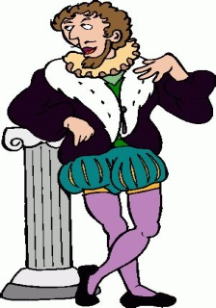
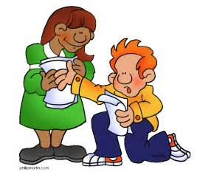
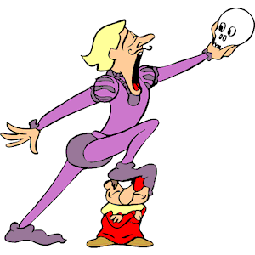
Acting: Offstage and in the Past
Everyone is an actor
Imitation
Role Playing
However, there are differences between the roles we play in everyday life and performing on stage
Social Roles
Mother, father, police officer
Women as teachers and secretaries
Personal Roles
Role with family and friends
Outgoing? Loner? Bragging? Gossip?
Acting can be physically and vocally demanding
Can take years of training to perform realistically

Slide 3
Acting: Offstage and in the Past
Acting on stage
Acting in Life
Actors are always being observed
Actors may play roles he or she may not play in real life
Can play widely divergent roles
Can play several roles during the play
Performers are always conscious they are playing a part
May be observed but not essential to the event
Not playing a role but are genuine
Only occupy roles that fit your education and experience

Slide 4
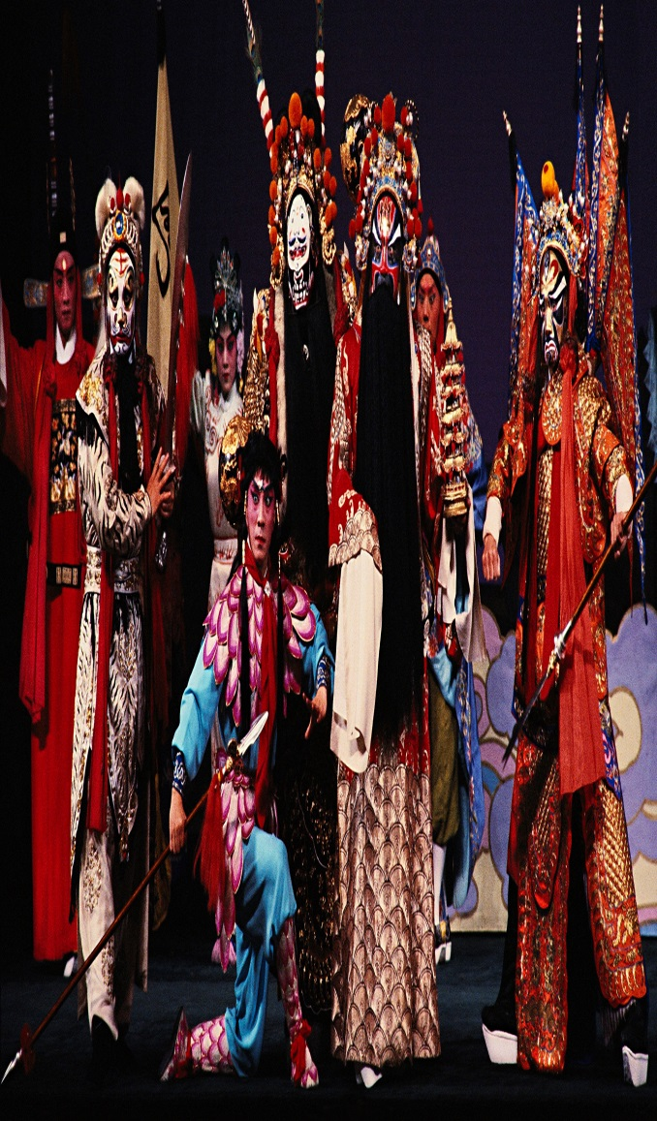
Stage Acting: A Historical Perspective
Physical demands of Acting:
Greek and Asian Theatre
Formal stylized movement
Dancing, Singing, Wearing masks
Elizabethan Theatre
Stage fights
Stylized speech to Audience
Contemporary Theatre:
Emphasis on real genuine performances

Slide 5
Stage Acting: A Historical Perspective
Hamlet’s speech to the Players ~ The speech that Hamlet gives to the players means to don't over act. The speech is given in Act 3 Scene 2 of the play.
Speak the speech I pray you as I pronounced it to you, trippingly on the tongue;
but if you mouth it as many of your players do, I had as lief the town - crier spoke my lines.
Nor do not saw the air too much with your hand thus, but use all gently; for in the very torrent, tempest, and, as I may say, whirlwind of your passion, you must acquire and beget a temperance that may give it smoothness.
Oh, it offends me to the soul to hear a robustious periwig - pated fellow tear a passion to tatters, to very rags, to split the ears of the groundlings, who for the most part are capable of nothing but inexplicable dumb - shows and noise.
Be not too tame neither, but let your own discretion be your tutor.
Suit the action to the word, the word to the action, with this special observance, that you o'erstep not the modesty of nature.
For anything so o'erdone is from the purpose of playing, whose end both at the first and now, was and is, to hold as 'twere, the mirror up to nature.

Slide 6
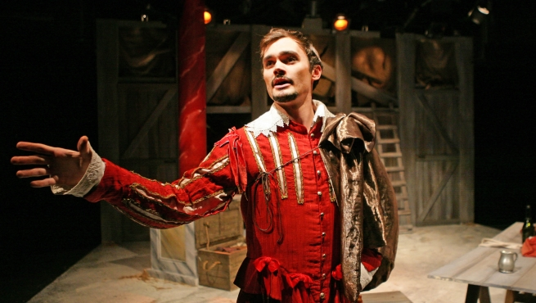
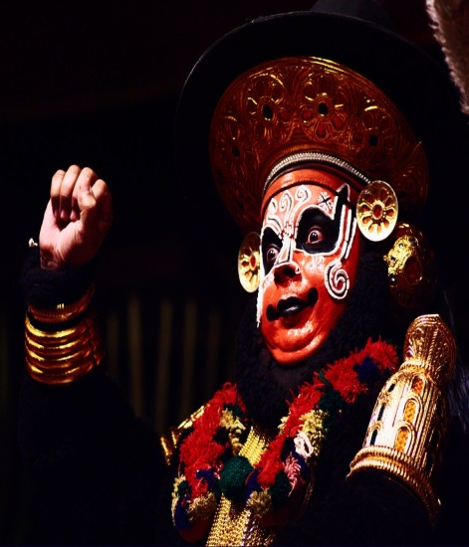
Vocal demands of Classical Acting
Understanding of how to read poetry and prose and the language
Projection
Stamina
What are the physical demands of a roll?
How would the character speak?
Soliloquies
Be able to show a wide range of emotions within a short space of time.
An example of classical acting, Marlowe’s Doctor Faustus:
O, thou art fairer than the evening’s air
Clad in the beauty of a thousand stars;
Brighter art thou than flaming Jupiter
When he appear’d to hapless Semele
More lovely than the monarch of the sky
In wanton Arethusa’s azured arms,
And none but thou shalt be my paramour!

Slide 7
Realistic Acting
Closely resembles everyday life
Avoid any hint of fakery or superficiality
From mid 17th century attempt to define the craft of natural acting:
Francois Delsarte
A system of expressions to express specific emotions.
Hand to heart – sadness or heartbreak
Hand to brow –anguish

Slide 8
Challenges of Acting Today
Wide range of theatres and wide range of roles
Physical health
Must learn the “craft” of acting
Develop internal and external skills of performance
Inner: internal (feelings or emotions)
Outer: external (vocal or physical demands)

Slide 9
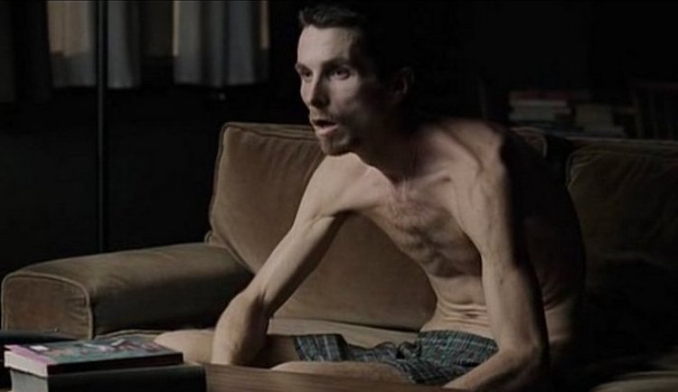
Challenges of Acting Today
Stanislavsky System
Create a system for realistic performances that can be used and passed on
Actor must believe in what he/she is doing
Goals/Aims:
To make outward behavior natural or convincing
To have the actor/actress convey the “inner needs” of a character
To make the make the life of the character onstage not only dynamic but continuous
To develop a strong sense of ensemble playing with other performers
Relaxation
Concentration and Observation
Circle of Attention
Importance of Specifics
Concrete Activities – Outer acts that convey emotion
Given Circumstances – where is this? What has happened?
Inner Truth
What is the character thinking or feeling?
What is not being said is as important as what is being said.
Magic if

Slide 10
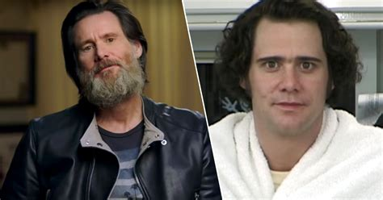
Challenges of Acting Today
Stanislavsky System
Action Onstage: What? Why? How?
Motivation?
Psychophysical Action
Action can bring about emotion
Through Line of a Role
Super objective
Beats or units - each has an objective
Ensemble Playing
Not just when the actor has lines but anytime he or she is onstage.

Slide 11
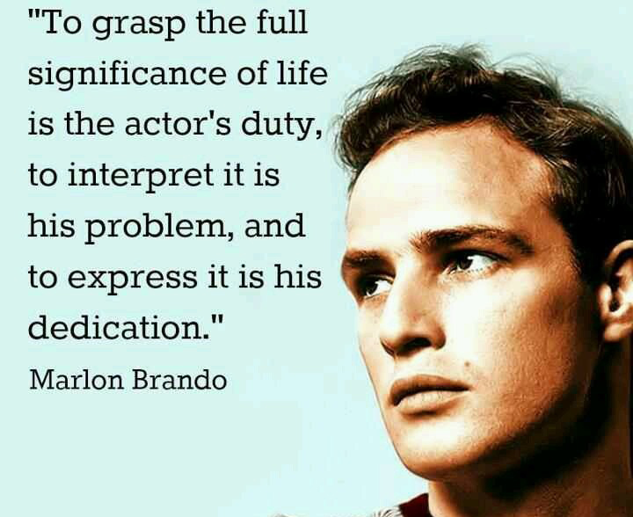
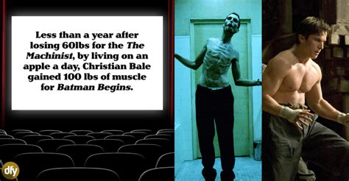
Challenges of Acting Today
Stanislavsky System
Later Interpretations of Stanislavsky
Chekhov – psychological gesture
The Group Theatre 1930’s
First used Stanislavski and Chekhov’s teaching in the United States
Often Criticized - Lee Strasberg
Actors Studio in New York
Emotional recall
Various Approaches
Uta Hagen – Respect for Acting
Emotional and memory recall
Robert Cohen – Acting One
Content – focus on the acting and voice
Robert Benedetti – The Actor at Work
Explore elements of rhythm, time, weight, intensity and space through improvisational work
Sanford Meisner
Magic if
Repetition Exercises

Slide 12
Who is Robert Benedetti?
A distinguished teacher of theatre, and three-time Emmy and Peabody Award-winning film producer, Robert Benedetti received his PhD from Northwestern University.
After serving as Artistic Director of the Court Theatre in Chicago, he was an early member of Chicago’s Second City Theatre, and then taught for fifty years at the University of Wisconsin, Carnegie-Mellon University, The National Theatre School of Canada, and the University of California, Riverside.
He was Chairman of Theatre at York University in Toronto, Chairman of the Acting Program at the Yale Drama School, and for eight years Dean of Theatre at The California Institute of the Arts.
He was until 2011 a tenured Full Professor at the University of Nevada, Las Vegas, and Artistic Director of the Nevada Conservatory Theatre.
His films are in the permanent collection of MoMA and many other museums and university art departments.

Slide 13
Who is Robert Benedetti?
As President of Ted Danson’s Anasazi Productions at Paramount Studios, and later as an independent screenwriter/producer, he won three Best Picture Emmys, two Humanitas Prizes, and a Peabody Award for producing Miss Evers’ Boys and A Lesson Before Dying for HBO, and six other films.
He most recently completed a screenplay for HBO on the 1885 Chicago Haymarket bombing.
Benedetti has also written six books on acting and film production, including The Actor At Work 10th edition, The Actor in You, 5th edition (recently translated into Danish), ACTION! Acting for Film and Television, and From Concept to Screen, an Overview of Film and TV production (recently published in Chinese.)
In 2005 he received the Lifetime Career Achievement Award from the Association for Theatre in Higher Education.
In 2012 he was inducted into the College of Fellows of the American Theatre at the Kennedy Center.

Slide 14
Sanford Meisner: The Theatre’s Best Kept Secret
Acting Teacher, Member of The Group Theater, head of the acting department of New York’s Neighborhood Playhouse School of Theater
Born Aug 31, 1905 and died on Feb 2, 1997
One of his most famous quotes, “An ounce of behavior is worth a pound of words.“
Elia Kazan once said “Take it from a director: if you get an actor that Sandy Meisner has trained, you’ve been blessed.”
A leading acting teacher who trained some of the most famous performers of the stage and screen, Sanford Meisner was a founding member of the Group Theatre.
The Group Theatre, a cooperative theater ensemble, became a leading force in the theater world of the 30s.
Meisner performed in many of the group’s most memorable productions, including The House of Connelly, Men in White, Awake and Sing, Paradise Lost and Golden Boy.
While still a member of the group, Meisner became the head of the acting department of New York’s Neighborhood Playhouse School of Theater.
After the Group Theatre dissolved in 1941 Meisner devoted himself to teaching, appearing only occasionally on Broadway and in films.
Over the course of forty-eight years at the Neighborhood Playhouse, Meisner honed his skills as an acting instructor.
Growing out of the days with the Group Theatre and the Russian theater theorist Constantin Stanislavsky, Meisner created a series of exercises for actors.

Slide 15
Sanford Meisner: The Theatre’s Best Kept Secret
For Meisner, acting was about reproducing honest emotional human reactions. He felt the actor’s job was simply to prepare for an experiment that would take place on stage. The best acting, he believed, was made up of spontaneous responses to the actor’s immediate surroundings.
Meisner explained that his approach was designed “to eliminate all intellectuality from the actor’s instrument and to make him a spontaneous responder to where he is, what is happening to him, what is being done to him.”
The primary tool Meisner employed in preparing his students was spontaneous repetition.
Among his many exercises was one in which two actors looked directly at each other and one would described a feature of the other. After this, the two actors would simply say the phrase back and forth. Because the phrases (such as, “You have soft eyes”) came from a physical reality apparent to the actors, the statement retained meaning no matter how often they were repeated.
Another example of Meisner’s method has two actors enter a room playing specific roles without specific lines. They begin to speak and the plot is formed out of nothing but the surroundings. The actor’s concern is to remain in character. Techniques such as these allow actors to move beyond the printed script and address the underlying emotional or philosophical themes of a play.
Meisner’s role within the theater community remained important throughout his long career.
Among his more famous students were actors Robert Duvall, Grace Kelly, Diane Keaton, Joanne Woodward, Lee Grant, and Peter Falk.
Gregory Peck said of Meisner, “What he wanted from you was truthful acting…He was able to communicate, and the proof of that is the number of people that have come out of [the Neighborhood Playhouse] over a forty-year period who’ve gone on to become people who set standards of acting.”

Slide 16
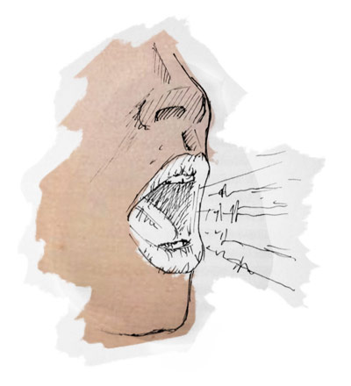
Challenges of Acting Today
Body and Voice Training
Projection – must be heard
Diaphragm and breathing exercises
Not throat exercises
Dancing, fencing, combat
Curtsy and bows – period movement
Centering
Similar to Yoga
Tai Chi
Achieve balance, freedom, flexibility

Slide 17
Acting Training and Means
Relaxation, Concentration, Imagination, Observation
Voice and body – must learn to control the voice and body to express to audience
Understand
Practice
Discipline
Tensions and blocks must be overcome usually through exercises, improvisations (enacting characters in a situation without planned script or blocking), theatre games (animals, stereotypes, machines, etc.).
Also used to arrive at a "neutral state" ("tabula rasa"– blank slate).
Many artists believe that to create they must first have a blank slate – an empty canvas – on which to place their art.
Actors must find various ways to achieve this ("centering oneself“).

Slide 18
Acting Training and Means
Relaxation, Concentration, Imagination, Observation
Imagination and Observation
Observe and imagine people in various relationships
The term "affective memory" has often been used to refer to use of the actor's memory to find things in his/her life that are similar to, or could evoke, the emotions required by the character on stage. This would involve:
Emotional memory (remembering feeling from the past)
Sense memory (remembering sensations)
Substitution (mentally replacing the thing / person in the play with something / someone in real life)
Control and discipline
Actors must learn how to develop their powers of concentration. Must be aware at all times of their current situation (being an actor on stage, with an audience out front) and the context of the play (what is the character doing/feeling/etc.) What am I doing? – NOT how am I doing?

Slide 19
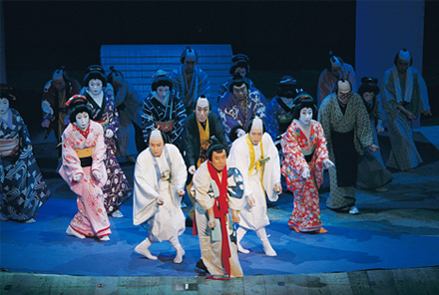
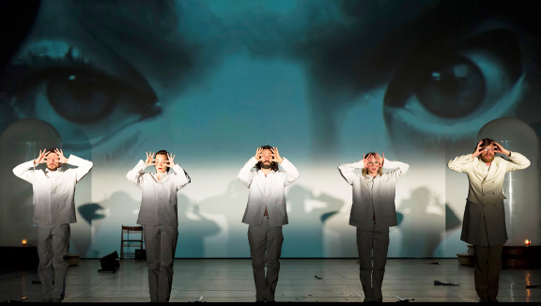
Training techniques from other Disciplines
Asian Theatre
Stylization and Symbolism
Control and mastery of the body and nerves
Each gesture tells a story
Study for years under a master
Tai chi
Musical Theatre
Dance
Singing
Pantomime
Physical communication without props or words
Avant-Garde or Experimental Theatre
Physical is as important as words.
Stress may be in the visual or realistic aspects of the work
Visual pictures
Ann Bogart

Slide 20
Who is Anne Bogart?
Anne Bogart is one of the most innovative and influential American theater directors working today, especially in Avant-Garde.
The former Artistic Director of the Actors Theatre of Louisville, Jon Jory, has called her “the most important acting and directing theorist since Stanislavski and Brecht.”
In 1992, she co-founded the Saratoga Theatre Institute (SITI), where she currently serves as Artistic Director.
She has taught classes at NYU in the Experimental Theater Wing for the undergraduate theatre students.
She also heads the Graduate Directing Program at Columbia University.
She has written several works on the theater, including, “Anne Bogart: Viewpoints,” “A Director Prepares,” and “And Then, You Act.” Today, she and Tina Landau’s “Viewpoints” method is one of the most consistently studied in the country.

Slide 21
Who is Anne Bogart?
Anne said “being a theater director was something that I chose long before college. My path was decided after my first directing experience at Middletown High School in Middletown, Rhode Island with the play “The Bald Soprano.” I had just turned 16 years old and that experience did it for me. I was hooked. I never wanted to act or design. I always knew that directing was for me.”
Bogart says that with her directing style she does “not feel avant-garde. Yes, it’s true that I am often described as experimental or avant-garde but really I do not think about making anything new, rather I am totally invested in the past. I mostly study the past. I study history and I believe that the job of the theater is to give voice to dead people who have things left to say. If the word theater were a verb, I think it would be “to remember.”
Anne has also mentioned in interviews that “male directors certainly have an easier career path than women directors. Women directors have to work twice as hard and have to be far wilier than the guys to get on with it. Often we have to go around and enter through the back door in order to get to the front. We have to go away and then return with a body of work.”

Slide 22
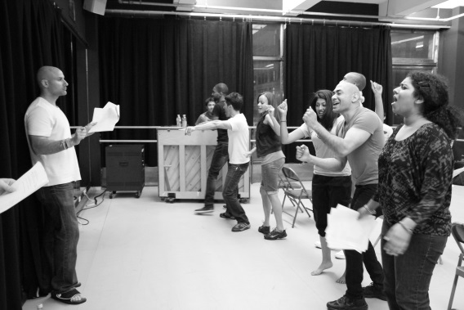
Stage Acting Today
Moving from Preparation to Performance
Technical training helps the actor prepare for performance
Steps to prepare for performance
Read and Analyze the script
Find the objectives
Work on the physical requirements
How does the character walk, talk, posture?
How do they look , dress, do their hair?
What are the internal aspects of the character?
Integrate both the physical and the internal aspects of the character
Intangibles: Presence, charisma, personality, star quality
Emphasis on reality brought about the creation of techniques to train actors
Konstantine Stanislavsky system
Most modern training has a foundation in Stanislavski
Physical training in addition to technique training is important
Intangible qualities cannot be learned.
The Audience is the judge as to whether or not the actor has been successful in using his training to create a believable

Slide 23
Works Cited
Astri von Arbin Ahlander. “Anne Bogart.” The Days of Yore, 27 June 2010, thedaysofyore.com/2010/anne_bogart/. Accessed 20 Sept. 2017.
Boisseau, R. (2015, June 19). Costumes of complexity: From Nô to Mata Hari, 2,000 Years of Asian Theatre. Retrieved September 17, 2018, from https://www.theguardian.com/fashion/costume-and-culture/2015/jun/19/paris-exhibit-asian-theatre-costumes
Branham, M. (2018, March 20). Maniacal Method Acting That Will Make You Appreciate These Roles Even More. Retrieved September 17, 2018, from http://www.mandatory.com/culture/1304661-maniacal-method-acting-will-make-appreciate-roles-even
LAMDA Limited. (2018). Semester Programme Classical Acting. Retrieved September 17, 2018, from https://www.lamda.ac.uk/our-courses/all-courses/lamda-semester-programme-classical-acting
PBS. (2015, August 04). Sanford Meisner. Retrieved September 19, 2017, from http://www.pbs.org/wnet/americanmasters/sanford-meisner-about-sanford-meisner/660/
Robert Benedetti Productions. “Biography about Robert Benedetti.” Robert Benedetti, www.robertbenedetti.com/Biography.htm. Accessed 19 Sept. 2017.
Wikimedia Foundation, Inc. (2018, August 08). History of theatre. Retrieved September 17, 2018, from https://en.wikipedia.org/wiki/History_of_theatre

