Slide 1
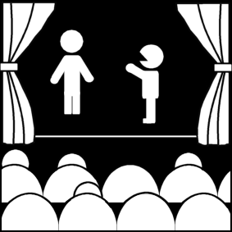
The Designers and the Theatre
Week 8
[Part 1]
Introduction to Theatre
College of the Desert

Slide 2
A Brief Background on Theatre Designers
Stage Design was not always considered essential.
The Scenery Designer creates the visual
world in which a play unfolds.
Costumes and mask-making are quite old.
Sound is a brand-new technology.
Lighting - may go back to the Renaissance - with gaslight in the 1800's, lighting came into its own.
Designers are more vulnerable to shifts in technology because they have to continue learning new and more advanced equipment and software.
Designers are both artists and artisans (craftspersons).

Slide 3
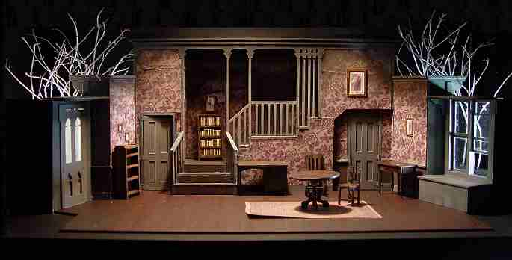
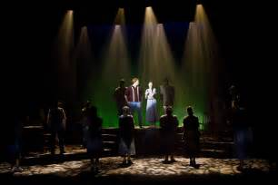
A Brief History of Design
In Greek Theatre:
Scenic devices used
Masks and costumes were used
Little is known of designers
Background was a permanent building structure.
In Medieval Theatre:
Scenic elements and costumes were important
Often had a "master of secrets" (usually machinists, guildsmen)
Usually had some intricate effects but had little concept of artistic unity
During the Renaissance:
Theatre buildings were constructed for the first time since the Roman Empire
Theatre designers start to become essential
In Elizabethan and Spanish Theatre:
Inigo Jones brought Italianate staging ideas to England
By the 17th century (1600's), design was a high art and designers were considered as artists.
Costumes – still little regard for artistic unity, though could be lavish -- often actors supplied their own costume.
1750-1900 - costume becomes more specific, along with scenery and lighting.
Director David Garrick hired Phillippe de Loutherbourg - a scenic designer – to unify with representations of real places.
Similar to Greek Theatre in that it had a permanent background structure
Used furniture pieces

Slide 4
Who was Sabastiano Serlio?
1475–1554, Italian Renaissance architect and scenic designer of the 16th century
He designed 3-dimensional scenery
His book, Architettura, was the first Renaissance work on architecture to devote a section to the theatre. It also incorporated his theories on perspective, the art of representing three-dimensional objects on a flat surface.
His many articles included illustrations of the tragic, comic and satyric stages, based on Vitruvius’s innovative ideas regarding the vanishing point.
He was also the first to employ the term “scenography,” and to make extensive use of the scenic space and lighting to give the impression of depth.
He did not limit himself to the painted backdrop, which was so popular at the time.
With his technical innovations, Sebastiano Serlio had a profound impact on the theatrical architecture of his age.
With his ideas and innovations, Serlio gave the Italian Renaissance the bridge it needed to start building its own theatres and expanding drama to the people of the period.

Slide 5
Who was Sabastiano Serlio?
He blended the idea of the true classical theatre with the art of the Renaissance and birthed central perspective into theatre. With that, he is able to transcend centuries as we are still using conventions engineered by him in productions today.
Serlio's contribution to theatre of his time has transcended the centuries and affects us today.
Serlio used a raked stage. This added to the visual effect of creating a centralized perspective. It made everything upstage look like it was farther away than it really was because it was getting smaller.
Serlio also used a series of wings to further draw the eye into the illusion. Usually, three sets of wings were used. Each pair was set in farther than the last. These began at the point on the stage where the actors did not perform. These wings not only added to the central perspective idea, they also allowed areas for the scenery and machines used for the spectacle in the intermezzi to be hidden.

Slide 6
Who was Joseph Furttenbach?
17th century designer
Known for quick scene changes, painted drops, and flats.
Joseph Furttenbach was born in Leutkirch, Germany.
From 1607/08 to 1620 he stayed in Italy (especially in Milan, Genoa and Florence). There he did an apprenticeship as a merchant under the supervision of his uncles. Moreover, he studied engineering, military architecture and grew an interest in theatre and stage design while abroad.
Through his travels he made detailed accounts of buildings that interested him as well as festivals, processions and dramatic performances.
In three of his books he wrote expositions on scenery and lighting for the theatre.
He had the most extensive accounts of backstage practices during the Renaissance.
After his stay in Italy, he moved back to Germany and settled in Ulm. There, he had a successful career as an architect and universal engineer.
His designs included a hospital, a waterworks system, a schoolhouse, a theatre, and homes.
He was eventually named city architect of Ulm, wrote many books, and served on the city council.

Slide 7
Who was Inigo Jones?
Inigo Jones was born on July 15, 1573 in Smithfield, London.
Inigo Jones was a British theatre designer and architect.
His works incorporated various new devices within the theatre and is often referred to as the first English architect.
He incorporated features of Roman and Renaissance themes into new styles of buildings.
The success of Inigo Jones in his careers within the theatre and the realm of architecture was the result of his cultural experiences and studies he undertook while traveling across Europe.
He took two tours during his lifetime: the first took place from 1598 to 1603 and the second from 1613 to 1614.
Among all the places he visited, it was Italy that truly inspired him.
There, he became skilled in painting, acquired a background in the theatre, and learned how to speak Italian.
What captivated him the most though was the architecture. He was amazed by the ruins of Ancient Rome and the new styles spawned by the Italian Renaissance.

Slide 8
Who was Inigo Jones?
His greatest influence however was the work of the famous architect Andrea Palladio. He studied his work over the course of his stay and purchased a vast quantities of the architect's drawings, which became a huge influence in his future works.
Anne of Denmark, Queen of James I, heard news of Jones’ work and employed him in 1605 to design the set and costumes for the masque The Masque of Blackness.
In preparation for the event, he worked with the masque’s poet Ben Jonson. Jones devised the costumes which incorporated features of the contemporary court mixed with exotic features to match the event's theme.
He also assembled the stage machinery such as a series which aided in the raising and lowering of characters onstage.
It was in The Masque of Blackness where Jones fist introduced three fundamental features that would be continued to be incorporated within his stage designs.
First was a rectangular space consisting of a raised stage at the lower end that was concealed at a curtain painted with scenery and a platform for the king at the center of the upper end.
Second was a painted scenery that was setup king to see the full effect of art.
The final aspect would be the use of machinery that moved props along the stage.

Slide 9
Who was Phillippe de Loutherbourg?
Born Oct. 31, 1740 — died March 11, 1812
Was an early Romantic painter, illustrator, printmaker, and scenographer, especially known for his paintings of landscapes and battles and for his innovative scenery designs and special effects for the theatre.
In 1771 he went to London with an introduction to the actor-manager David Garrick, who hired him in 1773 as his regular adviser on scenic effects at the Drury Lane Theatre.
Loutherbourg created elaborate Romantic settings that were designed to bathe the entire stage in an atmosphere of picturesque illusion.
He worked as a theatrical designer until 1785 and is considered the first to have introduced scrims (gauzes that appear solid or transparent depending on the direction of light) and three-dimensional scenery.
He also experimented with colored media for lighting.
He was made a member of the British Royal Academy in 1780.

Slide 10
A Brief History of Design
In Italy with the development of the proscenium theatre, actual scenery began to appear.
The Romantic era brought much more specificity, and led the way for realism, though Romantic theatre was not at all realistic.
In the 20th century, with electric light, from painting to architecture, from two- to three- dimensional cubes, from realism to symbolism and "selective realism," arena stages in the 1950s (though they appeared much earlier in the medieval period), thrust stages in the 1960s, stage design has become more diverse - but still attempts to unify a production.
Since then, scenery has progressed to become more realistic and have improved machinery.
Designers have also crossed into other media such as film, TV, Concerts, theme parks, hotels (Las Vegas), and things like Cirque de Soleil.
Robert Edmond Jones once said:
A good scene should be, not a picture, but an image. Scene designing is not what most people imagined it is – a branch of interior decorating. There is no more reason for a room on a stage to be a reproduction of an actual room than for an actor who plays the part of Napoleon to be Napoleon or for an actor who plays Death in the old morality play to be dead. Everything that is actual must undergo a strange metamorphosis, a kind of sea change, before it can become truth in the theatre.

Slide 11
Functions of Design: Scene Design
Help set the tone and style of the production
Establish the location and period in which the play takes place
Develop a design concept consistent with the director's concept
Provide a central image or metaphor, where appropriate
Ensure that scenery is coordinated with other production elements
Solve design problems
Help tell the story
Provide mood, color, emphasis
Enhance concept
Create environment in which actors can create convincing life
Be aesthetically pleasing on their own

Slide 12
Functions of Design: Scene Design
Establishing tone, style, and mood:
Tragedy vs. Comedy
Example: Julius Caesar's Rome must look and feel very different from the Rome in A Funny Thing Happened on the Way to the Forum.
Level of Abstraction – "natural" or "stylized" -- "realistic" or "nonrealistic?"
Historical period
If updating, retain mood of original
What does the audience think it looks like? (Cowboy hats of the 1940's movies were not realistic, but audiences probably thought they were.
"Realistic" concepts change: new images of the past are grittier - Lion in Winter and The Three Musketeers in 1976 were very dirty-looking.
Geographical location
Quality of light, is the sound coming from inside or out?
What is the essence?
Socio-economic circumstances
How do clothes and light and dealing with sets differ in characters' socio-economic circumstances?
How important is it to differentiate?
Example: In O'Neill's Desire Under the Elms, class is essential
Aesthetic effect
Even intentional ugliness can be beautiful - ugliness beautifully arrived at

Slide 13
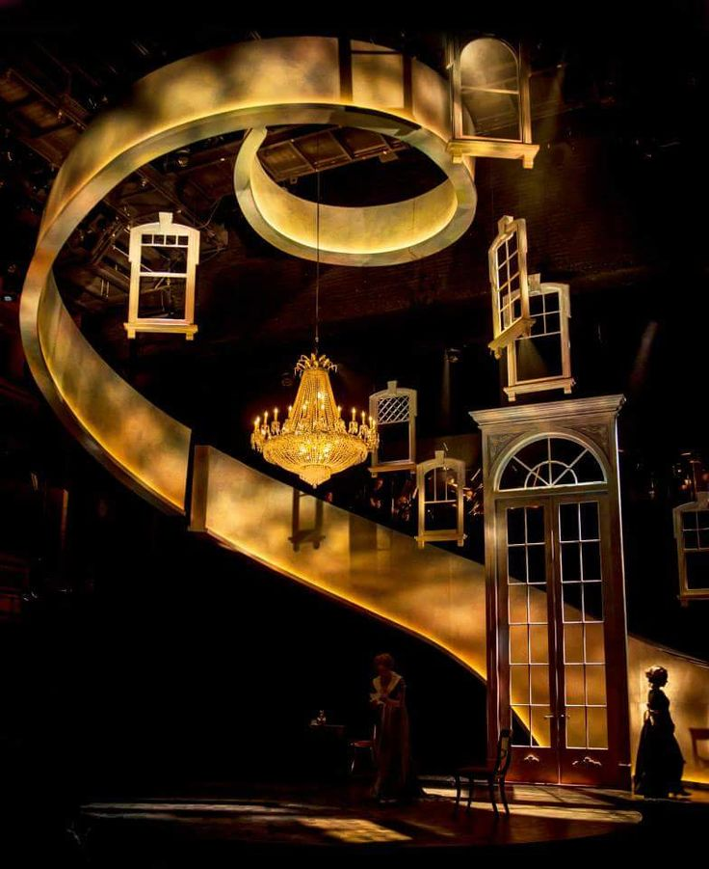
Factors of Design: Physical Aspects of Scene Design
Line
Mass
Composition
Texture
Color

Slide 14
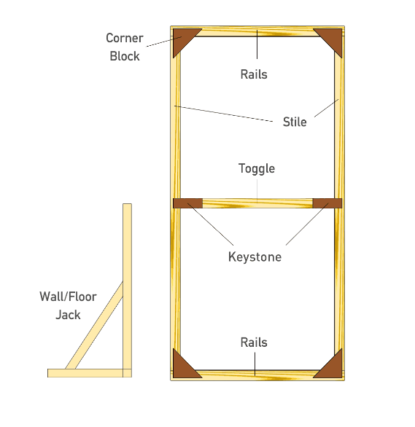
Set Designers at Work
Scene Designer - must consider:
A number of settings (one "unit set" which is designed to remain the same throughout the production [with minor changes in background, set props, etc.], but which can represent various locales; or different sets to be changed during the production)
Shape and size of the house - sight-lines
How scenery will be shifted
Rigged to "fly" from the fly loft, elevators, turntables, tracks and wheels
Materials of set designers:
Traditional "flats" (107)- 1 x 3 " wood frame covered with muslin (a rough cotton fabric) and then painted - can look like walls or other solid structures, yet very lightweight.
Platforms and parallels (collapsible platforms) are also common
Wood, plastic, and metal, etc. are becoming more widespread.
Cyclorama - U-shaped back of stage, for sky or background.
Scrims
“Flying" set pieces from the "fly-loft"
“Wagons," "treadmills"
Historical accuracy, if necessary
Budget and schedule

Slide 15
The Flat (or Plain Flat)
This is the back of the flat; the front is covered with muslin (unbleached cotton) that is stretched around, and glued & stapled.
Braces often not required for 4' X 8' flat; taller/wider usually need braces and perhaps an extra toggle.

Slide 16
Window and Door Flats

Slide 17
The Platform: A weight-bearing structure

Slide 18
The Parallel: Collapsible weight-bearing structure

Slide 19
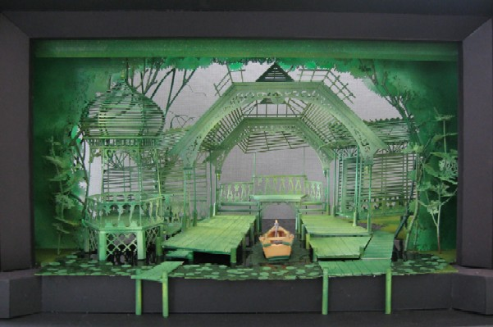
The Process of Set Design
Renderings - loose free-hand drawings of early impressions
Ground-plan - a bird's eye view
Three-dimensional models
Thumb-nail sketches
Elevations (scale drawings)
Instructions for building
Technical director oversees construction
The scene designer also often does the Properties (Props) that are not part of the regular scenery, handled by actors (canes, furniture [handled], letters, etc.)
Props are usually:
Designed and built or bought or rented

Slide 20
Who is Robert Lepage?
A Canadian writer, director, designer, and actor.
Born on December 12, 1957 (age 61).
Lepage was raised in a working-class family in Quebec City.
He graduated in 1978 from the Conservatoire d’Art Dramatique du Québec (now Conservatoire de Musique et d’Art Dramatique du Québec).
After studying in Paris with Swiss director Alain Knapp, Lepage in 1982 joined Théâtre Repère in Quebec.
This theatre company, founded by Jacques Lessard, relied on the active involvement of actors to discover the key object or pattern necessary to develop the production.
In 1985 Lepage became artistic director of the company.
That same year he staged a one-man show, Vinci, about a young photographer coping with a friend’s suicide.
Lepage was noted for juxtaposing multicultural elements in his plays, often to surprising effect.
His Dragon’s Trilogy (1985) was staged partly in Chinese.
For Tectonic Plates (1988; filmed 1992), which dealt with the collision of French Canadian and Scottish cultures, he used two pianos gliding across the stage to symbolize the continents of Europe and North America.
Lepage left Théâtre Repère to become head of the French theatre section of the National Arts Centre in Ottawa in 1989.
There he staged Needles and Opium (1991), in which French poet and filmmaker Jean Cocteau and American jazz trumpeter Miles Davis, both played by Lepage, exchanged places. Lepage envisioned the men in 1949 traveling between New York and Paris at the same time, both addicted to drugs.
In 1992 Lepage sparked controversy at the British National Theatre by setting Shakespeare’s A Midsummer Night’s Dream in a mud bath.

Slide 21
Who is Robert Lepage?
Lepage returned to Quebec City in 1994 to found a new theatre company, Ex Machina, having left his position at the National Arts Centre the previous year.
The company’s first production, The Seven Streams of the River Ota (1994), used the bombing of Hiroshima as a metaphor for contemporary problems such as AIDS. The play, set in the home of a Jewish Czech photographer living in Japan, revealed the story line through a series of flashbacks.
In 1997 the company moved into its new headquarters, Le Caserne Dalhousie.
The building, a renovated firehouse, housed Lepage’s scenery production workshop and film studio in addition to a theatre.
Many of the plays staged by Ex Machina were written and directed by Lepage, sometimes in collaboration with other members of the company.
La Géometrie des miracles (1998; The Geometry of Miracles) centred on the relationships between the American architect Frank Lloyd Wright and his acolytes.
The abstracted Zulu Time (1999) put Lepage’s trademark facility with lighting and intricately composed video projections on full display to tell the stories of a cast of characters ranging from flight attendants to terrorists.
A 2004 production, The Busker’s Opera, restyled John Gay’s The Beggar’s Opera (1728) to feature a group of modern musicians.
The Andersen Project (2005), in which Lepage also appeared, wove together several Hans Christian Andersen fairy tales.
Always intrigued by straining the boundaries of convention, Lepage staged Lipsynch, a nine-hour production, in 2007, and Eonnogata, the story of cross-dressing spy Charles de Beaumont, in 2009.

Slide 22
Who is Robert Lepage?
While working in the theatre, Lepage also was involved with a number of opera productions.
In 2005 at Covent Garden in London he staged 1984, an opera based on George Orwell’s novel, and in 2007 Igor Stravinsky’s The Rake’s Progress at Théâtre Royal de la Monnaie in Brussels.
Lepage also worked in film, first appearing in Jesus of Montreal (1988) as an actor playing Pontius Pilate in a Passion play.
Le Confessional (1995), which Lepage wrote and directed, created parallels between the events surrounding the filming of Alfred Hitchcock’s I Confess (1952) and the lives of his contemporary characters.
Possible Worlds (2000), based on a John Mighton play, plotted several permutations of the existence of one couple, played by Tilda Swinton and Tom McCamus.
Lepage wrote and directed La Face cachée de la lune (2003; The Far Side of the Moon), which also featured him in the roles of the two main characters; it was based on his play of the same name (2000).
Lepage applied his theatrical abilities to a multitude of other endeavors.
He staged tours for British rock singer Peter Gabriel in 1993 and 2002 and, in 2005, premiered KÀ, a Cirque du Soleil production that he had designed, in Las Vegas.
In 2008 he designed a massive light installation, The Image Mill, that projected scenes of Quebec’s history onto the side of a building in Quebec City.

Slide 23
Some examples of what Robert Lepage has done!
Here is a short introduction video about Lepage’s work:
https://youtu.be/Rs_TnUqx51w
Here is a short video of an opera he designed - Das Rheingold:
https://youtu.be/4R_kcWP0_SE

Slide 24
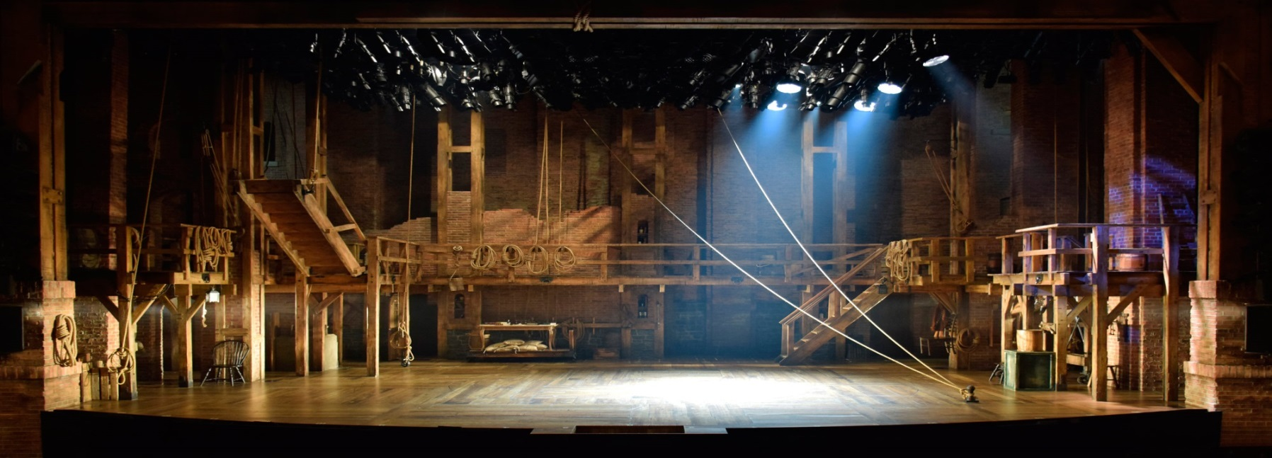
What Set Design Looks Like Today!
Here is a short video about working as a set designer today:
https://youtu.be/-cuyzb8NzJ4?list=PL48EDBCB4915D0ACA

Slide 25
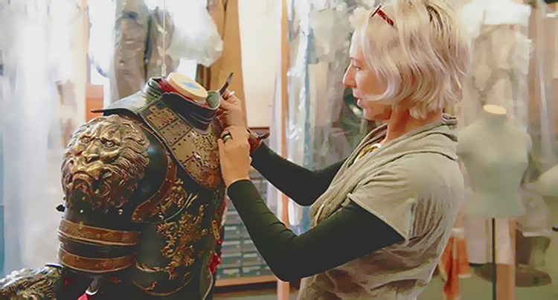
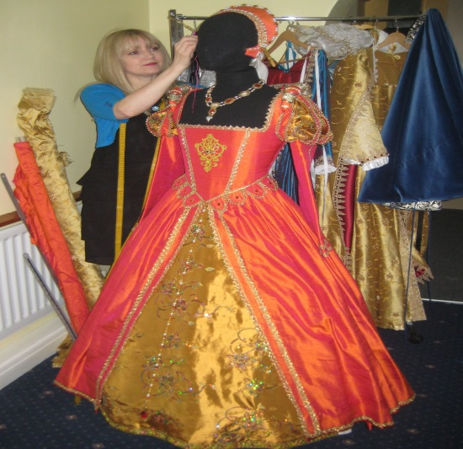
The Costume Designer
Clothes have always indicated or signaled a number of things regarding the wearer, including the following:
Position and status
Sex
Occupation
Relative flamboyance or modesty
The main duties of a costume designer are:
Preliminary sketches/rough drafts
Shows style: including period, color, possible fabrics
Renderings – usually with swatches attached
Meet with the cast and measure
Work with the costume shop to create costumes
Fittings – can have up to 3 with an individual actor
Dress rehearsals

Slide 26
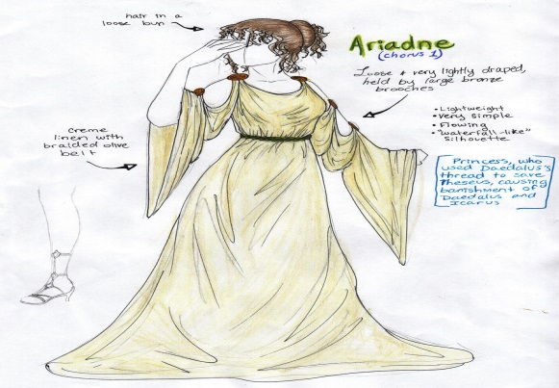
The Costume Designer
Costume Designer's Objectives:
Help establish tone and style of the production
Indicate the historical period of a play and the local in which it is set
Indicate the nature of individual characters or groups in a play:
Their stations in life
Their occupations
Their personalities
Show relationships among characters:
Separate major characters from minor ones
Contrast one group with another
Meet the needs of individual performers:
Make it possible for an actor or actress to move freely in a costume
Allow a performer to dance or engage in a sword fight, for instance; when necessary, allow performers to change quickly from one costume to another.
Be consistent with the production as a whole, especially with the other visual elements

Slide 27
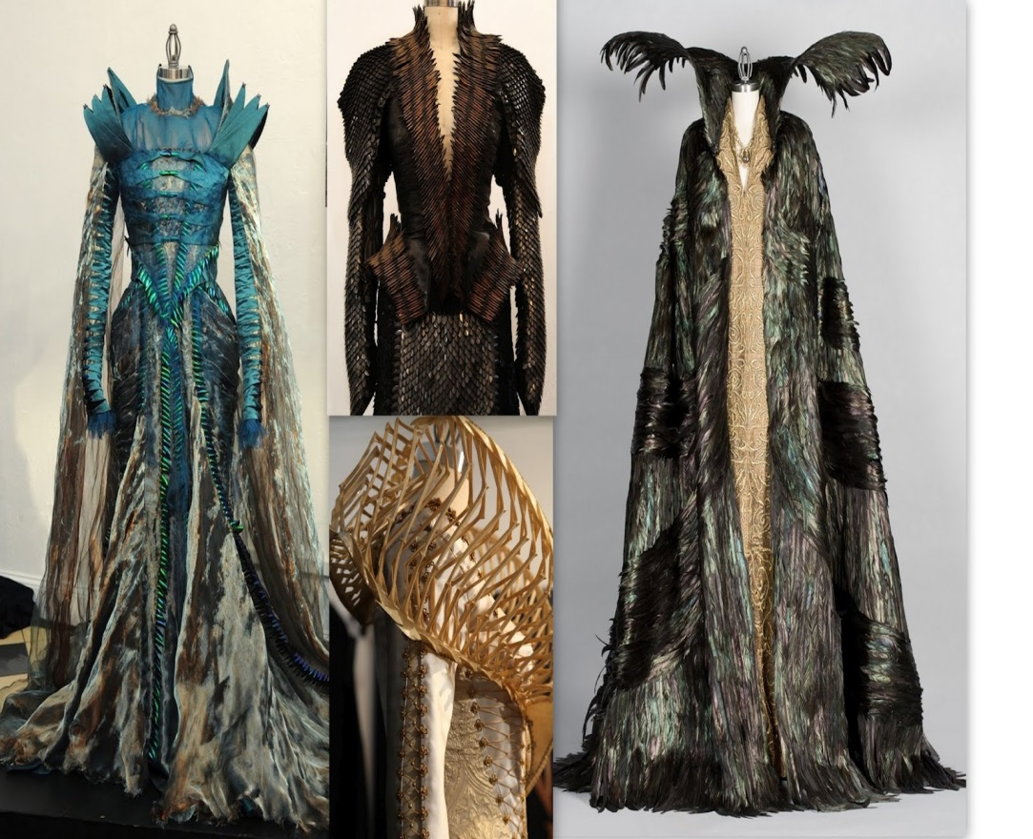
The Costume Designer
Costumes are often rented or bought ("pulling costumes"), built from scratch , or rebuilt, or borrowed.
Clothes must be "right" for the character.
Comfortable to actor (within reason) and usable.
Aesthetically pleasing - can make a big difference to actor's character
Designer must analyze:
Given circumstances - sex, age, health, social class, focal importance
Shape - silhouette (outline) pleasing
Movement of costume
Texture and draping
Enhancement or suppression of body lines
Different periods have different styles:
Pushed up bosoms of the French Empire
Flattened bosoms of the 1920's
Codpieces in medieval and Elizabethan
Togas in Rome
Individual actors - long necks, skinny arms, etc.
Costume shop foreperson executes the designs
Costume designer's resources:
Line, shape, and silhouette
Color
Fabric
Accessories
Makeup, hairstyles, and masks – all related to costumes.

Slide 28
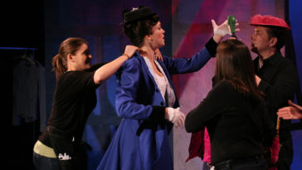
The Costume Designer
Collaborates with:
Costume shop supervisor/Manager
Usually hires the shop staff
Works with the designer to make sure the shop has everything it needs to complete the design
Draper
Makes pattern for costumes and supervises the First hands and stitchers
In charge of fittings and alterations
Supervise Muslin Mock-ups being constructed
First Hand
Cuts out the fabric
Stitcher
Sews costumes
Craftsperson
Creates anything worn that is not clothing such as hats jewelry
Dyeing and painting
Distressing – make costumes look old or worn
Stage manager
Schedules fittings
Wardrobe Supervisor/crew
Supports the actors during the dress rehearsals and show
Help with quick change
Help with dressing, hair, and makeup

Slide 29
What Costume Design Looks Like Today!
Here is a short video about working as a costume designer today:
https://youtu.be/bgxcWne7uzg?list=PL38C3370FBD126CA8

Slide 30
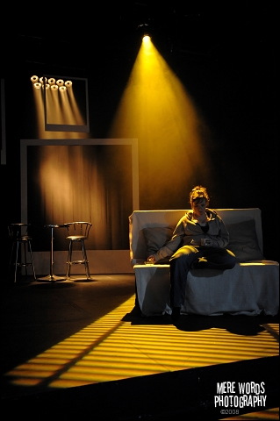
The Lighting Designer
Lighting in everyday life illuminates our world
Music and soft lighting can add mood and atmosphere to a restaurant.
In theatre, lighting was the last element added to theatrical design.
Lighting was not an important factor in design till 1830's with limelight, but even then needed sharper control
Electricity light not invented until 1879
Electricity was the key to imitate natural effects
Lighting was created with the intention to enhance:
Change shape, mood and tone
Lighting is now high-tech, computerized
Objectives of Stage Lighting:
Provide visibility – let the performers and other elements be seen
Help establish time and place
Help create mood and tone
Reinforce the style of the production
Provide focus onstage and create visual compositions
Establish rhythm of visual movement
Reveal shapes and forms
Reinforce a central visual image, establish visual information, or both.

Slide 31
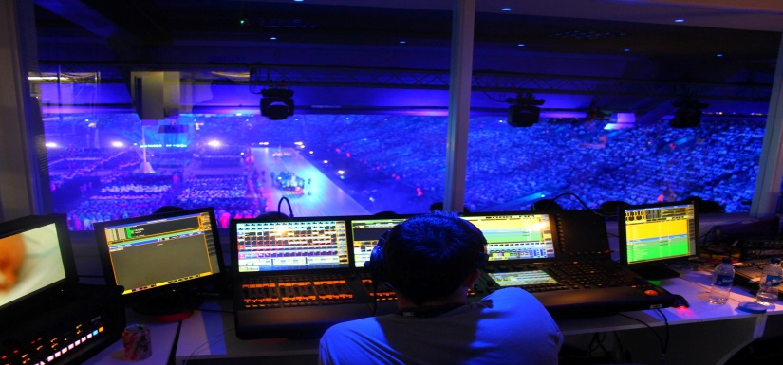
The Lighting Designer
Visibility
Must see the performers faces and their actions onstage
Shape and Form
Lighting objects from the front makes them look flat and uninteresting
Designer uses side, top, and back lighting to create depth and interest.
Focus and Composition
Light is aimed at a particular area.
Need to illuminate what they want the audience to see and can hide what they do not want the audience to see
Mood and style
Blue light can be cold or can be romantic mood light.
Yellow can be cheerful or hot summer day
Time and place
Can indicate time of day
Can indicate season
Indoors or outdoors
Rhythm
Slow fades and subtle changes create a different rhythm than quick blackouts and abrupt changes
Reinforcement of the Central Image
With little scenery, can have a dramatic affect on the production.

Slide 32
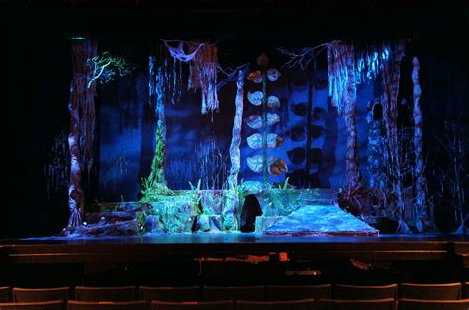
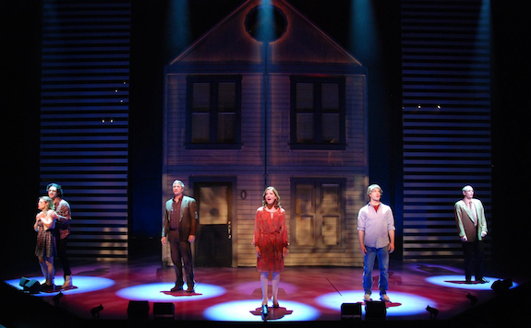
The Lighting Designer
Lighting instruments
The term used to refer to the units that deliver the light (including the housing and the light bulb, or lamp)
The lighting designer can influence only five things in lighting:
Color
Direction/distribution
Intensity
Form
Movement
Color
Changed by using gels – colored pieces of plastic (heat resistant - the only color light that will get through is the color of the gel)
Mixing of colors – warm lights (amber, straw, gold) with cool colors (blue, blue-green, lavender) can produce depth and naturalness
Direction / distribution – can be up to 150 lights in a production
Position and type of lighting instrument and angle
Footlights – lights actor from below
Today basic lighting is usually at a 45 degree angle
Intensity – brightness
Controlling the amount of current to instrument - "dimmers" control that amount
Brightness or darkness
Form – the shape of the light

Slide 33
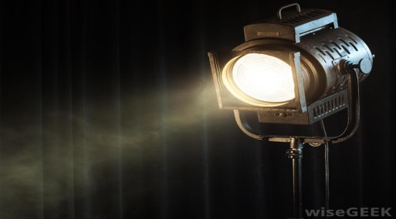
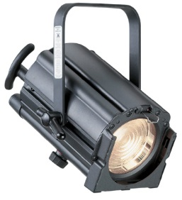
The Lighting Designer
Movement
Alterations in the other factors will give impression of movement – this would also include the movement of a "follow-spot" (powerful spotlight as that swivel and shine on different places).
Fades, cross-fades, blackouts can suggest movement and form
Change focus area
Types of Lighting Instruments:
Spotlights: ellipsoidal reflectors - long distances, sharp and clear
Bright hard - edged spot
Can focus or soften
Can have a gobo slot for pattern projection
Follow-spot
Fresnels (named after Frenchman Fresnel who designed a "step lens" - the lens had less and more even mass, so it would heat evenly, avoiding the problem of regular convex lenses heating unevenly and thus cracking - "fill" light - diffused, to "wash" or "blend."
High - wattage spot
Can cover a large area and create a wash of color
Striplights, footlights:
Footlights used very little these days, but strip lights used to add "fill" light.
Flood lights: no lens, no color - for a "flood" of light
Bathe a section of stage or scenery in a smooth diffused light.
Barn doors – flaps that cut off an edge of the beam
Lighting designers resources:
Three main elements to an instrument:
Lamp (bulb)
Reflector
Lens
Two categories of instruments:
Conventional are fixed – single focus, color etc.
Intelligent moving light fixtures are able to alter focus, change color, project multiple patterns, rotate patterns at varying speeds, change the size of the beam, and give sharp or diffused focus.

Slide 34
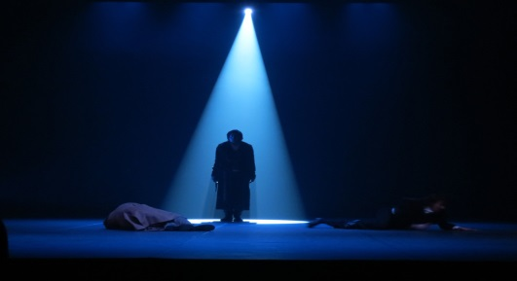
The Lighting Designer
Automated or Moving light
Alter focus, change color using color mixing, project multiple patters, rotate the patterns at varying speeds, change the size of the beam, and give a sharp or diffused focus.
Can create noise so not always ideal.
Widely used in large concerts
Lighting controls
Usually controlled by one person at a console
Cues are programmed into a light board ahead of time.
Create a blackout (all lights out)
Fade (lights dim slowly, changing scene from brighter to darker)
Cross - fade (One set of lights comes down while another comes up)
Split cross fade (The lights that are coming up are on a different fade count from the lights that are coming down)
Lighting Designers Collaborators:
Assistant designers – help create light plot
Master Electrician – Prepare, hang and focus light and all accessories
Moving light programmer – programming for moving lights

Slide 35
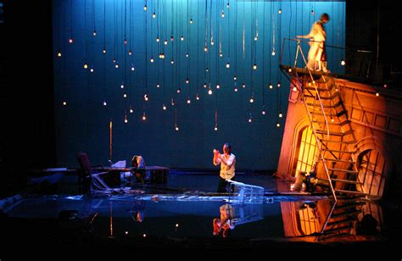
A History of Stage Lighting
Lighting cues seem to have been written into Greek plays
The festivals played from sunup to sunset, and many of the lines refer to times of day.
The sun was the first major source of lighting instrument, and clouds were the first dimmer.
Most theatre outdoors during the day for the first 2,000 years
The Romans moved pageants into the Great Halls.
In 1545:
Sabastiano Serlio used colored light liquids in bottles (red wine, saffron (yellow), ammonium chloride in a copper vessel (blue).
Brightly-polished barber basin and a round bottle as a lens
Three qualities of light:
Distribution
Intensity
Color

Slide 36
A History of Stage Lighting
1550:
Leone de Somi - full illumination for happy scenes, but tragedy much darker (candles, crude oil lamps, torches, and cressets (hanging lamps).
Stagehands walked around and snipped wicks, the audience was lit
Candles were of tallow and fat
1573:
Inigo Jones (English - stage designer) returns from Italy with knowledge of the Proscenium Arch and footlights, and comes up with ideas for masques.

Slide 37
Who was Leone de Somi?
Born in 1525 and died in 1590
He was a Jewish-Italian playwright, director, actor, poet, and translator.
Leone was a member of the renowned Portaleone family, which boasted many famous doctors and scientists. He, however, was the first of his family to garner literary fame, as the author of some 15 plays, most of them written in Italian, as well as poetry, and even a comedy, written in Hebrew, A Comedy of Betrothal (the earliest surviving work of its kind in the Hebrew language).
He is now most remembered for having written the first ever essay on the art of stage direction, which defines a precise methodology of play production, from the selection of a text through its performance.
This work, entitled, Four Dialogues on Scenic Representation ("Quattro dialoghi in materia di rappresentazioni sceniche"), takes the form of four conversations, between Veridico, a tailor/playwright/director, who acts as the voice of the author, and two curious gentlemen, Santino and Massimiano, who ask Veridico various questions about the theory and practice of the theater.
This work marks a major milestone in the modernization of the theater from the unsophisticated days of the Middle Ages, and it also supplies valuable information on how theatrical spectacles were conceived and performed at this point during the Italian Renaissance.
De' Sommi wrote most of his plays in poetry.
He wrote and directed many of the plays which the Jewish community were obliged to perform for the duchal court every year at the Carnival celebrations.
Unfortunately, almost all of his works were lost in a fire at the Biblioteca Nazionale di Torino, in which sixteen volumes of manuscripts of his work were destroyed.
The only works of de' Sommi which survive to this day are the aforementioned Hebrew comedy, the Four Dialogues, a comedy and a pastoral work written in Italian, and a poem in defense of women, entitled Shield of Women which consists of alternate lines in Hebrew and Italian.

Slide 38
A History of Stage Lighting
1580:
Teatro Olimpico is the first permanent theatre in Italy
1618:
Teatro Farnese in Parma - the first theatre with a permanent proscenium arch and curtains
1628:
Joseph Fursttenbach
Footlights (floats) and sidelights
1638:
Nicola Sabbatini - writes book on theatre - suggests system of dimmers lowering metal cylinders over the candles
17th century (1600's):
Paris - many chandeliers are used for lighting in the theatre
Gas becomes used for lighting
Used candles and oil lamps for illumination
1783:
Candles ruled the day till the invention in 1783 in France of the kerosene lamp with adjustable wick
Followed closely with a glass chimney - could make individual float lights
Used for 100 years
1791:
Illuminating gas produced in quantity - William Murdock - each building could produce its own
However, gas required constant attention and wasn't easy to control

Slide 39
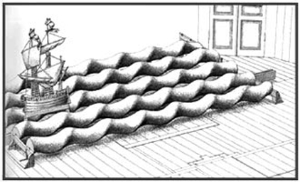
Who was Nicola Sabbatini?
Born in 1574 in Italy—died December 25, 1654 in Italy
He was an Italian architect and engineer who pioneered in theatrical perspective techniques.
In his major and most-enduring written work, Pratica di fabricar scene e macchine ne’ teatri (1638; “Manual for Constructing Scenes and Machines in the Theatre”), Sabbatini described contemporary theatrical techniques, including those used for stage lighting.
He demonstrated, for instance, how a bank of stage lights could be illuminated or dimmed simultaneously and discussed proper light positioning.
Among his other devices were the sliding of wings and scenery on grooves in the floor and methods of simulating fire and waves.
Although most of the stage machinery described by Sabbatini was probably not of his invention, the Pratica remains a comprehensive documentation of practical stagecraft of the Renaissance. Its influence was considerable during the 17th century and beyond.

Slide 40
A History of Stage Lighting
1803:
Limelight
Invented by Henry Drummond - heating a piece of lime with a flame of oxygen and hydrogen (for a followspot or to indicate sunlight). A green-ish tint.
Was used as the first spotlight in Paris Opera houses
A theatre in London installed gas lights
Constant fire threat
1845:
Drury Lane Theatre is the first to use gas in England
1809:
Electric Arc -- discovered by Sir Humphry Davy – took 90 years to be fully accepted.
1816:
First fully gas-lighted theatre – Chestnut Street Theatre in Philadelphia
Greater control of and more brightness (color-silk cloth or woven cotton).
Increased heat and many fires caused, and had gas smell and green-ish tint.
1878-1898:
Henry Irving (England) initiated lighting rehearsals, transparent lacquers of colored class to limelight with electricity to incandescents, footlights of different colors and broken into sections, and wanted to dim the house lights
Electric light bulb invented
Could control intensity
Could add color films to change light color
1841:
First incandescent lamp patent - Edison - not practical
1846:
The first electric carbon arcs used as spotlights at the Paris opera - inefficient – not a serious threat to limelight

Slide 41
A History of Stage Lighting
1879:
The Jablachkoff candle - the first useful lightbulb - "electric candle" - used at Paris Hippodrome - a carbon arc (invented 40-50 years earlier, but limelight was too ingrained, even well into the 1920's.
The first practical electric spotlight
1881:
Savoy Theatre in England - the first completely electric theatre
1882:
A big push - electric theatre at the exposition in Munich, Germany – with a saltwater dimmer to control the new power source - went like wildfire...
As technology develops and advances at a more rapid rate, so did development of more effective lighting equipment
Edison - first practical lightbulb
Incandescent to tungsten -halogen lamps
Lacquer to gels
Electric lighting went from the marquee to the outer lobby to the inner lobby to the house to the stage
Today, lighting is the most technologically advanced theatrical element.
Can be computerized and motorized.

Slide 42
Early Lighting Instruments

Slide 43
Lighting Design Today!
Here is a short documentary about working in the theatre as a lighting designer today
https://youtu.be/wqMYsjHU5rU

Slide 44
Sound Design
The Sound Designer is the person responsible for arranging and orchestrating all the Aural aspects of a production
Read script and note the needs
Decides on number and type of microphones if used
Placement of speakers
Consults with director
Prepare components for production
Include pre-show, post-show, and intermission music
Sound effects

Slide 45
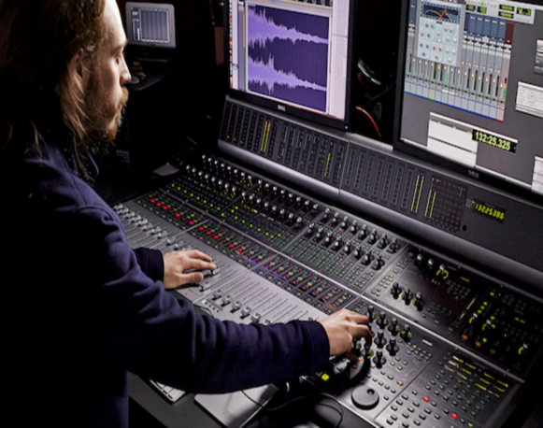
Sound Design
Sound design has always been used in some way
Rolling cannonballs for sound of thunder
But with modern technology, more precise sounds are possible.
Reproduction
The use of motivated (called for by the script)
Door slam, car noise, etc.
Environmental
Help create more illusion of reality
Everyday noise like street traffic noises, crickets chirping – could be considered background noise
Reinforcement
The use of amplification
Amplification of sounds produced by a performer or musical instrument.
Microphones or instrument amplifiers
Modern practice of "mic'ing", sound effects, background music - further technology and expertise may increase sound capabilities, as it appears to be one of the hardest to control.
Different kinds of microphones are used for all different sounds needs.

Slide 46
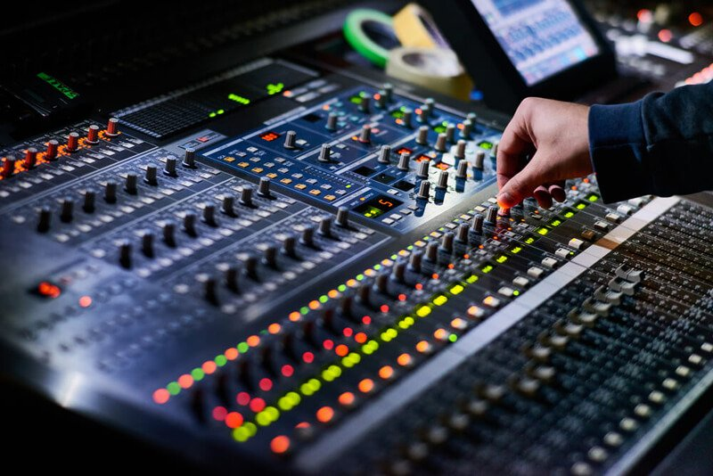
Sound Design
Sound in the theatre: Advantages and Disadvantages
Amplification
Should it be amplified?
How loud should it be?
May sound too artificial or mechanical
Sound Effects
Used to be created back stage with various noise makers.
Now we use digital sound

Slide 47
Sound Design
Sound Technology
Microphones or loudspeakers
Shotgun microphone –highly directional and is aimed from a distance at a specific area
General microphone – picks up sound in a general area toward which it is aimed
Body microphone – wireless microphone attached to a performers body or clothing.
Sound Recordings
During technical rehearsal create sound cues and set volume.
One person at a console will control.
In a musical or rock concert, usually mix sound as it is created.
Sound strongly affects mood and need to be consistent with concept of the production.

Slide 48
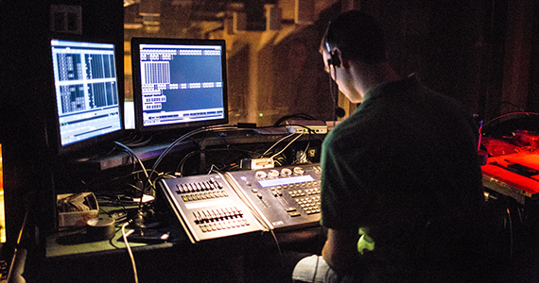
What Sound Design Looks Like Today!
Here is a short video about working as a sound designer today:
https://youtu.be/MGtX9P8gDI8

Slide 49
Works Cited
“Inigo Jones.” Inigo Jones - DigitalBard, digitalbard.lmc.gatech.edu/wiki/index.php/Inigo_Jones. Accessed 2 Oct. 2017.
Lapointe, J. (2016, November 17). Robert Lepage en réalité augmentée | Josée Lapointe | Entrevues. Retrieved October 10, 2018, from https://www.lapresse.ca/arts/livres/entrevues/201611/17/01-5042431-robert-lepage-en-realite-augmentee.php
“Sebastiano Serlio.” Italian Renaissance Theatre, italianrenaissancetheatre.weebly.com/sebastiano-serlio.html. Accessed 2 Oct. 2017.
The Editors of Encyclopædia Britannica. “Nicola Sabbatini.” Encyclopædia Britannica, Encyclopædia Britannica, inc., 9 Jan. 2015, www.britannica.com/biography/Nicola-Sabbatini. Accessed 2 Oct. 2017.

Slide 50
Works Cited
The Editors of Encyclopædia Britannica. “Philip James de Loutherbourg.” Encyclopædia Britannica, Encyclopædia Britannica, inc., 21 Mar. 2017, www.britannica.com/biography/Philip-James-de-Loutherbourg. Accessed 2 Oct. 2017.
Way, L. L. (2018, August 15). Robert Lepage. Retrieved October 10, 2018, from https://www.britannica.com/biography/Robert-Lepage
Wikimedia Foundation, Inc. “Joseph Furttenbach.” Wikipedia, Wikimedia Foundation, 14 Sept. 2017, en.wikipedia.org/wiki/Joseph_Furttenbach. Accessed 2 Oct. 2017.
Wikimedia Foundation, Inc. “Leone de' Sommi.” Wikipedia, Wikimedia Foundation, 3 Aug. 2017, en.wikipedia.org/wiki/Leone_de%27_Sommi. Accessed 2 Oct. 2017.

