Slide 1
The Director and the Theatre
Week 7
[Part 1]
Introduction to Theatre
College of the Desert

Slide 2
What is a Director?
Directing is still a relatively new phenomenon – late 19th, early 20th century – and is still developing.
Began to become more prominent during the Industrial Age and before Romanticism.
Now the director is the dominant figure in theatrical production.
According to the Oxford Dictionary, a director is a person who is in charge of an activity, department, or organization.
The word Director is a noun – directors (plural noun)
A director could mean a member of the board of people that manages or oversees the affairs of a business.
Or it could mean a person who supervises the actors, camera crew, and other staff for a movie, play, television program, or similar production.
The word director came from late Middle English: from Anglo-Norman French directour, from late Latin director ‘governor,’ from dirigere ‘to guide.’

Slide 3
History of Directing
Product of the Industrial Age and Realism
Some of the director's functions are done earlier by other personnel:
In Ancient Greek Theatre:
The "choregus" (head of the chorus) often directed / coordinated song and movement
Playwrights probably staged the plays, and probably cast them
We know too little to understand if they "unified" the production
Roman Theatre:
A wealthy citizen organized, but we still do not know to what extent they "unified"
In Medieval Theatre:
The "master of secrets" – a special effects expert (and there were many special effects in the medieval theatre)
"Keeper of the register“
The "register" was a master copy of the script
A "guild" (group of craftsmen) could hold on to the register and pass it on from generation to generation
All were primarily managerial skill, rather than artistic
With the rise of professional acting companies (during and after Shakespeare’s time (15-1600’s) – came the "actor / manager"

Slide 4
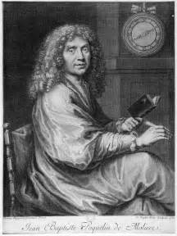
Who was Molière (Jean Baptiste Poquelin)?
Moliere is considered the world's greatest writer of comedies.
Born, Paris, France, 1622
Died, Paris, France, 1675
Many of his plays have also been translated for performances in English theatres, giving him a considerable reputation abroad.
Moliere, whose real name was Jean Baptiste Poquelin, was born in Paris.
He studied with the Jesuits at the College de Clermont.
In 1643 he embarked on a theatrical venture under the title of L'Illustre Theatre, which lasted for over three years in Paris.
In 1658 he played before the king, and organized a regular theatre.
From 1659 no year passed without at least one major dramatic achievement.
His plays range from simple farce to very sophisticated comedy. They ridicule the weakness and foolish actions of the people of his time, and point up their false values.
In Tartuffe Moliere invented one of his famous comic types, that of a religious hypocrite. The play was so cheeky that King Louis XIV, although he found it amusing, did not permit a public performance for five years, fearing that it would offend the powerful French higher clergy.
Moliere died while playing the leading part of his last play, The Imaginary Invalid. It was in the midst of a stage performance that he burst a blood vessel in a fit of coughing and died shortly thereafter.

Slide 5
Who was Molière (Jean Baptiste Poquelin)?
Moliere wrote, "Tis a mighty stroke at any vice to make it the laughing stock of everybody; for men will easily suffer reproof; but they can by no means endure mockery. They will consent to be wicked but not ridiculous.“ These are the words of the man who is rated by most critics as the greatest comic dramatist of all times and considered worthy to stand with Sophocles and Shakespeare. They were written in defense of the play, Tartuffe, ranked as his most outstanding and most representative play.
For in the 17th century, as in ours, powerful cliques attempted to censor every play that did not happen to coincide with their own views or selfish interests. We can realize the bitterness of the campaign against Tartuffe from the fact that it was not finally licensed for public performance until more than five years after its first performance before Louis XIV.
"Molière" was in reality only the stage name assumed when, as a young man, the embryo genius joined a group of strolling players. So famous did he make it, that few of us today recognize the surname "Poquelin."
Molière's father was a prosperous tradesman, upholsterer to the King by appointment. Since this was a hereditary honor, the son shrewdly made use of it to establish and strengthen himself in the King's favor, when, after twelve years in the provinces, he returned to Paris.
These twelve years of trouping and training not only made Molière a comedian of unsurpassed ability; they also gave him that insight into life and character that were to make his later comedies outstanding, perhaps, for all time.

Slide 6
Who was David Garrick and why should we care about him?
David Garrick – actor/manager of the Drury Lane Theatre in London (from 1747-1776) , which still exists today.
His innovations:
No audience members on stage (had been the practice for wealthier, higher status folks to be on stage during the performance)
"Natural" style of acting (though to us it would probably still seem overformal)
Importance of scene design
Garrick was considered a director in his day, but the term would not have been used (even today in Great Britain, the term "producer" is used instead)

Slide 7
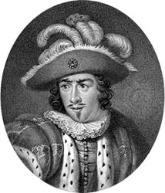
Who was David Garrick?
According to Britannica.com:
David Garrick, (born February 19, 1717, Hereford, Herefordshire, England—died January 20, 1779, London), English actor, producer, dramatist, poet, and co-manager of the Drury Lane Theatre in London.
His business took him into places of entertainment, where he soon had a large acquaintance, including the actor Charles (“Wicked Charlie”) Macklin, with whom he conferred on modern theories of acting, and the elegant but unreliable Charles Fleetwood, manager of Drury Lane Theatre, one of the two theatres authorized by the 1737 Licensing Act, the other being Covent Garden.
In April 1740, Drury Lane produced Garrick’s first comedy, Lethe, or Esop in the Shades.

Slide 8
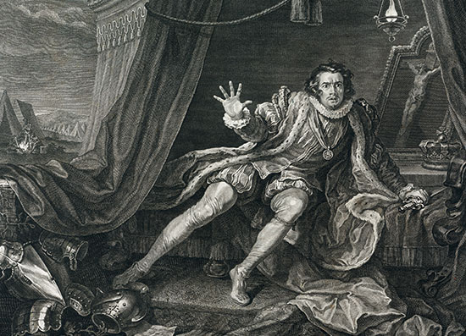
Garrick’s Acting Career
Garrick entered the acting profession anonymously, in a mask.
In March 1741, upon the illness of the actor billed to take the part, he dashed onto the stage as Harlequin at a small, unlicensed theatre in Goodman’s Fields. He was thereafter well received in several parts, but when he applied at Drury Lane and Covent Garden, neither Fleetwood nor old John Rich, manager of Covent Garden, wanted him.
His mother had died in 1740, but he still dared not tell his family that he had entered a profession then generally held in low esteem.
Not until the night after his astounding first appearance as Richard III in 1741 did he break the news to his family.
The instant success of a young, unknown actor in a major tragic Shakespearean part remains one of the romances of theatrical history. The Garrick legend was founded in a single night.
Audiences, weary of the pompous narrative and stately attitudinizing imposed by French tradition, were ready for the naturalistic new style, and they soon perceived that Garrick could do anything.
Fleetwood was now eager to secure him for Drury Lane and offered a salary larger than ever proposed to any performer.

Slide 9
Garrick’s Acting Career
Before the season of 1742–43 Garrick went over to Dublin, where he played at the theatre in Smock Alley. There, his success was tremendous, and he continued to triumph at Drury Lane from 1742–45, playing such diverse roles as Hamlet and the simple-minded Abel Drugger in Ben Jonson’s The Alchemist.
But Fleetwood’s patent of the theatre was running out, and he was a ruined man.
In 1743 Garrick sued him for £600 amount outstanding of salary and led an actor’s strike against him.
In the winter of 1745–46 Garrick was in Dublin, sharing with Thomas Sheridan, the playwright and actor-manager, in the direction of the Theatre Royal.
During this time negotiations began for Garrick to become part owner and manager of Drury Lane Theatre.
In the season of 1746–47 Garrick made his only appearances at Covent Garden.

Slide 10
Reforms of Drury Lane Theatre
In April of 1747 friends in the city helped Garrick to raise £8,000, his share of the purchase money for the lease and furnishings of Drury Lane Theatre and renewal of the patent, in partnership with one James Lacy, a failed actor with a flair for the entertainment trade, who had been stage manager at Covent Garden.
Garrick was to perform and to choose plays and players; Lacy, assisted by a weakish, devoted younger Garrick, “Brother George,” dealt with the business side.
Drury Lane, redecorated, reopened in September 1747 with Macklin as Shylock and a prologue by Johnson that set forth Garrick’s principles, as a producer, of devotion to Shakespeare and reform of plays and players.
Garrick was unwell, however. He had endured many minor sicknesses, indicative of overstrain, in the past months, during which he had never acted more emotionally.
He had announced to his brilliant new troupe that they would find his rule stricter than any to which they were accustomed.
He had made plans for reforming audiences as well as actors.
He tried refusing admittance behind the scenes and on the stage and attempted to discontinue the practice of reduced entry fees for those who left early or came late, but these changes resulted in riots.
He planned to bring down the orchestra from the gallery and to enlarge the auditorium.
The apron—a forestage in front of the curtain onto which players marched, struck a pose, and took up their stances for lengthy soliloquies—became less prominent with the new, natural style of acting.

Slide 11
Reforms of Drury Lane Theatre
Garrick hoped to introduce new lighting, but not until 1765 did he get his footlights and sidelights, which were oil lamps with reflectors.
Most important was to be his choice of plays and manner of production.
He was going to produce much more Shakespeare, purged of the coarse language and effects of Restoration drama: the name of Garrick should be remembered with that of Shakespeare.
He would add a death scene between Romeo and Juliet but restore much of the original text lost in adaptations by the Restoration playwrights, Thomas Otway and Colley Cibber.
He would present Nahum Tate’s 1681 adaptation of King Lear, without the Fool and with a happy ending, and give The Fairies (A Midsummer Night’s Dream) without the clownish artisans and Hamlet without the gravediggers and the tragic fate of Ophelia.
In general, his audiences, accustomed to rewritings of Shakespeare, accepted his “improvements” with obedience: they at least had the merit of keeping the plays on the stage by suiting them to the taste of the time.
Moreover, Garrick’s acting and casting often succeeded in interpreting character in a way closer to Shakespeare and new to the audience.

Slide 12
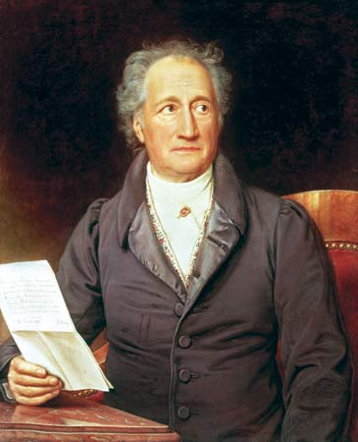
Who is Johann Wolfgang von Goethe?
Johann Wolfgang von Goethe (born August 28, 1749, Frankfurt am Main [Germany]—died March 22, 1832) [pronounced Gerrt'-uh]– Weimar Classicism— was very strict, distrusted others’ talents.
He was a German poet, playwright, novelist, scientist, statesman, theatre director, critic, and amateur artist, and is considered the greatest German literary figure of the modern era.
Goethe tells of his early interest in puppet-plays and theaters, and in the French company of actors which remained in his native city after the Seven Years' War.
In 1770, he went to Strasburg to study law, he took up in earnest his work of criticizing French art and standing for a truly German art.
Goethe received his degree in 1771 and returned to Frankfurt, where he began to practice his profession.
In the Spring of 1790 we again find Goethe in Italy.
In 1791 he was appointed director of the Ducal theater. It was in this capacity that he was best known to the citizens; for he had the final decision on every detail, whether of subject, scenery or acting, and in later years a large arm-chair was reserved for him in the middle of the pit, applause being hardly permitted until he gave the signal for it. At the same time he was occupied with biological, physical, botanical, and chemical research, and many works appeared with the results of his inquiries.
He was greatly influenced by Herder, who showed him the beauty of Shakespeare.

Slide 13
Who is Johann Wolfgang von Goethe?
Shakespeare was performed no longer in burlesque, but in serious renditions of his plays, and the actors were instructed in the delivery of blank verse.
Stress was laid on the excellence of the ensemble as against the predominance of particular stars, and the theatre was considered as a school not only of wholesome entertainment but of natural culture.
His wife died in 1816.
The next year he retired from his position as theater director.
He died at Weimar in 1832.
Throughout a great part of Goethe's work there is a stream of criticism which renders it difficult to re-construct a complete critical theory.
Goethe's broad outlook, his sympathy with and his deep knowledge of man and art, gave him a most catholic view, and possibly the best statement of his creed is found in Calvin Thomas' Goethe: . . . "the simple creed that informs Goethe, and gives him his criteria for judging the work of others. It is that the artist as such must have no creed; that is no creed derivable from the intellect or accountable to it. Rules, conventions, theories, principles, inhibitions of any sort not born of his own immediate feeling, are no concern of his. They proceed from an inferior part of human nature, being the work of gapers and babblers."

Slide 14
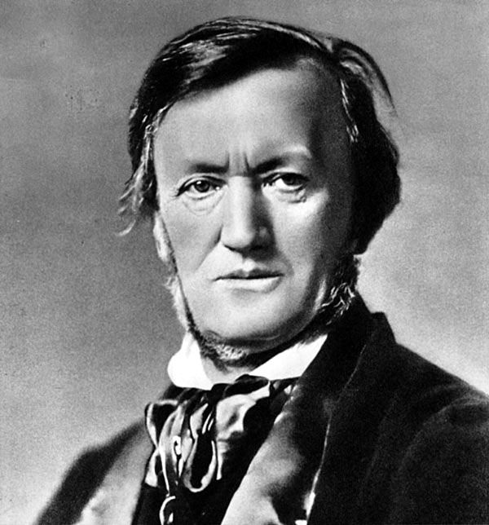
Who is Richard Wagner?
Richard Wagner (1813-1883) [pronounced Vahg'-ner]– is a theorist and composer
He wrote operas that were fantastic, mythical, and patriotic.
In 1834, Wagner joined the Würzburg Theater as chorus master, and wrote the text and music of his first opera, Die Feen (The Fairies), which was not staged.
He ran the Bayreuth Theatre [pronounced "Bye'-roit"] (1876-1883) (which still exists, run by Wagner’s descendants, and until a few years ago they did nothing but Wagner’s operas).
Wagner became the first musical director of the theater.
He wanted total control over the production, and focused on illusionistic theatre.
He was an important factor in the development of realism, but his operas were not at all realistic.
Richard Wagner is best known for creating several complex operas, including Tristan and Isolde and the four-part, 18-hour Ring Cycle.
Unable to enter Germany for the next 11 years due to his political stances, Wagner wrote the notoriously antisemitic Jewishness in Music, as well as other criticisms against Jews, composers, conductors, authors and critics.
He was a favorite of Adolf Hitler and there is evidence that Wagner's music was played at the Dachau concentration camp to "re-educate" the prisoners making Wagner's legacy more controversial.
Wagner had a tumultuous love life, which involved several scandalous affairs.
He died of a heart attack in Venice on February 13, 1883.

Slide 15
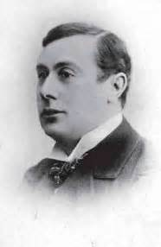
Who is André Antoine?
André Antoine was an actor, theatrical manager, critic, and film director, a pioneer of naturalistic drama who founded the Théâtre-Libre (Free Theatre) in Paris in 1886.
He founded the Théâtre-Libre as a showcase for the work of contemporary naturalistic playwrights.
In its heyday (1887–93), the Théâtre-Libre introduced to French audiences the work of Ibsen, Hauptmann, Strindberg, and others.
It greatly influenced the modern French theatre and spawned a host of imitators around the world, among them the Freie Bühne in Berlin and the Independent Theatre in London.
In 1896 financial losses forced him to close the theatre, but a year later, after serving briefly as co-director of the Théâtre de l’Odéon, he founded the Théâtre-Antoine, offering productions similar to those of his original company.
In 1906 he was appointed sole director of the Odéon; he resigned after eight years to become a drama critic and an extremely innovative film director (1914–24).
He directed such films as Les Frères corses (1915), Mademoiselle de la Seiglière (1920), and L’Arlésienne (1921).
His contributions to the development of realism in modern films was only beginning to gain appreciation in the second half of the 20th century.
Fourth-wall realism
Used real beef onstage for a slaughterhouse scene

Slide 16
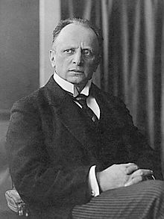
Who is Otto Brahm?
Otto Brahm (1856-1912)
German literary critic and man of the theatre whose realistic staging exerted considerable influence on 20th-century theatre.
In 1889 Brahm helped establish and then directed the theatre company Freie Bühne (“Free Stage”) in Germany.
The Freie Bühne introduced the iconoclastic plays of Henrik Ibsen and Leo Tolstoy to Germany and staged the first performances of plays by the major German dramatist Gerhart Hauptmann.
Despite its influence, it closed after two seasons, though it staged occasional productions for another three years whenever a play Brahm deemed worthy was denied a public license.
Brahm was appointed director of the Deutsches Theater in Berlin a few years later.
His productions, which were obsessively concerned with the exact reproduction of reality, aimed at natural dialogue and the careful integration of character, incident, and environment.
Brahm stimulated existing German realism to fresh efforts and encouraged writers to treat such topics as abnormalities of conduct, crime, disease, and the lives of the working class.
Under his guidance, the Deutsches Theater was a popular and critical success.
When he resigned his post in 1904 and turned leadership over to Max Reinhardt, Brahm was appointed director of the Lessing Theatre in Berlin, where he remained until his death.

Slide 17
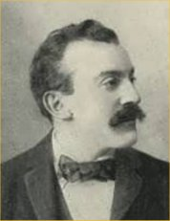
Who is J.T. Grein?
Jacob Thomas "Jack" Grein (generally referred to as J. T. Grein was born October 11th, 1862 and died June 22nd, 1935) was a British producer and drama critic of Dutch origin who helped establish the modern theatre in London.
Born and raised in Amsterdam, Grein moved to London in 1885 and was naturalized as a British subject in 1895.
His greatest achievement was founding the Independent Theatre Society in 1891.
Their first production was Henrik Ibsen's Ghosts in 1891.
Their performances were held as "private" subscription performances, which allowed them to present plays that were not officially licensed by the Lord Chamberlain's Office.
In 1892 the Society produced George Bernard Shaw's first play, Widowers' Houses.
The Greins worked continually to introduce European drama to London.
They founded the German Theatre in London Programme in 1900, hosting German actors and directors such as Max Behrend and Hans Andresen in productions of German drama (performed in German). This programme lasted, in various forms, until 1908.
Grein died of a heart attack at his London home at the age of 72

Slide 18
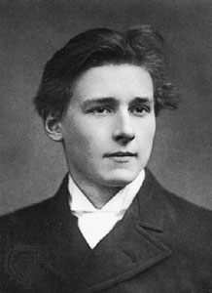
Who is Edward Gordon Craig?
Edward Gordon Craig was an English actor, theatre director-designer, producer, and theorist who influenced the development of the theatre in the 20th century.
He began his career as an actor, in Henry Irving’s company at the Lyceum Theatre, London, and in several touring companies (1889–97).
For the Purcell Operatic Society, Graig began his design career with Henrik Ibsen’s play The Vikings (1903) at the Imperial Theatre, London.
In his sets, decor, and costumes for these productions, Craig asserted his revolutionary theories of theatrical design.
His productions were marked by simplicity and unity of concept, with the emphasis being placed on the movement of actors and of light. But his productions—their artistic impact notwithstanding—were commercial failures, and the financial support that would have permitted him to develop his ideas was not forthcoming in England.
His best-known essay was The Art of the Theatre.
He finally arrived in Italy, where he created the sets for a production in Florence. There he invented (1907) the portable folding screens used in set designs for a co-production with Konstantin Stanislavsky of Hamlet at the Moscow Art Theatre in 1912.
In Florence he published the etchings illustrating his scenographic concepts in A Portfolio of Etchings (1908) and also wrote Towards a New Theatre (1913), which contains 40 plates of his original scenic designs.

Slide 19
Who is Edward Gordon Craig?
He established his School for the Art of the Theatre in 1903.
After World War I, Craig turned increasingly to theatrical history. He did take part in some outstanding productions, though, directing and designing scenery for Ibsen’s The Pretenders (Copenhagen, 1926) and for Macbeth (New York, 1928).
He defined his theory of the history of stage design and expounded his ideas of a stage setting based on the use of portable screens and the part played by light in evoking atmosphere.
Craig propounded an art of the theatre in which reality, instead of being reproduced by traditional representational methods, would be transcended and interpreted by symbol.
To him outlines, forms, colours, and lighting were a means of conveying atmosphere.
His most original theatrical concept was that the entire “scene” in a dramatic work should be movable in all parts; both the floor and the ceiling were to be composed of squares that, under the control of the artist, could be moved up and down independently or in groups within a constantly changing pattern of light. Thus an emotional response might arise in the audience through the abstract movement of these plastic forms.

Slide 20
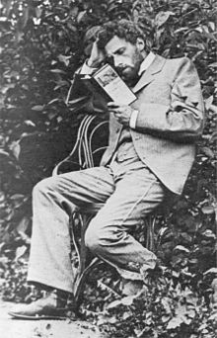
Who is Meyerhold?
Vsevolod Meyerhold (1874-1940)
Meyerhold was a Russian and Soviet actor and theater director, and the creator of a new acting system called “biomechanics”. It is hard to overestimate his role in the development of the Russian theater.
He went to see Othello as staged by Konstantin Stanislavsky. This simple experience changed Meyerhold's life: inspired by Stanislavsky's talent, he left the law department and attended the Theater and Musical School of the Moscow Philharmonic Society.
His tutor, the theater director Vladimir Nemirovich-Danchenko, appreciated Meyerhold’s talent, knowledge, and energy.
When Nemirovich-Danchenko decided to found a new theater together with Stanislavsky, Meyerhold was among the first students who were invited to join the troupe. Meyerhold accepted the invitation, and in 1898 after graduating joined the newly formed Moscow Art Theater.

Slide 21
Who is Meyerhold?
The newly created theater was headed by Nemirovich-Danchenko and Konstantin Stanislavsky.
In those days, Stanislavsky was working on his acting system based on deep character study and realistic acting, which nowadays is world famous.
Meyerhold had been Stanislavsky’s apprentice until 1902.
That year, after playing twenty parts on Moscow Art Theater's stage, Meyerhold announced his rejection of Stanislavsky’s methods, left the troupe and turned from acting to directing.
Meyerhold was looking for a new theater style and new expressive means.
As opposed to Stanislavsky, Meyerhold was usually indifferent to the psychological side of acting, but he was fascinated by its visual side. He made the actors work on body movements, not on character study, and assured them that “buffoonery and clowning are necessary for an actor, and the simplest simplicity should include the elements of the clown”.
His performances resembled marionette theater shows.

Slide 22
Who is Meyerhold?
Stanislavsky found Meyerhold’s experiments too radical and bizarre.
Meyerhold kept experimenting.
In Ibsen's Hedda Gabler he used the acting methods of symbolic theater: slow movements and emotionless speech combined with expressive, sculpture-esque poses and gestures.
To stage A Puppet Show by Aleksandr Blok, Meyerhold studied the traditions and principles of Italian folk mask theater, comedia dell’arte.
Meyerhold's ideas were becoming more and more radical. He kept experimenting:
He wanted to abolish the profession of an actor and to let the common people to participate in plays
He wanted to give free theater tickets to workers and peasants
He wanted to change all the names of the USSR theaters to the abbreviation “RSFSR”: “RSFSR-1” ("Russian Soviet Federated Socialistic Republic 1”), and “RSFSR-2”, and so on
Meyerhold’s new acting system based on body movements.
Meyerhold considered that the art of acting is the art of moving, and that to understand the character the actor has to begin with his mobility. Poses and gestures, according to Meyerhold, represented thoughts and feelings more clearly than words.
THUS – by 1900, the term "director" was in wide-spread use and the primacy of director became clear – directors placed themselves at the center of production.

Slide 23
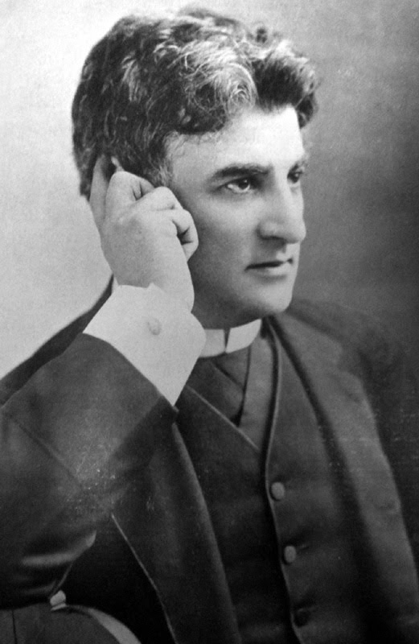
Who is David Belasco?
David Belasco (July 25, 1853 – May 14, 1931) was an American theatrical producer, director and playwright.
He was the first writer to adapt the short story Madame Butterfly for the stage, and he launched the theatrical career of many actors, including Mary Pickford and Barbara Stanwyck.
Belasco pioneered many innovative new forms of stage lighting and special effects in order to create realism and naturalism.
Belasco demanded a natural acting style, and to complement that, he developed stage settings with authentic lighting effects to enhance his plays. His productions inspired several generations of theatre lighting designers.
He began working in a San Francisco theatre doing a variety of routine jobs, such as call boy, script copier or as an extra in small parts.
He received his first experience as a stage manager while on the road. He said, "We used to play in any place we could hire or get into—a hall, a big dining room, an empty barn; any place that would take us.”

Slide 24
Who is David Belasco?
From late 1873 to early 1874, he worked as an actor, director, and secretary at Piper's Opera House in Virginia City, Nevada.
He eventually was given the opportunity to act and serve as a stage manager, learning the business inside out.
A gifted playwright, Belasco went to New York City in 1882 where he worked as stage manager for the Madison Square Theatre (starting with Young Mrs. Winthrop), and then the old Lyceum Theatre while writing plays.
By 1895, he was so successful that he set himself up as an independent producer.
During his long creative career, stretching between 1884 and 1930, Belasco either wrote, directed, or produced more than 100 Broadway plays including Hearts of Oak, The Heart of Maryland, and Du Barry, making him the most powerful personality on the New York city theater scene. He also helped establish careers for dozens of notable stage performers, many of whom went on to work in films.

Slide 25
Who is David Belasco?
Belasco's contributions to modern stage and lighting techniques were originally not appreciated as much as those of his European counterparts, such as André Antoine and Constantin Stanislavski, however today he is regarded as "one of the first significant directorial figures in the history of the American theatre," writes theatre historian Lise-Lone Marker.
He brought a new standard of naturalism to the American stage as the first to develop modern stage lighting along with the use of colored lights, via motorized color changing wheels, to evoke mood and setting.
With regard to these modern lighting effects, Belasco is best remembered for his production of Girl of the Golden West (1905), with the play opening to a spectacular sunset which lasted five minutes before any dialogue started.
Belasco became one of the first directors to use traditional footlights in favor of lights concealed below floor level, thereby hidden from the audience.
He also used follow spots to further create realism and often tailored his lighting configurations to complement the complexions and hair of the actors.
He ordered a specially made 1000-watt lamp developed just for his own productions, and was the only director to have one for the first two years after its introduction (1914-1915).
In his own theatres, the dressing rooms were equipped with lamps of several colors, allowing the performers to see how their makeup looked under different lighting conditions.

Slide 26
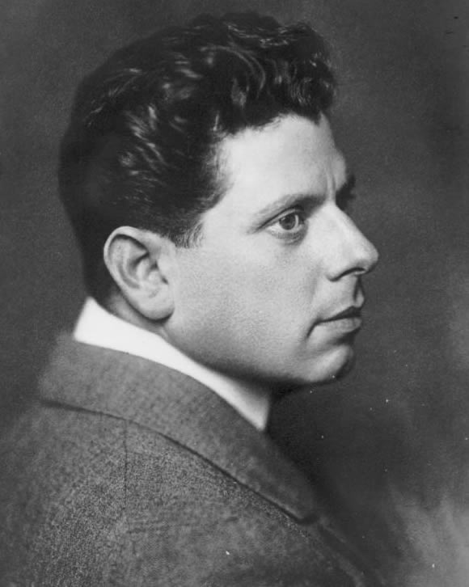
Who is Max Reinhart?
Max Reinhardt (September 9, 1873 – October 30, 1943) was an Austrian-born American theatre and film director, and theatrical producer.
With his innovative stage productions, he is regarded as one of the most prominent directors of German-language theatre in the early 20th century.
In 1901, Reinhardt together with Friedrich Kayßler and several other theatre colleagues founded the Schall und Rauch ("Sound and Smoke") Kabarett stage in Berlin.
Re-opened as Kleines Theater ("Little Theatre") it was the first of numerous stages, where Reinhardt worked as a director until the beginning of Nazi rule in 1933.
From 1903 to 1905, he managed the Neues Theater (present-day Theater am Schiffbauerdamm) and in 1906 acquired the Deutsches Theater in Berlin.
By employing powerful staging techniques, and harmonizing stage design, language, music and choreography, Reinhardt introduced new dimensions into German theatre.
The Max Reinhardt Seminar in Vienna, which is arguably the most important German-language acting school, was installed implementing his ideas.
Compared with most of his contemporaries, Reinhardt was more interested in film than in theater. He made films as a director and from time to time also as a producer. His first staging was the film Sumurûn in 1910. After that, Reinhardt founded his own film company.
In 1920, he established the Salzburg Festival.
Reinhardt opened the Reinhardt School of the Theatre in Hollywood, on Sunset Boulevard.
In 1940, he became a naturalized citizen of the United States.

Slide 27
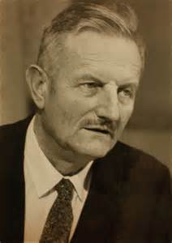
Who is Tyrone Guthrie?
Tyrone Guthrie (1900-1971)
A British theatrical director whose original approach to Shakespearean and modern drama greatly influenced the 20th-century revival of interest in traditional theatre.
He was knighted in 1961.
Guthrie graduated from the University of Oxford and in 1923 made his professional debut as an actor and assistant manager of the Oxford Repertory Company.
He was briefly an announcer and director for the British Broadcasting Company (BBC) and directed the 1926–27 season of the Scottish National Theatre troupe.
He then returned to the BBC to become one of the first writers to create plays designed for radio performance.
As director of productions at the Festival Theatre, Cambridge (1929–30), he experimented with new approaches to traditional theatre.
Guthrie produced his own play, Top of the Ladder, at the St. James Theatre, London, in 1950.
His 1953 productions of Shakespeare’s Richard III and All’s Well That Ends Well at the first Shakespeare Festival at Stratford, Ont., were considered outstanding achievements.
He continued at Stratford for the next four seasons, strongly influencing the development of Canadian theatre.

Slide 28
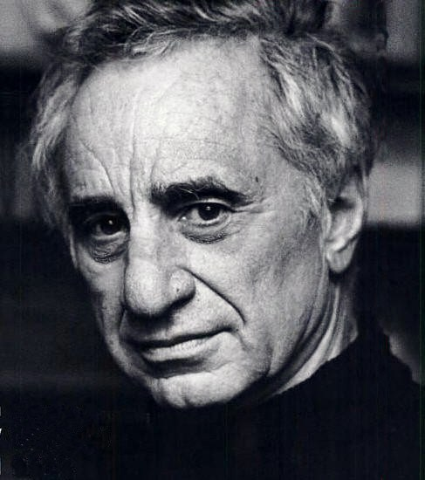
Who is Elia Kazan?
Elia Kazan (1909- ) – Group Theatre in the 30s – mentor, critic, therapist of actors – used Stanislavsky’s "inner" "psychological realism“
Turkish-born American director Elia Kazan is best known for his successes on stage and in film
Elia Kazan was born to Greek parents living in Turkey on September 7, 1909.
After his family immigrated, he grew up in New York City and attended Williams College and Yale University.
As a theater director, he worked with major writers like Arthur Miller and Tennessee Williams.
In Hollywood, he directed award-winning films like A Streetcar Named Desire and On the Waterfront, both starring Marlon Brando, and East of Eden with James Dean.
Over his career, Kazan received three Tony Awards and two Academy Awards for his directorial work.
He was often controversial, most of all when he "named names" of Communist Party members in a 1952 government investigation.
He died in New York City in 2003.

Slide 29
Videos on Directing
How To be a Theatre Director | Theatre Directing
https://youtu.be/yBu255CjJyk
What does a director do?
https://youtu.be/XkMLM_sRJl4
How To Direct a Play | Theatre Directing
https://youtu.be/GiblvjvqGJc
Katie Mitchell devising Beauty and the Beast
https://youtu.be/BPYt-D4xbr0?list=PL494AA606A3F8B076
Sam Mendes on his rehearsal process
https://youtu.be/JevThnO92_c?list=PL494AA606A3F8B076
Steven Spielberg Interview - Best Directing Advice
https://youtu.be/2LYJhvMbwn8
Directing | WICKED the Musical
https://youtu.be/IIS4w4up4Sw
Directing Frankenstein
https://youtu.be/E67Ty4diDgE
Good Advice for Young Directors | Advice for Theatre Directors
https://youtu.be/Qz3QPXCPExU

Slide 30
Works Cited
The Editors of Encyclopædia Britannica. “Sir Tyrone Guthrie.” Encyclopædia Britannica, Encyclopædia Britannica, inc., 17 Jan. 2008, www.britannica.com/biography/Tyrone-Guthrie. Accessed 26 Sept. 2017.
The Editors of Encyclopædia Britannica. “André Antoine.” Encyclopædia Britannica, Encyclopædia Britannica, inc., 28 Nov. 2012, www.britannica.com/biography/Andre-Antoine. Accessed 25 Sept. 2017.
The Editors of Encyclopædia Britannica. (2016, February 17). David Garrick. Retrieved September 22, 2017, from https://www.britannica.com/biography/David-Garrick .
The Editors of Encyclopædia Britannica. “Otto Brahm.” Encyclopædia Britannica, Encyclopædia Britannica, inc., 25 Oct. 2011, www.britannica.com/biography/Otto-Brahm. Accessed 25 Sept. 2017.
Wikimedia Foundation, Inc. “David Belasco.” Wikipedia, Wikimedia Foundation, 21 Sept. 2017, en.wikipedia.org/wiki/David_Belasco. Accessed 26 Sept. 2017.
Wikimedia Foundation, Inc. “Max Reinhardt.” Wikipedia, Wikimedia Foundation, 23 Sept. 2017, en.wikipedia.org/wiki/Max_Reinhardt. Accessed 26 Sept. 2017.

Slide 31
Works Cited
A&E Television Networks, LLC. “Elia Kazan.” Biography.com, A&E Networks Television, 2 Apr. 2014, www.biography.com/people/elia-kazan-9361216?_escaped_fragment_=. Accessed 26 Sept. 2017.
Bablet, Denis. “Edward Gordon Craig.” Encyclopædia Britannica, Encyclopædia Britannica, inc., 31 May 2017, www.britannica.com/biography/Edward-Gordon-Craig. Accessed 25 Sept. 2017.
Bates, A. (2002). GOETHE AS THEATRE DIRECTOR. Retrieved September 22, 2017, from http://www.theatrehistory.com/german/goethe007.html
Boyle, N. (2017, August 23). Johann Wolfgang von Goethe. Retrieved September 22, 2017, from https://www.britannica.com/biography/Johann-Wolfgang-von-Goethe
Clark, H. (n.d.). Johann Wolfgang von Goethe. Retrieved September 22, 2017, from http://www.theatredatabase.com/18th_century/johann_wolfgang_von_goethe_001.html
Hyperhistory.com. “Moliere.” Moliere, www.hyperhistory.com/online_n2/people_n2/persons6_n2/moliere.html. Accessed 22 Sept. 2017.
Revolvy, LLC. “"J. T. Grein" on Revolvy.Com.” Revolvy, www.revolvy.com/topic/J.%20T.%20Grein. Accessed 25 Sept. 2017.
TheatreHistory.com. (2002). JEAN BAPTISTE POQUELIN DE MOLIÈRE. Retrieved September 22, 2017, from http://www.theatrehistory.com/french/moliere006.html.

