Slide 1
The Playwright and the Play
Week 5
[Part 2]
Introduction to Theatre
College of the Desert

Slide 2
The Playwright’s Mind
The creative process for a writer is unclear, but we do know that writers use both the subconscious and conscious mind, digging up material from a place that is not consciously under their control, then they use their intellect to organize, shape, and edit their work.
Dialogue must be represented precisely on the page to give the performer clues about how to deliver it; a comma in the wrong place or a poorly chosen word can drastically affect the actor’s interpretation of a line.
The playwright must be aware that they are creating a blueprint – a document that is not complete in itself but is rich and full enough to inspire visual and interpretive artists and artists of the body and voice (actors) to create an aesthetic whole.
In a musical, the playwright is know as the librettist.
In early Greek theatre, the playwrights would perform and stage their own plays – they were the actor, playwright, and director.
Thespis and Aeschylus were actors as well as playwrights.

Slide 3
History of the Role of the Playwright
Playwrights were often unknown during the Middle Ages. It wasn’t until the Renaissance that the identity of the writer because more important.
During Elizabethan theatre, a writer could begin selling his plays to competing theatrical troupes.
In general, a playwright sold a play for a flat fee to a company, which usually chose not to publish the text, since to do so would make it available to competitors.
Some of Shakespeare’s first publications were pirated editions; someone in the audience, or perhaps a disgruntled actor, scribbled out dialogue from memory and sold the copy to a printer.
Until the late 19th Century, most playwrights received only a flat rate for their plays and would only receive additional payments if their was a benefit night. These benefit nights would only be on the 3rd, 6th, and 20th night of a play’s run – if they even went that long.
In 1971 the French National Assembly passed the first law giving royalties (a fee for each performance) to playwrights.

Slide 4
History of the role of the Playwright
The first professional woman playwright in England was Aphra Behn.
Playwrights were often looked down upon because their profession was often compared to that of prostitutes because they were selling their plays to the highest bidder.
Towards the end of the 19th century, the social position of the playwright began to improve, along with the rest of the theatrical profession.
The work of Henrik Ibsen and the playwrights who followed his example led to an increased emphasis on the theatrical text as literature.
Because of the controversy surrounding productions of the early plays of realism, such as A Doll’s House, the public often was first introduced to these works in printed form.
Ibsen’s plays were frequently discussed, attacked, and praised by readers long before they were seen in productions.

Slide 5
Copyright Regulations
In the late 19th and early 20th century, international copyright laws brought recognition of the play as a writer’s intellectual property.
England passed its first copyright law in 1833.
No theatre may produce a play, no publisher may print it, without first receiving the permission of the writer and (usually) compensating the writer financially.
To violate this standard is unethical as well as illegal; a playwright should be paid a royalty each time a play is produced.
For works created after January 1978, the author has ownership of the work for life and to the author’s estate for 70 years after the author’s death.
Most works published between 1964 and 1977 are under copyright, works between 1924 and 1963 may be under copyright if the original term was renewed; and works published before 1924 are considered in the public domain and can be produced freely.

Slide 6
The Playwright and the Production
The relationship between actors and playwrights have changed throughout time.
Shakespeare and Moliere wrote parts for people they worked with on a daily basis and for themselves.
In the 19th Century it was common for an author to create a work for a specific star.
The American Actor, Edwin Forrest even sponsored contests for the best play to be written for him as the leading role which resulted in some of his most famous characters, such as Metamora, written by John A. Stone.
Tracy Letts wrote his Pulitzer Prize winning play, August: Osage County (2007) with his theatre company in mind (Steppenwolf Theatre Company), and most of the principal character came from that ensemble when it opened in Chicago and then continued on to Broadway.

Slide 7
The Playwright and the Production
Playwrights can even play to the strengths when writing plays and musicals with certain actors in mind.
An actor’s appearance, personality, or history can help to shape the fictional character, and a stage-wise playwright would of course take into account the various levels of talent available in the company and any specialties, such as:
Comedy
Tragedy
Singing
Dancing
Acrobatic Ability
Shakespeare even changed his characters when an actor joined or left his company. For example:
The clown roles altered dramatically when William Kempe who played Dogberry in Much Ado about Nothing was replaced by Robert Armin who played Feste in Twelfth Night.
When the lead actor was replaced in the musical Urinetown, a new song was added to the musical because of the talents by the new lead actor.
Playwrights of the 17th and 18th century were often limited in where they placed the settings of their play because they relied on using stock scenery that was own by the theatre.

Slide 8
The Playwright and the Production
Playwright Eugene O’Neill never had specific actors in mind when writing his plays, but he would create detailed physical descriptions of his characters which were based on the vivid pictures in his mind.
However, writers don’t always get what they ask for. For example:
In O’Neill’s play Anna Christie, the lead was supposed to be a tall blonde. When it opened on Broadway, the actress was a short redhead, but Pauline Lord’s performance captivated audiences. It wasn’t until after O’Neill died that the revival productions of his play on Broadway had actresses that resembled more of what he originally wanted (which was the 1977 revival and the 1993).
It is said that playwrights write better for the stage when they study theatre and attend live productions.
Young playwrights who do not study the theater, often think in filmic terms, imagining visuals that are not possible in live theater (such as a close up), or write in a style that is more appropriate for silent reading than oral delivery.
An understanding of the limitations as well as the imaginative possibilities of the live theatre is essential for someone who is planning the skeletal structure on which many contributing artists will build.

Slide 9
The Playwright and the Production
The playwright can offer a theater company interpretations of the script, explain developments of characters, and give their opinions of performances and designs.
Many times there is conflict between the playwright and the first director of the original production.
The playwright enters the process with a prior sense of ownership, and the director feels responsible for the final production.
When actors and designers get mixed messages from the playwright and the director, personal and artistic confusion can result.
A dramaturg is often brought in to help a playwright.
A Dramaturg is a specialist in dramatic literature and theatre history. They typically read the script, attend readings, rehearsals, and offer suggestions to the playwright and the director. The dramaturg may consult with the playwright on issues of structure, characterization, and/or dialogue or offer advice on solving problems that they play may have.

Slide 10
The Playwright and Rehearsals
During the beginning of the rehearsal process, the playwright may see structural problems with the script and may move scenes around, cut, or add additional scenes.
As the rehearsal process continues, the changes from the playwright become less and less because actors need a set script.
However, in commercial theater, changes can be made up to the last minute, even after the show is in front of an audience.
During the first half of the 20th century, shows bound for Broadway did “out of town” performances so the writer, director, and designers could make adjustments and revisions before officially opening on Broadway in New York.
Many shows have “previews” before the official opening night. Previews can be in Chicago or soft-openings where tickets are sold at a lower price before the official opening of the production which critics are invited.
Playwrights also feel the need to direct their own plays so they can have total control over their work.
However, this sometimes limits the creativity the others can bring out in the playwright’s work that the playwright may have not seen or realized before.
Many theaters offer readings of plays and musicals to help writer’s develop their works. For example:
Avenue Q and Spring Awakening came from these workshop readings.
Stephen Sondheim often chooses to develop his shows in workshop for a long time prior to public performance.

Slide 11
Non-Traditional Playwriting
Some playwrights develop their material in front of a live audience and see where ideas take them.
Playwrights such as Anna Deavere Smith used material not from her own life but from interviews with a wide variety of Americans.
In her 1992 play, Twilight: Los Angeles, she conducted research in the wake of riots over the beating of Rodney King by Los Angeles police.
In her 2009 play Let Me Down Easy, she interviewed 300 people about their attitudes towards the human body, the state of the healthcare system, and the experience of death.
Some playwrights work with companies who choose to develop a play from the beginning in a workshop setting, like Moises Kaufman did for his play, The Laramie Project.
He worked with Tectonic Theatre Group and members of Laramie, Wyoming.
Through interviews and workshops, the collaborators explored the horrific, homophobia-inspired murder of Matthew Shepard in 1998.
Ten years later they Kaufman returned to Laramie to re-interview citizens and explore what effect the event had on the community (The Laramie Project: 10 Years Later).

Slide 12
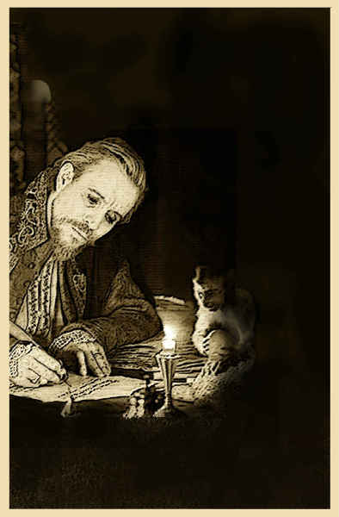
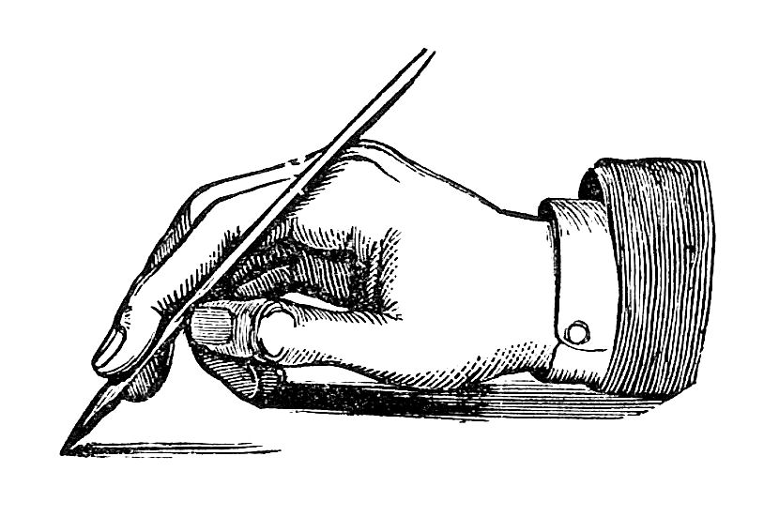
Freedom in Playwriting
There are no artistic rules for playwrights to follow, they are free to choose models from the past, establish new conventions, and let their imaginations soar.

Slide 13
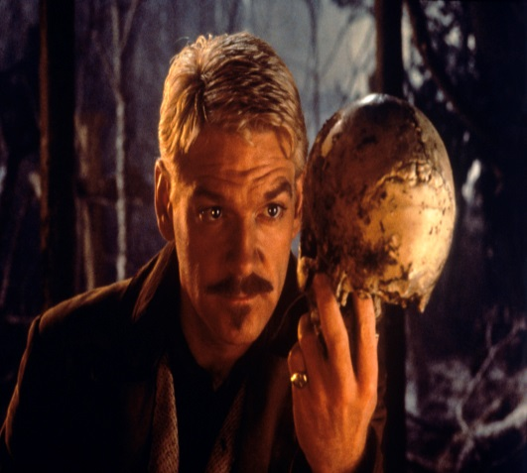
Creating the World of the Play
The playwright chooses the order of the events of the play
Can have an effect on the action
Chooses the degree of seriousness to take toward the subject
Comic, tragic, sympathetic, satiric, cynical, celebratory, etc.
Chooses the subject and verb of the drama
The subject is always people
The verb is the action of the play
Can be a test or challenge
Fight for a person or fight for a kingdom
Intellectual or moral test

Slide 14
Creating the World of the Play
The playwright has rules for the action:
Limited Space
Stage space and setting of play
Limited Time
Time it takes for the performance to be completed or the time limit of the play itself
Elapsed time in a play can be a few hours or a few days
Strongly opposed forces
Protagonist vs. Antagonist
People who are bound to clash
Family members have built in rivalries
A balance of forces
Hard fought and relatively equal contest between forces
Incentive and Motivation

Slide 15
Most Iconic American Plays
Death of a Salesman by Arthur Miller
Angels in America by Tony Kushner
A Streetcar Named Desire by Tennessee Williams
Long Day’s Journey Into Night by Eugene O’Neill
Who’s Afraid of Virginia Woolf by Edward Albee
Our Town by Thornton Wilder
The Glass Menagerie by Tennessee Williams
A Raisin in the Sun by Lorraine Hansberry
The Crucible by Arthur Miller
Fences by August Wilson
You Can’t Take it With You by Kaufman and Hart

Slide 16
Works Cited
Critchley, S., & Webster, J. (2013, August 31). 9 Things You Can Learn From 'Hamlet'. Retrieved September 11, 2018, from https://www.huffingtonpost.com/simon-critchley/9-things-you-can-learn-fr_b_3529453.html
Enos. (1970, January 01). Mrs. Enos' Reading Realizations. Retrieved September 11, 2018, from http://readingwithenos.blogspot.com/2013/10/characterization-protagonist-vs.html
Vasilyev, V., Dr. (n.d.). Tutorial: Creating Simple 3D PDF documents using Adobe Acrobat 9 Pro Extended. Retrieved September 11, 2018, from http://sf.anu.edu.au/~vvv900/cct/appl/jmoleditor/manual/tutorials/3d-pdf/simple-acrobat.html
Wainscott, R. H., & Fletcher, K. (2012). Theatre: collaborative acts (4th ed.). Upper Saddle River, NJ: Pearson Education.

