Slide 1
The Theatre Environment Society, Critic, and the Theatre
Week 3
Introduction to Theatre
College of the Desert

Slide 2
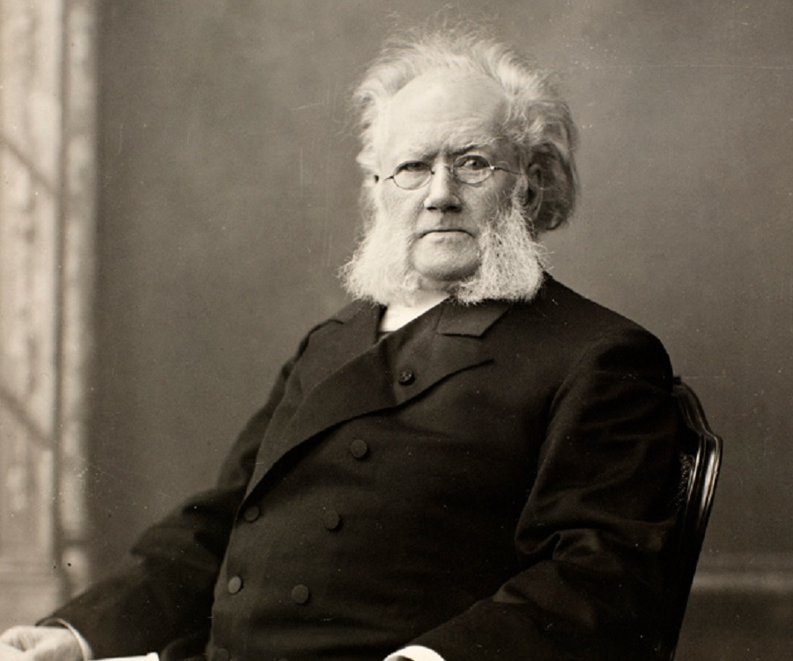
Who is Henrik Ibsen?
Henrik Ibsen was born March 20th, 1828, in Skien, Norway.
His great importance lies in the fact that he took the "well-made" play where the French had left it and brought it to a state of perfection which no one has as of yet improved upon.
A “well-made” play is a play constructed according to a predetermined pattern and aiming at neatness of plot and theatrical effectiveness but often being mechanical and stereotyped.
Above all, Ibsen believed in the individual, in his right to live his life in accordance with his personal creed, despite all obstacles; he says time and again that a man in order to realize the best that is in him must have the courage, the will, to be himself.
He believes that Nora must "live her life"; she is forced, in order to do this, to leave her home and family.

Slide 3
Summary of the Play
ACT 1
The play takes place in the Helmer's residence.
When the play opens, seven years after the forging of the note, Nora comes upon the stage, a dancing, twittering, flitting spirit, she is laden with Christmas gifts for the children – a horse and sword, trumpets and dolls and cradles – tiny things, inexpensive and useless and full of love.
She carries, too, the little bag of macaroons on which she nibbles, assuring Torvald, when he sternly questions her, that she has not touched one. His "little lark" he calls her, his "squirrel" and "spendthrift." She is charming and dishonest, always fluttering, never resting, a light-headed, light-hearted, inconsequent thing.
As she ate macaroons Mrs. Linde visits. She makes Nora aware that since the passing of her husband, who left her no savings, life has become difficult and she is looking for a job; with this conversation, Nora gives in to talking to her husband to offer Linde a job at the bank.
Continuing with the conversation, Nora tells her that she decided to forge her father’s signature to obtain a bond; Nora lets Linde know that she borrowed the money that financed her husband’s treatment in Italy and Torvald is not aware of this.
Nora makes certain that Mrs. Linde understands she is not a superficial creature, but a strong woman who used her intelligence and wit to save her husband’s life.
Nora maintains the conviction that if she can keep Torvald from discovering her past indiscretion, all will be well in their marriage.
She has her little presents for the children, the Christmas tree, the macaroons, the surprise for Torvald, and last, and most important, her costume for the fancy-dress ball. She is to dance the tarantelle, the Neapolitan dance that her husband has taught her. She is eager to dance it well for his sake and for her own.

Slide 4
What is Tarantella?
Accroding to dictionary.com:
Tar-an-tel-la [tar-uh n-tel-uh]
Example: https://youtu.be/Uuer7Si9b94
Is a noun
Meaning:
A rapid, whirling southern Italian dance in very quick sextuple, originally quadruple, meter, usually performed by a single couple.
A piece of music either for the dance or in its rhythm.
Origin of tarantella is Italian (1775-1785) equivalent to Tarant(o) Taranto + -ella -elle

Slide 5
What is Tarantella?
The tarantelle is not an ordinary dance. It is named for the tarantula, and its swift movement and dizzying rounds are measured to the victims of that poisonous sting. Round and round, in frenzied, hurrying course, swifter and swifter – laughter and chatter and flight – till they drop dead. Only a miracle may save them.
The tarantelle is the symbol of Nora. Its wild, un-resting movement is the tragedy of her nature – light and frivolous on the surface, but concealing underneath a deadly secret – a wound that carries death in its train. It is the gruesome climax of Nora's doll life, and it is placed where the chief symbol of Ibsen's play is always placed, at the climax of the play. It is the culmination of the plot. The action approaches it and recedes from it.

Slide 6
Summary of the Play
ACT 1
Dr. Rank leaves the study and talks to the two ladies about the issue of corruption.
The man who Nora borrowed money, Krogstad enters and goes to speak with Torvald in the study concerning the keeping of his job.
He later leaves shortly and Dr. Rank asserts that Krogstad is one of the morally corrupt individuals in this society.
Rank and Linde later leave and Krogstad comes again.
It is Nora’s wish to maintain her happy household; its only shadow being the payment of her debt to Krogstad. When Krogstad, driven by the fear of losing his position (and therefore, any chance at respectability) at the bank, ups the ante and threatens to blackmail Nora with exposure of the bond she forged, she frantically tries to satisfy his demand that she asks her husband (the new bank manager) to keep his job. He says he will tell her husband of her forgery if she will not convince her husband to retain him at the bank.
He leaves after saying this, Nora's husband comes and he is confronted by what she had discussed with Krogstad.
He does not understand why his wife, a woman he considers no more than a decorative doll, pleads with him to retain Krogstad, a shady lawyer and friend of his past.
Torvald stood his grounds that Krogstad must be fired due to his dishonesty so that Linde gets the job; he goes back to the study.

Slide 7
Summary of the Play
ACT 2
Ann, the nurse enters giving Nora a ball gown, she makes a statement that explains her leaving her kids to take care of Nora, she later leaves.
Linde comes back and helps Nora in stitching her dress, and both talked about Dr. Rank.
With the entrance of Nora's husband, Linde leaves and goes to the nursery.
Nora asks Torvald for the second time not to fire Krogstad of which he does not accept.
He gives a pink slip to the maid so that it can be mailed to Krogstad and leaves to his study.

Slide 8
Summary of the Play
ACT 2
Dr. Rank enters and tells Nora about his worsening health conditions; the two flirt and Dr. Rank confesses that he loves Nora making her say that she never loved him but liked having fun with him.
Dr. Rank informs Nora when he sends one of his cards with a black cross upon it, she is to understand the process of death has begun for him.
With his departure comes Krogstad, he is very furious about his dismissal and he leaves a letter explaining Torvald's wife’s crime, this makes Nora very worried.
Nora then tells Linde what has transpired and Linde assured Nora that she will set things straight by talking to Krogstad.
Linde left and Dr. Rank and Torvald come from the study and the two assisted Nora in her dance practice and later left.

Slide 9
Summary of the Play
ACT 3
The arrival of Linde makes Nora aware that Krogstad has left town and she has left him a note, Nora asserts that only a miracle can help the situation.
During the dance, Linde conversed with Krogstad and made him understand that she left him for money but still loves him, they reconciled and Krogstad forgot the whole issue of Nora borrowing his money.
Linde asked Krogstad not to demand for his letter since Torvald does not know of it. The two leave and go to Nora’s.
Mrs. Linde’s observation of how the Helmer’s are accustomed to interacting, leads her to change her mind about enabling Nora in her deception, and making sure Torvald will discover the truth.
Torvald goes to the mail box where he finds the letters, some being business cards from Dr. Rank having black crosses. Nora meanwhile was contemplating committing suicide. She was confronted by her husband who asks her what the black crosses meant, Nora tells him that it is Dr. Rank announcing his death.

Slide 10
Summary of the Play
ACT 3
As Nora is unable to meet the demands of Krogstad, Krogstad exposes her past actions to Torvald, who turns on Nora. Nora, expecting her husband to stand by her, is hurt and angered by his reaction.
The content of Krogstad’s letter made Torvald say to Nora that she is unfit to raise his kids and he calls her dishonest and immoral and their marriage will be referred to as a matter of appearance.
Once he finds out Nora had borrowed money (and forged her father’s signature) from Krogstad, he turns on his wife, despite the fact she did it to save his life.
Once Krogstad, redeemed by the love of Mrs. Linde, returns the bond to Torvald, he forgives Nora and prepares to resume their marriage.
Torvald is willing to forgive and forget after Krogstad returns the bond, but it is too late. In Nora’s eyes, the marriage is irreversibly damaged.
Once it is clear that Torvald puts himself and his reputation before his wife, Nora realizes she is no longer in love with him, gives her wedding ring back, and prepares to leave him.
Nora leaves her wedding rings together with the keys, leaving her husband completely surprised with what had transpired.

Slide 11
Discussion Topics About The Play
“Was Nora in the right to leave her husband?"
"Was their marriage an ideal one?"
“Was Nora right to have deceived her husband?"
"Was Nora justified in forging the note?"
"Is one ever justified in breaking a law?"
"Was Nora's conduct ideal?“
“Was it right for Nora to leave her children behind?”

Slide 12
What do we learn at the end of the play?
Throughout the play, Nora is aware of her husband and children’s needs, without paying attention to her own. By leaving Torvald, Nora will have the opportunity to explore who she really is and learn to stand on her own.
Mrs. Linde’s sensitivity to her loved ones without regard to her own needs has left her alone, a childless widow of a loveless marriage-arranged only to provide for her bedridden mother and two younger brothers. Mrs. Linde becomes self-appreciating and allows herself happiness by planning to marry her first love, Krogstad. Mrs. Linde accepts Krogstad for who he actually is.
Once he is certain his own end is near, Dr. Rank takes the time to appreciate his own existence.
Once Nora chooses to be self-aware, she will be a better person for herself and others.

Slide 13
What do we learn at the end of the play?
If Torvald could change his possessive and unbending nature, he would have a chance at a happy marriage.
Torvald’s perception of Nora as a doll, (not a real woman) and their life in the doll’s house (not a real marriage), causes problems for Nora, and ultimately, for himself.
Nora and Torvald come into conflict because their ways of thinking differ; Torvald’s basis of evaluation is honor, Nora’s is love.
Nora is subjected to Torvald having the upper hand in their marriage, emotionally and economically.
As Torvald fails to understand Nora, he must visualize a life without her; Nora must visualize a life without her husband and children.

Slide 14
Theme of A Doll’s House
Marriage and the Sacrificial Role of Women
From the play, it is evident that women do play a bigger role in shaping men and the entire family through hard work and sacrifice. It is evident from the beginning of the play that Nora did borrow money to finance their trip to Italy. She kept that secret and only confessed it to Linde that indeed it was Krogstad who provided her with the money to restore the health status of Torvald. Additionally, she worked hard in her quest to repay the loan without engaging her husband.

Slide 15
Theme of A Doll’s House
Marriage and the Sacrificial Role of Women
Similarly, when things seemed to have hit a snag when she was blackmailed by Krogstad that her secrets will be revealed if she fails to convince her husband to retain him in the bank, she contemplated committing suicide. This was to show that she did not want her husband to sacrifice for her deed. The sacrifices women make despite their economic status is summarized with what Nora says in Act 3, "although most men refuse to sacrifice their integrity, hundreds of thousand of women have."

Slide 16
Theme of A Doll’s House
Marriage and the Sacrificial Role of Women
Another woman who showed an element of sacrifice is Linde; she left Krogstad for a richer man so that she can be in an position to support two of her brothers and mother. At the end of the play, she confesses to Krogstad that she left him for money but still loves him.
Nora additionally exhibited self sacrifice when she left not only her husband but also the kids, although she deeply loved them. She says that this will give her time to realize who she is.
Within this theme, the minor theme of a husband’s dominance comes into play. Nora is treated just like a kid by her husband. He is the one who dictates everything in the family. Nora asserts that she is tired as her father controlled her life and her husband is doing the same.

Slide 17
Theme of A Doll’s House
Unreliability of appearance
From the onset of the play, characters are depicted in a manner that is not real when the play unfolds.
We later learn some very strong attributes of characters painted to be weak while those we deemed to be strong and morally up right are later seen to be weak.
Nora is painted as being childish and a silly woman but as the play unfolds, we see her as being an intelligent woman who is determined, courageous, and can work very had to realize her dreams. She worked round the clock to repay the loan she borrowed from Krogstad. Additionally, she is brave.
On the same note, we see her husband as being a strong character and very bold. Later, after receiving the letters from Krogstad, his character changes and we see him as a coward man, petty, and who is very selfish.
Additionally, there is a misinterpretation of events; whereas we thought that Krogstad and Linde hated one another, the reality at the end is that both were in love. Dr. Rank also confesses that he loves Nora, although Nora assures him that she does not love him but enjoy having fun with him.
The marriage of Nora and her husband is full of suspicion and lacks trust although it can be seen from the initial stage that it is a good one.

Slide 18
First Critique Due – 9/13/22 A Doll’s House
Critiques are expected to be AT LEAST FIVE (5) full double-spaced typewritten pages long. 1 inch margins, 12 pt. Time New Roman font.
Cite your sources APA style (go to “Son of Citation Machine” for help online with citing sources).
VERY IMPORTANT: DO NOT, I REPEAT NOT, GIVE A SYNOPSIS OF THE PLAY (A DESCRIPTION OF WHAT HAPPENS – THE STORY, IF YOU WILL), EXCEPT FOR A VERY BRIEF ONE (ONE PARAGRAPH OR SHORTER). ASSUME YOUR READER IS FAMILIAR WITH THE PLAY. ANY ELEMENTS OF A SYNOPSIS SHOULD BE USED ONLY TO HELP SUPPORT / DEVELOP THE IDEAS YOU MENTION AS YOU ANALYZE THE PLAY / PRODUCTION.
YOUR CRITIQUE MUST BE AN ANALYSIS OF THE PLAY / PRODUCTION.
BE SURE TO BACK UP / SUPPORT / CLARIFY YOUR IDEAS WITH SPECIFIC EXAMPLES FROM THE PLAY.
Please make sure that you have one specific question you are trying to analyze and that it is clearly stated in your thesis statement.

Slide 19
First Critique Due – 9/13/22 A Doll’s House
Do TWO of the following:
Describe and analyze the play's characters.
Are the characters clearly defined?
Are they realistic or symbolic?
Which characters are in conflict?
How do minor characters relate to major ones? Are they mirror images, contrasts, parallels?
Which characters are poorly presented? Are they incomplete, inconsistent, unbelievable?
Which characters did you identify most closely with? Why?
Describe and analyze the content and plot structure of the play.
Is the structure serious or comic? Realistic or fantastic? If serious, is it tragic or more down-to-earth? If comic, is it plain comedy or farcical.
Does it mix elements? Serious with comic, realistic with unrealistic?
Is the play written in climactic form, episodic form, or some other form?
What is the major conflict and its initiating incident?
Does the play have an early or a late point-of-attack?
How is precursor action made clear?
How are complications developed and how does the play resolve?
Describe and analyze the theme of the play.
What is the play about? Is it easy to understand or not?
Does the play present the subject clearly?
Does the playwright seem to have an opinion, or does the playwright appear neutral?
How is the theme brought about? Words? Actions? Symbols?
Is there more than one theme? Are they consistent with one another?

Slide 20
Essay Topics
Discuss the title of the play and the metaphor of Nora as a doll. Why is the title important?
You could also go into details about all of the play's symbols.
What does Torvald’s fascination with beauty and appearances imply about his personality? Do his attitudes change at all over the course of the play?
You can look at and analyze all of the nicknames he gives Nora. Do these nicknames determine the way he looks at his wife?
Discuss the play's treatment of lies and deception; you can talk about:
Nora lies to Torvald about macaroons, about working to pay off a loan, and about borrowing money without his consent. How does Nora view her own deception? Why does she lie? What is she afraid of?
How does Torvald view lying? How does he react to Nora's lies when he discovers them? How does he react to Krogstad's deceitful behavior?
How do the characters lie to and deceive themselves? Is the atmosphere of deceit in the Helmer household unhealthy?

Slide 21
Essay Topics
Compare and contrast Torvald’s and Nora’s attitudes toward money.
Why is freedom important in the play?
Is A Doll's House a feminist play?
You could also look at Ibsen’s portrayal of women during the 19th century. Was his portray accurate?
Does the ending of the play illuminate the author’s worldview?
In Act One, Mrs. Linde describes Nora as “a child.” Is this assessment of Nora’s state of development valid?
How do the feelings between Kristine Linde and Nils Krogstad reinforce the theme of true love in “A Doll’s House”?

Slide 22
Works Cited
Clark, Barrett H. The Continental Drama of Today. New York: Henry Holt and Company, 1914. pp. 17-19.
Who is Henrik Ibsen? Everything You Need to Know. (n.d.). Retrieved August 23, 2017, from https://www.thefamouspeople.com/profiles/henrik-ibsen-198.php
Lee, J. (n.d.). A DOLL'S HOUSE: AN ILLUSTRATION OF SYMBOLISM. Retrieved August 23, 2017, from http://www.theatrehistory.com/misc/henrik_ibsen_003.html
UK Essays. (2015, March 15). Critical Analysis Of A Dolls House English Literature Essay. Retrieved August 23, 2017, from https://www.ukessays.com/essays/english-literature/critical-analysis-of-a-dolls-house-english-literature-essay.php
Write Brothers, Inc. (n.d.). MenuDramatica®The Next Chapter in Story Development. Retrieved August 23, 2017, from http://dramatica.com/analysis/a-dolls-house

