Slide 1
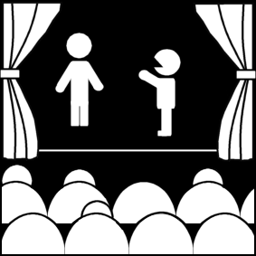
What is theatre? (Part 2)
Week 1
Introduction to Theatre
College of the Desert

Slide 2
Theatre as an Institution
Origins of Theatre -- Theories:
Theatre appears to exist and has existed in all societies in some form.
Some things have theatrical elements (parades, gameshows, sports, dances, religious services, political campaigns), but they are different from theatre, the art form.
There is no clear evidence about the origin of theatre, so all theories are speculation.
Aristotle suggested that mimesis (imitation) is innate in humans; theatre probably came from the dithyramb [Pronunciation – dith – er – ram]
Dithyramb is a hymn sung or chant before religious rituals in honor of Dionysus, the god of wine, rebirth, and fertility.
The word "tragedy' seems to have come from the Greek words for "goat" and "song"--so tragedy was a goat-song (whether sung to, by, or for the goat is anyone's guess).

Slide 3
Who was Dionysus? Why should we care about him?
According to Greekmythology.com, “Dionysus was the god of fertility and wine, later considered a patron of the arts.”
“The festival for Dionysus was held in the spring when vines would start bearing leaves. It became one of the most important events of the year and its primary focal point was the theater. Most of the great Greek plays were initially written to be performed at the feast of Dionysus. All participants, writers, actors, spectators, were regarded as sacred servants of Dionysus during the festival.

Slide 4
Theatre as an Institution
Origins of Theatre -- Theories:
Storytelling
Pleasurable and natural, a narrator elaborates by impersonating
Movement / Dance
Imitating physical behavior of animals and humans, donning skins as garments – eventually talking was added
Judicial System
Necessity to speak in court required expansion, desire to perform and see performances
Supreme act of an unidentified artist (Perhaps Thespis, perhaps Aeschylus)
A revolutionary discovery – to synthesize many other already existing elements

Slide 5
Who is Thespis?
According to ancientathens.org, “Thespis of Icaria is considered to be the first actor in the theatre. The English word “thespian,” which means actor, is derived from his name. Along with being an actor on the Ancient Greek stage, Thespis was also a celebrated playwright, stage director and producer. None of his plays are” in existence.
“His innovations included connecting the chorus directly to the plot, developing the idea of the power of the protagonist in drama and replacing” actors wearing makeup to “more refined linen masks to” define their character.
Aristotle’s Take
“According to Aristotle, Thespis transformed the presentation of stories forever by emerging from the Greek chorus and acting an individual role. Greek tragedy is said to have been descendent from dithyrambic poetry, which were the choral presentations of Greek myth that included movement.
With Thespis, the chorus remained playing its role, while the first actor played various roles by switching masks. Greek tragedy would not add another principal actor to the stage until some 50 years later in the fifth century when playwright/actor Aeschylus first wrote tragedies to be performed by two actors and a chorus.”

Slide 6
Who is Aeschylus?
According to Ancientgreece.com, “Aeschylus was born in the city of Eleusis, near Athens, in 525 BC and died in 456 BC. He was a Greek dramatist, the earliest of the city's great tragic poets. As the predecessor of Sophocles and Euripides, he is the founder of Greek tragedy.” “His tragedies, first performed about 500 BC, were presented as trilogies, or groups of three, usually bound together by a common theme, and each trilogy was followed by a satyr drama (low comedy involving a mythological hero, with a chorus of satyrs). The titles of 79 of his plays are known, but only 7 have survived.”
According to the famouspeople.com, “Aeschylus was a Greek tragedian who gave his life to dramatic arts. He laid the foundation and groundwork that was required for the art to flourish in the world. While he served as the initiator, Sophocles and Euripides took over as his notable successors.” “Aeschylus [was] often referred to as the father of tragedy, [and] was truly the founder of Greek tragedy. It is through his works that the basic understanding of the earlier tragedies was developed. His plays [still] have been serving as the point of reference” in today’s theatre. “At the time when Aeschylus began writing, theatre was just about evolving. Plays performed then were just about choral poetry supplemented with expressive dance. Aeschylus not just worked on the genre but brought about [a] new theme by introducing a second actor in the play in the form of [the] chorus. Nevertheless, these seven plays help in the basic understanding of earlier tragedies.”

Slide 7
Who is Sophocles?
According to Ancientgreece.com, “Sophocles was born about 496 BC in Colonus Hippius (now part of Athens), he was to become one of the great playwrights of the Golden Age. The son of a wealthy merchant, he would enjoy all the comforts of a thriving Greek empire. Sophocles was provided with the best traditional aristocratic education. He studied all of the arts.”
“Sophocles wrote more than 100 plays of which seven complete tragedies and fragments of 80 or 90 others are preserved. He was the first to add a third actor. He also abolished the tri-logic form. Sophocles chose to make each tragedy a complete entity in itself—as a result, he had to pack all of his action into the shorter form, and this clearly offered greater dramatic possibilities. Sophocles also effected a transformation in the spirit and significance of a tragedy; thereafter, although religion and morality were still major dramatic themes, the plights, decisions and fates of individuals became the chief interest of Greek tragedy.”

Slide 8
Who is Euripides?
“Euripides represented the new moral, social, and political movements that were taking place in Athens towards the end of the 5th century BC. It was a period of enormous intellectual discovery, in which "wisdom" ranked as the highest earthly accomplishment. New truths were being established in all departments of knowledge, and Euripides, reacting to them, brought a new kind of consciousness to the writing of tragedy. His interest lay in the thought and experience of the ordinary individual rather than in the experiences of legendary figures of the heroic past.”
According to Ancientgreece.com, “Euripides was born in 480 BC and died in 406 BC. Euripides was the youngest of the three principal fifth-century tragic poets. His work, which was quite popular in his own time, exerted great influence on Roman drama.”

Slide 9
Theatre as an Institution
Origins of Theatre -- Theories:
5. Ritual Theory –This is the most pervasive and accepted of theories, but much questioned.
From primitive religious rituals usually connected with spring and the seasonal cycle, drama evolved
Few say that theatre came directly from ritual, but that ritual influenced theatrical forms
Sir James Frazer's theory (late 19th century)
Primitive cultures with no written language performed rituals to win the favor of natural forces, then it is formalized, then stories grew up to explain the rituals – people were impersonating gods, beings, or forces – and there resulted a developing dramatic sense.
Eventually, rituals were abandoned or modified, but myths / stories remain as oral tradition. A big step toward drama occurs when these are acted out in simple drama.
Aesthetic gradually overtakes the religious or utilitarian aims of ritual.

Slide 10
Who is Sir James Frazer?
Sir James Frazer was a British anthropologist, folklorist, and classical scholar, best remembered as the author of the The Golden Bough. A classic in anthropology as well as in studies of comparative religion, magic, and folklore, the work has also had a tremendous impact on the fields of literature, psychology, and anthropology.
In addition to introducing the world to a rich sampling of the world's cultural diversity, it also made readers profoundly aware of the parallels and commonalities existing between the religions and mythologies of various cultures, including between pagan beliefs and early Christianity. His work was a primary source material for the neo-pagan movement and influenced such notables as Sigmund Freud, James Joyce, and T. S. Eliot.

Slide 11
Theatre as an Institution
Against ritual theory – Functionalists – 1915
Suggest the possibility that cultures develop differently from one society to another – they argue against the "cultural Darwinism" which holds that all human institutions have developed similarly – and suggest that perhaps that’s not the case.
Post WW II Structuralists – Claude Levi Strauss
Two ways of thinking:
Scientific
Mythical/Magical
In primitive societies they are integrated; in ours, fragmented
Theories tend to have the same beliefs in common:
Ritual and Myth seem to be important in all societies
Ritual is one source of theatre, but not all societies develop the same way

Slide 12
What is Functionalism?
Functionalism is a theory of the mind in contemporary philosophy, developed largely as an alternative to both the identity theory of mind and behaviorism. Its core idea is that mental states (beliefs, desires, being in pain, etc.) are constituted solely by their functional role – that is, they have causal relations to other mental states, numerous sensory inputs, and behavioral outputs.

Slide 13
What is Structuralism?
Structuralism is the methodology that elements of human culture must be understood in terms of their relationship to a larger, overarching system or structure. It works to uncover the structures that underlie all the things that humans do, think, perceive, and feel.

Slide 14
Who is Claude Levi Strauss?
According to the New York Times, Claude Lévi-Strauss was a “French anthropologist whose revolutionary studies of what was once called “primitive man” transformed Western understanding of the nature of culture, custom and civilization.” He was a powerful thinker, who studied the mythologies of primitive tribes, and transformed the way the 20th century came to understand civilization itself. Tribal mythologies, he argued, display remarkably subtle systems of logic, showing rational mental qualities as sophisticated as those of Western societies.
Mr. Lévi-Strauss rejected the idea that differences between societies were of no consequence, but he focused on the common aspects of humanity’s attempts to understand the world. He became the premier representative of “structuralism,” a school of thought in which universal “structures” were believed to underlie all human activity, giving shape to seemingly disparate cultures and creations.

Slide 15
Theatre as an Institution
Theatre and Ritual are Similar in the following ways:
Five Functions of Ritual:
1. A form of knowledge
2. Didactic
3. Influence or control
4. To glorify
5. To entertain and give pleasure

Slide 16
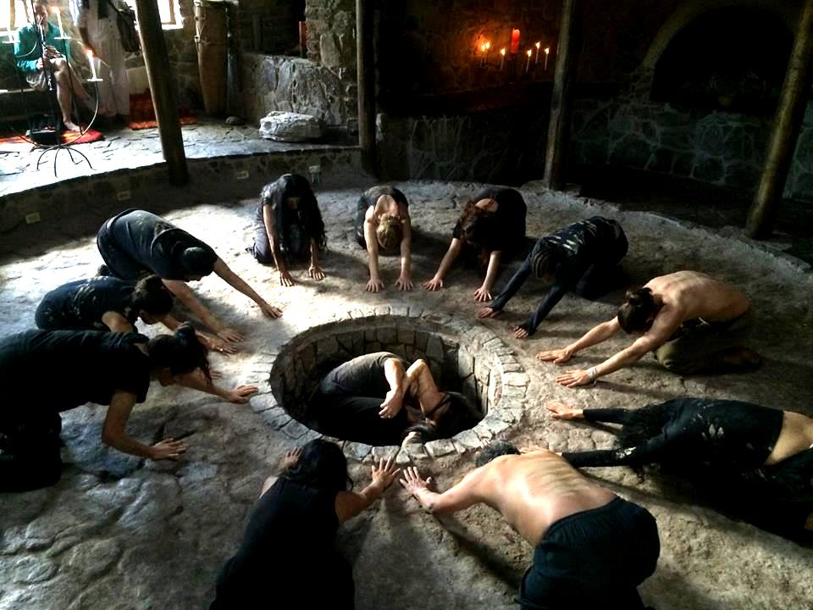
Theatre as an Institution
Theatre and ritual both employ similar means:
Music
Dance
Spectacle
Masks
Costumes
Speech
Performers
Audience
Stage
Makeup
Etc.
They have similar themes:
Pleasure
Power
Duty
They have similar production methods:
A technical director to make sure things run smoothly
Eventually, theatre emerged on its own

Slide 17
Theatre as an Institution
Western vs. Eastern Theatre
Western:
Myths – relationship between gods and humans
Change and Progress are the sense of reality – constantly changing
Conflict is the essence of our lives – the struggle
Eastern:
Myths – oneness between man and gods
Change and progress are illusions – peace and tranquility are truths
Tradition and balance
The origins of Western theatre in ancient Athens may have been influenced by eastern rituals and myths, but the Greek developed ritual into theatre, while the Eastern (Egypt and Asian Indian) never went beyond ritual.

Slide 18
Works Cited
AH. (2017, February 20). EXPLORING THE INTERSECTION BETWEEN THEATER AND RITUAL, BETWEEN POLITICAL ACTION AND HEALING. Retrieved July 30, 2017, from http://imaginaction.org/exploring-the-intersection-between-theater-and-ritual-between-political-action-and-healing
Karas, M. (2017, July 26). Dionysus. Retrieved July 30, 2017, from https://www.greekmythology.com/Other_Gods/Dionysus/dionysus.html
Rothstein, E. (2009, November 03). Claude Lévi-Strauss, 100, Dies; Altered Western Views of the ‘Primitive’. Retrieved July 30, 2017, from http://www.nytimes.com/2009/11/04/world/europe/04levistrauss.html
Soylent Communications. (2014). Sir James Frazer. Retrieved July 30, 2017, from http://www.nndb.com/people/600/000099303/
TheFamousPeople.com. (2014, September 10). Who is Aeschylus? Everything You Need to Know. Retrieved July 30, 2017, from http://www.thefamouspeople.com/profiles/aeschylus-622.php

Slide 19
Works Cited
Thespis. (2010). Retrieved July 30, 2017, from http://www.ancientathens.org/people/thespis
University Press Inc. (n.d.). Aeschylus. Retrieved July 30, 2017, from http://www.ancientgreece.com/s/People/Aeschylus/
University Press Inc. (n.d.). Euripides. Retrieved July 30, 2017, from http://www.ancientgreece.com/s/People/Euripides/
University Press Inc. (n.d.). Sophocles. Retrieved July 30, 2017, from http://www.ancientgreece.com/s/People/Sophocles/

