Slide 1
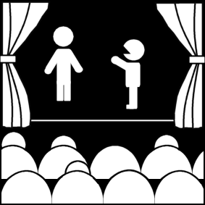
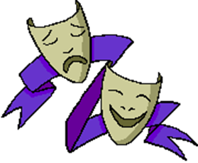
What is theatre? (Part 3)
Week 1
Introduction to Theatre
College of the Desert

Slide 2
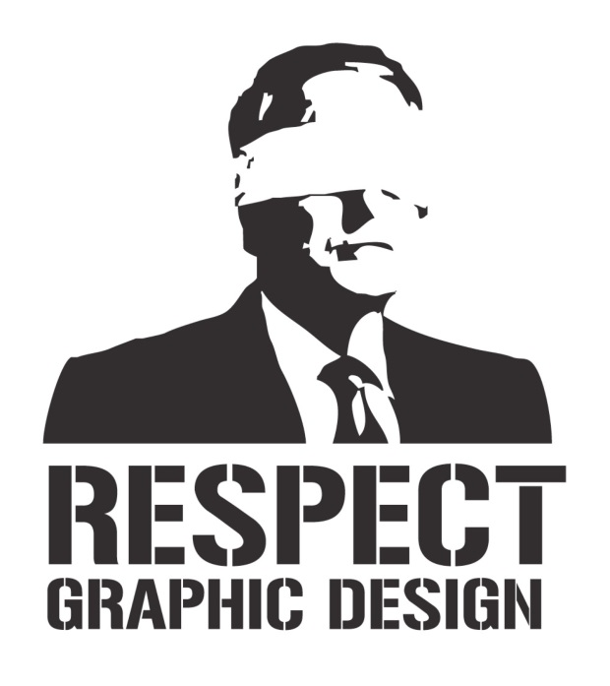
Theories of the Theatre
Theatre – What is it?
A performing art
A graphic art
A literary art (although sometimes not written down)
A popular art (entertainment) - diversion for a mass audience.

Slide 3
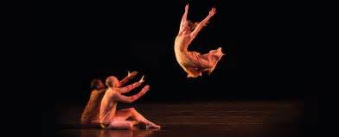
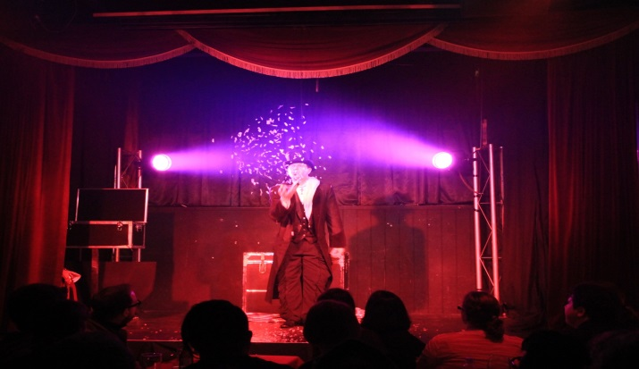
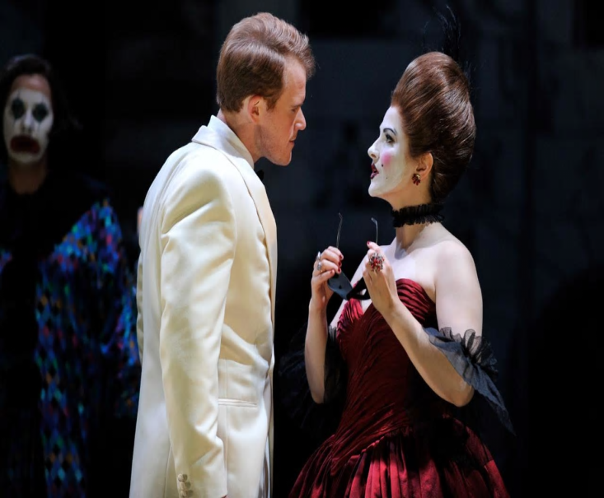
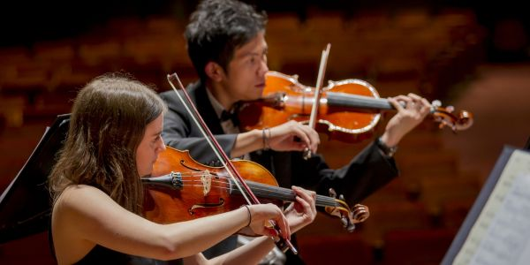
What are the FOUR types of Performing Arts?
Theatre
Dance
Opera
Music

Slide 4
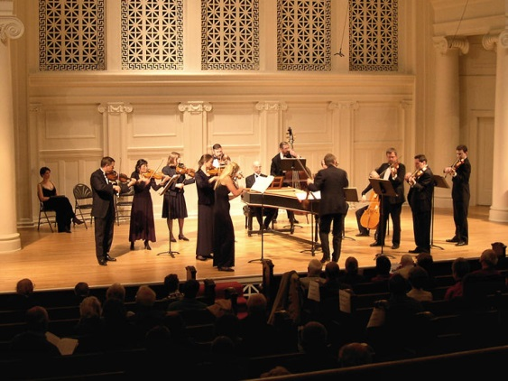
What characteristics do all the performing arts have in common?
They all require:
A creator
Playwright or composer
An interpreter
Actor, dancer, singer, or musician
An audience
They also require that the interpreter and audience occupy the same space (the theatre) at the same time.

Slide 5
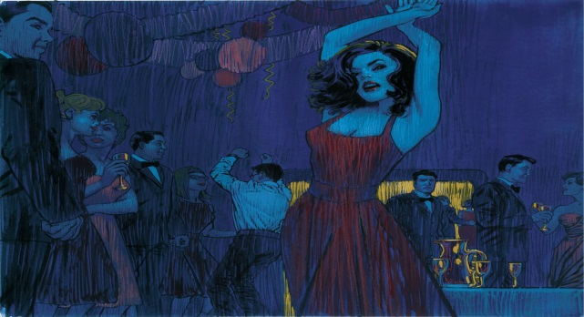
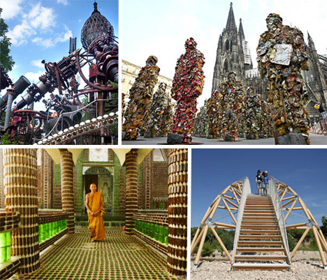
What is Art?
The arts can be divided traditionally into the:
Useful arts
Medicine, politics, persuasion can be taught
Fine arts
Literature, politics, painting, sculpture, architecture, music, dance – the traditional wisdom says that we cannot really be taught to DO art, but we can be taught to appreciate art

Slide 6
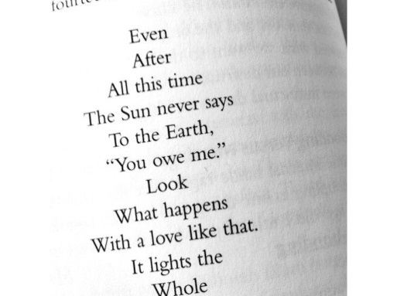
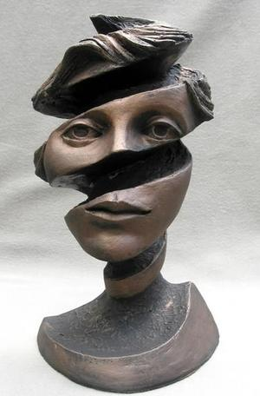
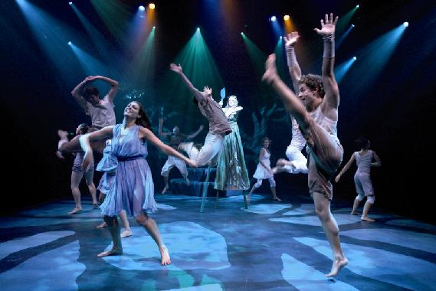
The Three Categories of Art
Literary
Poetry, drama, fiction
Visual
Painting, sculpture, architecture
Performing

Slide 7
What does ART help to do?
Art helps people understand the world:
It involves a search for meaning
It can help shape our perceptions (which comes through our emotions, imaginations, and intellect – in art, experience is presented, not necessarily explained – the audience can be involved directly; therefore, art is different from history, philosophy, science, etc.)

Slide 8
What does ART help to do?
2. Art gives us a "God's eye view" of experience – a "heightened reality."
We know we are not watching (experiencing) reality, but art
Art is a refinement of life
Look at the four verbs of creativity – select, rearrange, condense, intensify – to examine art's relationship to life
We have "aesthetic distance" – “the factor which allows us to enter into an imaginative world – even though we are aware that it is separate from everyday reality..."
The separation of audience and artist through art – We can watch others kill and die and will not stop or help. It is a state in which we view art objectively, at least partially.
Simultaneously, we must also feel EMPATHY for the characters on-stage – we are involved, yet also detached.

Slide 9
What is Empathy?
According to the Oxford Dictionary, the word Empathy is a noun. Meaning:
The ability to understand and share the feelings of another.
It’s ORIGIN:
Early 20th century: from the Greek word, empatheia (from em- ‘in’ + pathos ‘feeling’)

Slide 10
Suspension of Disbelief
Who is Samuel Taylor Coleridge? Why should we care about him?
According to Rosemary Ashton, “though he's really only known today for his poetry, Coleridge's contributions to the field of criticism and our language were many. For instance, he not only coined the word 'selfless,' he introduced the word 'aesthetic' to the English language.” He also coined the phrase “Suspension of Disbelief.”
Samuel Taylor Coleridge said that literature involves "the willing suspension of disbelief." We agree to accept non-reality as reality for the duration of the art experience (performance). The production and all its elements attempt to create an illusion of reality, verisimilitude, and "the audience completes the illusion by accepting as real what it sees and hears."

Slide 11
What does the word aesthetic mean?
According to the Oxford Dictionary, the word aesthetic (aes·thet·ic) is an adjective meaning:
Concerned with beauty or the appreciation of beauty:
For example, "the pictures give great aesthetic pleasure."
Giving or designed to give pleasure through beauty; of pleasing appearance.
Synonyms:
Artistic · tasteful · in good taste · graceful · elegant · exquisite · beautiful · attractive · pleasing · lovely
As a Noun it can mean:
A set of principles underlying and guiding the work of a particular artist or artistic movement.
For example "the Cubist aesthetic“
The origin of the word comes from the late 18th century:
In the sense ‘relating to perception by the senses’
From the Greek word aisthētikos, from aisthēta ‘perceptible things,’ from aisthesthai ‘perceive.’
The sense ‘concerned with beauty’ was coined in German in the mid 18th century and adopted into English in the early 19th century, but its use was controversial until late in the century.

Slide 12
What is Verisimilitude?
Verisimilitude’s Definition, according to literarydevices.net, is:
“In a literary work, verisimilitude is likeness to the truth”
For example, “resemblance of a fictitious work to a real event even if it is a far-fetched one.”
“Verisimilitude ensures that even a fantasy must be rooted in reality, which means that events should be plausible to the extent that readers consider them credible enough to be able to relate them somehow to their experiences of real life.”
The Origin of Verisimilitude is:
“The theory of verisimilitude comes from a Platonic and Aristotelian dramatic theory called “mimesis”. According to this theory, a work of art should convince the audience by imitating and representing nature and having basis in reality. The playwright, conforming to the above mentioned theory, had to draw themes from sources well-known to the common people of his time and maintain the unities of action, place and time. Besides, he had to bring a realistic union between the style and the subject.”
Video Explanation: https://youtu.be/GEeIycTzsx4

Slide 13
Suspension of Disbelief
What is it?
Suspension of Disbelief according to literarydevices.net, is that “the theory of verisimilitude leads to the idea of “suspension of disbelief” or “willing suspension of disbelief,” a term coined in 1817 by Samuel Taylor Coleridge. He was of the opinion that if a writer was able to fill his work with a “human interest and a semblance of truth”, the readers would willingly suspend or delay their judgment in relation to the doubtfulness of a narrative.
In his Biographia Literaria, Coleridge says:
“… It was agreed, that my endeavors should be directed to persons and characters supernatural, or at least romantic, yet so as to transfer from our inward nature a human interest and a semblance of truth sufficient to procure for these shadows of imagination that willing suspension of disbelief for the moment, which constitutes poetic faith. Mr. Wordsworth on the other hand was to propose to himself as his object, to give the charm of novelty to things of every day, and to excite a feeling [similar] to the supernatural, by awakening the mind’s attention from the lethargy of custom, and directing it to the loveliness and the wonders of the world before us …”

Slide 14
What does ART help to do?
3. Art is "safe“
The artistic self-awareness of the artists and audiences mean that art NEED NOT have any influence on the outside world; it MAY have an influence (some say it should, some say that it should not, and certainly in many cases it DOES), but it doesn't need to.
4. Art is imitation – It is "made" – it is not natural
Elements of life and art are similar, but not the same
We can examine it as an imitation object
We can break it down and analyze it
Artist and spectator have artistic self-awareness or intention.

Slide 15
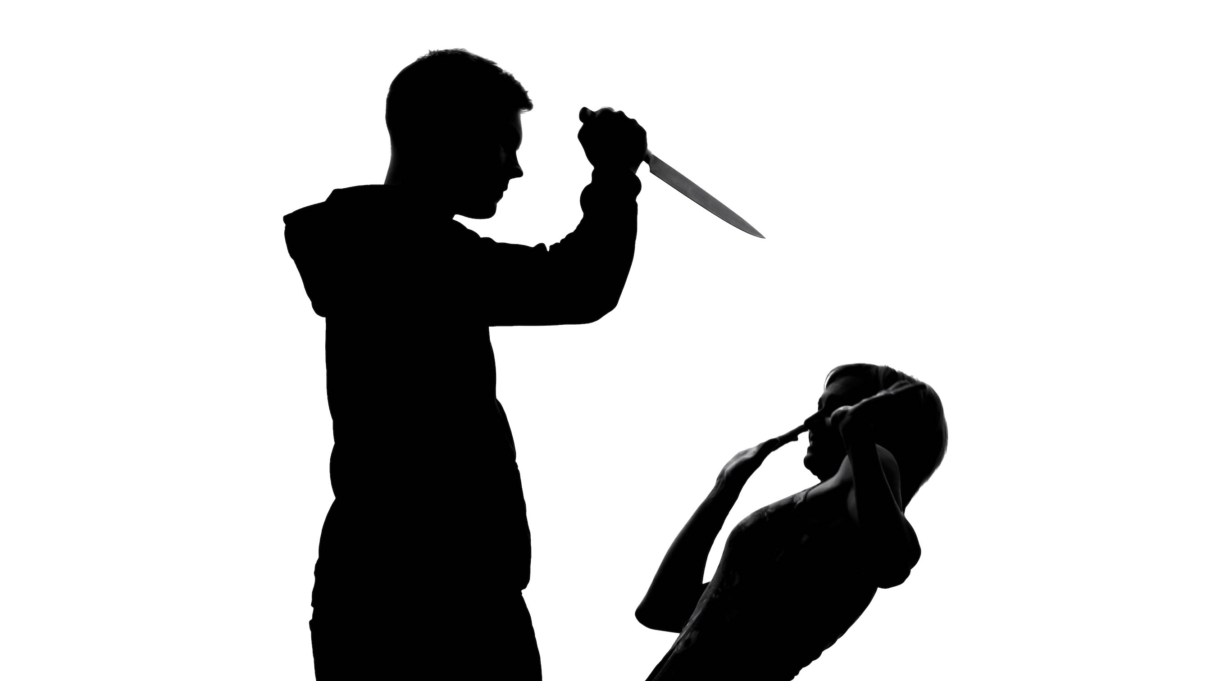
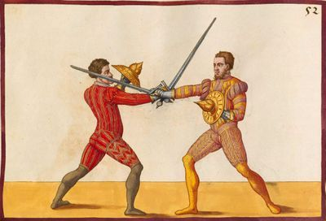
What is the difference between a real-life knife fight and a staged knife fight?
Real
People and spectator can get hurt
There is no artistic intention or awareness, no intention to create/exhibit art
Staged (art)
People MAY get hurt, but don't have to – there is no specific intention to harm
Artist and spectator are AWARE – that they are creating / experiencing art

Slide 16
Accidents Can Happen while Creating Art
Theatre Accidents:
During a showing of the play Hamlet at the Sylvan Theatre in 1966-67, a sword broke during a fight scene, flying out to the audience – who COULD have gotten hurt.
“Daniel Hoevels, 30, was said to have had blood "pouring from his neck" after he stabbed himself with the knife in a suicide scene. The company admitted that a female prop manager had bought a knife for use on stage and forgotten to blunt it.”
In 2016, two teen actors in New Zealand sustained neck wounds after a stage production about a murderous barber Sweeney Todd went wholly awry. The prop razor used in the scene had been reportedly safety-checked multiple times. The two 16-year-old boys were taken to hospital following the accident, one with serious injuries, the other with moderate injuries.

Slide 17
Accidents Can Happen while Creating Art
Movie Accidents:
People have even gotten killed – “actor Vic Morrow and child actors Myca Dinh Le (age 7) and Renee Shin-Yi Chen (age 6) died in an accident involving a helicopter being used on the set. The helicopter was flying at an altitude of only 25 feet (8 meters), too low to avoid the explosions of the pyrotechnics used on set. When the blasts severed the tail rotor, it spun out of control and crashed, decapitating Morrow and Le with its blades. Chen was crushed to death as the helicopter crashed. Everyone inside the helicopter survived sustaining minor injuries.”
“As one of the scenes of The Crow was being filmed, Brandon Lee – Bruce Lee's son – was shot and killed by a prop .44 Magnum. The scene involved the firing of a full-powder blank (full charge of gunpowder, but no bullet) at Brandon's character; however, unknown to the film crew/firearms technician, a bullet was already lodged in the barrel and hit Lee in the abdomen.”
While filming 2004’s Troy, “George Camilleri, a keen bodybuilder, broke his leg while filming an action sequence at Ghajn Tuffieha. He was operated on the following day but suffered complications and died 2 weeks later.”

Slide 18
Accidents Can Happen while Creating Art
Movie Accidents:
While shooting the 2021 film, Rust, Alec Baldwin fired a prop gun, killing cinematographer Halyna Hutchins.
The tragic shooting came after Baldwin was inadvertently given a real loaded gun by assistant director David Halls, according to a search warrant obtained by the Santa Fe County Sheriff’s Office. The weapon was supposed to have blanks in it.
Halls, rookie movie-set armorer Hannah Gutierrez Reed and Baldwin were all known to have handled the weapon before the fatal shooting, according to the warrant.
According to the warrants, Baldwin was rehearsing a scene where he was due to pull the gun while sitting in a church pew and point the weapon at the camera.
Halls gave the weapon to the actor and yelled “Cold gun,” meaning it was safe to use in the scene.
Cameraman Reid Russell told police he did not know if the gun had been checked before it was given to Baldwin.
For more examples and details: https://youtu.be/5JsuJGpym2M

Slide 19
Arts Differ in:
The nature of their audiences
Their means of communication
Their permanence / recoverability

Slide 20
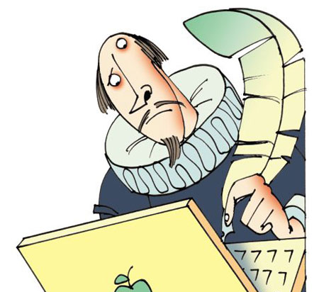
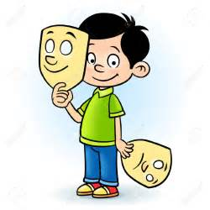
Is theatre a pure art?
No!
Theatre, in performance, is produced by the collaboration of many theatrical artists: writers, actors, directors, designers, producers, managers. Each of these collaborators considers himself/herself an artist.

Slide 21
Works Cited
Ashton, Rosemary. The Life of Samuel Taylor Coleridge. Cambridge, MA: Blackwell Publishers Inc., 1996.
Coleridge on knowing the philosophy of the age. (2012, January 06). Retrieved August 11, 2017, from https://lifeondoverbeach.wordpress.com/2012/01/06/coleridge-on-knowing-philosophy-of-the-age/
Combs, M. (2014, July 14). Weekend Arts Roundup: Performance Art Abounds. Retrieved August 14, 2017, from http://www.thecurrent.org/feature/2014/07/24/weekend-arts-roundup-performance-art-abounds
Commercial Art > Graphic Art > Graphic Design > Visual Communicator. (2011, March 15). Retrieved August 11, 2017, from https://thoughtlessdelineation.wordpress.com/2011/01/17/commercial-art-graphic-art-graphic-design-visual-communicator/
Connolly, K. (2008, December 15). Actor cutting neck was stage accident, Hamburg theatre says. Retrieved August 14, 2017, from https://www.theguardian.com/world/2008/dec/15/austria-theatre

Slide 22
Works Cited
Empathize Meaning. (n.d.). Retrieved August 11, 2017, from http://www.suggest-keywords.com/ZW1wYXRoaXplIG1lYW5pbmc/
Lisle, C. (2012, March 08). Noir Art | Sean Phillips. Retrieved August 11, 2017, from https://noirwhale.com/2012/03/08/noir-art-sean-phillips/
Literary Devices. (2015, March 11). Verisimilitude - Examples and Definition of Verisimilitude. Retrieved August 11, 2017, from https://literarydevices.net/verisimilitude/
Murano, G. (2009, March 12). 9 Worst Movie Set Disasters (movie set accidents, movie set deaths). Retrieved August 14, 2017, from http://www.oddee.com/item_96604.aspx
S. (2009, November 22). 10 of the World's Most Radical Recycling Projects. Retrieved August 11, 2017, from http://webecoist.momtastic.com/2009/01/06/creative-alternative-recycling-projects-art/

