Slide 1
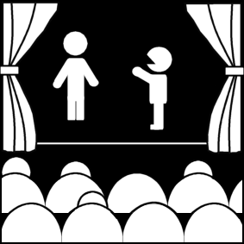
Elements of Theatre Audience and Theatre
Week 2
Introduction to Theatre
College of the Desert

Slide 2
Theatre as an Art Form
Theatre is a Literary Art : The Play
Perhaps the only concrete and lasting (permanent) element of the theatre is the play itself.
The other elements are moments in time (non-permanent), audiences only experience them once. Except for perhaps set and costume design, of which photos can keep a permanent record.
We have to look at the play in combination with its time and place – its context – for better understanding.
What makes a good play?
Theorists throughout history have disagreed and bickered about what makes a good play. Most base their arguments at least in part on Aristotle or variations of Aristotle – The Poetics (334 BC) – disagreeing, agreeing, or reinterpreting.
Although there is not one coherent theory of a good play, many basic premises have been determined by which we can evaluate a script – realizing, however, that our criteria may not necessarily be the same as the criteria for a good play when the play was written – how the play was looked at at the time.
Interpretations / evaluations are different based on different ways of looking at the world, at people, at life, and at the nature and purpose of the theatre.
By looking at various theories and examining play scripts of different styles and periods, our ability to discern and evaluate aesthetic elements of the drama will become more important.

Slide 3
Theatre vs. Drama
The word theatre comes from the Greek “theatron,” literally "seeing place," or "place where something is seen."
The word was first used in its current form in 1576 when James Burbage named his playhouse the Theatre. Since Burbage’s playhouse was one of the first, if not the first, structure built specifically for the production of plays, the name theatre eventually came to mean first the buildings and then the entire genre.
The companion term drama comes from the Greek word dran, literally "to do." It is "something done."
Frequently the terms are used interchangeably, although the theatre always refers to the structure where the performances are held as well as to the company of players who perform.
Theatre also refers to the designers, administrators, technicians, etc. who work together to produce plays as well as the body of ideas that animates the artists and brings the plays to life.
Drama is a more limited term and tends to refer mainly to the plays that are produced. In other words, drama is the script itself; theatre is all the elements that combine to bring that play to life.

Slide 4
Who is James Burbage and why should we care about him?
According to the Elizabethian-Era.com, “James Burbage was an Elizabethan entrepreneur. He realized considerable profit by staging plays at Elizabethan Inn-yards and had the vision to build 'The Theatre' and the 'Globe'. He was at the forefront of the early days of Elizabethan commercial theatre and played an important part in the history of the Globe Theatre and William Shakespeare. James Burbage was born in 1531 and is said to have been born at Stratford-upon-Avon.” “The Theatre was designed as a construction which was similar to a small Roman amphitheater - the Elizabethan Amphitheatre. They modified the features of the existing blood sport rings with the addition of a fixed stage, unlike the trestle supported stage used in the inn-yards. This allowed the new stage productions to become far more sophisticated. Plays featured the use of props such as canons (although these massive props often had to be left on stage for the entire performance) and a much larger stage area for the actors which was complete with trap-doors.”
An Elizabethan Theatre

Slide 5
What is a play? What is involved?
Drama requires the reader to contribute more than any other form of literature does.
Not only must the reader see and understand what is explicitly said and done, but he must also be aware of all that is merely implied or left unsaid.
READ STAGE DIRECTIONS. Frequently at the beginning of the play, the playwright or someone will have described the set. Make a little sketch of it if you have to. You MUST be able to visualize what is going on as you read.
Dramatic Action - A play is a representation of people in action. The term, action means more than just physical movement, it involves the motivations as well, the person’s thoughts and feelings, as well as deeds. It is what he does and why he does it.
Because each playwright is unique, his/her plays are unique; however, good plays tend to have qualities in common.

Slide 6
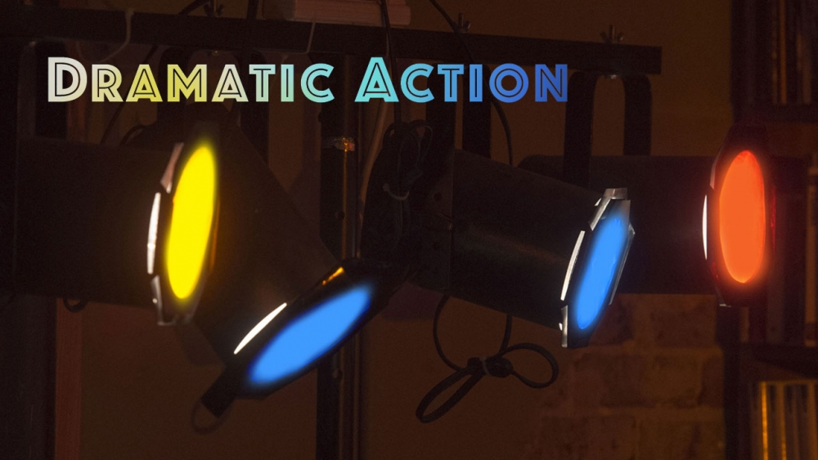
What is a play? What is involved?
Dramatic action should be:
Purposeful - Organized to arouse a specific response, such as pity, fear, laughter, anger, etc.
Varied - variety in plot, ideas, mood, characterization, spectacle necessary to avoid dullness or predictability.
Engage and maintain interest - situation should be compelling enough to arouse interest; issues must be vital enough to arouse concern; or aural/visual devices must be sufficiently novel enough to hold interest.
Probable - Within the world of the play, events must be logical. As a play progresses, its guidelines are revealed. The audience then expects the playwright to observe the rules he has established. Even if the playwright wants to show that life is inconsistent, he must be consistent in his inconsistency.
For example, at the beginning of the play, The Bald Soprano, a clock strikes 17 times, and Mrs. Smith promptly announces that it is 9 o’clock. Despite the title of the play, there is no soprano, bald or otherwise. This warns the audience that nothing is logical in this play.

Slide 7
Theatre as an Art Form
Theatre is a Performing Art: The Production
The production itself is shortly-lived and immediate.
People view productions as “the home of the now,“ at least for the time the audience experiences the performance.
Robert Edmund Jones (early 20th century scenic designer) claimed that performances were where people could be "aware of the now."
An art for everyone.
Acting, directing, design, construction, running crew (musicians, singers, dancers) are all working together to create a production.
A mixture of all the arts – making it either the least pure or the most pure.
Needs talent and skill to plan and execute, from all elements of the production.
The final product is a result of the efforts of many.
We can increase aesthetic and technical appreciation for the individual arts going into making theatre and for the different styles and periods of theatre.

Slide 8
Who is Robert Edmond Jones? Why should we care about him?
Robert Edmond Jones was born on December 12, 1887, in the township of Milton, New Hampshire, roughly halfway between Portland and Portsmouth, in a house built by his great grandfather Levi Jones. Edmond Jones (1887-1954) designed scenes for the theater that were simple and conducive to a more complete and coherent collaboration between the director and the designer. His work provided the foundation for the whole present-day tradition of scene design in the United States. Perhaps his most famous written work is The Dramatic Imagination, published in 1941. This collection of essays defined an understanding and respect for the art of the theater that was as relevant over 40 years later as at the time it was written.

Slide 9
Theatre is a Major Form of Entertainment
Theatre holds the audience's attention – the primary form of public entertainment until the advent of radio and movies.
Theatre is fun
Theatre is play (work, food, exercise) for the soul, for the mind, for the body.
All work and no plays would be boring.
Eric Bentley – suggested the concept of "eros" is essential for theatre – actual sweating breathing human beings in front of us – “eros” being the drive of creativity and love

Slide 10
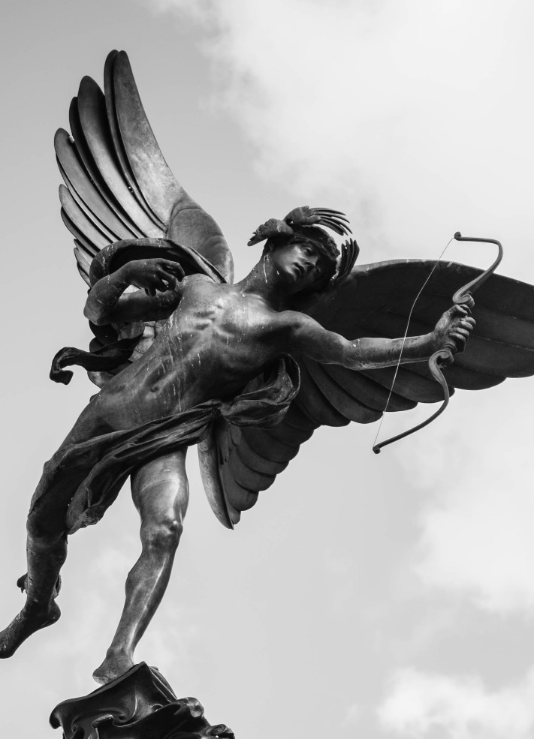
What is the Eros Theory?
A concept developed by Sigmund Freud
Eros is the internal drive of life and creation
The word Eros translated from ancient Greek translates to love, but more on the emphasis of romantic and intimate love.
Eros is better known in ancient Greek culture as striking individuals with lustful passion often with “arrows of love,” we know Eros more by his Latin counter-part Cupid.

Slide 11
What is the Eros Theory?
Some of the more famous Greek myths involving the Greek goddesses involve lust and the consequences, such as Hera and the swan.
Freud was not the first philosopher to contemplate the ideas of Eros, lust, and love. Once again going back to the ancient Greeks, Plato philosophized that Eros had two dimensions where we love not only by sensual and lustful attractions, but also an internal love that goes beyond mere physical attraction.
According to Joseph Brown, “Freud believed that we derive pleasure from creation and creation can come in many forms.”
Freud believed we derive pleasure from being creative from making things, so in a sense it can be seen as almost biological.

Slide 12
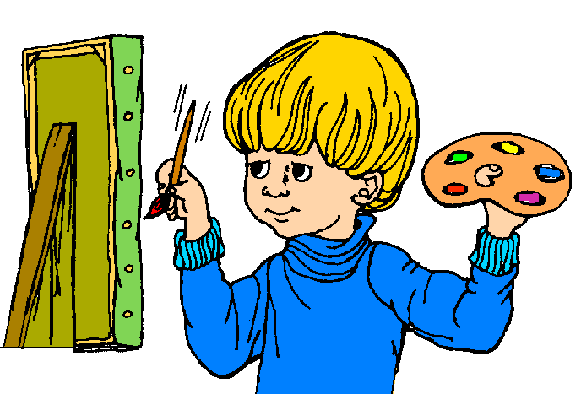
Examples of people using Eros Theory
Composers such as:
Ludwig Von Beethoven
Franz Schubert
Richard Wagner
These composers had musical compositions that went against the Classical style of compositions of Mozart and Bach during the Romantic Era of music because the music of Beethoven and Wagner had more emotion and feeling from their music, in fact the entire music industry from past to present shows the exact meaning of Eros pleasure from creating on the basis of merely wanting to create.
Whereas painters and sculptors like…
Leonardo Da Vinci
Michelangelo
Vincent Van Gogh
… were paid to create and one could argue that they did not create for pleasure

Slide 13
Examples of people using Eros Theory
The Culinary World:
If there were no creativity in the culinary world, we could merely survive on the bare basics of nutrition, however just looking at such cuisines as Italian, Indian, and Mexican we see a plethora of different flavors ranging from bold to subtle and we derive pleasure from consuming and creating these dishes.
If it were so basic that humans were like any other animal like the behaviorists assume, humans wouldn’t have such a vast culinary palette. We would consume foods in their most basic forms and that would be it.

Slide 14
What is the Eros Theory?
The Negative Side:
Love has lust which if unchecked can lead to unspeakable perversions:
Rape
Pedophilia
Creativity has given us:
the airplane
harnessing electricity
works of art
On the other hand, it has also given us:
Machine guns
Atomic weapons
And the different means of hurting our fellow man

Slide 15
Who is Sigmund Freud?
According to biography.com, “Sigmund Freud was an Austrian neurologist best known for developing the theories and techniques of psychoanalysis.” “Freud was born in Freiberg, which is now known as the Czech Republic, on May 6, 1856. Freud developed psychoanalysis, a method through which an analyst unpacks unconscious conflicts based on the free associations, dreams and fantasies of the patient. His theories on child sexuality, libido and the ego, among other topics, were some of the most influential academic concepts of the 20th century.”

Slide 16
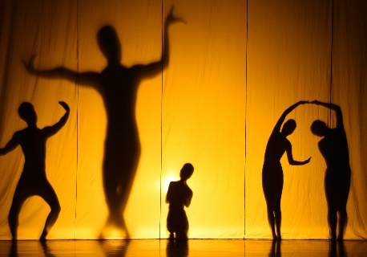
Theatre as Performance
Performance:
Requires an audience a group of individuals gathered together at a certain time and place for no purpose other than to see the performance (though some may be doing other things: placing bets, writing reviews, wasting time, etc.) that is aware of itself as a group.
Audience:
The audience for a theatre performance has artistic self-awareness.
Audience for sports (spectators) – competition – outcome is not pre-determined (as it is with most theatre – though some plays have varied outcomes (Sheer Madness, The Night of January 16, and The Mystery of Edwin Drood, for instance, have endings determined by the audience).

Slide 17
Theatre vs. Other Arts
ART FORM | Represents (Abstract or Concreate) | Uses what senses? | Must Use Space | Must use Time | Is the Artist Present?
Music | Abstract--Could be considered the most pure--uses only one sense. | Hearing | No | Yes | ?
Graphic Art | Concrete/Abstract | Sight | Two Dimensions | No | No
Sculpture/ Architecture | Concrete/Abstract | Sight | Two Dimensions | No | No
Dance | Concrete/Abstract | Sight and Hearing | Two Dimensions | Yes | Yes
Literature | Abstract (Uses words to convey both concrete and abstract ideas; cognitive) | Sight and Imagination | Not the work itself. (The book exists physically, but what is the "literature?") | To read, yes, but varies from reader to reader. | No
Theatre | Both concrete and abstract and imagination through IMITATION: "MIMESIS" | Either the least pure or the most pure—uses all the sense | A mixture of the all the Arts--Uses space, time, (Literature) dance (Movements) | Architecture, Graphic Design, Music (Sound) | Yes

Slide 18
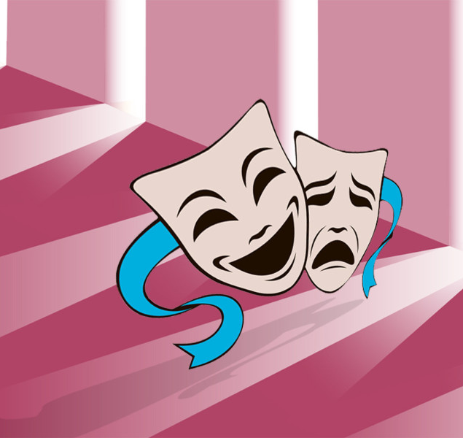
Different Types
Types of performances:
Movie, dance, television, opera, music, salesmen, preachers, teachers, drill sergeants – all are theatrical / theatre-like.
Kinds of arts:
Dance, music, movies, television, opera, painting, architecture, graphic arts, literature, performance art -- theatre.
Kinds of Stages:
Location can shape many aspects of a performance.

Slide 19
Types of Stage Spaces
The Proscenium or Traditional Stage
Pros of the Proscenium Stage:
Can use lots of scenery--allows for a "realistic" visual "picture frame."
More realism possible
Easier to light (from one direction.)
Room backstage
Uses traditional stage areas (upstage, downstage etc.)

Slide 20
Types of Stage Spaces
Arena Stage (Theatre-in-the-Round)
Pros of the Arena Stage:
Very intimate-closer to the action than with a proscenium stage; can see other audience members across the stage
Lends itself to varied kinds of plays
Cons of the Arena Stage:
Can't use very realistic scenery
Someone's back is always facing the audience
Can't use traditional stage areas

Slide 21
Types of Stage Spaces
Thrust Stage (Three-quarter Round)
Pros of the Thrust Stage:
Blend of proscenium and arena
Versatile
Can use big, realistic sets
Still have intimacy – audience sits on three sides
Cons of the Thrust Stage:
Must use/rearrange some audience space

Slide 22
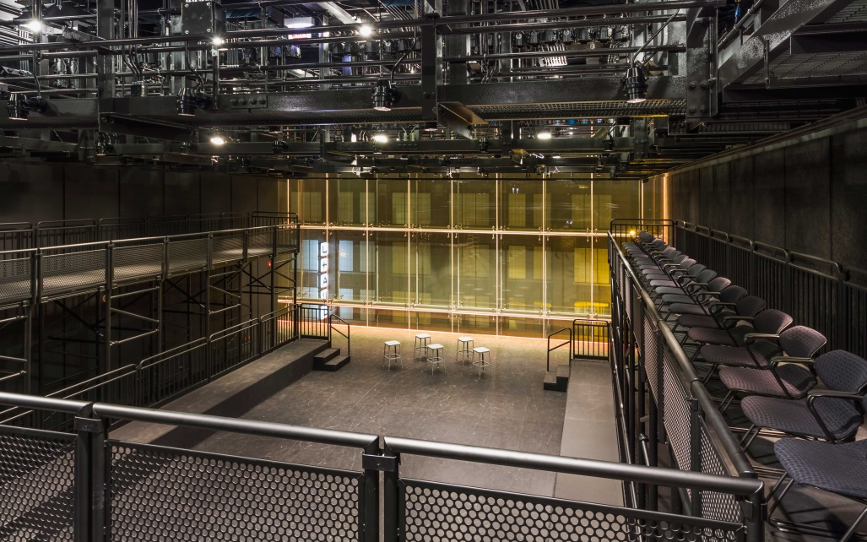
Types of Stage Spaces
Flexible Stage
Pros of the Flexible Stage:
Uses the environment that already exists in a room/space
Sometimes audiences can be in the performance space
Sometimes performers within audience space
Uses available space, modified or no
Includes the Alley Stage – which is like a runway

Slide 23
Works Cited
Biography.com Editors. (2017, April 28). Sigmund Freud. Retrieved August 16, 2017, from https://www.biography.com/people/sigmund-freud-9302400
Brown, J. (n.d.). Thanatos and Eros. Retrieved August 16, 2017, from http://www.academia.edu/4551692/Thanatos_and_Eros
Robert Edmond Jones. (2017, August 11). Retrieved August 16, 2017, from https://en.wikipedia.org/wiki/Robert_Edmond_Jones
“Robert Edmond Jones Facts.” Biography, LoveToKnow, Corp, biography.yourdictionary.com/robert-edmond-jones. Accessed 16 Aug. 2017.

