Slide 1
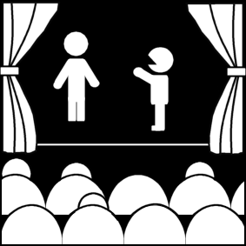
Greek and Roman Theatre
Week 9
[Part 2]
Introduction to Theatre
College of the Desert

Slide 2
The Documentary Evidence for Pre-Classical Drama
Before we begin, we must address a problem that immediately confronts anyone exploring the origin of Western drama.
There is a pitiful lack of written texts available for reconstructing the path that led to classical drama.
Those dated to the early periods of Greek history are particularly scarce, and artistic sources (vase paintings, in particular) are a little better.
Remarkably few instructive depictions of early drama exist at all—about twenty representations of choruses and dancing painted on vases surviving from the late sixth and early fifth centuries BC—and even so it is not clear how these may connect, if they do at all, to institutional theatre.
Furthermore, there is no written source on early theatre and drama contemporaneous with the period in which the art form arose.
All our documentation comes from later authors.
That is, it is secondary evidence, and so its bearing on our search for origins is at best suspect.
Even Herodotus, who lived in the age of classical drama, presents few reliable data about the preceding century in which theatre developed as an art form. In all the nine books of The Histories he notes only twice what seem to be theatre-like activities.

Slide 3
Research on the Origins of Theatre and Drama
The search for the origins of theatre is a very old one, dating back at least to the Greek philosopher Aristotle who lived in the century after the Classical Age.
His researches, now seen as "data" about classical theatre, are—and one must always remember this—the results of his own investigations into theatre history and, just like ours, no more or less reliable than the data on which they rest. Because he lived in ancient times and speaks so often from authority about the ancient life, we must never forget that Aristotle is, in essence, secondary evidence when it comes to the birth of Greek theatre, an event which occurred two centuries before his day.
The standard views of the origin of Greek drama and theatre center for the most part around three distinct and incompatible pieces of data:
(1) accounts concerning Thespis who is allegedly the "inventor" of tragedy
(2) the meaning and evolution of the Greek word tragoidia ("tragedy" )
(3) the historical account of early Greek theatre found in the fourth chapter of Aristotle's Poetics.
Some ancient sources report that tragedy was the invention of a person named Thespis who was famous for riding around in a cart and performing his dramas.
Others see an important clue to tragedy's rise in the Greek word tragoidia, meaning literally "goat-song," and from that we assume a goat was the prize for the winning playwright at primitive Greek festivals featuring drama.
In the words of Oscar Brockett, one of the pre-eminent theatre historians of our age, "the chorus danced either for a goat as a prize or around a goat that was then sacrificed."
Finally, the renowned fourth-century (i.e. post-Classical) philosopher Aristotle, the first person we know to have researched the origins of drama, concluded in his famous work on drama and theatre, The Poetics, that tragedy evolved out of another form of performance popular in the day, a type of choral singing called dithyramb.

Slide 4
Thespis Theory
First, except for what we are told concerning the origin of drama, Thespis is entirely unknown, a name that means essentially nothing to us except as the alleged founding father of Greek drama.
Worse yet, all sources which talk about him are late, none even vaguely contemporary.
For instance, our information about his cart comes primarily from Horace, a Roman poet who wrote more than half a millennium after the age when Thespis would have to have lived.
All this makes him sound more like a fabrication of later ages attempting to simplify theatre history by assembling what limited data there is under one name, in much the same way that young children in America are taught "George Washington was the founding father of the United States." Yet historians will note that the reality of early America is vastly more complicated, involving hundreds, if not thousands, of "founding fathers." The embellishment of George Washington is a way of simplifying the complex history of the American Revolution for those who have little room in their lives for the actual and complex realities of the past.

Slide 5
Thespis Theory
The history of George Washington can be telling in other ways as well. For one, the American general actually existed and is not a fictitious icon. One might conclude the same about Thespis except that there is no primary evidence for his existence as there is for the American founding fathers—the records of the Pre-Classical Age were scarce, even in ancient times—thus, it would have been much easier back then to concoct a Thespis than it would be today to counterfeit a George Washington.
Moreover, that very lack of evidence would also have driven the need to explain somehow tragedy's origin.
Whatever the truth, by all fair standards of history, Thespis is undated, unattested, and unassociated by any credible primary source with any particular practices in early theatre.
Except for the legends surrounding his name, we have no outside corroboration even of his existence, much less his contribution to drama.

Slide 6
Tragoidia Theory
The Greek word tragoidia presents even more of a mystery.
It means "goat (trag-) song (-oidos)"
It is certain because there is no other way to interpret the word satisfactorily in Greek, but to what the "goat" refers is not at all clear.
Goats are not known as prizes for winning playwrights in any other ancient venue, nor would one make a very attractive reward.
Frankly, one hopes ancient playwrights competed for something a bit more becoming.
Goats, in fact, are featured nowhere in the existing primary records of ancient Greek theatre, so to conclude that they were sacrifices, as Brockett and others do, is pure speculation.
Still there is no writing off the goats entirely, the way one can with Thespis, because "goat" is firmly anchored in the very name of the genre and that name goes back to the origin itself of the art form.
The desperation of this situation has led otherwise conservative and judicious critics to make uncharacteristically wild guesses at the reason goats are found grazing around the ancient stage.
For instance, Margarete Bieber suggests that "goats" may be a nickname for the worshipers of Dionysus, the god in whose honor drama is performed at Athens.
It has been suggested by another scholar that "goat-song" may refer not to goats as such, but to an ancient Greek slang term, "to goat," referring to the breaking or cracking of a young man's voice during puberty.
If ancient tragic choruses were performed by young men, this could make an odd sort of sense.
The term tragoidia would then be a joke, based on the cracking of the young men's voices—though not during an actual performance one hopes!
All in all, the reason why there are goats in tragedy is an unresolved conundrum, though in light of theatre and ancient history the "goating voice" explanation makes better sense than suggesting that goats once served as prizes.

Slide 7
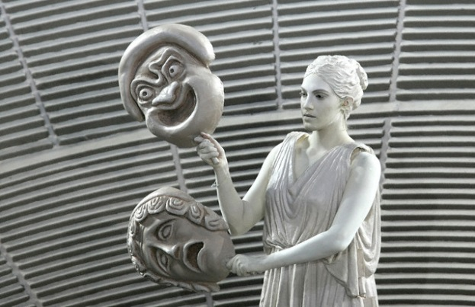
Ancient Greek Theatre
Everything we think we know from the Ancient Greek theatre, and about the origins of theatre, comes from the following sources:
From the 5th century B.C.:
Three Playwrights:
Tragedies:
Aeschylus - 525-456 B.C. - 80 plays, 7 in existence
Euripides - 480-406 B.C. - 90 plays, 18 or 19 in existence
Sophocles - 495-406 B.C.-100 plus plays, 7 in existence
Comedies:
Aristophanes - 448-338 or 380 B.C. 50 plays, 11 in existence
Lysistrata, 411 B.C. – His most famous play
From the 4th century B.C., there are some lengthy existing fragments of some of the 100 plus plays of :
Menander - 342-291 B.C., the only one of some 64 writers known about - The Grouch is the longest play fragment - influenced by Roman comedy
This period was called the period of New Comedy (Aristophanes was Old Comedy).
Greek comedy moved away from the daring personal and political satire of Aristophanes.
Lacking complete political independence, writers of this New Comedy found themselves moving towards safer more mundane subject matter.
They found their inspiration in the daily life of Athens. Their characters were drawn from the cooks, merchants, farmers and slaves of the city.
According to ancient report, the most gifted of these new writers was Menander.

Slide 8
Who was Aristophanes?
According to Britannica.com:
Aristophanes, (born c. 450 BC—died c. 388 BC), the greatest representative of ancient Greek comedy and the one whose works have been preserved in greatest quantity.
He is the only existing representative of the Old Comedy—that is, of the phase of comic dramaturgy (5th century BC) in which chorus, mime, and burlesque still played a considerable part and which was characterized by bold fantasy, merciless criticism and outrageous satire, unabashedly wicked humor, and a marked freedom of political criticism.
But Aristophanes belongs to the end of this phase, and, indeed, his last existing play, which has no choric element at all, may well be regarded as the only existing specimen of the short-lived Middle Comedy, which, before the end of the 4th century BC, was to be superseded in turn by the milder and more-realistic social satire of the New Comedy.

Slide 9
Who was Aristophanes?
According to Britannica.com:
Little is known about the life of Aristophanes, and most of the known facts are derived from references in his own plays.
He was an Athenian citizen belonging to the clan named Pandionis, but his actual birthplace is uncertain.
The fact that he or his father, Philippus, owned property on the island of Aegina may have been the cause of an accusation by his fellow citizens that he was not of Athenian birth.
He began his dramatic career in 427 BC with a play, the Daitaleis (The Banqueters), which appears, from surviving fragments, to have been a satire on his contemporaries’ educational and moral theories.
He is thought to have written about 40 plays in all.
A large part of his work is concerned with the social, literary, and philosophical life of Athens itself and with themes provoked by the Peloponnesian War (431–404 BC).
That war was essentially a conflict between imperialist Athens and conservative Sparta and so was long the dominant issue in Athenian politics.

Slide 10
Who was Aristophanes?
According to Britannica.com:
Aristophanes’ reputation has stood the test of time; his plays are still frequently published and produced in numerous translations, which manage with varying degrees of success to convey the flavor of Aristophanes’ puns, witticisms, and topical allusions.
But it is not easy to say why his comedies still appeal to an audience more than two millennia after they were written.
In the matter of plot construction, Aristophanes’ comedies are often loosely put together, are full of strangely inconsequential episodes, and often degenerate at their end into a series of disconnected and boisterous episodes.
Aristophanes’ greatness lies in the wittiness of his dialogue; in his generally good-humored though occasionally malevolent satire; in the brilliance of his parody, especially when he mocks the controversial tragedian Euripides; in the cleverness and inventiveness, not to say the laughable absurdity, of his comic scenes born of imaginative fantasy; in the peculiar charm of his choric songs, whose freshness can still be conveyed in languages other than Greek; and in the wicked frankness of many scenes and allusions in his comedies.

Slide 11
Who was Menander?
Menander, the child of a distinguished family, wrote more than 100 plays during a career that spanned about thirty-three years.
He was known for the delicacy and truthfulness of his characterizations, and his poetic style was often mentioned in the same breath as Homer's (The Odyssey).
Although he won first prize at only eight festivals, he did much to move comedy towards a more realistic representation of human life.
Menander's characters spoke in the contemporary dialect and concerned themselves not with the great myths of the past, but rather with the everyday affairs of the people of Athens.
His plots revolved around young boys in love with young girls, parents concerned with the misbehavior of their children, unwanted pregnancies, long-lost relatives, and all sorts of sexual misadventures.
His first play, The Self Tormentor, was written at the age of twenty.
He won his first victory with a play entitled Anger in 316 B.C.
Menander's plays held a place in the standard literature of western Europe for over 800 years.
At some point, however, his manuscripts were lost or destroyed, and what we now know of the poet is based primarily on ancient reports, a few manuscripts which have been recovered in the last hundred years, and adaptations by the Roman playwrights Plautus and Terence.
There is only one complete play—Dyskolos (The Grouch)—which was not rediscovered until 1957.
A few long fragments have survived as well from such plays as The Arbitration, The Girl from Samos, The Shorn Girl, and The Hero.

Slide 12
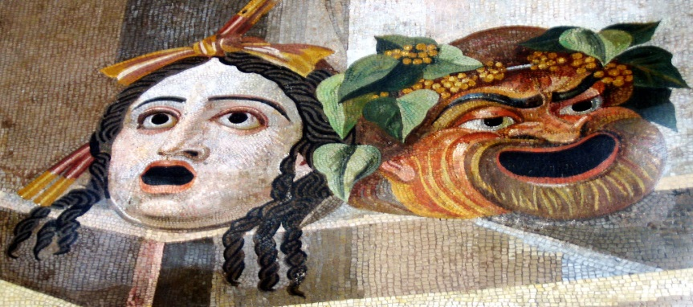
Ancient Greek Theatre
Sources of information for theatre origins and Greek theatre:
Extant plays and fragments
Records of dramas (scattered)
Commentaries (such as Aristotle)
Archeological remains of buildings
Visual art - primarily from vase painting
Therefore, the conclusions we make are highly hypothetical, but we can discuss the standard accepted views of Greek theatre.
8th century B.C. – the first drama in recorded history
By 5th century B.C. The "polis" or city-state was the governing unit
Athens was the strongest polis for art and literature
The first democracy – all could participate (citizens – no women, slaves, or foreigners)

Slide 13
Ancient Greek Theatre
Greek theatre must have arisen in the early or mid-500's BC, because drama is simply not mentioned in texts or credible sources prior to that time.
By 534 BC theatre is clearly under way because that was when Pisistratus, the tyrant of Athens, inaugurated the urban ceremonies honoring the god Dionysus, a festival that for the first time in recorded history included theatrical performances.
The form of worship sanctioned in Dionysian religion was ecstasy, literally "the act of standing outside oneself."
At the highest pitch of the celebration, it was believed that worshipers left themselves, as the god entered their bodies, and they could then perform miracles and wondrous acts beyond normal human capabilities.
That the "impersonation" of a human by the god bears some resemblance to what an actor does in performing a drama has led many a scholar to assert an evolutionary connection between this sort of worship and the performance of drama.
For this and other reasons, Bieber asserts: "The religion of Dionysus is the only one in ancient times in which dramatic plays would have developed."
Thus, all reasonable evidence suggests that Athens was the cradle, if not the birthplace, of early drama.

Slide 14
Pericles (c. 460-430 B.C.) – "first citizen" of Athens
He led Athens in the "Golden Age of Greece" the "Age of Pericles“
He emphasized culture – architecture, art, and drama
Had temples and public building built, including the Theatre of Dionysus (Dionysus) and the Parthenon
Athens was defeated in the Peloponnesian War in 404 B.C.
Greek society viewed gods in human terms
Gods held grudges, etc., fought with each other - therefore their destiny (and those of humans) was uncertain
A strong concern for humanity - the founders of philosophy came from this period
Humans were elevated from animals, but harmony depended on a conjunction of human and divine forces. If disharmony, peace was endangered.
Drama therefore focused on human struggles, but with a "supernatural" element.

Slide 15
Who was Pericles? Why should we care about him?
According to history.com:
Pericles was born into one of Athens’ leading families.
His father Xanthippus was a hero of the Persian War and his mother belonged to the culturally powerful Alcmaeonidae family.
He grew up in the company of artists and philosophers.
Pericles’ earliest recorded act, the financial sponsorship of a play by Aeschylus in 472 B.C., foreshadowed the future leader’s wealth, artistic taste and political savvy. The play expressed support for Athens’ embattled populist leader Themistocles over Pericles’ future archrival, the aristocrat Cimon.
During the 440s and 430s Pericles tapped the league’s treasury to fund vast cultural projects in Athens, most notably a series of structures on the city’s hilltop Acropolis: the temple of Athena Nike and the towering Parthenon. Built to the highest standards of aesthetics, engineering and mathematics, these white marble structures were decorated with intricate statues and murals carved by the era’s greatest sculptors.
Pericles’ social innovations were equally important to the era. He worked to democratize the fine arts by subsidizing theater admission for poorer citizens and enabled civic participation by offering pay for jury duty and other civil service.
Pericles maintained close friendships with the leading intellects of his time.
The playwright Sophocles and the sculptor Phidias were among his friends.
Pericles himself was a master orator. His speeches celebrate the greatness of a democratic Athens at its peak.

Slide 16
An Overview of Classical Greek Drama
According to Aristotle, the Athenians developed tragedy first, with comedy following a generation or so later.
Comic dramas as opposed to comedy itself—that is, humorous plays versus the formal genre of "comedy"—appear to have evolved alongside their tragic counterpart, perhaps even before it.
The satyr play, in particular, a farcical rendition of myths more often treated seriously which featured a chorus of rowdy, disrespectful satyrs (half-human half-animal spirits of the wilderness notorious for their lust and gluttony), emerged early in the tradition of Greek theatre, though exactly how early is not clear.
Nevertheless, the historical sources for theatrical performances in the Classical Age focus largely on tragedy as the hub of early dramatic activity, even if its pre-eminence probably looks clearer in hindsight than it seemed in the day.
Aeschylus lived a generation earlier than the other two (Sophocles and Euripides) so his work provides our first hard look at Greek drama.
To modern viewers his plays seem static and slow-moving, there can be little doubt they were exciting and controversial in their day.

Slide 17
An Overview of Classical Greek Drama
The elder of the later pair, Sophocles is often seen as the best playwright of the three—in the general estimation of many in the scholarly community, Sophocles remains the finest exponent of tragic arts ever—and certainly his polished dramas were very well-respected in the Classical Age, as they have been for the most part ever since.
Euripides, while alienating his contemporaries and considered by many a distant second to Sophocles when the two of them were alive, left behind a body of drama which commanded the stage after the Classical Age.
Euripides had a knack for putting on stage eye-catching situations and creating memorable characters with extreme personality disorders.
Accordingly, theatrical records show that his works were very frequently produced in later ages, outstripping both Sophocles and Aeschylus.
No Greek tragedy from the fourth century or later (the Post-Classical Age) has been preserved intact, making it hard to determine the course of tragic drama in Greece after the lifetime of Sophocles and Euripides. We can, however, follow the evolution of its close kin, comedy, in later Greek theatre.

Slide 18
Four Qualities of Greek Drama
1. Performed for special occasions (festivals)
Athens had four festivals worshipping Dionysus – (Bacchus in Latin, Roman) god of wine, fertility, rebirth
2. Competitive – prizes awarded
Actors and playwrights competed
3. Choral – singing seems to have been an important part
A chorus of men (varied in size form 3 to 50) – many think the choral song – dithyramb – was the beginnings of Greek drama (but origins are unclear)
4. Closely associated with religion - stories based on myth or history
Some believe the chorus sang, moved, danced
Most believe the chorus underscored the ideas of the play, provided point-of-view, and focused on issues of the play and implications of the action, established the play's ethical system, and participated in the action

Slide 19
Theatron
The physical remains of Greek theatre from the Classical Age are pitifully few, making it a treacherous enterprise to reconstruct the theatre spaces, sets, costumes, music or any of the material features of theatre in the great age which fostered Greek tragedy (the 400's BC).
Most Greek theatres visible today around the Mediterranean basin were constructed after the Classical Age, while those few which belong to the earliest periods of theatre evolution have almost universally been renovated in later periods of ancient times, leaving them doubtful sources of information about classical theatre.
That is, they constitute "secondary sources," for the most part.
Our data concerning classical stage practices, such as acting styles, costumes, musical accompaniment and the like, are in general equally unclear.
Though some historical sources seem to provide reliable information about the performance of classical tragedy, the modern appreciation of this data still relies heavily on the fifth-century dramas that happen to have survived.
To make matters worse, ancient theatre was in its customs and practices a rather fluid enterprise, and what rules applied to one period—or even one decade—may not necessarily have applied to another.

Slide 20
Theatron
The performance spaces of classical ancient times are enormous by today's standards, closer in size to modern sports stadiums than the sorts of theatres with which we are most familiar.
Outdoors and most often situated on steep slopes that curve around the playing area, many ancient theatres were capable of housing thousands of spectators.
These theatra (the plural of theatron)—the Greek word originally referred only to the seating area in a theatre—call for a certain style of performance.
In order to be heard, for instance, the ancient actor had to have a strong voice.
Likewise, costumes, sets and movement also needed to be visible from and intelligible at great distances.
Unlike modern realistic plays which for the most part call for intimate, indoor theatre spaces with controlled lighting, ancient drama had more the feel we associate with large-scale athletic events.

Slide 21
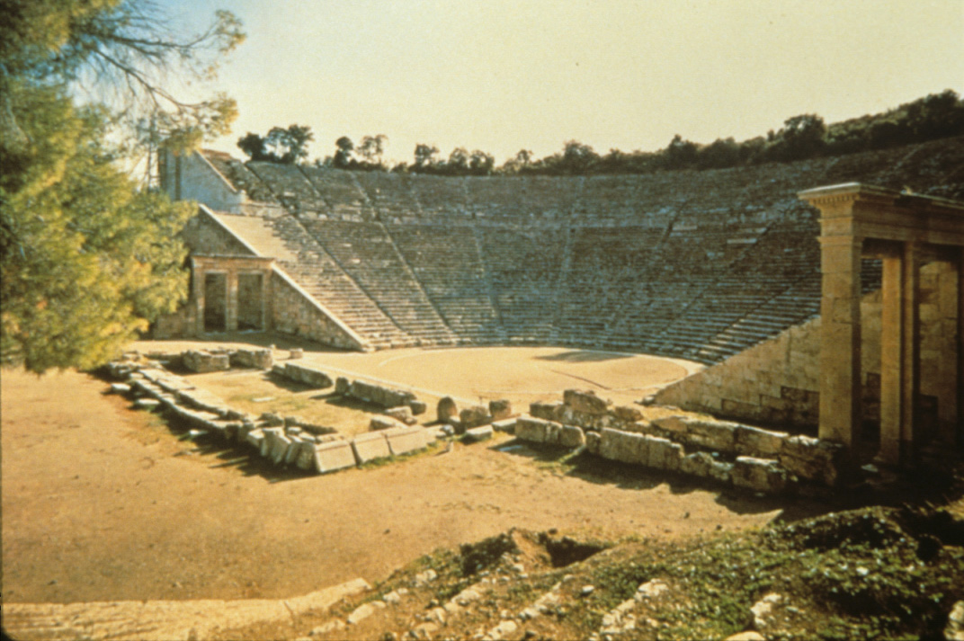

Slide 22
The Theatre in the Classical Age
The primary and primordial performance space in ancient Athens and the home of the City Dionysia was the Theatre of Dionysus.
Built into the slopes of the Acropolis where it could utilize the natural terrain to create seating, this "instrument for viewing" is, if not the actual birthplace, certainly the cradle of Western drama.
But its exact structure in the Classical Age is impossible to determine.
It was substantially refurbished twice in ancient times, once in the later fourth century (300's BC) and once again in Roman times, making it unlikely that a single stone visible in the theatre today was there in the Classical Age. Thus, it is improbable any of the classical tragedians would recognize much of the theatre we see now other than its location.
The orchestra—"dancing place" (literally, "instrument for dance")—of the Theatre of Dionysus, is the flat area at the bottom of the theatre where the chorus sang and danced.
Second, the only known theatre which has remained unchanged from that day, the Theatre at Thorikos—Thorikos was an Athenian deme ("district, borough")—has a rectangular orchestra with only its corners rounded.
Nevertheless, it is not certain that the Theatre at Thorikos was used as a space for performing drama, or just a public meeting ground.
In sum, it is hard to speak definitively about the physical nature of the Theatre of Dionysus as it existed in the Classical Age, except to say that it was a large structure capable of housing crowds which were huge even by modern standards.

Slide 23
Greek Theatre as a Courtroom
Actually, if the ancient Greeks had compared drama to anything in their day, it would probably have been courtroom trials.
Lawyers back then were seen as "actors" of a sort inasmuch as they provided some of the more sensational and theatrical moments in Greek history. Often pleading cases before thousands of people and hardly shy about dramatizing their appearance in court, orators in ancient times rarely hesitated to allude to drama during litigation, one at least even going so far as to quote tragedy at some length as if he were an actor.
In fact, the ancient Athenians fairly often used their large, centrally located acting venue, the Theatre of Dionysus, as the site of important trials.
So, if theatre seemed like anything to the ancient Greeks, it was most likely a lawsuit and, as such, Greek drama imports at times a distinctly controversial atmosphere where characters appear to prosecute each other, appealing on occasion to the audience as if it were a jury. Nor is this at all out of line with reality since most of the Athenian spectators would have served as jury-members at some point during their lives, some watching the play from the very same seats in which they had sat as jurors.
In that light, the ancient Greeks saw little reason for maintaining an invisible "fourth wall" or building characters with interiority (i.e. psychological delicacy effected through subtext), features conventional in modern theatre.
Instead, presentationalism and overt grandeur symbolize Greek theatre and drama.
Like the trials and public spectacles which Greek drama so often resembles—and which it surely shaped, in turn—ancient theatre in Greece had little choice but to meet the enormity of the arena it played in.
In other words, the ancient Greeks would have felt right at home watching any of the sensational trials televised today, especially the prosecution of celebrities, and would probably have watched Senate hearings on CSPAN in far greater numbers than we do.

Slide 24
The Skene
From the very dawn of Greek drama there was probably a backstage area of some sort, into which the actors could retire during a show and change costume.
There is no ancient theatre existing which does not preserve or have room for the remains of a "backstage" of some sort.
The Greeks referred to this part of the theatre as the skene ("tent"), recalling, no doubt, its origins as a temporary structure, perhaps even an actual tent into which the first actors of ancient times withdrew during performance.
Aeschylus' earliest plays were produced in the Theatre of Dionysus—they are the oldest Greek tragedies preserved in its entire—but they do not call for any permanent structure on stage. Thus, it is not clear that the Theatre of Dionysus prior to the 460's BC had any building as such on stage; in that case, the skene could have been merely a "tent."
So, we can be certain that the Theatre of Dionysus had a permanent skene building only after the first decades of the Classical Age.
On the other hand, mask and costume changes which all of Aeschylus' dramas entail require some sort of structure into which the actor can briefly retire out the audience's sight during performance.
Aeschylus' later plays do indeed call for a skene building with a roof strong enough to hold an actor standing on top of it, as in the opening scene of Aeschylus' Agamemnon, shows that by at least 458 BC there must have been some type of skene building in the Theatre of Dionysus.

Slide 25
The Skene
Other dramas preserved from the Classical Age shed a bit more light on the nature of the skene building in the Classical Age. For instance, they show that it must have had at least one door, because several fifth-century tragedies call for actors to enter from a building or for the chorus to pass from the orchestra into the skene building.
Therefore, there was not only a backstage structure of some sort but relatively easy access between it and the area where the chorus danced.
The roof of the skene building must have been flat and strong enough to support at least one actor's weight—and two or more by the end of the Classical Age—so it follows that there had to have been stairs or a ladder inside the skene leading up to the roof.
But, unfortunately, this is really all we can say with certainty about the ancient skene.
Surviving classical dramas do not refer to it often or call for its extensive utilization argues it was not particularly complex in its design or application.
If true, perhaps, of the Classical Age, the same did not apply to the post-classical Greek world.
By that time the "tent" was being used to depict a play's setting through a process the Greeks called skenographia ("tent-drawing," implying some sort of painted backdrop) from which comes our word "scene" in the sense of scenery.
So, even if the skene started out as a weak presence in classical theatre, it grew later, in the fourth century BC, into an elaborate structure and, without doubt, represents the beginnings of set design.

Slide 26
The Greek Tragedy
Structure of Greek Tragedy:
Late point of attack
Violence and death offstage
Frequent use of messengers to relate information
Usually continuous time of action
Usually a single place
Stories based on myth or history, but varied interpretations of events
Focus is on psychological and ethical attributes of characters, rather than physical and sociological.

Slide 27
The Three Greek Tragedians
"The Artists of Dionysus" seem to have been a sort of actors' union in the 3rd century B.C.
1. Aeschylus
His are the oldest surviving plays
Began competing 449 B.C. at Dionysus Theatre
Most of his plays were part of trilogies; the only existing Greek trilogy is The Orestia
He is believed to have introduced the 2nd actor
Thespis was one, the 2nd added
After 468 B.C. Sophocles is believed to have introduced the 3rd actor, which Aeschylus then used
Characteristics of Aeschylus's plays:
Characters have limited number of traits, but clear and direct
Emphasizes forces beyond human control
Evolution of justice, impersonal
Power of state eventually replacing personal revenge
Chain of private guilt and punishment - all reconciled at the end

Slide 28
The Three Greek Tragedians
2. Sophocles: (496-406 B.C.)
He won 24 contests
Never placed lower than 2nd
Believed to have introduced the 3rd actor; fixed the chorus at 15 (had been 50)
Characteristics of Sophocles' plays:
Emphasis on individual characters
Reduced the role of the chorus
Complex characters, psychologically well-motivated
Characters subjected to crisis leading to suffering and self-recognition - including a higher law above man
Exposition carefully motivated
Scenes suspenseful and climactic
Action clear and logical
Poetry clear and beautiful
Few elaborate visual effects
Theme emphasized: the choices of people

Slide 29
The Three Greek Tragedians
3. Euripides (480-406 B.C.)
Very popular in later Greek times
Little appreciation for him during his life
Sometimes known as "the father of melodrama"
Characteristics of Euripides' plays:
Dealt with subjects usually considered unsuited to the stage which questioned traditional values (Medea loving her stepson, Medea murdering her children)
Dramatic method often unclear -not always clearly causally related episodes, with many reversals, deus ex machina endings
Many practices were to become popular: using minor myths or severely altered major ones
Less poetic language, realistic characterizations and dialogue
Tragedy was abandoned in favor of melodramatic treatment
Theme emphasized: sometimes chance rules the world, people are more concerned with morals than gods are

Slide 30
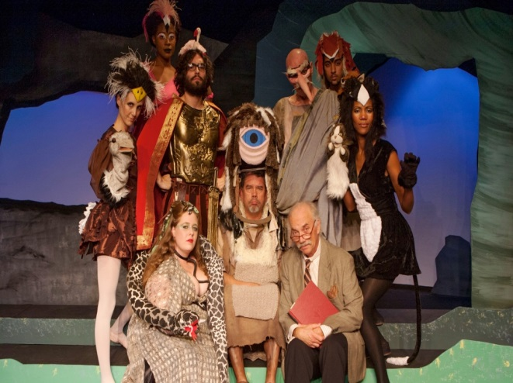
The Satyr Play
The Satyr Play, of unknown origin, had to be mastered by tragedians
Chorus-half-man, half-beast - satyrs, companions of Dionysus
Sometimes the story is connected with the tragedy it accompanies, but not usually
Burlesque of mythology - ridiculing gods or heroes
Structure similar to tragedy
Everyday and colloquial language
Shorter afterpieces to tragedies
Examples:
The Cyclops - Euripides - from The Odyssey - where Odysseus meets the Cyclops and a captive band of satyrs
The Trackers - Sophocles - much is existing - about Apollo's attempt to find a herd of cattle stolen by Hermes, god of thieves.

Slide 31
An Overview of Greek Comedy
The presentation of humorous material has deep roots in ancient Greece, perhaps as old as tragedy itself, but because comedy was seen as a lesser art form until quite late in the evolution of Western Civilization, the evidence for this genre of drama is scarce.
Historical records make it clear skits designed to provoke laughter were being written throughout and even before the Classical Age—comedy officially premiered at the Dionysia at some point during the 480's BC, between the Persian Wars—and this type of theatre, now termed "Old Comedy," gained popularity steadily across the fifth century.
In particular, it began to attract widespread attention during the Peloponnesian War when productions of comedy provided the Athenians much needed relief from the anxiety and sorrow of their conflict against Sparta.
While the names of several exponents of this genre in the fifth century are preserved, and in some cases fragments of their work as well, the plays of only one Old Comedy playwright, Aristophanes, have come down to us complete.
His drama—and presumably that of his predecessors and contemporaries, too—was primarily built around current events and issues.

Slide 32
An Overview of Greek Comedy
Indeed, all indications point to political and social satire as the hallmark of Old Comedy, especially toward the end of the Classical Age.
Later, however, after the end of the Peloponnesian War, as Greece moved into the Post-Classical period, comedy underwent a major transformation. From ridiculing celebrities and the regime in power to focusing on the lives and lifestyles of less prominent people, comic drama evolved toward the end of the fourth century (the 300's BC) into a new and very different-looking type of entertainment.
The master of this "New Comedy" was Menander, heralded by at least one ancient critic as an author unsurpassed in quality.
However, his work did not survive the Middle Ages.
Fortunately, the sands of Egypt have rendered up several of his plays, although in "rags and patches" but well enough preserved for us to see what his drama looked like.
Character-driven, highly stylized pieces with recurring characters and inclined toward subtle rather than broad humor
Menander and New Comedy in more ways than one marks the beginning of modern drama.

Slide 33
Greek Comedy
Not admitted to the Dionysus festival till 487-486 B.C. - late
Unknown origins or influences
Perhaps from improvisations of leaders of phallic songs or from mime - satirical treatment of domestic situations or burlesqued myths
Six comic dramatists besides Aristophanes (his is the only existing work)
Called "Old Comedy"
Menander's plays are considered to be Greek "New Comedy"
Commentary on contemporary society, politics, literature, and Peloponnesian War.
Based on a "happy idea" - a private peace with a warring power or a strike to stop war
Exaggerated, farcical, sensual pleasures

Slide 34
Greek Comedy
Structure of the Comedy:
Part One:
Prologue - chorus gives debate or conflict over merits of the ides
Parabasis - a choral ode addressing the audience, in which a social or political problem in discussed
Part Two:
Scenes show the result of the happy idea final scene: (komos) - all reconcile and exit to feast or celebrate
In 404 B.C., Athens was defeated in the Peloponnesian War; social and political satire declines
Greek "New Comedy":
The plays of Menander are the only surviving fragments...
Instead of Old Comedy's focus on social, political, and cultural satire, Greek “New Comedy” dealt with romantic and domestic problems.

Slide 35
Middle Comedy
The radical changes in social and political conditions which rained down on Greece in the 300's BC led to equally elemental changes in theatre.
As tragedy slowly faded from public attention, revivals of "old" tragedies—meaning classical fifth-century plays by Euripides and Sophocles primarily—began to play a more central role in Greek theatre.
Mime was vulgar, low-brow nature looked, no doubt, simplistic to audiences nursed on the vigorous intellectualism of the arts in the Classical Age.
What theatre was starving for was something novel and original, but the recipe for survival was not immediately forthcoming. There was still much middle ground to cross. Social and political issues had to settle into some sort of scheme before drama could reflect the "new" order.
Without a single complete Greek play—tragedy or comedy—surviving between Aristophanes' last (388 BC) and Menander's first (316 BC), there is little way for us to measure the evolution of what we call Middle Comedy.
The change from idea-driven to character-driven comic drama must have transpired at some point during the long and murky medieval age known now as Middle Comedy which spans most of the fourth century BC.
In some ways, the evidence suggests Middle Comedy looked back to its forebears in the Classical Age.
For instance, current politicians and well-known figures were ridiculed, just like in Old Comedy, but probably not as directly, centrally or vigorously as Aristophanes had done.
Middle Comedy was the mockery of classical myth and tragedy—particularly Euripides—another sort of backwards glance. But in spoofing Euripides, Middle Comedy playwrights were, in fact, not just ridiculing him but also re-appropriating his plots, characters and dramatic dynamic for their own purposes, a grand display of flattery if ever there was. Indeed, Euripides' influence on later Greek comedy is arguably the greatest of all fifth-century dramatists, even Aristophanes'.
The evolution of Middle Comedy makes it clear that the Greeks were well on the way to inventing the "variety hour."

Slide 36
Production / Finance:
Playwrights applied to the archon (religious leader) for a chorus
Expense borne by a choregai, wealthy citizen chosen by the archon as part of civic / religious duty
Choregus paid for training, costuming, etc.
The term choregus also refers to leader of the chorus
The State was responsible for theatre buildings, prizes, payments to actors (and perhaps to playwrights). Prizes were awarded jointly to playwrights and choregus
Dramatists themselves probably "directed" the tragic plays, but probably not the comedies
Aeschylus and others in his time acted, trained chorus, wrote music, choreographed, etc.
Playwrights called didaskalas (teacher) – [didactic = teaching]

Slide 37
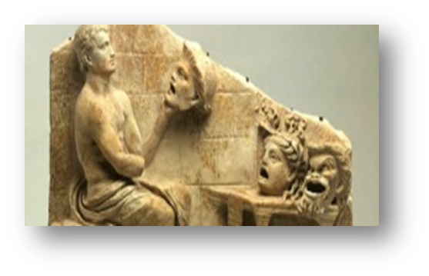
Actors and Acting:
Tragedy:
Playwrights originally acted, but by 449 B.C. with the contests for tragic actors, they didn't.
Actors were semi-professional, at best.
Three-actor rule (that only three actors were in productions) - seems supported by evidence, but questioned by some.
Comedy:
Fewer restrictions
Playwrights cast till 449 B.C., with the advent of the contests, then the main actors were chosen by lot and the others by the main actors and the playwright.
Actors were paid by the State.
Only the leading actors were eligible for competition.
A vocal acting - declamatory - to project appropriate emotional tone, mood, and character.
Three kinds of delivery:
Speech
Recitative
Song
No facial importance - masks used.
Gesture and movement were broadened and simplified.

Slide 38
Actors and Acting:
A. The Three-Actor Rule
Besides the chorus, only three actors performed all the speaking roles in tragedies produced at the Dionysia, although the authorities who oversaw these celebrations of Dionysus allowed on stage any number of mute actors.
These non-speaking parts were probably played by young actors-in-training whose voices were not as yet fully matured and could not project well enough to be heard throughout the enormous arenas encompassed by classical theatres.
But all known tragedies include more than three speaking characters, which means actors must have taken more than one role in a play.
While on the modern stage multiple-role-playing may sometimes entail difficulties—audiences today who sit relatively close to the stage will naturally expect a high level of realism which may be all but impossible for the actor playing more than one role to effect—the same was not true in ancient Greece.
Role-changing was perfectly practicable on the Athenian stage, not only because the majority of the viewers sat some distance from the stage but, more important, because the actors wore masks and costumes facilitating their ability to play different parts.
Within the scope of a single tragedy, an actor might portray as many as five different characters, sometimes very different ones, with relative ease since altering his façade through a change of mask and costume was a traditional element in Greek theatre.
Indeed, extant dramas prove that the ancient Greek actor was expected to be able to impersonate the full range of humanity, from young girls to old men, by adapting his voice and mannerisms, much as is still done in various types of Asian theatre.
Men played all parts. As a result, the art of ancient acting centered around a performer's flexibility carried out with the help of the masks and costumes which hid his own face and form from the audience's view.

Slide 39
Actors and Acting:
A. The Three-Actor Rule
Furthermore, it is clear that three actors portrayed all the roles in any classical drama, a tendency today called the "three-actor rule." That this was, in fact, a restriction meticulously enforced at the Dionysia is also certain, and not just because later historical sources like Aristotle allude to it, but because the surviving dramas of this period show this rule in action.
In other words, the plays constitute "primary" evidence that three actors at most performed all the speaking roles in classical tragedy and satyr plays, for the simple reason that all such drama—even the surviving fragments—require no more than three speaking characters on stage at once.
No existing tragedy staged before the end of the Peloponnesian War requires actors to share a part.
That is, ancient Greek playwrights disposed the action in their dramas such that the characters assigned to any particular actor never converse on stage. That is, if one actor plays both Electra and Menelaus, those particular characters never meet and speak together in front of the audience.
The Greek tragedians also invariably give actors a certain period of time off stage (usually the interval covered by about fifty lines of dialogue) to make mask and costume changes.
That comfort margin, so to speak, along with the other aspects of Greek tragedy mentioned above seal the case for the "three-actor rule."

Slide 40
Actors and Acting:
B. Voices on Stage: Dialogue and Trialogue
Aeschylus’ characters never engage in a trialogue—that is, all three actors conversing in a scene—even when there are three speaking actors on stage.
So, for instance, during the confrontation between Agamemnon and Clytemnestra in Aeschylus' Agamemnon, the actors portraying these two characters speak to each other. Though another actor is on stage dressed as Cassandra (Agamemnon's Trojan concubine and prisoner-of-war), that actor says not a word during this scene. Rather, he remains on stage silent for a long time and only finally speaks two scenes later. Thus, in the scene where Agamemnon and Clytemnestra have their dialogue, Aeschylus does, in fact, put three speaking actors together on stage, even if they do not all join in the same conversation and engage in a trialogue.
It is important to remember drama was a new art form in Aeschylus' day. It had most likely grown from a one-man show with a chorus as back-up—in the earliest recorded stages of tragedy, there is no mention of actors, only a playwright and a chorus, which supports the theory that playwrights originally performed all the speaking character parts—to a two-performer and then a three-performer arena.
As a result, a conservative approach to dialogue is visible in Aeschylus' plays where, any time two characters have a dialogue, the situation is always carefully managed.
For instance, the action leading up to a dialogue in an Aeschylean drama tends to proceed in the following manner: each of the speaking characters is brought in separately, they deliver discrete monologues (often punctuated by choral interjections), and only after some time do they at last exchange words back and forth. This cautious approach, as the playwright makes sure that the audience has heard both the actors' voices and understands the two characters' distinct points of view, confirms that in the early Classical Age the audience required some preparation before a conversation could take place on stage.

Slide 41
Actors and Acting:
B. Voices on Stage: Dialogue and Trialogue
The rhythms of dialogue in tragedy were somewhat predictable to the audience, especially if changes of speaker occurred at breaks in the poetic meter, the way, in fact, they regularly do in classical tragedy.
That is, typically one character speaks a single full line of meter, and the other says the next and then the first another and so on, in a type of interchange called stichomythy (in Greek, stichomythia, "line-talking"). This clear and predictable pattern of exchanges of dialogue line by line helped the ancient audience understand which character was talking at any given moment, because they knew in advance when one character would stop speaking and the next one would begin.
The size of the theatres in which Greek dramas were presented put most spectators some distance from the action—add to that the fact that the actors were wearing masks so that, even if seated close to the stage, viewers could not see the performers' lips moving—thus it's easy to understand the need for such a stylized conversation device as stichomythy.
Careful preparation before a dialogue and a predictable exchange of words would have greatly improved the audience's ability to follow a conversation on stage, especially when presented with masked actors who were playing in an immense arena.
Given all that, most spectators would have benefitted greatly from any help determining which character was talking at each particular moment.

Slide 42
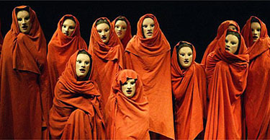
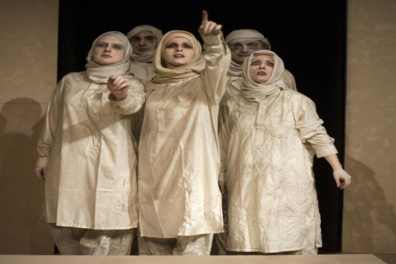
Acting Styles:
Actors usually played more than one role
Men played all the parts
Stylized - used masks, choral declamation, etc.
Tragedy leaned toward idealization; comedy toward burlesque.
Other elements affecting 5th century Greek productions:
The chorus - tragedies dominant in early tragedies (so main actors could change roles ) by Euripides, chorus only loosely related to the action
Size of Chorus:
Traditional view: from 50 to 12 to 15
Generally believed to be 15 by the time of Sophocles and Euripides
Later diminished in time
Entered with stately march, sometimes singing or in small groups.
Choral passages sung and danced in unison, sometimes divided into two groups
Sometimes exchanged dialogue with the main characters, rarely individual speaking (though some say the choregus may have spoken / sung alone)
The type of groupings are unknown

Slide 43
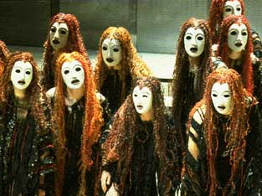
The Chorus
Chorus for "Old Comedy" (Menander's plays are considered to be Greek "New Comedy"):
24 people, sometimes divided into two
Could have both genders (Lysistrata)
More varied entrances, groupings, etc.
More active
In both comedy and tragedy, the chorus probably entered after the prologue and then stayed
Functions of the chorus:
An agent: gives advice, asks, takes part
Establishes ethical framework, sets up standard by which action will be judged
Ideal spectator - reacts as playwright hopes audience would
Sets mood and heightens dramatic effects
Adds movement, spectacle, song, and dance
Rhythmical function - pauses / paces the action so that the audience can reflect
The chorus was usually made up of amateurs - 11 months training - the most expensive part of the production.

Slide 44
The Music, Dance, and Costumes
Music
Most believe music was integral
Probably a singe flute, sometimes a lute
No one knows who composed the music nor what it sounded like
Probably resembled oriental quarter tones
Different modes of music associated with comedy or tragedy
Dance:
Mimetic - expressive of character or situation
In comedy - less dignified - jumping, spinning, etc.
In satyrs - lewd pantomime, etc.
Costume:
Many say a standard costume:
Sleeved, decorated tunic, full-length usually, derived from robes of Dionysian priests - called a chiton.
Cotharnus is a high boot or soft shoe, perhaps elevated with a thick sole.
A short cloak may also have been worn, called a chalmys, or a long one called a himation.
Vase painting are our major evidence, but the vases are earlier than the 5th century B.C.; many vase painting show other garments, including nudity.
Perhaps there were symbolic uses of some costumes/props - warrior with a spear
The plays themselves have few references to costumes
Chorus usually had more realistic costumes.
Most agree more on comic costumes:
Adapted from everyday Greek life
Chiton made too short to emphasize comic elements
Male characters, not the chorus, wore a phallus.
Slaves and old men wore comically exaggerated costume
Women probably wore more everyday costume
Satyr plays:
Goatskin loincloth with phallus in front and tail in back
Masks:
All tragic players (except flutes?) wore masks
None survived - made of cork, linen, wood
In 5th century, probably not exaggerated. Later became so.
Covered whole face - hair, beard, etc.
Comedy - more varied
Often birds, animals, etc. Probably not realistic.
Characters had exaggerated masks, some in chorus wore identical masks.
Satyr chorus...hairy, bearded, painted ears, sometimes horns

Slide 45
Works Cited
Kearney, E. (2012, October 28). The Cyclops @ Long Beach Playhouse Theatre. Retrieved October 19, 2018, from http://www.workingauthor.com/the-cyclops-long-beach-playhouse-theatre
History.com Staff. “Pericles.” History.com, A&E Television Networks, 2009, www.history.com/topics/ancient-history/pericles.
Imagi-nation. “Menander.” Menander (342 B.C. - 291 B.C.), 2017, www.imagi-nation.com/moonstruck/clsc14.htm.
Taplin, Oliver, and Maurice Platnauer. “Aristophanes.” Encyclopædia Britannica, Encyclopædia Britannica, inc., 30 Dec. 2016, www.britannica.com/biography/Aristophanes.

