Slide 1
Modern Drama: Romanticism, Melodramas Expressionism, and Absurdism
Week 14
[Part 1]
Introduction to Theatre
College of the Desert

Slide 2
Romanticism: The Age of Independence
The Rise of the middle class was occurring
Trading and manufacturing joined agriculture as major sources of wealth
Concentration of people in towns and cities increased
Between 1750 and 1800, Romanticism took hold, and flourished between 1789 and 1843 in Europe
The American Revolution (1770) and the French Revolution (1791) further asserted that men had freedom to act on their own consciences
Often called the Age of Independence
Going along with this was the view that Nature was something to honor. God had created nature, and we must know as much about it as possible. Nature is Truth

Slide 3
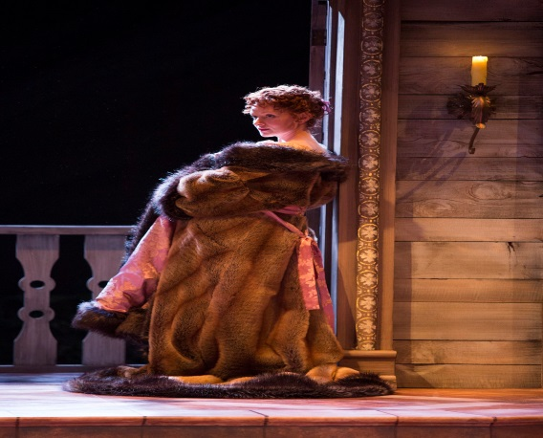
Major Characteristics of Romanticism
1. Abiding trust in nature’s goodness:
Emotions and instinct more important than reason (reason is the product of education – not natural – corruptible)
Glorification of "The Natural Man" – the "noble savage" – the primitive and untutored personality (American Indians, African Blacks, South Sea Islanders) – all worthy people to observe)
Primitivism – the simple and unsophisticated life was best.
Led to an interest in old civilizations
Archeology develops as a science
Egyptian and Medieval became important areas of study
Glorification of Greek society (not Roman)
Medieval studies
Urged by nationalism
Helped nations develop identity – which was an important aspect of Romanticism ideas
2. Equality of people
Social and economic classes ridiculed
An era of revolutions – since overthrow of governments often seemed to require elimination of social classes
3. A premium on detail
Detail is the pathway to truth
Tended to look for the particular, specific, and unique, not the general or typical
All creation was unified, a one-ness; therefore, each detail was important

Slide 4
Major Characteristics of Romanticism
4. Ultimate truth must always be sought, but we will probably never find it
Artists become seen as misunderstood geniuses, both blessed and cursed by their art
Common folk could not understand
The struggle for truth, which was unattainable, let to a melancholy strain in Romanticism
5. Art served a dignified purpose
The role of art was to lead people, to perceive the underlying unity of all existence and thus to eliminate conflict – "to make man whole again"
6. Subjectivity
Both artist and critic were necessarily subjective and personal.
There was no objective set of external criteria for achieving art or critiquing art.
The focus was not so much on the art, but on the artist or the perceiver of the art.
Thus, there was a "democratization" of art – one’s feeling are as good as anyone else’s.

Slide 5
Major Characteristics of Romanticism
Romantic Plays, old and new, tended to appeal to emotions rather than intellect
Special effects therefore focused on the supernatural and the mysterious – visual over verbal, sensational rather than intellectual
Aristocrats tended to go to the opera and ballet, and more middle-class now went to the theatre
Some notable people from the Romanticism movement in theatre:
Johann Wolfgang von Goethe [Guurr’-tuh) (1749-1832)
His plays characterized by sprawling action, long and strenuous.
Faust parts I and II, (1801 and 1831) is now accepted more as a closet drama, a literary work, rather than one to be presented on stage.
Friedrich Schiller (1759-1805)
Wilhelm Tell (1804) – a stirring celebration of democracy, individualism, and nationalism.
In France – Victor Hugo’s Hernani (1830) -- caused a riot.
Should long-accepted Romantic ideals be allowed in France’s National Theatre?
Remember, the French Academy had determined that all French plays would be neoclassical in form!!
It contained elevated language, noble characters, and the five-act form, and was thus Neoclassical
However, it also had common people as some important characters, struggles with a ruler, violence and death, and humor -- and was thus NOT neoclassical.
Eventually, Romanticism won out, even in France, but not without a struggle.

Slide 6
Who is Johann Wolfgang von Goethe? (Review)
Johann Wolfgang von Goethe (born August 28, 1749, Frankfurt am Main [Germany]—died March 22, 1832) [pronounced Gerrt'-uh]– Weimar Classicism— was very strict, distrusted others’ talents.
He was a German poet, playwright, novelist, scientist, statesman, theatre director, critic, and amateur artist, and is considered the greatest German literary figure of the modern era.
Goethe tells of his early interest in puppet-plays and theaters, and in the French company of actors which remained in his native city after the Seven Years' War.
In 1770, he went to Strassburg to study law, he took up in earnest his work of criticizing French art and standing for a truly German art.
Goethe received his degree in 1771 and returned to Frankfurt, where he began to practice his profession.
In the Spring of 1790 we again find Goethe in Italy. In 1791 he was appointed director of the Ducal theater. It was in this capacity that he was best known to the citizens; for he had the final decision on every detail, whether of subject, scenery or acting, and in later years a large arm-chair was reserved for him in the middle of the pit, applause being hardly permitted until he gave the signal for it. At the same time he was occupied with biological, physical, botanical, and chemical research, and many works appeared with the results of his inquiries.
He was greatly influenced by Herder, who showed him the beauty of Shakespeare.
Shakespeare was performed no longer in burlesque, but in serious renditions of his plays, and the actors were instructed in the delivery of blank verse. Stress was laid on the excellence of the ensemble as against the predominance of particular stars, and the theatre was considered as a school not only of wholesome entertainment but of natural culture.
His wife died in 1816. The next year he retired from his position as theater director. He died at Weimar in 1832.
Throughout a great part of Goethe's work there is a stream of criticism which renders it difficult to re-construct a complete critical theory. Goethe's broad outlook, his sympathy with and his deep knowledge of man and art, gave him a most catholic view, and possibly the best statement of his creed is found in Calvin Thomas' Goethe: . . . "the simple creed that informs Goethe, and gives him his criteria for judging the work of others. It is that the artist as such must have no creed; that is no creed derivable from the intellect or accountable to it. Rules, conventions, theories, principles, inhibitions of any sort not born of his own immediate feeling, are no concern of his. They proceed from an inferior part of human nature, being the work of gapers and babblers."

Slide 7
Who was Friedrich Schiller?
According to Britannica.com:
Friedrich Schiller, in full Johann Christoph Friedrich von Schiller (born Nov. 10, 1759, [Germany]—died May 9, 1805, Weimar, Saxe-Weimar)
He was a leading German dramatist, poet, and literary theorist, best remembered for such dramas as Die Räuber (1781; The Robbers), the Wallenstein trilogy (1800–01), Maria Stuart (1801), and Wilhelm Tell (1804).
His adolescence under the rule of a petty tyrant confronted Schiller with the problem of the use and abuse of power, a theme that recurs in most of his plays.
His resentment found expression in some of his early poems and especially in his first play, Die Räuber, a stirring protest against stifling convention and corruption in high places.
The hero of the play, Karl Moor, a young man of fiery spirit and abundant vitality, has led a somewhat disorderly life at the university. His villainous younger brother Franz poisons their aged father’s mind against the prodigal elder son. When the old Count Moor disowns Karl, the young man turns gangster and defies all established authority at the head of a band of outlaws, until, before long, he discovers that however corrupt the existing order may be, violence and anarchy do not offer a workable alternative and society cannot be reformed by terrorism and crime. He decides to give himself up to justice, thus submitting to the law that he had disobeyed.
Schiller could therefore claim to have written in defense of law and morality. At the same time, Karl Moor is represented as a “sublime criminal,” and the play is a scathing indictment of a society that could drive so fundamentally noble a character to a career of crime.
In order to have the play accepted, Schiller had to prepare a stage version in which the rebellious ardour of his original text was toned down.

Slide 8
Who was Friedrich Schiller?
According to Britannica.com:
Nevertheless, the first performance (Jan. 13, 1782) at the National Theatre at Mannheim created a sensation; it was a milestone in the history of the German theatre.
“The idea of freedom,” Goethe said, “assumed a different form as Schiller advanced in his own development and became a different man. In his youth it was physical freedom that preoccupied him and found its way into his works; in later life it was spiritual freedom.”
Schiller’s early tragedies are attacks upon political oppression and the tyranny of social convention; his later plays are concerned with the inward freedom of the soul that enables a man to rise superior to the frailties of the flesh and to the pressure of material conditions; they show the hero torn between the claims of this world and the demands of an eternal moral order, striving to keep his integrity in the conflict.
In his reflective poems and in his essays, Schiller sets out to show how art can help man to attain this inner harmony and how, through the “aesthetic education” of the individual citizen, a happier, more humane social order may develop. His reflections on aesthetics thus link up with his political and historical thinking.

Slide 9
Who was Victor Hugo?
According to Britannica.com:
Victor Hugo, in full Victor-Marie Hugo (born February 26, 1802, Besançon, France—died May 22, 1885, Paris)
He was a poet, novelist, and dramatist who was the most important of the French Romantic writers.
Though regarded in France as one of that country’s greatest poets, he is better known abroad for such novels as Notre-Dame de Paris (1831) [Eng. trans. The Hunchback of Notre-Dame], and Les Misérables (1862).
Hugo emerged as a true Romantic, however, with the publication in 1827 of his verse drama Cromwell. The subject of this play, with its near-contemporary overtones, is that of a national leader risen from the people who seeks to be crowned king. But the play’s reputation rested largely on the long, elaborate preface, in which Hugo proposed a doctrine of Romanticism that for all its intellectual moderation was extremely provocative.
He demanded a verse drama in which the contradictions of human existence—good and evil, beauty and ugliness, tears and laughter—would be resolved by the inclusion of both tragic and comic elements in a single play.
Such a type of drama would abandon the formal rules of classical tragedy for the freedom and truth to be found in the plays of William Shakespeare.

Slide 10
Who was Victor Hugo?
According to Britannica.com:
Cromwell itself, though immensely long and almost impossible to stage, was written in verse of great force and originality. In fact, the preface to Cromwell, as an important statement of the views of Romanticism, has proved far more important than the play itself.
The generosity of his ideas and the warmth of their expression still moved the public mind, for Hugo was a poet of the common man and knew how to write with simplicity and power of common joys and sorrows.
Hugo’s knowledge of the resources of French verse and his technical brilliance in metre and rhyme, moreover, rescued French poetry from the sterility of the 18th century.
Hugo is one of those rare writers who excites both popular and academic audiences alike.

Slide 11
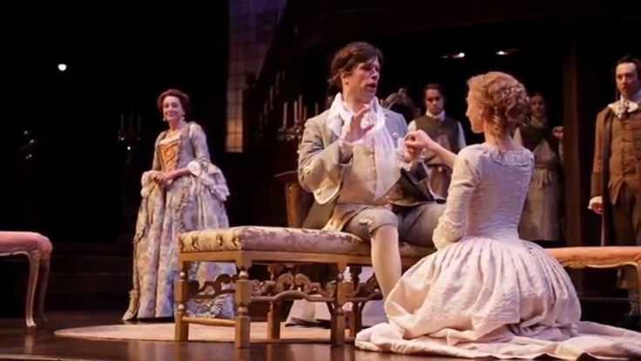
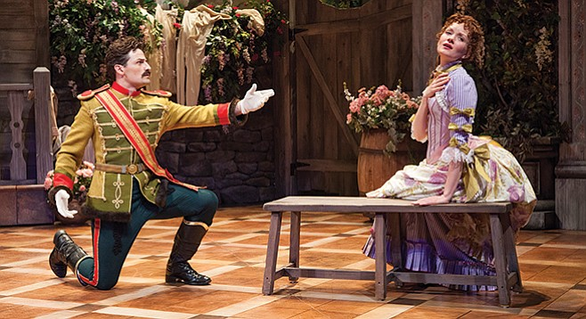
Actors During the Romantic Period
The Kembles – dominated English theatre till 1815:
John Phillip Kemble (1757-1823), and Mrs. Sarah Siddons, his sister (1755-1831)
Their acting was idealized – with grace, dignity, a "classical style”
Edmund Kean (1787-1833)
Considered to have "perfected" the romantic style.
Usually played villainous roles – sacrificed dignity for emotion.
William Charles Macready (17930-1873)
A compromise between the Kembles and Kean – careful rehearsals, detailed characterizations.
He popularized historical accuracy in settings and costumes.
Tyrone Power (1785-1844)
Did comic Irish portrayals.
A comic actor.
Henry Irving (1838-1905)
The first English actor to be knighted
Worked with Ellen Terry (1847-1928)
Synthesized trends in complexity and realism in staging (concealing set changes, for instance).
Was also a manager, as were most famous actors at that time.
In France:
Sarah Bernhardt (1845-1923)
Specialized in "breeches roles" (women playing men)
Edwin Booth (1833-1893)
Brother of John Wilkes Booth
Famous for interpretations of Shakespearean roles

Slide 12
Romantic Theatre Practice
Audience size increased even more
As seeing becomes more important than hearing (remember, the sound was so important before, and detailed, realistic sets were not the norm), the orchestra seats (which had up till then been the cheap seats) became more valuable
The upper galleries – the "gods" – were the cheapest
Audiences, especially those in the gods, were loud and vocal
Scenery included drops, flats, ground rows (cutaway flats standing free on the stage floor)
Carefully and realistically painted
Natural settings
Candles or oil lamps – but by 1830, gaslight was used
Chestnut Street Theatre in Philadelphia was the first to be lit by gas, in 1816.
By the 1820’s, Covent garden and Drury lane Theatres in London used gaslight
Gaslight increased illumination, had better control of intensity, but still had wavering flames

Slide 13
Romantic Theatre Practice
Many special effects:
Flying, trap doors, water pump systems, moving panoramas to give the illusion of travel, treadmills by the late 1800 (allowed for horses and chariot races, etc.), volcanic eruptions, fires, etc.
Assumptions:
The stage was to present an illusion of reality, with many details, and was to be historically and geographically accurate
Significance:
While Romanticism was not at all realistic in its acting, drama, or direction, in set, costume, and lighting it attempted to be as realistic as possible
Romanticism inadvertently paved the way for easier acceptance of Realism

Slide 14
19th Century Melodrama
The Primary 19th Century Theatrical Form
Melodrama was the primary form of theatre during the 19th century, despite other influences, becoming the most popular by 1840.
Melodrama is still with us today.
In the early 1800’s, most were romantic, exotic, or supernatural.
In the 1820’s, they became more familiar in settings and characters.
In the 1830’s, became more elevated: "gentlemanly" melodrama.

Slide 15
Characteristics of Melodrama
Comes from "music drama“
Music was used to increase emotions or to signify characters (signature music)
A simplified moral universe; good and evil are embodied in stock characters
Episodic form:
The villain poses a threat, the hero or heroine escapes, etc.—with a happy ending.
Almost never five acts – usually 2-5 (five acts reserved for "serious" drama).
Many special effects:
Fires, explosions, drownings, earthquakes.

Slide 16
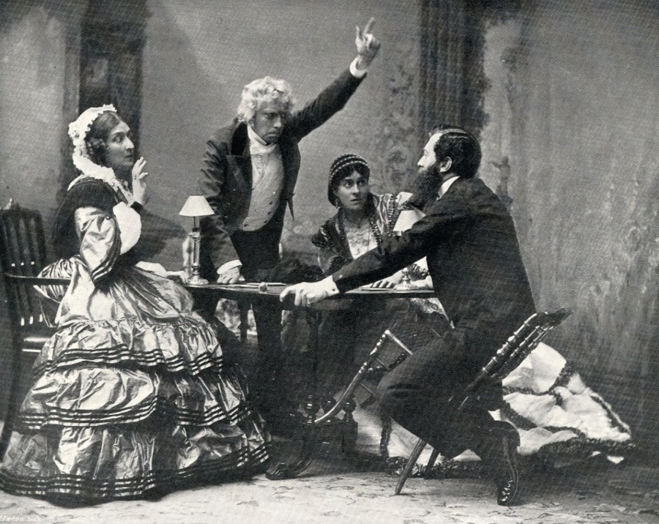
Types of Melodrama
Animals were used (along with the Romantic concept of nature):
Equestrian dramas:
Horses, often on treadmills – forerunners of the modern Western
Canine melodramas:
Like Lassie
Nautical melodramas:
Interest in the sea
Disaster melodramas

Slide 17
Melodramatic Writers
Melodramatic writers who formalized melodrama – in France:
August Friederich von Kotzebue (1761-1819)
German – wrote over 200 plays
Domestic melodramas
Treated common people with dignity
Often introduced controversial views without offending the audience, helping them to ask questions of life and society
Often called the "father of sensationalism" – he mixed sentimental philosophy with startling theatrical effects
René Charles Guilbert de Pixérécourt (1773-1844)
Wrote over 100 plays
Specialized in canine melodramas, disaster melodramas (floods, volcanoes, etc.)
Sometimes he "directed" his own plays
Plays had easily identified character types and startling theatrical effects that were more important than the dialogue.
In the United States:
Dion Boucicault (1822-1890)
The most successful English-language melodramas
Corsican Brothers (1852)
The Octoroon (1859)
Combined sentiment, wit, and local color with sensational and spectacular endings
He was the first in the U.S. to demand and receive royalties for performances of his plays
Instrumental in The International Copyright Agreement of 1886
His plays contained volcanoes, earthquakes, burning buildings, etc.

Slide 18
Who was August von Kotzebue?
According to Britannica.com:
August von Kotzebue, (born May 3, 1761, [Germany]—died March 23, 1819, Mannheim, Baden)
He was a German playwright widely influential in popularizing poetic drama, into which he instilled melodramatic sensationalism and sentimental philosophizing.
Kotzebue’s first comedy, written while he was a law student at Jena, gave him entrée into court literary circles in Weimar, but in 1781 he was forced to go into exile for a reason that is not clear.
Entering government service in Russia (1783), he became president of the magistracy of the province of Estonia in 1785 and was ennobled.
In 1801 he returned to Weimar, but he was not on good terms with Johann Wolfgang von Goethe or with the Romantics; he went back to Russia in 1806.
In 1817 he was again sent abroad by the emperor Alexander to report on current Western ideas in politics, finance, and education.
Execrated by political radicals as a spy in the pay of a reactionary power, Kotzebue was assassinated by Karl Sand, a member of a radical student association.
The assassin was executed and the universities placed under strict control as a result.
As a dramatist Kotzebue was creative (he wrote more than 200 plays) and superficial, but dramatically skillful.
He is at his best in such comedies as Der Wildfang (1798; “The Trapping of Game”) and Die deutschen Kleinstädter (1803; “The German Small-towner”), which contain admirable pictures of provincial German life.
He also wrote some novels as well as historical and autobiographical works.

Slide 19
Who was René Charles Guilbert de Pixérécourt?
According to Britannica.com:
Guilbert de Pixérécourt, (born Jan. 22, 1773, Nancy, France—died July 27, 1844, Nancy, France)
He was an astonishingly prolific dramatist who delighted popular audiences in Paris with a succession of more than a hundred plays during the first third of the 19th century.
These were performed in the théâtres des boulevards, which were patronized by a far less exclusive audience than those of the official theatres and were less bound by convention.
His greatest successes were melodramas
Victor (1798) and Coelina (1800)
These are plays full of exciting incidents and local colour, with comedy and pathos juxtaposed, which invariably end with virtue saved and vice punished.
Pixérécourt, who directed the production of his own plays, laid great stress on realistic scenery.
With his melodramas Pixérécourt started a theatrical tradition that survived throughout the 19th century.

Slide 20
The Most Successful and Popular Melodrama
Uncle Tom’s Cabin – the novel by Harriet Beecher Stowe (1852) had several dramatizations:
George L. Aiken’s was the most popular—1853
Six acts, done without an afterpiece – established the single-play format
325 performances in New York
In the 1870’s, at least 50 companies doing it in the U.S.
In 1899: 500 companies performing it
In 1927: 12 still doing it
12 movie versions since 1900
The most popular melodrama in the world until the First World War.

Slide 21
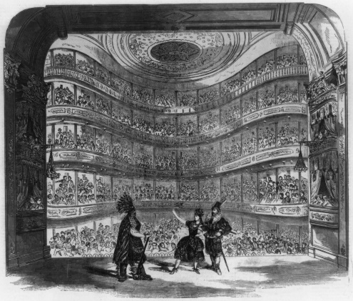
Other Popular 19th Century Theatrical Forms
Specialty acts:
Jugglers, tumblers, etc.
Pantomimes:
Elaborate tricks with scenery and costume
Short musical revues ("vaudevilles" in France) – topical
Comic operas – sentimental stories, original music
Revivals of Shakespeare
Usually Bowdlerized ("Bowdlerizing" a play – refers to deleting or changing parts of a script, removing socially "unacceptable" or sexually "offensive" parts of the script)
From Thomas Bowdler, who published the "Family Shakespeare," with sexual innuendo and reference left out, and turning sad endings into happy ones.
The well-made play: "piece bien-fait"
Eugène Scribe (1791-1861) (pronounced "Schreeb") – French – over 300 plays
His plays gave the appearance of having tightly woven plots unifies by causality, when in fact his plays had many lines of action unfolded by coincidence and chance.
But his influence on later writers was great—Ibsen in particular.

Slide 22
Who was Eugène Scribe?
According to Britannica.com:
Eugène Scribe, in full Augustin-Eugène Scribe (born Dec. 24, 1791, Paris, France—died Feb. 20, 1861, Paris, France)
He was a French dramatist whose works dominated the Parisian stage for more than 30 years.
Scribe began his career as a playwright by resurrecting the vaudeville, an obsolete form of short satirical comedy that used rhymed and sung couplets and featured musical interludes.
He soon began replacing its stock characters with ones drawn from contemporary society and introducing elements of the comedy of manners into his plays.
He eliminated the musical interludes altogether and expanded the elements of comic intrigue until his plays had become genuine comedies.
He went on to become one of the great masters of the neatly plotted, tightly constructed well-made play.

Slide 23
Major Trends in 19th Century Theatre
The typical producing organization was the resident company performing a large number of plays each season, till the end of the 19th century.
"Stock companies" – actors together played a wide variety of roles in many plays, usually with fixed salaries.
Some variations:
Visiting stars, touring companies, long runs
Exploitation of stars – the star system, after 1810, was popular.
English actors would tour with American companies as stars, perform famous roles with resident companies.
By 1850, the craze was universal.
Many stars made round-the-world tours.
This was helped by the Romanticist’s idea of individual genius, and better transportation (U.S. railroad system from coast to coast complete by 1870).
Stars received unfairly high salaries – one French actress made as much as France’s Prime Minister (imagine ACTORS getting that much money!).

Slide 24
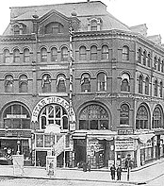
Major Trends in 19th Century Theatre
After 1850, the size of the repertory decreased as the length of the runs increased – took longer to recoup investment in the show
Wallock’s Theatre in New York had 60 plays per season in the mid 1850’s; only 5-10 by the 1880’s.
The repertory system finally fell when the long-term contract was deemed unfeasible, as some actors were idle during some shows; actors began to be employed only for the length of the play.
So, by 1900, the repertory system had all but disappeared in favor of the "single play, long run policy."
The number of plays and amount of theatrical activity increased, however.

Slide 25
Major Trends in 19th Century Theatre
With touring, came changes:
New York became the theatrical center
Actors went there to get hired, local managers would book events.
By the 1880’s, the booking system was chaotic, since managers had to negotiate with several producers – there were many defaults on contracts.
The Theatrical Syndicate was formed in 1896:
In effect, it was a monopoly, dominating American theatrical production from 1896 to 1915, placing commercial over artistic motives.
Other trends:
Theatres grew in size – this encouraged spectacle
After mid-1800’s, regular drama and specialty acts separated, and theatres specialized in one form of entertainment
The pit was renamed the orchestra and became the best seats

Slide 26
19th Century Staging
Increased interest in historical accuracy.
Expanded to interest in unusual or exotic; therefore, authentic folk dances and costumes and picturesque settings became to be on stage.
Charles Kemble’s production of Shakespeare’s King John (London, 1823) was the first to claim complete historical accuracy. By 1850, it was important everywhere.
Realism of spectacle led to the elimination of the wing and drop sets, and the development of the "box set," with three walls and perhaps a ceiling to represent interiors. It was not used consistently until the end of the 19th century.
This "realism" also led to the leveling of the stage floor, stagehands moving scenery manually (though grooves or chariot-and-pole systems were still used), revolving stages, elevators, rolling platforms, groundrows (cutaway flats), closed front curtain, acting upstage of the proscenium line (rather than on the apron), and the 4th wall convention was accepted more fully.
With the use of electric lighting, which illuminated much better, there was an increased need for greater scenic realism.
But the plays themselves were still romantic and melodramatic. The movement of Realism would shake things up a bit.

Slide 27
Works Cited
Barrère, J. (2017, July 20). Victor Hugo. Retrieved November 30, 2017, from https://www.britannica.com/biography/Victor-Hugo
The Editors of Encyclopædia Britannica. (2014, December 15). August von Kotzebue. Retrieved November 30, 2017, from https://www.britannica.com/biography/August-Friedrich-Ferdinand-von-Kotzebue
The Editors of Encyclopædia Britannica. (2016, January 04). Eugène Scribe. Retrieved November 30, 2017, from https://www.britannica.com/biography/Eugene-Scribe
The Editors of Encyclopædia Britannica. (1998, July 20). Guilbert de Pixérécourt. Retrieved November 30, 2017, from https://www.britannica.com/biography/Guilbert-de-Pixerecourt
Witte, W. (2017, November 15). Friedrich Schiller. Retrieved November 30, 2017, from https://www.britannica.com/biography/Friedrich-Schiller

