Slide 1
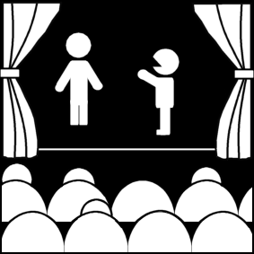
The Play and The Theatre
Week 4
[Part 1]
Introduction to Theatre
College of the Desert

Slide 2
First Critique Due – 9/13/22 A Doll’s House / Our Town
Critiques are expected to be AT LEAST FIVE (5) full double-spaced typewritten pages long. 1 inch margins, 12 pt. Time New Roman font.
Cite your sources APA style (go to “Son of Citation Machine” for help online with citing sources).
VERY IMPORTANT: DO NOT, I REPEAT NOT, GIVE A SYNOPSIS OF THE PLAY (A DESCRIPTION OF WHAT HAPPENS -- THE STORY, IF YOU WILL), EXCEPT FOR A VERY BRIEF ONE (ONE PARAGRAPH OR SHORTER). ASSUME YOUR READER IS FAMILIAR WITH THE PLAY. ANY ELEMENTS OF A SYNOPSIS SHOULD BE USED ONLY TO HELP SUPPORT / DEVELOP THE IDEAS YOU MENTION AS YOU ANALYZE THE PLAY / PRODUCTION.
YOUR CRITIQUE MUST BE AN ANALYSIS OF THE PLAY / PRODUCTION.
BE SURE TO BACK UP / SUPPORT / CLARIFY YOUR IDEAS WITH SPECIFIC EXAMPLES FROM THE PLAY.
Please make sure that you have one specific question you are trying to analyze and that it is clearly stated in your thesis statement.

Slide 3
First Critique Due – 9/13/22 A Doll’s House / Our Town
Do TWO of the following:
Describe and analyze the play's characters.
Are the characters clearly defined?
Are they realistic or symbolic?
Which characters are in conflict?
How do minor characters relate to major ones? Are they mirror images, contrasts, parallels?
Which characters are poorly presented? Are they incomplete, inconsistent, unbelievable?
Which characters did you identify most closely with? Why?
Describe and analyze the content and plot structure of the play.
Is the structure serious or comic? Realistic or fantastic? If serious, is it tragic or more down-to-earth? If comic, is it plain comedy or farcical.
Does it mix elements? Serious with comic, realistic with unrealistic?
Is the play written in climactic form, episodic form, or some other form?
What is the major conflict and its initiating incident?
Does the play have an early or a late point-of-attack?
How is precursor action made clear?
How are complications developed and how does the play resolve?
Describe and analyze the theme of the play.
What is the play about? Is it easy to understand or not?
Does the play present the subject clearly?
Does the playwright seem to have an opinion, or does the playwright appear neutral?
How is the theme brought about? Words? Actions? Symbols?
Is there more than one theme? Are they consistent with one another?

Slide 4
Types of Drama
Form / genre / types are intended to be categories that are not firm – there are endless sub-categories, and many plays will fit into a number of different categories simultaneously.
It can become dangerous to evaluate a play as one form, when it might not indeed fit that form.
Genre – French for "category" or "type" – means sharing a particular point of view/ forming a group.
Genre criticism – can show how a play does or does not fit into a particular category, but can also be useful as a way of examining the plays and discovering more about them – as a learning tool.
Such categories as "dramedy," "tragic farce," etc. have been used to show the merging of "types."
Shakespeare's Polonius in Hamlet ridiculed categorical obsessions:
"tragedy, comedy, history, pastoral, pastorical-comical, historical-pastoral, tragical-historical, tragical-comical-historical-pastoral." (Act II, scene ii).

Slide 5
Types of Drama
Reviewing what a Tragedy is:
Origins of Tragedy:
"tragos" + "oide" – goat song usually involves a calamity (death, etc.), but attention is focused on what reactions are to that calamity by the characters and what those reactions can tell us about life.
The "dithyramb" – hymns sung and danced in honor of Dionysus.
Tragedy is usually about the struggles of the "protagonist", moral issues, the effects of suffering.
Struggle is ethical, spiritual – protagonist’s integrity is tested.
Tragedy raises questions about the meaning of human existence, moral nature, and social / psychological relationships.
Evil often shown along with good, which does not always win.
Often seems inevitable and predetermined (we can look and decide for ourselves later).
Magnitude: characters have high stature – ethically superior but sufficiently imperfect
Modern tragedies – more common characteristics (Willy Loman in Death of a Salesman).
The Tragic Hero (protagonist) has a flaw in character or makes an error in judgment – "tragic flaw"
Universal human values – When a play touches something that is human in all of us and has lasting value through time

Slide 6
Types of Drama
Reviewing what a Tragedy is:
It is a play written in a serious, sometimes impressive or elevated style, in which things go wrong and cannot be set right except at great cost or sacrifice.
Aristotle said that tragedy should purge our emotions by evoking pity and fear (or compassion and awe) in us, the spectators.
The tragic pattern:
A theme of fatal passion (excluding love) as a primary motive
An outstanding personality as center of conflict (classical tragedy demanded a “noble” character)
A vital weakness within the hero’s character (his tragic flaw which precipitates the tragedy)
The conflict within the hero is the source of tragedy

Slide 7
Types of Drama
Comedy
Comedy is a play written in a caring or humorous tone, perhaps bitter or satiric, in which the problems or difficulties of the characters are resolved satisfactorily, if not for all characters, at least from the point of view of the audience.
Low characters as opposed to noble; characters not always changed by the action of the play; based upon observation of life.
Comedy and tragedy are concerned more with character, whereas farce and melodrama are concerned more with plot.
Henri Bergson "On Laughter“ said the comedy is "anesthesia of the heart" –audiences view comedy objectively
For example, the banana peel fall is funny, as long as it is not us and if not hurt (cartoons).
Aristotle's book of comedy, if there was one ever, is not existent. In tragedy, people are better than they really are; in comedy, people are worse that they really are.
Often: if a happy ending, therefore a comedy. A kind of catharsis through laughter and amusement – helps remind us of our frailties and helps keep us sane.

Slide 8
Types of Drama
Comedy – Characteristics
A way of looking at the world in which basic values are asserted but natural laws suspended – to underscore human follies and foolishness – sometimes hilarious.
Comedies have suspension of natural laws
There is a contrast between social order and individual
Comic premise:
The idea or concept that turns the accepted notion of things upside down and makes it the basis of the play – provides structural and thematic unity and can be a springboard for comic dialog, characters, and situations.
Involves exaggeration and incongruity and contradictions
Incongruity mean illogical, an out of place surprise.

Slide 9
Types of Drama
Comedy – Characteristics
Comic techniques:
Verbal humor
Puns
Malapropisms – misusing wrong words in such a way that they sound similar but usually are strikingly different from the word intended.
The television series, The Rugrats, for example, use a number of malapropisms:
Angelica said once that there was a "whole world to deplore" out there (the best are like this – the word sounds similar but means something strikingly different).
Justin Wilson, the "Cajun cook," was famous for his malapropisms: he called himself "a half-bleed Cajun" who "granulated high school."

Slide 11
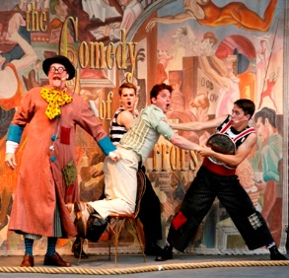
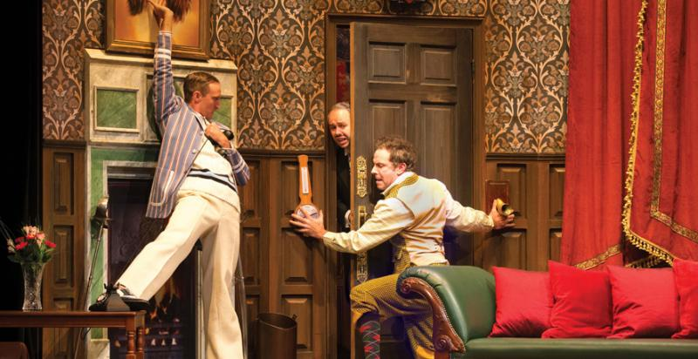
Types of Drama
Comedy – Characterizations
Incongruity between the way characters see themselves or pretend to be, as opposed to the way they really are
Complications – especially in farce
Coincidences:
Mistaken identities
For example, in the plays Comedy of Errors or The School for Scandal
Shakespeare – uses comedy in tragedy and tragedy in comedy and different kinds of comedies – difficult to categorize.

Slide 12
Kinds of Comedy: "High" and "Low"
Farce
Often considered a separate form
Often considered to be "low comedy" (versus "high comedy")
A comedy in which story, character, and especially situations are exaggerated to the point of improbability; the situation begins with a highly improbable premise, but when that is accepted everything that follows is completely logical.
Fast moving; uses such theatrical devices as duplications, reversals, repetitions, surprises, disguises, chance encounters, often many doors and closets.
Physical Comedy
“Slapstick" – physical action provokes the thought
Very high incongruity (surprise, something out of place or unexpected)
Comedy of situation, but extreme incongruity
Buffoonery, accidents, mistaken identities, ludicrous situations

Slide 13
Kinds of Comedy: "High" and "Low"
“Aside" (Sometimes referred to as breaking the proscenium or breaking the fourth wall, the term refers to a speech or comment made by an actor directly to the audience about the action of the play or another character. The audience is to understand that this comment is not heard or noticed by the other characters in the play)
For example, "take" (broad look at the audience and/or another character[s] in surprise, astonishment, disgust, etc.) or "mugging" (obviously playing to the audience, usually with broad facial expressions and movements)
Burlesques – lampooning other works of art, including theatre pieces
Satire – ridicule of public institutions and figures
Domestic Comedy – home and family life
Comedy of Manners / Wit
Similar to character and situation aristocratic and witty characters
Comedy of Ideas

Slide 14
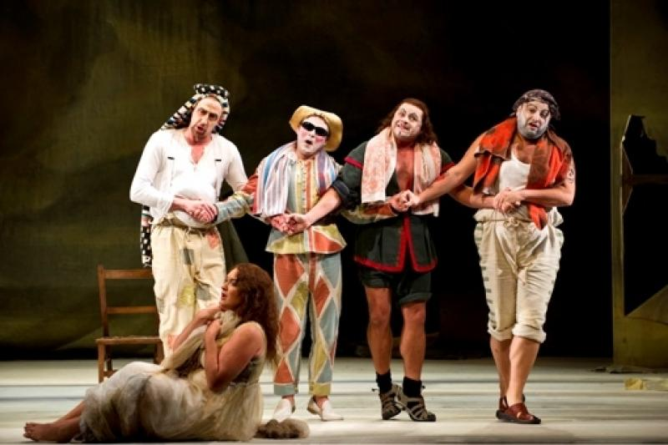
Types of Drama
Other Serious forms:
Heroic Drama
Retains parts of a tragedy
Has heroic or noble characters
Verse (heroic verse) – where the kind of drama got its name – heroic verse consists of "couplets" – two rhyming lines of iambic pentameter – and other elevated language
Extreme situations
But differs from tragedy because:
Usually has a happy ending
Generally, an optimistic view, even if ending is sad
Seriocomic Forms :
“Melodrama“
Comes from "Music drama"
Good and evil are most clearly defined – Evil is overcome by good
Entanglement of the protagonist in a series of circumstances threatening him or her; eventually rescued or escapes
Most television series
Many movies:
Wronged innocence is vindicated and evil chastised
Like tragedy – serious action
Like comedy – happy ending
A play in which the characters are types rather than individuals, the story and situations exaggerated to the point of improbability or sensationalism and the language and emotion over-emphasized

Slide 15
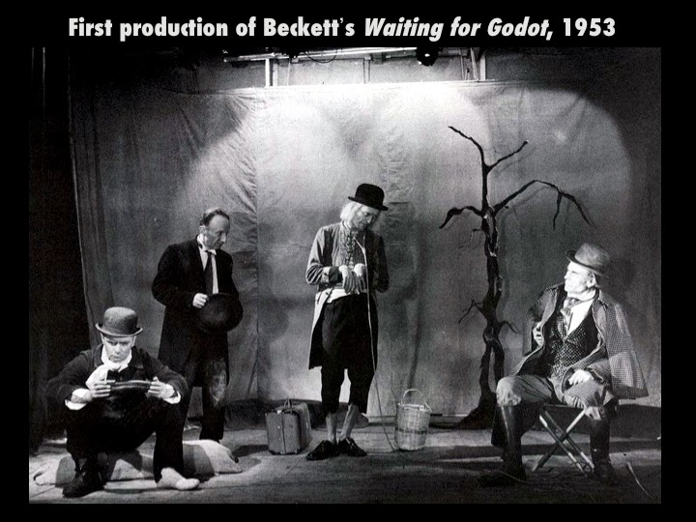
Types of Drama
Domestic Drama
Deals with "ordinary" people, from everyday life.
Has in the last 150 years replaced both classical tragedy and "heroic" drama as the predominant form of serious drama
Tragi-Comedy
A play with the sincerity and earnestness of tragedy but without its inevitability of impending disaster, and with the kindly and tolerant attitude of comedy but without its underlying spirit of humor; uses tense situations and moments of extreme conflict, but the tragedy is averted and transcended.
More complex than melodrama
Ends happily, but raises complex issues of love, friendship, cowardice, courage, and death; societal norms, morality concealed identities, misinformation, and coincidence, last-minute revelations.
Many modern plays called tragi-comedy
Able to send conflicting messages
Mixed Forms:
Mingling of forms
Expressionism
Theatre of the Absurd
Has been called comedy of menace – associated with Theatre of the Absurd
Theatre of Cruelty
The Epic Theatre of Bertolt Brecht
Vaudeville
Mime
Propaganda plays (or didactic drama)

Slide 16
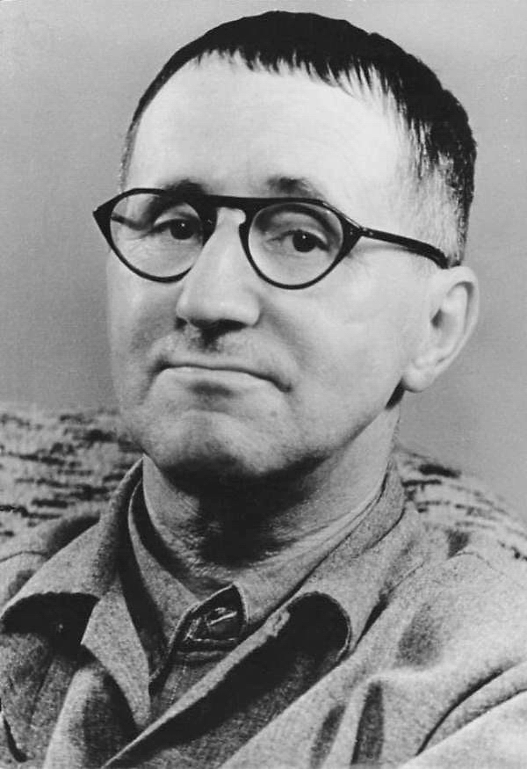
Who is Bertolt Brecht?
Brecht was a German poet, playwright, and theatrical reformer whose epic theatre departed from the conventions of theatrical illusion and developed the drama as a social and ideological forum for leftist causes.
He developed his theory of "epic theatre" and a serious form of irregular verse. He also became a Marxist.
A Marxist is a supporter of the political and economic theories of Karl Marx and Friedrich Engels
In Germany, his books were burned, and his citizenship was withdrawn. He was cut off from the German theatre; but between 1937 and 1941 he wrote most of his great plays, his major theoretical essays and dialogues.
His most famous plays are: 1941’s Mother Courage and Her Children, a chronicle play of the Thirty Years' War; 1957’s The Resistible Rise of Arturo Ui, a parable play of Hitler's rise to power set in prewar Chicago; and The Caucasian Chalk Circle (first produced in English in 1948), the story of a struggle for possession of a child between its aristocratic mother, who deserts it, and the servant girl who looks after it.
Brecht was, first, a superior poet, with a command of many styles and moods. As a playwright he was an intensive worker, a restless piecer-together of ideas not always his own (The Threepenny Opera is based on John Gay's Beggar's Opera). He was a man of rare musical and visual awareness; but he was often bad at creating living characters or at giving his plays tension and shape. As a producer he liked lightness, clarity, and firmly knotted narrative sequence; a perfectionist, he forced the German theatre, against its nature, to underplay. As a theoretician he made principles out of his preferences – and even out of his faults.

Slide 17
Who is Bertolt Brecht?
The essence of his theory of drama, as revealed in his work, is the idea that a truly Marxist drama must avoid the Aristotelian premise that the audience should be made to believe that what they are witnessing is happening here and now. For he saw that if the audience really felt that the emotions of heroes of the past – King Lear or Hamlet – could equally have been their own reactions, then the Marxist idea that human nature is not constant but a result of changing historical conditions would automatically be invalidated.
Brecht therefore argued that the theatre should not seek to make its audience believe in the presence of the characters on the stage – should not make it identify with them, but should rather follow the method of the epic poet's art, which is to make the audience realize that what it sees on the stage is merely an account of past events that it should watch with critical detachment.
Hence, the "epic" (narrative, nondramatic) theatre is based on detachment, on the alienation effect, achieved through a number of devices that remind the spectator that he is being presented with a demonstration of human behavior in scientific spirit rather than with an illusion of reality, in short, that the theatre is only a theatre and not the world itself.

Slide 18
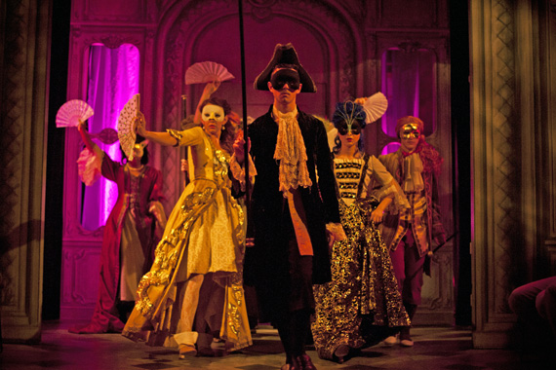
Style in Drama
Style: The distinguishing characteristics of a play that reflect conventional practice.
Styles are usually associated with a period or with an "-ism."
Some Examples:
Classicism
Neo-Classicism
Elizabethan
Restoration
Romanticism
Realism
Naturalism
Impressionism
Expressionism
Absurdism
Not only is genre studies concerned with the type / form of the play, but also with the style of the play.

Slide 19
Classicism
In regard to the arts, Classicism is an emulation of the arts of the ancient world, particularly of Greece and Rome.
It is an artistic genre that has been popular through many periods such as the Renaissance and Enlightenment eras.
Classicism, as an artistic influence, typically presents its classic ideals in art, literature, architecture, and music.
Artists began to emulate classical art in form, symmetry, balance, and an overall sense of order. Leading artists of Renaissance Classicism include Michelangelo.
Classical ideals were especially expressed during the Renaissance in sculpture, drawing, and painting.
The art of classicism typically seeks to be formal and restrained.
The classicism of the Renaissance lead to, and gave way to, a different sense of what was "classical" in the 16th and 17th centuries. In this period, Classicism took on more overtly structural overtones of orderliness, predictability, the use of geometry and grids, the importance of rigorous discipline and pedagogy, as well as the formation of schools of art and music.
This period sought the revival of classical art forms, including Greek drama and music.
Opera, in its modern European form, had its roots in attempts to recreate the combination of singing and dancing with theatre thought to be the Greek norm. Examples of this appeal to Classicism included Shakespeare in poetry and theatre.
Tudor drama, in particular, modeled itself after classical ideals and divided works into Tragedy and Comedy.
Studying ancient Greek became regarded as essential for a well-rounded education in the liberal arts.

Slide 20
Neo-Classicism
Neo-Classicism art originated in France during the late eighteenth century in response to the Baroque. The movement’s aim was to restore the ideals of ancient Greek and Roman art, so artists used classical methods to illustrate the virtues of courage, sacrifice and patriotism.
The Neo-Classicism art movement came about as a result of the Enlightenment, often referred to as the Age of Reason, when a large number of individuals began to think for themselves, outside of the restrictions imposed by religion and traditional authority. Literary leaders such as Voltaire began to use intellectual wit to mock vice and praise equality, diligence and sincere behavior.
What is important for you to know about the Neo-Classical period is that it was a time when the social order was undergoing great change. The middle class was rising in power and prestige. The creation of new wealth through trade was challenging established hierarchies.
Important works of literature of the time (including Moliere's play Tartuffe) used marriage as a trope for social obligations and social contracts. There was strong presumption that individuals would marry within their social class in order to form alliances and provide a stable framework for the passing down of wealth.

Slide 21
Elizabethan
The Elizabethan Theatre was a booming business. People loved the Theatre. The Elizabethan plays and theatres were as popular as the movies and cinemas of the early 20th century.
Before the 1500s there were no such thing as a theatre in England! There were wandering entertainers who travelled from one town and castle to the next, some street players who entertained people at markets and fairs. The entertainers were expected to memorize long poems and these recitals were included in their repertoire.
Many of the wandering entertainers, or strolling players, were viewed as vagabonds and had the reputation as thieves. The spread and frequent outbreaks of the Bubonic Plague, or Black Death during the Elizabethan era resulted in regulations restricting all people who travelled around the country – licenses were required to travel. This led to licenses for entertainers. Licenses were granted to the nobles of England for the maintenance of troupes of players.
The Elizabethan Acting Troupes were formed and the development of the Elizabethan Theatre moved on.
The Elizabethan Theatre started in the cobbled courtyards of Inns, or taverns – there were no Elizabethan Theatres until 1576 – plays were performed in the courtyards of inns – they were referred to as 'inn-yards‘. As many as 500 people would attend play performances. There was clearly some considerable profit to be made in theatrical productions.
James Burbage was an actor, who at one time would have played in the Inn-yards and, no doubt, negotiated a high price with the Inn keeper to perform on his premises. It was the idea of James Burbage to construct the first purpose-built Elizabethan theatre - it was called 'The Theatre'.
This type of Elizabethan Theatre was based on the style of the old Greek and Roman open-air amphitheaters. 'The Theatre' was to be the first of many – the Elizabethan Theatre had arrived! The Globe Theatre was constructed in this style. This type of Elizabethan Theatre could hold an audience of up to three thousand Elizabethans! The money started to roll in. However, the profits dropped in the winter as people would not venture to the cold open arenas of this massive open-air amphitheater style of architecture which was first favored in the Elizabethan Theatre. An indoor structure for an Elizabethan theatre was clearly required.
The development of the Elizabethan Theatre moved on to indoor theatres which were called Playhouses. The Elizabethan theatre style of the playhouses were therefore used for many winter productions. Many of the playhouses were converted from the old coaching inns or other existing buildings – all productions were staged in the comparative warmth of the indoor design of the Elizabethan Theatre.
Most people associated Elizabethan theatre with William Shakespeare and Christopher Marlowe.

Slide 22
Restoration
Restoration theatre was truly a unique era of plays and play writing.
When Charles Stuart was restored to the throne in 1660, theatres were reopened after an eighteen-year ban.
Restoration theatre became a way to celebrate the end of Puritan rule, with its strict moral codes.
To celebrate the opening of the theatres Restoration plays were lavish, often immoral by Puritan standards, and poked fun at both royalists and roundheads.
The lightheartedness of the plays reflected a society recovering from years of division and unrest.
Although the audience enjoyed tragedies, comedies were the hallmark of Restoration plays.
Restoration comedies involved quick wit and comedic situations.
Comedic plays relied on situational humor: disguises, mistaken identity, and misunderstandings which stems from deception and leads to confusion. The audience is aware of the trickery; whereas other characters are left in the dark, only to have all revealed in the end.
Restoration comedies also differed from their predecessors by using prose instead of the traditional heroic couplets. Restoration comedies became social commentaries; they were not a mirror of society, but rather exaggerations of society that the audience would recognize and appreciate. The typical audience was upper class, and one had to pay to see the plays since the playhouses were intimate.
One major factor in the success of Restoration theatre was the support of Charles II.

Slide 23
Romanticism
During the latter part of the eighteenth century the drama in France had steadily declined from the glorious position which it had achieved in the reign of Louis XIV.
The plays of the new style, vaguely called drames, were intended to be true to life and to teach the proper principles of society.
Only the drama could give a truly national character to the Romantic movement.
Artists of the Romantic era did not fully reject the Enlightenment interest in reason and social change, but they did place more emphasis on personal experience and irrational/emotional desires and beliefs.
Romantics did, on the other hand, reject Classicism, which emphasized restraint and Classical rules of harmony and form. Romantics preferred medieval architecture and folk tales rather than Roman and Greek ruins and myths.
Victor Hugo’s (1802–1885) preface to the play Cromwell (1827) is Romanticism’s manifesto and rejects the three unities required in Classical drama, instead asking for historically accurate stages and sublime and grotesque themes.
Romantics valued Shakespeare because he mixed high with low characters, comedy with tragedy, and fantastic events. William Shakespeare was, in a sense, one of the theatre first "romantic" playwrights. His plays posses many of the elements of romantic drama – A broad sweep of action, many short scenes, and a dedication to love and adventure.
Many Romantic dramas were not performed, being written for reading only, and form the most important dramatic genre of the period, known as closet dramas, e.g., Wordsworth’s The Borderers (1796) and Goethe’s Faust (1808).
Romantic drama is the theatre of the "long ago and far away." The audiences of the early 19th century wanted to escape the dull, petty frustrations of their lives.

Slide 24
Realism
Realism in the last half of the 19th century began as an experiment to make theater more useful to society. The mainstream theatre from 1859 to 1900 was still bound up in melodramas, spectacle plays (disasters, etc.), comic operas, and vaudevilles.
It holds the idea of the stage as an environment, rather than as an acting platform.
Characters are believable, everyday types.
Costumes are authentic.
The realist movement in the theatre and subsequent performance style have greatly influenced 20th century theatre and cinema and its effects are still being felt today.
Triggered by Stanislavski’s system of realistic acting at the turn of the 20th century, America grabbed hold of its own brand of this performance style (American realism) and acting (method acting) in the 1930s, 40s and 50s (The Group Theatre and The Actors Studio).
Stage settings (locations) and props are often indoors and believable.
The ‘box set’ is normally used for realistic dramas on stage, consisting of three walls and an invisible ‘fourth wall’ facing the audience.
Settings for realistic plays are often bland (deliberately ordinary), dialogue is not heightened for effect, but that of everyday speech (vernacular).
The drama is typically psychologically driven, where the plot is secondary and primary focus is placed on the interior lives of characters, their motives, the reactions of others etc.
Realistic plays often see the protagonist (main character) rise up against the odds to assert him/herself against an injustice of some kind (E.g., Nora in Ibsen’s A Doll’s House).
Realistic dramas quickly gained popularity because the everyday person in the audience could identify with the situations and characters on stage
Norwegian playwright Henrik Ibsen (A Doll’s House, Hedda Gabler) is considered the father of modern realism in the theatre.

Slide 25
Naturalism
In terms of style, Naturalism is an extreme or heightened form of realism.
As a theatrical movement and performance style, naturalism was short-lived.
Stage time equals real time – E.g., three hours in the theatre equals three hours for the characters in the world of the play – Marsha Norman’s play ‘Night, Mother does this.
Costumes, sets and props are historically accurate and very detailed, attempting to offer a photographic reproduction of reality (‘slice of life’).
As with realism, settings for naturalistic dramas are often bland and ordinary.
Naturalistic dramas normally follow rules set out by the Greek philosopher Aristotle, known as ‘the three unities’ (of time, place and action).
The action of the play takes place in a single location over the time frame of a single day.
Jumps in time and/or place between acts or scenes is not allowed.
Naturalism explores the concept of scientific determinism (spawning from Charles Darwin’s theory of evolution) – characters in the play are shaped by their circumstances and controlled by external forces such as hereditary or their social and economic environment.
Often characters in naturalistic plays are considered victims of their own circumstance and this is why they behave in certain ways (they are seen as helpless products of their environment).
Characters are often working class/lower class (as opposed to the mostly middle-class characters of realistic dramas).
Naturalistic plays regularly explore disgusting subject matter previously considered taboo on the stage in any serious manner (e.g. suicide, poverty, prostitution).

Slide 26
Impressionism
Impressionism affirmed the beauty of everyday reality and simple, democratic motifs and sought vivid authenticity in artistic representation.
Impressionism imparted aesthetic significance to contemporary life in its natural state, in all the richness and glitter of its colors, capturing the visible world with its inherent changeableness and reconstituting the unity between man and his surroundings.
In theater at the turn of the century, the attention of directors and performers was increasingly focused on the problem of conveying the atmosphere of the action, the mood of a given scene, and the unveiling of its concealed meaning. Thus, the authentic feeling and richness of life were conveyed by means of intentionally fleeting references combined with vividly expressive details that disclosed the shaded feelings of the hero, his thoughts, and the impulses behind his actions.
Sudden changes in rhythm sound effects, and bright, colored sets and costumes were used by directors to create in the performance a certain emotional saturation, which uncovers the internal growth of dramatic tension hidden in routine existence.
The expressive means of Impressionism were applied in productions by the Moscow Art Theater (for example, productions of Chekhov’s plays).

Slide 27
Expressionism
Its atmosphere was often vividly dreamlike and nightmarish. The mood was aided by shadowy, unrealistic lighting and visual distortions in the set. A characteristic use of pause and silence, carefully placed in counterpoint with speech and held for an abnormal length of time, also contributed to the dream effect. Settings are virtually abstract and un-localized, and the scene frequently appears angular and distorted, suggesting a bad dream. The properties are few and symbolic.
Settings avoided reproducing the detail of Naturalistic drama, and created only those starkly simplified images the theme of the play called for. The decor was often made up of bizarre shapes and sensational colors.
The plot and structure of the play tended to be disjointed and broken into episodes, incidents and tableaux, each making a point of its own. Instead of the dramatic conflict of the well-made play, the emphasis was on a sequence of dramatic statements made by the dreamer, usually the author himself. From this structure, grew Brecht’s epic theatre.
The action of the play is still broken into episodes, and these may represent stages in the hero’s life, or a sequence of visions as seen through his subconscious mind, as in a dream play.
Characters lost their individuality and were merely identified by nameless designations, like The Man, The Father, The Son – such characteristics were stereotypes and caricatures rather than individual personalities, and represented social groups rather than particular people – they could appear grotesque and unreal.
The characters for the most part remain nameless and impersonal, often moving grotesquely. They always represent some general class or attitude, their characteristics being emphasized by costume, masks or make-up.
The dialogue, unlike conversation, was poetical. The dialogue is increasingly clipped, fragmented and unreal. It became known as ‘telegram style’.
The style of acting was a deliberate departure from the realism of Stanislavsky. Moreover, in avoiding the detail of human behavior, a player might appear to be overacting, and adopting the broad, mechanical movements of a puppet. Actors might erupt in sudden passion and attack each other physically. Speech was rapid, breathless and staccato, with gesture and movement urgent and energetic

Slide 28
Absurdism
'The Theatre of the Absurd' is a term coined by the critic Martin Esslin for the work of a number of playwrights, mostly written in the 1950s and 1960s.
The term is derived from an essay by the French philosopher Albert Camus. In his 'Myth of Sisyphus', written in 1942, he first defined the human situation as basically meaningless and absurd.
The origins of the Theatre of the Absurd are rooted in the avant-garde experiments in art of the 1920s and 1930s. At the same time, it was undoubtedly strongly influenced by the traumatic experience of the horrors of the Second World War, which showed the total impermanence of any values shook the validity of any conventions and highlighted the precariousness of human life and its fundamental meaninglessness and arbitrariness. The trauma of living from 1945 under threat of nuclear annihilation also seems to have been an important factor in the rise of the new theatre.
Life is essentially meaningless, hence miserable.
Reality is unbearable unless relieved by dreams and illusions.
Man is fascinated by death which permanently replaces dreams and illusions.
There is no action or plot. Very little happens because nothing meaningful can happen.
The final situation is absurd or comic.
Absurd drama is not purposeful and specific as it solves no problem. It is like an abstract painting which is supposed not to convey a definite meaning.
The Absurd Theatre hopes to achieve this by shocking man out of an existence that has become trite, mechanical and complacent.

Slide 29
Works Cited
Ahmed, A. (n.d.). Basic Concept of the Theatre of the Absurd. Retrieved September 05, 2017, from http://www.academia.edu/4752768/Basic_Concept_of_the_Theatre_of_the_Absurd
Beal, V. (2017, February 27). BWW Review: THE PLAY THAT GOES WRONG at Comedy Theatre. Retrieved August 31, 2018, from https://www.broadwayworld.com/australia-melbourne/article/BWW-Review-THE-PLAY-THAT-GOES-WRONG-at-Comedy-Theatre-20170227
Cash, J. (n.d.). Realism and Naturalism Theatre Conventions. Retrieved September 05, 2017, from http://www.thedramateacher.com/realism-and-naturalism-theatre-conventions/
Classicism. (n.d.). Retrieved September 05, 2017, from http://theatreforall.weebly.com/classicism.html
Encyclopaedia Britannica, Inc. “Brecht, Bertolt.” Bertolt Brecht, 1995, www.cs.brandeis.edu/~jamesf/goodwoman/brecht_bio.html. Accessed 5 Sept. 2017.

Slide 30
Works Cited
Gianni, D. (1970, January 01). Theatre in Europe After World War II: I - France and Germany. Retrieved August 31, 2018, from http://heironimohrkach.blogspot.com/2014/01/theatre-in-europe-after-world-war-ii-i.html
Heine, M. (2015, September 29). Politisch inkorrekt: Bertolt Brecht war schlimmer als Thilo Sarrazin - WELT. Retrieved September 4, 2018, from https://www.welt.de/kultur/buehne-konzert/article125384495/Bertolt-Brecht-war-schlimmer-als-Thilo-Sarrazin.html
Johnson, L. (2013, July 30). Chicago Shakespeare returns Bard to parks with merry madness of 'Comedy of Errors'. Retrieved August 31, 2018, from https://chicagoontheaisle.com/2013/07/27/preview-of-chicago-shakespeare-theater-free-summer-parks-tour-of-the-comedy-of-errors/
Kristy Ferreira and Shanna O’Berry. (n.d.). Restoration Theatre. Retrieved September 05, 2017, from http://www.london.umb.edu/index.php/entry_detail/restoration_theatre/theatre_intro/
Malapropism (noun). (n.d.). Retrieved August 31, 2017, from https://iwastesomuchtime.com/75259
Stewart, Z. (2012, December 10). Restoration Comedy. Retrieved September 4, 2018, from https://www.theatermania.com/new-york-city-theater/reviews/restoration-comedy_63925.html
W.W. Norton and Company, Inc. (n.d.). The Norton Shakespeare. Retrieved September 05, 2017, from http://www.wwnorton.com/college/english/nadrama/content/review/shorthistory/19c-present/romanticism.aspx

