Slide 1
The Playwright and the Play
Week 5
[Part 1]
Introduction to Theatre
College of the Desert

Slide 2
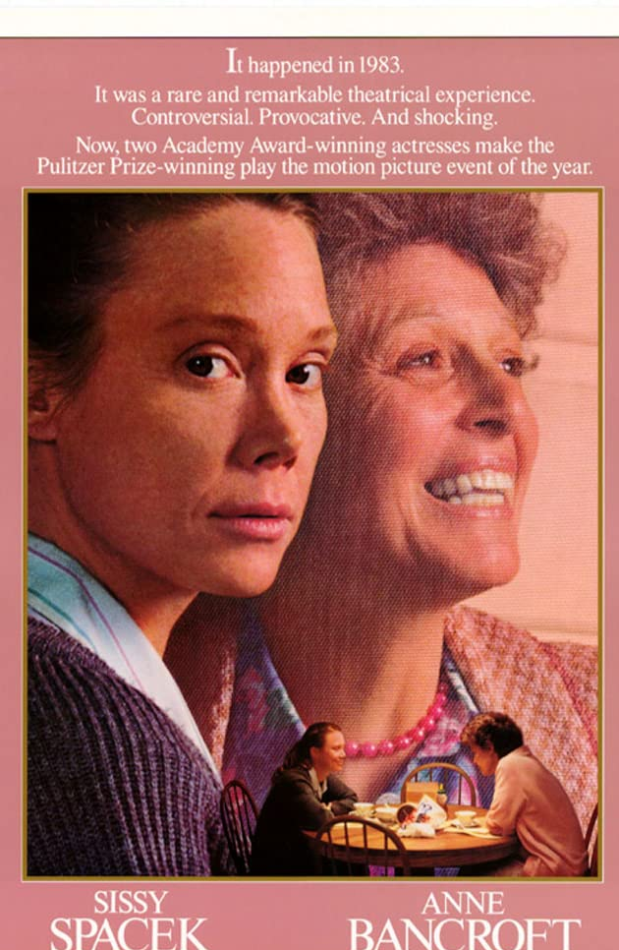
General Information about the Play
Marsha Norman’s first play, ‘Night, Mother, opened on Broadway in March of 1982.
It was awarded the Pulitzer Prize for drama in 1983.
Written in 1981, ’night, Mother was produced by Robert Brustein at the American Repertory Theatre in Cambridge, Massachusetts, in 1982.
The play later moved to the John Golden Theatre on Broadway, where it ran for ten months to mostly favorable reviews.
In 1983, Marsha Norman was awarded the Susan Smith Blackburn Prize, given annually to a female playwright from an English-speaking country. The drama later played regional repertory theaters and has appeared widely in colleges.
‘Night, Mother was made into a film in 1986 starring Sissy Spacek and Anne Bancroft. It was directed by Tom Moore who had also directed the play on Broadway.

Slide 3
General Information about the Play
’Night, Mother is a tightly crafted drama.
Norman wants to create real people, yet she divorces them from any set environment. The house where the drama takes place should not show any character traits. It is neither messy nor quaint. The town is not to be associated with any regional locale or accent.
The play holds to the classical unities:
There are only two characters, fixed in one location.
Narrative time is synchronized to performance time so that all the clocks on stage start at 8:15 p.m., or curtain time, and run throughout the performance.
There are no breaks or intermissions.
The drama, which moves swiftly and inevitably toward the climax, is based on the unraveling of past events.

Slide 4
General Information about the Play
The play depicts women’s lives as hopeless and futile.
The two women in the drama undergo an emotional revelation, but little is done to change their lives.
Much of what they do emphasizes the deadly routine of women’s lives, but little is done to affect a revolution.
Many of the women’s problems surround their relations with absent men—fathers, husbands, sons, and brothers.
There are no act divisions, intervals, scene changes, or other lapses of time to interrupt the tense mood.
The audience feels the tension early in the play, when Jessie, asked by Mama why she is cleaning her father’s old revolver, offhandedly replies that she intends to kill herself.
To this point, the conversation has seemed ordinary and even trivial, though it is immediately clear how different these women are.

Slide 5
Who is Marsha Norman?
Marsha Norman was born in Louisville, Kentucky in 1947.
As a child, she played the piano, read books, and attended the theater.
She worked for WHAS television in the summers and saw Tennessee Williams’s The Glass Menagerie at Actors Theatre of Louisville.
She received her bachelor’s degree in humanities from University of Louisville (UofL) in 1969.
Norman began to work as a journalist after graduation, writing articles and reviews of books, plays, and films for the Louisville Times.
She also wrote for Kentucky Educational Television.
In 1971, she received her Masters in Teaching from the University of Louisville.
Norman taught in Jefferson County Public Schools from 1970 to 1973 and worked for the Kentucky Arts Commission from 1973-1976.
By 1976, Ms. Norman had turned to full-time playwriting.
Norman’s first play, Getting Out (1977), was inspired by her work at Central State Hospital, while she was getting her Master’s Degree at UofL.
After the success of this play, Norman moved to New York City. In 1982, she wrote ‘night, Mother, which won the Pulitzer Prize the following year.
Four years later she published her first novel, The Fortune Teller in 1988.
In 1991, she wrote the book and lyrics for The Secret Garden, a Broadway musical for which she won a Tony Award.
She also wrote the book and lyrics for The Red Shoes and the libretto for the musical The Color Purple.
She has written extensively for television and film, most recently American Girl: Samantha, The Audrey Hepburn Story, and Law and Order: Criminal Intent.
She is the Vice-President of the Dramatists Guild of America, and with Christopher Durang, the co-chair of the Playwriting Program at the Juilliard School.

Slide 6
Who is Marsha Norman?
None of Marsha Norman’s plays display any regionalism or mannered characterization. All of her plays portray essentially simple people facing some moment of overwhelming crisis.
Norman’s gift for portraying American life resembles that of Arthur Miller (Death of a Salesman), though without political overtones.
She writes psychological portraits, as does Tennessee Williams (Cat on a Hot Tin Roof). Her tense style resembles that of Samuel Beckett (Waiting for Godot), but her plays are entirely realistic, classified as Naturalism.

Slide 7
Quick Summary of the Play
On a seemingly normal evening, we meet Thelma Cates (Mama), an aging mother and widow who lives with her daughter, Jessie.
Jessie is the divorced mother of a hoodlum son, who - unsatisfied and depressed - struggles with life as an unemployed epileptic.
On this night, Jessie comes into the room asking her mother about the whereabouts of her father’s old revolver.
When Jessie finds it in the attic, she confesses to her mother that she is going to kill herself. Tonight.
At first, Mama laughs it off, thinking Jessie is just making a sick joke. But, as Jessie makes her way around the house, organizing, making lists, and teaching Mama her responsibilities, it soon becomes clear that it is not.
As Mama pleads for Jessie to reconsider her decision, old secrets are revealed and long-ignored feelings rise to the surface.
The mother-daughter bond between Jessie and Mama becomes stronger and lovelier than ever, making it possible for Jessie to end her noisy, cluttered existence, and enter a quieter, calmer life with closure and love.

Slide 8
Discussion Topics
Who is the “real” mother in ‘Night, Mother? Is it Jessie or Mama?
The emptiness of her life is an oppressive force for Jessie. Discuss the issue of alienation and isolation that defines Jessie's life.
In ‘Night, Mother Jessie identifies herself in relationship to her father, husband, son, and especially her mother; she appears to have no identity of her own. How has Jessie struggled to create an identity separate from these family members. Is suicide the only means available to her?
The play ‘Night, Mother addresses the human condition and how character human depth influences the way readers understand drama. The invisible characters play a large part on how the two main character’s act, and how it influences their dialogue. The father, the son of Jessie, and her ex-husband are mentioned throughout the play, and they set up the dynamics of the story, physically and emotionally. How do these invisible characters play a role in the play and how does their role affect Jessie and Mama?
How much control should a person have over his/her destiny?
What gives meaning to our lives?
What preparations has Jesse been making for her suicide? Why has she been so careful in her planning? Why did she wait until this particular time to commit suicide?

Slide 9
Does this play glorify suicide?
According to Jessie, it is better to exchange a disastrously frustrated life with the redemptive joy and worth of suicide.
To Jessie, suicide might have emerged worthwhile because her present life with a trademark of pointlessness was sterile and worthless.
The significant factor of 'night, Mother is not the event of Jessie's suicide but Jessie's planning and preparation for suicide in a casual manner.
She not only prepares for suicide, but discusses with her mother, Thelma, about her seriously and thoughtfully developed desire to commit suicide.
By dramatizing Jessie's cool style of discussing suicide Marsha Norman has not tried to defend a right to suicide in the wake of utter pointlessness and frustration in life. Nor does the playwright intend to vindicate Jessie's act of suicide.
Still Marsha Norman has not asserted a defeated and frustrated woman's right to give appropriate destination for her shipwrecked life.
Jessie's life was shipwrecked. Her life became an oven of frustration and breeding ground of pointlessness. To bring the shipwrecked life of her to the destination she chooses suicide.
What do you guys think? Does ‘Night, Mother glorify suicide? How is this different than 13 Reasons Why?

Slide 10
Suicide Statistics
Do you think Jessie’s location played a role in her decision?

Slide 11
Facts About Suicide
Men are four times more likely than woman to die by suicide, but women try to commit suicide twice as often as men (they're just unsuccessful).
Such attempts are often viewed as a "cry for help" rather than an actual attempt to end the person's life.
Guns are the most commonly-used method for committing suicide.
Using a gun to kill oneself accounted for nearly 60 percent of suicides in 1996.
Attempted Suicides
No national surveillance data on attempted suicide are available; however, reliable scientific research has found that:
There are an estimated eight to 25 attempted suicides to one completion; the ratio is higher in women and youth and lower in men and the elderly.
The strongest risk factors for attempted suicide in adults are depression, alcohol abuse, cocaine use, and separation or divorce.
The strongest risk factors for attempted suicide in youth are depression, alcohol or other drug use disorder, and aggressive or disruptive behaviors.
The majority of suicide attempts are expressions of extreme distress that need to be addressed, and not just a harmless bid for attention.
A suicidal person should not be left alone and needs immediate mental health treatment.
Discussion:
Do you think Thelma failed Jessie by not calling for help?
Do you think Jessie needed psychological help or was suicide her only way to be at peace?

Slide 12
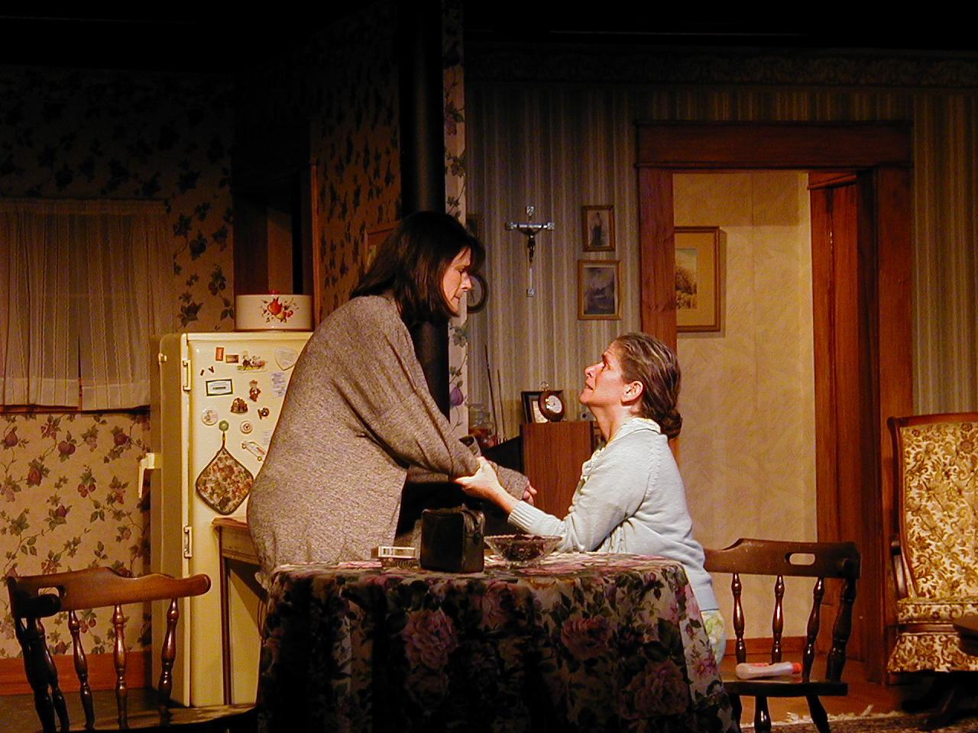
Main Themes of the Play
Communication
Mother-Daughter Relationship
Suffering
Suicide
Family
Complex morality
Food

Slide 13
Looking at the Play a little Deeper
Marsha Norman’s ’night, Mother is a play about most people’s inability to communicate meaningfully, even when an obvious crisis requires it.
Suicide is merely the catalyst that forces Jessie and Mama to talk with one another.
It seems that Mama, at least at first, considers it a considerable sacrifice when she volunteers not to watch television that evening. It is no surprise, then, that the two women learn more about each other in less than two hours than they had in a lifetime of living together.
The previous lack of communication between the two is perhaps the major theme of the play.
It is ironic that a woman who talks as much as Thelma has neglected to say so many truly meaningful things.
Jessie has never asked questions, shared her opinions, or chosen to talk to anyone except her father. When Thelma asks what the two of them whispered about, Jessie replies that they were discussing important things such as why black socks are warmer than blue socks. Jessie has been very secure with her father’s habit of just sitting, of being quiet, and of not doing anything; Thelma has never understood it. In making strings of paper “boyfriends” and animals for Jessie, her father has given her the only memory of her childhood that she seems to value.

Slide 14
Looking at the Play a little Deeper
Jessie never sees that her father’s withdrawals might have indicated a medical condition similar to her own.
Mama remains childlike to the end; her wants are all sense-related and can be satisfied by eating a cupcake, watching television, or opening a trinket from the grab bag Jessie has left for her. There is no indication that Mama feels any guilt for Jessie’s death or that she will assume some new maturity.
In this reversal of roles, the child, Jessie, becomes her mother’s guardian, but only long enough to make sure that all is in order. Jessie rises to a certain nobility, but its only lasting effect is self-destruction.
Some might consider that the playwright, Norman, suggests that suicide is an acceptable alternative to living a life one considers intolerable, but Jessie’s view is not necessarily that of the playwright. Norman does not take an authorial point of view at all; she simply allows the women of her play to speak frankly.
The result is that ’night, Mother is a tragedy only in the sense that its characters have missed a lifetime of opportunities to understand each other and reach only a limited mutual insight in Jessie’s final hours.
Unlike characters in classical tragedy, neither realizes the full extent of their loss.

Slide 15
Looking at the Play a little Deeper
A critical issue in 'night, Mother is the relationship between Jessie and her mother, Thelma.
It is evident in Jessie's preparations for her suicide that she regards herself as her mother's primary caretaker. Jessie is responsible for her mother's diet, for the maintenance of the home, and for her mother's health, or so Thelma lets her believe.
In assuming so much control over her mother, Jessie has reversed the mother-daughter relationship and has become a mother to her own mother.
In deciding that she will kill herself, Jessie is finally establishing an identity of her own and setting a boundary between them that her mother cannot cross.
When Jessie announces her decision to kill herself at the end of the evening, she sets in motion a series of events that must end with her death; there is never any doubt that Jessie will die at the play's conclusion because it is necessary for her to die to free herself.
The choice she makes is one that only she can make; her mother has no say in the matter.
Their dialogue establishes that this may have been the first significant decision Jessie has ever made independent of her mother.

Slide 16
Looking at the Play a little Deeper
Jessie has always been bound to her mother.
She left her mother's home to marry the man her mother selected for her, and, when that marriage failed, she returned home to her mother. And with the example of her parent's unhappy and uncommunicative marriage before her, Jessie accepted that a retreat to her mother's house was her only option.
According to developmental psychology, adult maturation is partially achieved through a separation from parental figures, as a person acquires independence and the ability to make independent decisions.
This maturation process has been lacking in Jessie's life. She has been sheltered and protected, kept isolated in her mother's home, and closeted with only her family to provide socialization.
Consequently, a complete break from her family is the only option if Jessie is to become an individual; the tragedy of this play is that for Jessie suicide is the only avenue to this independence.
Discussion
Do you think people must leave their parent’s house to become an independent individual? What if they are paying their parents rent and going to college? Are they still independent?

Slide 17
Looking at the Play a little Deeper
The isolation of an existence without friends and a lack of the socialization that accompanies the emotional and physical growth of most young women is an important feature of Jessie's loneliness.
The emptiness of her life is the primary reason for her decision to kill herself.
Thelma recognizes and understands Jessie's isolation. She has lived a long time with solitude. Any thought that her daughter would provide companionship evaporated when Jessie demonstrated that she preferred the company of her silent father; but since Jessie, too, has a susceptibility for silence, it is unlikely that Jessie could ever have provided Thelma with a substantial form of companionship.
Instead of conversation, Thelma has satisfied her social needs and combated her loneliness with needlepoint, junk food, and candy. But for Jessie, the craving for something more in her life cannot be satisfied with food or cross-stitching.
Turn to page 76. What was Jessie reason for why she had no other choice?
Like many people who commit suicide, Jessie Cates sees this as the only option left to her; it is the only way to cancel a life filled with hopelessness, helplessness, and emptiness. Jessie Cates had struggled throughout her life with depression, seizures, memory loss, abandonment, a forced marriage and a controlling mother. She knew no other world, enslaved to these conditions of her existence and base of familiarity. Her concept of time was blurred.
The play is a convincing critique of the myth of the failed American dream. The American women's dream was to be happy and comfortable with marital life. This dream shattered to the effect that the frustrated victims of the dream had to choose suicide as a measure to the liberation.

Slide 18
Looking at the Play a little Deeper
‘Night, Mother is full of food imagery and references. From the opening stage directions to Jessie’s constant kitchen chores, food is intertwined in every moment of the play.
Norman’s food references serve to show what is missing in the lives of Jessie and her mother Thelma and the ways they fill these holes with food.
Jessie and Thelma have different strategies for this substitution, one creating through consumption, the other through preparation, but with close analysis through the lens of food advertising and psychological associations with food, love is found to be the driving motivation behind these preoccupations with food.
Thelma has a big appetite for sweets. This is apparent from the opening scene of the play. The stage directions read: “Mama hums a tune as she stretches to reach the cupcakes in a cabinet in the kitchen. She can’t see them, but she can feel around for them, and she’s eager to have one, so she’s working pretty hard at it. This may be the most serious exercise Mama ever gets” (Norman 5).
Jessie’s conversations with Thelma lead to the understanding that candy and sweets are a large part of Thelma’s diet.
After Jessie has confessed her intentions to commit suicide, she goes about doing chores to keep Mama’s sweets stocked after she’s gone. Throughout the night, Jessie refills both the honey and sugar jar, replenishes the candy bowls, and cleans the empty papers out of Thelma’s box of chocolates.
Sweets for Thelma are a replacement for love.
Laura Morrow in her article “Orality and Identity in ‘night Mother and Crimes of the Heart” (1988) says, “Sweets are for [Thelma] a happy substitute for genuine human interaction; they provide Mama with the sensual gratification and the sense of fullness she failed to obtain from her marriage.”
Thelma’s constant consumption of sugary treats can be interpreted as an attempt to solve her feelings of discontent. She latches on to the idea suggested by Jessie that she make hot chocolate and caramel apples. This is another attempt to change Jessie’s mind about suicide.
If Thelma could just get Jessie to feel the same sense of love from food that she does, maybe she could save her.

Slide 19
Looking at the Play a little Deeper
Jessie’s attitude towards food in the play is very different from her mother’s.
Jessie only consumes a single taste of hot chocolate over the course of the entire play.
This is clearly shown in Jessie’s line: “It was maybe, if there was something I really liked, like maybe if I really liked rice pudding or cornflakes for breakfast or something, that might be enough” (Norman). But Jessie cannot find that passion for food, or for anything in fact.
The only thing Jessie does show some liking for is smoking. She claims Cecil left her for refusing to quit and describes her relationships with cigarettes thus: “Smoking is the only thing I know that’s always just what you think it’s going to be. Just like it was the last time and right there when you want it and real quiet” (Norman). Smoking is Jessie’s food replacement.
This is a very purposeful choice made by Norman, because smoking is highly destructive, yet it is this what Jessie finds solace in.
Laura Morrow relates Jessie’s cigarette addiction to her use of the gun as well: “Norman here invokes the traditional metaphorical fusion of gun, cigarette, and phallus as symbols of personal power.” It is the power that Jessie gets out of smoking that she really appreciates the most.
The gun also serves as an symbol of food replacement. When Thelma asks Jessie where she got the bullets from, Jessie replies, “Feed store Dawson told me about” (Norman). She’s not getting feed from the feed store, rather something destructive and powerful—things that are much more important to her.

Slide 20
Looking at the Play a little Deeper
For Thelma, the emptiness is caused by a husband who wouldn’t speak to her and who she didn’t love.
For Jessie, it is her family’s destruction and her failure to find a love for anything besides smoking.
The shared rejection of the nutrient-packed milk of the hot chocolate and the realization that she doesn’t really have anything to sustain her life any more than Jessie does, is what leads to Thelma’s painful understanding of Jessie’s need to commit suicide.

Slide 21
Second Critique Due – 9/27/22 Night, Mother
Critiques are expected to be AT LEAST FIVE (5) full double-spaced typewritten pages long. 1 inch margins, 12 pt. Time New Roman font.
Cite your sources APA style (go to “Son of Citation Machine” for help online with citing sources).
VERY IMPORTANT: DO NOT, I REPEAT NOT, GIVE A SYNOPSIS OF THE PLAY (A DESCRIPTION OF WHAT HAPPENS -- THE STORY, IF YOU WILL), EXCEPT FOR A VERY BRIEF ONE (ONE PARAGRAPH OR SHORTER). ASSUME YOUR READER IS FAMILIAR WITH THE PLAY. ANY ELEMENTS OF A SYNOPSIS SHOULD BE USED ONLY TO HELP SUPPORT / DEVELOP THE IDEAS YOU MENTION AS YOU ANALYZE THE PLAY / PRODUCTION.
YOUR CRITIQUE MUST BE AN ANALYSIS OF THE PLAY / PRODUCTION.
BE SURE TO BACK UP / SUPPORT / CLARIFY YOUR IDEAS WITH SPECIFIC EXAMPLES FROM THE PLAY.
Please make sure that you have one specific question you are trying to analyze and that it is clearly stated in your thesis statement.

Slide 22
Second Critique Due – 9/27/22 Night, Mother
Do TWO of the following:
Describe and analyze the play's characters.
Are the characters clearly defined?
Are they realistic or symbolic?
Which characters are in conflict?
How do minor characters relate to major ones? Are they mirror images, contrasts, parallels?
Which characters are poorly presented? Are they incomplete, inconsistent, unbelievable?
Which characters did you identify most closely with? Why?
Describe and analyze the content and plot structure of the play.
Is the structure serious or comic? Realistic or fantastic? If serious, is it tragic or more down-to-earth? If comic, is it plain comedy or farcical.
Does it mix elements? Serious with comic, realistic with unrealistic?
Is the play written in climactic form, episodic form, or some other form?
What is the major conflict and its initiating incident?
Does the play have an early or a late point-of-attack?
How is precursor action made clear?
How are complications developed and how does the play resolve?
Describe and analyze the theme of the play.
What is the play about? Is it easy to understand or not?
Does the play present the subject clearly?
Does the playwright seem to have an opinion, or does the playwright appear neutral?
How is the theme brought about? Words? Actions? Symbols?
Is there more than one theme? Are they consistent with one another?

Slide 23
‘Night, Mother Essay Questions
You are not limited to these topics; these questions are only for inspiration, but you may use them for your essays:
What purpose do the minor characters serve in 'Night, Mother?
What is the playwright's intention in ‘Night, Mother?
Has Jessie ever had independence?
What is the relationship like between Jessie and her mother?
Do you think Jessie did the right thing by taking her own life?
How do Jessie and Thelma view life?

Slide 24
Works Cited
Grohol, J. M., Dr. (2005, April 4). Facts about Suicide. Retrieved September 11, 2018, from https://psychcentral.com/library/suicide_facts.htm
Kaplon, M. P. (2012, June 01). Food, Love and Death in Norman's "'night Mother". Retrieved September 08, 2017, from http://www.inquiriesjournal.com/articles/653/food-love-and-death-in-normans-night-mother
Males, M. (2018, February 02). The truth about teen suicide. Retrieved September 11, 2018, from https://washingtonmonthly.com/2018/01/30/the-truth-about-teen-suicide/

