Slide 1
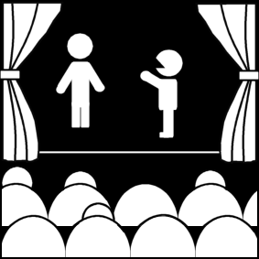
The Renaissance and Spanish Theatre
Week 11
[Part 1]
Introduction to Theatre
College of the Desert

Slide 2
The Renaissance
Around 1300 (had beginnings in 1200’s) the Renaissance was founded primarily in Italy
Renaissance means rebirth
There were new ideas, based on classical teachings
By the 16th century, the Renaissance had saturated most of European thought
Influences on the Renaissance:
Weakening Church influence
In 1405, Constantinople (present-day Turkey) fell to the Turks.
Scholars fled West with valuable manuscripts, including some Greek dramas
1465 – the Printing Press invented – the Bible and some manuscripts were printed
By 1467-1470, the printing press and printed manuscripts get to Italy, and classical plays become staged at Universities and Courts or Academies (club-like learning organizations).
Manuscripts also dealt with ancient architecture, Aristotle’s works, Horace, etc.
In Italy, the nobility patronized the arts; playwrights were then often under noble patronage
The Major Renaissance contributions to the Theatre:
1. Neoclassical ideal in playwriting and criticism
2. Italianate staging and architecture
3. Commedia dell’Arte

Slide 3
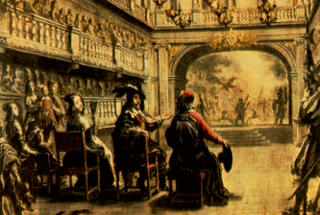
Neoclassicism: "New Classicism”
Interest in the ancient "rediscovered" classics – based more on Roman (where Italy now stood) than on Greek
Central concepts of neoclassicism:
Verisimilitude
“Truth seeming" – what is truth?
In drama – could represent only what could be reasonably expected in real life
Decorum
Characters were expected to display traits normally held by members of their class, or to suffer ridicule or punishment if not
Good was to be rewarded, and evil punished – there was an eternal truth
Purity of Genres
Comedy and tragedy were not to be mixed – NO element of one should be in the other
Tragedy was to have:
Characters of high station
Deal with affairs of state
Have elevated language
Have an unhappy ending
Comedy was to have:
Lower and middle-class characters
Deal with domestic affairs
Use less elevated language
Have a happy ending
Therefore: the prose tragedy or domestic tragedy was unacceptable

Slide 4
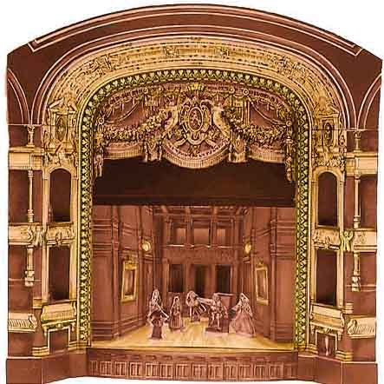
Neoclassicism: "New Classicism”
Neoclassicism focused on:
Unity of Time:
Required a reasonable time
No more than 24 hours
Actual Time
Unity of Place:
No more than one room, place, or a town [or country, etc.]
Unity of Action:
No sub-plots, counter-plots, secondary plots
Not as important an influence as the other two unities
Five act form
Two-fold purpose:
To teach and to please
Moral Rules:
A justification for theatre – partly in order to appease those who still thought theatre was immoral [such as the Church], theatre took on an very important societal function—to teach as well. Not just an art form. Perhaps Plato would have approved.
By 1600, Renaissance thought had moved to other parts of Europe
Remained dominant for over 200 years, especially among upper classes.

Slide 5
Italianate Staging
Involved a mixture of ideas (like neoclassicism) of classical Rome and present-day Italy
1486 – Virtuvius’s De Architectura (16-13 B.C.) was printed and published.
Ten volumes, one of them on theatre buildings and scenic displays
1500 – Perspective was "rediscovered" – had been known to the ancients
1545 – Sabastiano Serlio – Dell’Architettura – an interpretation of Vitruvius
He set guidelines for theatres and design – tried to fit classical theatre (circular and outdoors) into indoor theatres, able to use perspective
1585 – Teatro Olimpico – in Vicenza, Italy.
The oldest surviving Renaissance theatre
1618 – Teatro Farnese – in Parma
The first theatre built with a permanent proscenium arch – it protected the illusion of perspective
Additional arches were farther back to add depth

Slide 6
Italianate Staging
Italianate staging in the 16th, 17th, and 18th centuries:
Single-point perspective, calculated from the back of the house
Scenery – consisted of a series of wings / flats
Scenery was behind the proscenium arch – a background for action
“Raked" stage – higher in back (UP-stage), tilting down to the front (DOWN-stage)
Used to increase the sense of depth – although sometimes the acting area was level
Overhead rigging and machinery – hidden by border flats
Proscenium arch, or several, made for a framed picture
Elongated U-shaped auditorium
Boxes in tiers around walls (usually 2 or more)
Undivided gallery above top row (for servants / lower classes)
Central floor space (orchestra or pit) was not a popular place for the elite until the late 19th century, and some theatres had no seats till the late 18th century
Spectators could stand and move about—for fashionable young men and would-be critics – middle-classes. Priced less than boxes but more than the gallery.

Slide 7
[Review] Who was Sabastiano Serlio?
1475–1554, Italian Renaissance architect and scenic designer of the 16th century
He designed 3-dimensional scenery
His book, Architettura, was the first Renaissance work on architecture to devote a section to the theatre. It also incorporated his theories on perspective, the art of representing three-dimensional objects on a flat surface.
His many articles included illustrations of the tragic, comic and satyric stages, based on Vitruvius’s innovative ideas regarding the vanishing point.
He was also the first to employ the term “scenography,” and to make extensive use of the scenic space and lighting to give the impression of depth.
He did not limit himself to the painted backdrop, which was so popular at the time.
With his technical innovations, Sebastiano Serlio had a profound impact on the theatrical architecture of his age.
With his ideas and innovations, Serlio gave the Italian Renaissance the bridge it needed to start building its own theatres and expanding drama to the people of the period.
He blended the idea of the true classical theatre with the art of the Renaissance and birthed central perspective into theatre. With that, he is able to transcend centuries as we are still using conventions engineered by him in productions today.
Serlio's contribution to theatre of his time has transcended the centuries and affects us today.
Serlio used a raked stage. This added to the visual effect of creating a centralized perspective. It made everything upstage look like it was farther away than it really was because it was getting smaller.
Serlio also used a series of wings to further draw the eye into the illusion. Usually, three sets of wings were used. Each pair was set in farther than the last. These began at the point on the stage where the actors did not perform. These wings not only added to the central perspective idea, they also allowed areas for the scenery and machines used for the spectacle in the intermezzi to be hidden.

Slide 8
Italian Artificial Lighting
Candles and oil lamps were used
Chandeliers were used over the house and stage
Candles were used behind proscenium arch and as footlights and behind the wings
Little effective control, though "dimmers" were used
To perfect this system, Italian artists tried new ways to shift the scenery
Used mostly in public opera houses, which had opened in Venice in 1637
In other words, Italianate stage occurred primarily in the theatres doing plays that were not neoclassical
Serlio wanted three-dimensional sets – hard to shift – so it was changed to two-dimensional
Pageant wagons were used for carrying portable things
By 1550, periaktoi (triangular "flats") were used for changing wings
Nicola Sabbattini (1574-1654) in 1638 published a Manual for constructing theatrical scenes and machines. Angle wings were replaced with flat wings and suggested ways of shifting scenery.

Slide 9
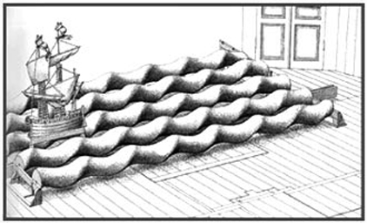
[Review] Who was Nicola Sabbatini?
Born in 1574 in Italy—died December 25, 1654 in Italy
He was an Italian architect and engineer who pioneered in theatrical perspective techniques.
In his major and most-enduring written work, Pratica di fabricar scene e macchine ne’ teatri (1638; “Manual for Constructing Scenes and Machines in the Theatre”), Sabbatini described contemporary theatrical techniques, including those used for stage lighting.
He demonstrated, for instance, how a bank of stage lights could be illuminated or dimmed simultaneously and discussed proper light positioning.
Among his other devices were the sliding of wings and scenery on grooves in the floor and methods of simulating fire and waves.
Although most of the stage machinery described by Sabbatini was probably not of his invention, the Pratica remains a comprehensive documentation of practical stagecraft of the Renaissance. Its influence was considerable during the 17th century and beyond.

Slide 10
The Chariot-and-Pole System
Giacomo Torelli in 1645 came up with a new innovation in all of Europe except England: The Chariot-and-Pole System
Chariots or wagons on tracks – below the stage
Poles came up through slots cut parallel to the front of the stage
Scenery and wings and backs attached to poles
A system of ropes and pulleys helped get a simultaneous shift of scenery
Groove system – in England after 1640
Grooves in the floor and pieces of wood overhead
Italianate Special Effects:
Neoclassicism in drama still wanted little attention to the supernatural, so dramas were done with few special effects
Operas (which had become popular in Italy), intermezzi (short courtly shows given between acts of dramas), and lavish dances had extravagant special effects:
Trap doors, scenes shifted with no curtain

Slide 12
Who was Giacomo Torelli?
According to Britannica.com:
Giacomo Torelli, also called Jacopo was born Sept. 1, 1608 —died June 17, 1678
He was an Italian stage designer and engineer whose innovative theatre machinery provided the basis for many modern stage devices
Nothing is known of Torelli’s early life.
In 1641 he was a military engineer at Venice.
Already known as an architect, he built two churches there.
Having erected the Teatro Novissimo at Venice, he furnished it with ingenious machines, including a revolving stage and the chariot-and-pole system for changing scenery.
His inventions amazed 17th-century Europe and earned for him the title il gran stregone (“the great wizard”).
He was called to France in 1645.
There Torelli equipped the Théâtre du Petit-Bourbon in Paris with numerous devices such as the first effective machinery for rapid changes of heavy sets, which greatly encouraged the development of elaborate stage effects.
Torelli later returned to Italy (c. 1662) and built an elaborately equipped theatre at Fano.
His successor at the Petit-Bourbon, Gaspare Vigarani, destroyed his sets, apparently out of jealousy, but the designs for them were reproduced in the Encyclopédie (1751–72) of French philosopher Denis Diderot.

Slide 13
Commedia dell’Arte
Came into prominence in Italy after 1550
By the end of the 1500’s, there were troupes in other parts of Europe; by the 17th century, in all of Europe
But it diminished after 1750 and was "dead" by 1800
Played to all kinds of audiences in all kinds of places
The basic story was described in a scenario – almost 800 still survive, but there is still no clear picture of the quality of the performances, although accounts say the performers were skilled
Never achieved international prominence
The scenario was improvised, with stock characters and proven comic routines or comic bits were used
A stock character is a stereotypical person whom audiences readily recognize from frequent recurrences in a particular literary tradition. Stock characters are archetypal characters distinguished by their flatness; as a result, they tend to be easy targets for parody and to be criticized as clichés.

Slide 14
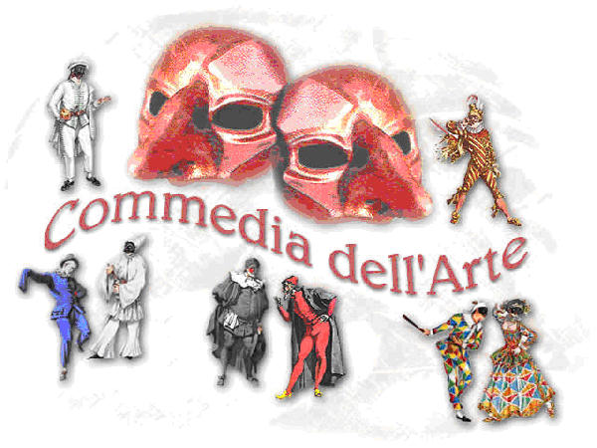
Commedia dell’Arte
Types of Characters seen in Commedia Dell’Arte:
Pantalone – the old man, a fool
Dottore – the doctor, a drunk or glutton
Capitano – braggart soldier
Inamorati – the young lovers – the only "normal" characters
“Zanni" -- foolish servants
Harlequin (or Arlecchino) was the most popular
By 1750, Italian theatre was no longer in prominence, except for the opera
France and England became the prominent forces for world theatre
Video of Commedia dell’Arte:
The World of Commedia dell'Arte
https://youtu.be/h_0TAXWt8hY

Slide 15
The Golden Age of Spanish Theatre
The Output of the Golden Age of Spanish Theatre was from the 1500s – 1700s
By 1700, 30,000 plays were written
In quantity and vigor, the Spanish theatre was equal to England’s between 1585 and 1642
Spanish drama flourished in the 16th and 17th centuries, like England, but came form different influences:
Catholicism was able to become secure in Spain while religious infighting was rampant in the rest of Europe:
Ferdinand and Isabella, after 1479, were able to unite much of Spain by establishing the Inquisition to hunt down and punish heretics, expel Moors and Jews—Catholicism became secure
Influences of Spanish drama:
Moorish influence:
Women and honor
The Moors are Muslims who travelled all over Europe, and eventually Spain. They called Spain Al Andalus, meaning “Land of the Vandals”. The Vencians, Greeks and Romans conquered Spain hundreds of years before the Moors
Christian influence:
Religious faith and doctrine
Spain was a dominant power by 1550, but after the defeat of the Spanish Armada in 1588, its influence and power declined

Slide 16
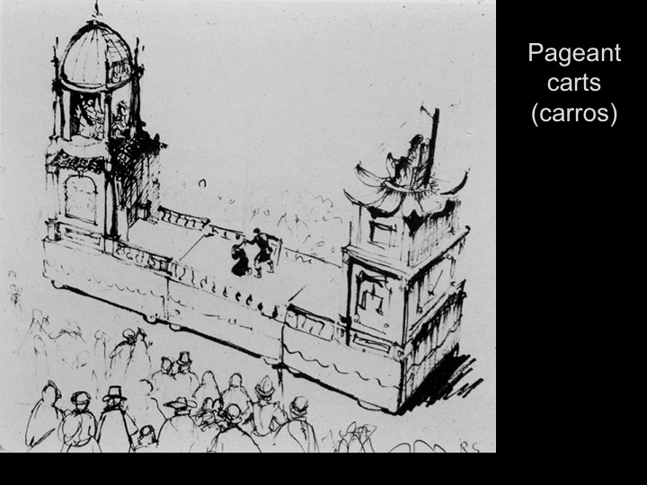
Spanish Religious Drama
Extensive in the North Eastern areas because the Moorish influence was less there.
As Moors were expelled, religious drama expanded
The term "Moors" refers primarily to the Muslim inhabitants of Spain
It was similar to much of the rest of Europe till 1550, then took on distinctive characteristics
Auto sacramentale – associate with Corpus Christi – the sacraments – combined characteristics of morality and cycle plays, human mixed with allegorical, drawn from many sources as long as it illustrated dogma
Dogma is a principle or set of principles laid down by an authority as unquestionably true
Trade guilds were responsible for the productions, but professional troupes took over by the mid-1500’s. But they were still religious.
Toured neighboring towns
Usually done on wagons or carros.
First 2, then 4.
They were wooden frames covered with painted canvas
By the 1690’s, they were 16 feet long by 36 feet tall
Similar to the English pageant wagon staging
By 1647, fixed platforms were also used
Performed first in front of churches, then courtyards, then streets; no evidence that they were ever performed in the church itself
The autos were forbidden in 1765 – called too carnival in spirit.
Some of the farces and dances elements considered objectionable.
Also, having the plays performed by possibly immoral actors was objectionable.
However, the autos were an adjunct for professional acting for 200 years

Slide 17
Spanish Secular Drama
1450-1550
Spain and Italy were close, they both had an interest in classical learning
In 1508, a University was founded, which studied Greek, Latin, Hebrew, classical dramas
Many works were translated
Some secular works written, but not widely performed
By 1454, many actors were paid at Corpus Christi, and by 1550 there were a number of professional troupes
Lope de Rueda (c. 1510-1565), often called the father of Spanish professional theatre (but was probably just the most successful), toured widely, wrote plays resembling medieval farces. There were not yet any permanent Spanish theatres.
Juan de la Cueva (1550-1610) – used Spanish history and classical themes as subjects.
Miguel de Cervantes (1547-1616) [Don Quixote]– 36 plays about contemporary Spanish life, but came to be seen as overformal after the plays of de Vega
By the end of the 16th century – full-length plays, serious or comic, 3 acts (the 5-act form was never adopted in Spain).

Slide 18
Who was Lope de Rueda?
According to Britannica.com:
Lope de Rueda was born 1510 in Sevilla, Spain—died in 1565
Outstanding figure of the early Spanish theatre who did much to popularize it and prepared the way for Lope de Vega
A gold-beater by trade, Rueda was probably attracted to the stage by touring Italian actors
He organized a traveling theatre company and as its author, or author-manager, took his troupe throughout Spain.
He became popular and played before all kinds of audiences, from Philip II to crowds of rural townfolk.
His work was seen by Cervantes, who praised him both as an actor and as a writer of verse.
His most important contributions to early Spanish drama are the pasos, comic representations drawn from the events of daily life and intended to be used as humorous relief between the acts of longer works or even incorporated into them as amusing interludes. Written in prose, they brought to the stage a natural language spoken by conventional figures such as the simpleton and the master.
His longer works, the comedias Medora, Armelina, Eufemia, and Los engañados and the dialogues Camila, Tymbira, and Prendas de amor, derive directly from Italian comedy.

Slide 19
Who was Juan de la Cueva?
According to Britannica.com:
Juan de la Cueva, in full Juan de la Cueva de Garoza was born in 1550 in Sevilla [Spain]—died in 1610, Sevilla.
He was a Spanish dramatist and poet, one of the earliest Spanish writers to depart from classical forms and use national historical subjects.
Cueva differed from his contemporaries in having his plays published, thus transmitting to posterity intact examples of early, mediocre, Spanish drama.
Cueva was particularly skilled at adapting medieval Spanish legends and ballads
His Tragedia de los siete infantes de Lara (1588; “Tragedy of the Seven Princes of Lara”) and La muerte del rey don Sancho (1588; “The Death of King Don Sancho”) were later used by Lope de Vega and the Romantic novelists.
Other important plays by Cueva include the mythological farces El saco de Roma y muerte de Borbón (“The Sacking of Rome and the Death of [the Duke of] Bourbon”) and El infamador (1581; “The Slanderer”).

Slide 20
Who was Miguel de Cervantes?
According to Britannica.com:
Miguel de Cervantes, in full Miguel de Cervantes Saavedra was born September 29th, 1547 in Spain—died April 22, 1616 in Madrid, Spain.
He was a Spanish novelist, playwright, and poet, the creator of Don Quixote (1605, 1615) and the most important and celebrated figure in Spanish literature.
His novel Don Quixote has been translated, in full or in part, into more than 60 languages.
Cervantes was a great experimenter.
He tried his hand in all the major literary genres except the epic.
He was a notable short-story writer, and a few of those in his collection of Novelas exemplares (1613; Exemplary Stories) attain a level close to that of Don Quixote, on a miniature scale.
Translated almost immediately into English, French, and Italian, Don Quixote was viewed primarily as a comic work or a satire of Spanish customs. Ironically, it was the German Romantics, selectively reading Don Quixote as a tragic hero, who granted his author world standing.

Slide 21
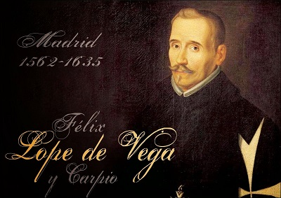
The Two Major Playwrights
The first was also the most prolific playwright:
Lope Félix de Vega Carpia [known as Lope de Vega] (1562-1635)
He was a member of the Armada
He was a secretary to noblemen
Had many love affairs
Was a priest after 1614
By 1609 he had written 483 comedies (he claimed) – some estimate 1800 plays.
450 have survived, some written in a few days.
By the end of his life, it was rumored that he wrote 2 plays per week.
General characteristics of de Vega’s plays:
Clearly defined actions, arousing suspense, dealing with conflicting claims of love and honor
Happy resolved endings
Characters representing every rank and condition of people
Female roles were among his best
Extended the simpleton character (gracioso)
Natural and lively dialog – MANY FORMS USED - Spanish equivalent of blank verse
Lope de Vega was never ranked with Shakespeare – never penetrated deeply into human life, the darker side glossed over
Lope de Vega was the most popular playwright of his time, though there were many minor playwrights

Slide 22
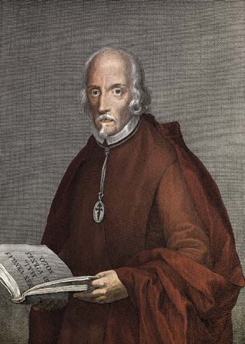
The Two Major Playwrights
The second major Spanish playwright was:
Pedro Calderón de la Barca [known as Calderón] (1600-1681)
Challenged de Vega’s superiority
Wrote primarily for the court theatres rather than public theatres (many see this shift to court theatres leading to the decline of Spanish theatre after 1650)
Son of a court official
University-educated
Entered the service of a nobleman
Became a priest after 1651
**Both major playwrights becoming priests later in life—Catholicism, remember, was strong influence
Approximately 200 plays, 100 survived
His best secular plays came between 1622 and 1640.
Two categories:
Cape and sword – capa y espada
Revolving around men of minor rank -- dealing with intrigues and misunderstandings
Serious
Dealing with jealousy and honor
His most famous play is Life is a Dream (c. 1636)
The play is about philosophical allegory about the human situation and the mystery of life
Calderón’s secular plays were usually short and light, based on classical myth—with choral passages, much of the dialog set to music
In his autos, he embodied Catholic dogma in symbolic stories, using lyrical dialogue
Again, Spanish influence declined, including theatrical influence, after 1700, and had almost no influence on the world’s theatre

Slide 23
Work Cited
Cruz, A. J., & Riley, E. C. (2016, June 20). Miguel de Cervantes. Retrieved November 02, 2017, from https://www.britannica.com/biography/Miguel-de-Cervantes
The Editors of Encyclopædia Britannica. “Giacomo Torelli.” Encyclopædia Britannica, Encyclopædia Britannica, inc., 14 Feb. 2008, www.britannica.com/biography/Giacomo-Torelli.
The Editors of Encyclopædia Britannica. (2007, October 11). Juan de la Cueva. Retrieved November 02, 2017, from https://www.britannica.com/biography/Juan-de-la-Cueva-de-Garoza
The Editors of Encyclopædia Britannica. (2013, August 25). Lope de Rueda. Retrieved November 02, 2017, from https://www.britannica.com/biography/Lope-de-Rueda

