Slide 1
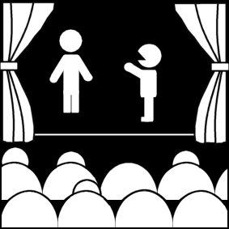
The Theatre Environment Society, Critic, and the Theatre
Week 3
[Part 3]
Introduction to Theatre
College of the Desert

Slide 2
What is Plot?
Plot – the arrangement of the parts – the arrangement of events or the selection and order of scenes in a play.
Plot is different from the story – the story is WHAT happens; the plot is HOW it happens.
A story is a full account of an event or series of events, usually in chronological order; a plot is a selection and arrangement of scenes.
Aristotle, in The Poetics, said that plot is the soul of tragedy:
It holds story together contains the incidents in the play, produces tragic effects, has the most tragic element (reversals, discoveries).

Slide 3
Elements of Plot
Exposition
Exposition is important information that the audience needs to know in order to follow the main story line of the play.
It is the aspects of the story that the audience may hear about but that they will not witness in actual scenes. It encompasses the past actions of the characters before the play’s opening scenes progress.
Exposition
Everything the audience needs to know to understand the play. [Can occur throughout the play...]
What is the "precursor action" (everything that has happened before the play begins)? and how is it revealed?
What is the "point of attack" – (where does the play begin in relation to the story?) Is it an early or late point of attack?

Slide 4
Elements of Plot
Rising Action
Rising action is the section of the plot beginning with the point of attack and/or inciting incident and proceeding forward to the crisis onto the climax.
The action of the play will rise as it set up a situation of increasing intensity and anticipation.
These scenes make up the body of the play and usually create a sense of continuous mounting suspense in the audience.
The point of attack is the moment of the play at which the main action of the plot begins.
This may occur in the first scene, or it may occur after several scenes of exposition.
The point of attack is the main action by which all others will arise. It is the point at which the main complication is introduced.
Point of attack can sometimes work hand in hand with a play’s inciting incident, which is the first incident leading to the rising action of the play.
Sometimes the inciting incident is an event that occurred somewhere in the character’s past and is revealed to the audience through exposition.

Slide 5
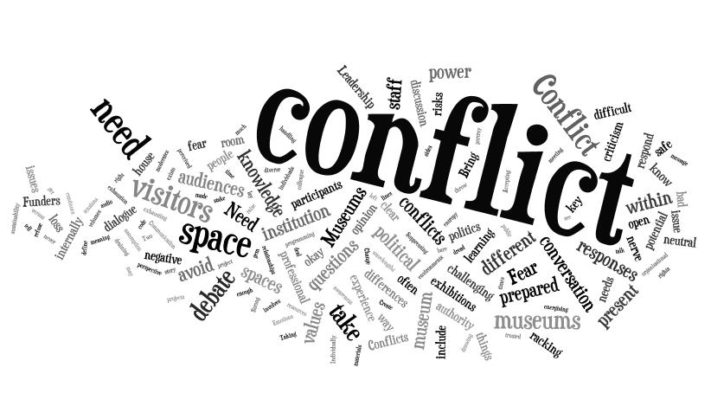
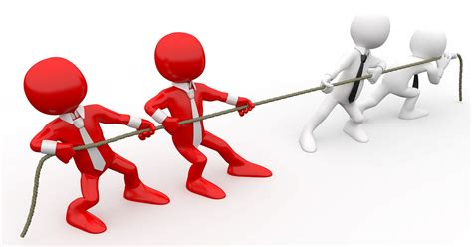
Elements of Plot
Conflict
The clash of opposing forces:
man vs. self, vs. man, vs. environment, vs. natural forces, vs. group, vs. God
Or group vs. group
"Inciting incident" (or "initiating incident"):
The event that occurs in the play to begin the conflict. The inciting/initiating incident of the play must occur within the play itself.

Slide 6
Elements of Plot
Climax
The point at which one or the other of the forces is favored; the point at which events must turn in one direction or another.
Not necessarily the "high point."
All of the earlier scenes and actions in a play will build technically to the highest level of dramatic intensity.
This section of the play is generally referred to as the moment of the plays climax.
This is the moment where the major dramatic questions rise to the highest level, the mystery hits the unraveling point, and the culprits are revealed.
This should be the point of the highest stage of dramatic intensity in the action of the play.
The whole combined actions of the play generally lead up to this moment.

Slide 7
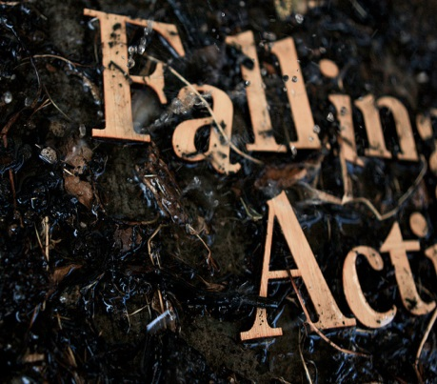
Elements of Plot
Falling Action
Resolution / Denouement – whatever comes after the climax.
Not always resolved satisfactorily: the "deus ex machina":: -- "god of the machine" – a contrived or unrealistic or unbelievable ending / resolution.
The resolution is the moment of the play in which the conflicts are resolved.
It is the solution to the conflict in the play, the answer to the mystery, and the clearing up of the final details.
This is the scene that answers the questions raised earlier in the play.
In this scene the methods and motives are revealed to the audience.

Slide 8
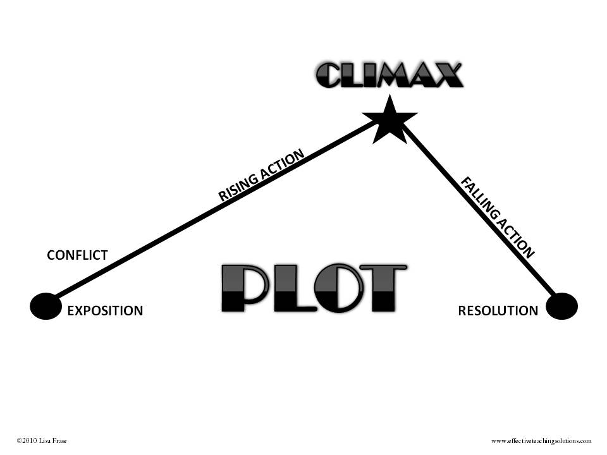
Elements of Plot

Slide 9
Categories of Plot Structure
Climatic Structure
I. Plot begins late in story, closer to the very end or climax
II. Covers a short space of time, perhaps a few hours, or at most a few days
III. Contains a few solid, extended scenes, such as three acts with each act comprising one long scene
IV. Occurs in a restricted locale, one room or one house
V. Number of characters is severely limited, usually not more than six or eight
VI. Plot in linear and moves in a single line with few subplots or counter plots
VII. Line of action proceeds in a cause-and-effect chain. The characters and events are closely linked in a sequence of logical, almost inevitable development

Slide 10
Categories of Plot Structure
Episodic Structure
I. Plot begins relatively early in the story and moves through a series of episodes
II. Covers a longer period of time: weeks, months, and sometimes years
III. Many short, fragmented scenes; sometimes an alternation of short and long scenes
IV. May range over an entire city or even several countries
V. Profusion of characters, sometimes several dozen
VI. Frequently marked by several threads of action, such as two parallel plots, or scenes of comic relief in a serous play
VII. Scenes are juxtaposed tone to one another. An event may result from several causes, or no apparent cause, but arises in a network or web of circumstances

Slide 11
Outline of Playwriting
Along with the basic understanding of these basic components of plot, the playwright must take the aspects of unity into great consideration.
At the center of every play there should be unity.
Unity in playwriting means harmony among the component parts. It also aids in the process of starting the initial development of a play and adds credibility to the work.
Some of these important aspects and considerations listed in the outline should be strongly considered before a playwright puts pen to paper.

Slide 12
Outline of Playwriting
These important aspects include the following:
Research and Knowledge of:
Themes and Subject Matter Explored
Unity in the Genre/Form and Clarity of Style/Mode of the Intended Work
Knowledge of the Time Period Presented
Research of Any other Relevant data presented in the play
Inspiration:
A painting/photo that encapsulates the world of the Play
A metaphor that describes the themes at work in a single sentence
Any other relevant Ideas of inspiration

Slide 13
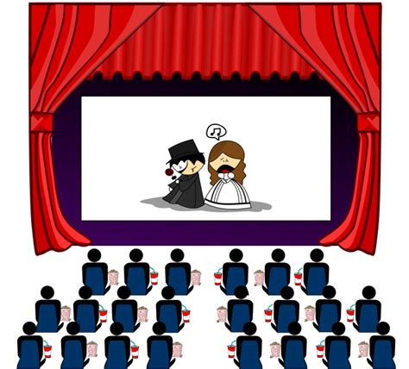
Outline of Playwriting
Concepts:
Questions you should be able to answer:
What does the play represent?
What is its theme?
Why is it important?
Why does it deserve to be witnessed?
What is the moral?
What universal truth does it illustrate?
What excites you, the playwright, about the work?
What aspects of the drama fires your imagination?
What makes you feel zealous and impassioned?
What moves you?
What about the material gives you a deep feeling of satisfaction?
What in the play makes it worthy of an audience’s attention?
Why is it compelling?

Slide 14
Outline of Playwriting
Predominant Elements: What is the leading element in your dramatic work?
Theme
Waiting for Lefty by Clifford Odets is a thesis play directly promoting the theme that the common man will continue to be oppressed until he succeeds in organizing into unions. It is nearly a propaganda play. Character and dialogue serve the theme exclusively. The spectacle is limited to a bare stage. The language is didactic to the point of preachiness.
Plot
The Tavern by George M. Cohan is a play in which the predominant element is almost exclusively plot. The action hurls itself relentlessly at the audience. Character is continuously subservient to plot. The theme, crime does not pay, is apparent from the beginning, and the spectacle requires on an upstage door and a winter wind (example of Music) so powerful it drives all the players to the wall.
Character
All the plays of Chekhov have the predominant element of character. One could barely choose plot as the secondary element. It is also unlikely that one would choose language, because language in Chekhov is intentionally commonplace. There is Theme in Chekhov, but it is subservient to character, it lays quiet and low in the play and rises gracefully and gently to the surface.

Slide 15
Outline of Playwriting
Predominant Elements: What is the leading element in your dramatic work?
Spectacle
Barnum by Mark Bramble and Michael Stewart won a number of prizes in New York, despite the fact that it has no plot, no characters of consequence, and no significant language; its theme, at best, could be stated, a circus causes sweat. The sheer intensity and speed of the spectacle, the unrelenting energy, the nonstop sensation of movement, sound, and color; the surprises, the acrobatic feats, dances, magic, and razzmatazz overwhelmed and gratified audiences.
Language
Under the Milk Wood by Dylan Thomas is subtitled “A Play for Voices.” It is a demonstration of the most miraculous parade of words in the spoken English. It is poetry at its most dazzling. The theme is vague at best. As for plot, it is a patchwork of incidents involving sixty-four characters in a tiny Welch town in the course of a summer day. The characters are sketched, not developed. The predominant element in this play is clearly the most radiant language ever assembled. Spectacle would ruin this work.

Slide 16
Outline of Playwriting
Predominant Elements: What is the leading element in your dramatic work?
Mixtures
Most commonly you will find that the majority of plays have mixtures of all of the elements of drama.
Many playwrights tend to utilize a bit of all the elements.
One of the greatest exceptions and examples of incredible use of all the elements is the plays of Shakespeare.
The reason his plays tower above all others is that he fuses the elements of theme, plot, character, spectacle, and language so magnificently.
In Shakespeare we can marvel at the great skill with which these elements have been united.

Slide 17
Outline of Playwriting
Outlining: Beginning, Middle, and End
Beginning:
Prologue and or start of play with introduction of characters, date, place, time, setting, and exposition and inciting incident introduced
Point of attack, introduce primary conflict and central dramatic question
Middle:
Characters pursue objectives and encounter obstacles
Answers sought; goals of characters conflict with other characters
Characters attempt to overcome obstacles and challenges
Characters plan tactics, succeed, fail, attack, retreat, surprise, and are surprised, encounter major reversals and a crisis is reached
End:
Characters engage in final conflict (climax of play)
A character’s main objective is achieved or lost
Central dramatic question is answered, theme or ideas of play confirmed. Resolution where order is established

Slide 18
Playwriting is an Art
Artistic consideration in playwriting requires selection and arrangement.
Art is skill acquired by experience, study, and clear observations.
Playwrights must consciously set about making choices with a competent plan and creative imagination. Only then than we consider the playwrights work as a viable start to the theatrical process.
Before anyone begins to write a play, it is important to understand the medium for which you intend on writing.
Writing for the stage demands an understanding of two fundamentals:
The essence of drama
The nature of theatre

Slide 19
CHARACTER
Characters are the essences of human behavior.
Representative or quintessential characters – the embodiment of the characteristics of an entire group
Characters are only human as much as the playwright and the production have made them distinguishable from other characters, physically, socially, psychologically, morally.
The concept of "decorum" was important in the Neoclassical period – characters should behave according to their class /circumstances.

Slide 20
CHARACTER
The following terms help describe characters according to their function in the play :
Protagonist -- "agon" = struggle; the pro side of the struggle – often used to refer to the lead character in a tragedy.
Antagonist -- the anti side of the struggle – often the bad guy, but could be anyone / thing that struggles against the protagonist.
Foil / Counterpart -- reveals some aspects of the main characters by having similar or different circumstances or by behaving similarly or differently
Stock characters -- exemplify one particular characteristic, as in commedia dell' arte
Type – a character who is larger than life who has a "dominant trait" – as opposed to a "real" or life-like individual. Similar to "stock" characters
For example: the "villain," the "good cop gone bad," the "precocious child," etc.
Narrators / Chorus and Non-Human characters
Confidante – a character whom the protagonist or other important character confides in.
Author's character – speaks for the author, giving the author's morals or philosophy – usually not the protagonist

Slide 21
Works Cited
Edwin. “Plot vs Narrative.” TSI Games, 26 Mar. 2015, www.tsi-games.com/plot-vs-narrative/. Accessed 31 Aug. 2017.

