Slide 1
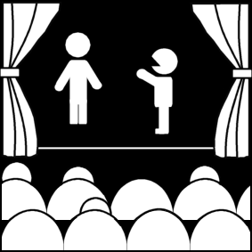
What is theatre? (Part 4)
Week 1
Introduction to Theatre
College of the Desert

Slide 2
How have people from the past viewed theatre?
Those who have tried to define it have often resorted to metaphors. For example:
Samuel Johnson called theatre "an echo of the public's voice"
Shakespeare called it "a mirror"
Giraudoux "a trial"
Farquhar "a banquet," he carried his comparison on at some length:
Like hungry guests, a sitting audience looks:
Plays are like suppers; poets are the cooks:
The founder's you: the table is this place:
The carver's we: the prologue is the grace.
Each act a course, each scene a different dish

Slide 3
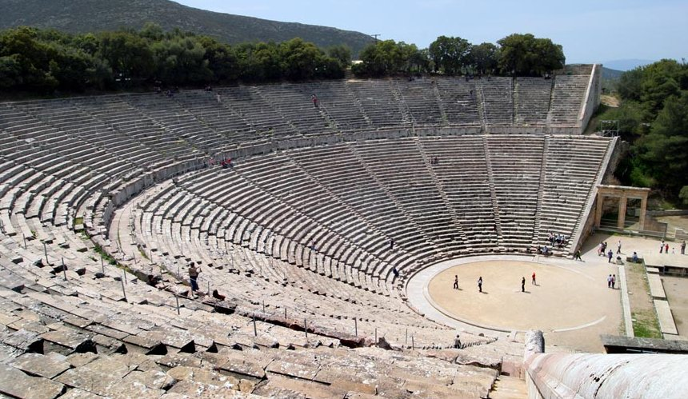
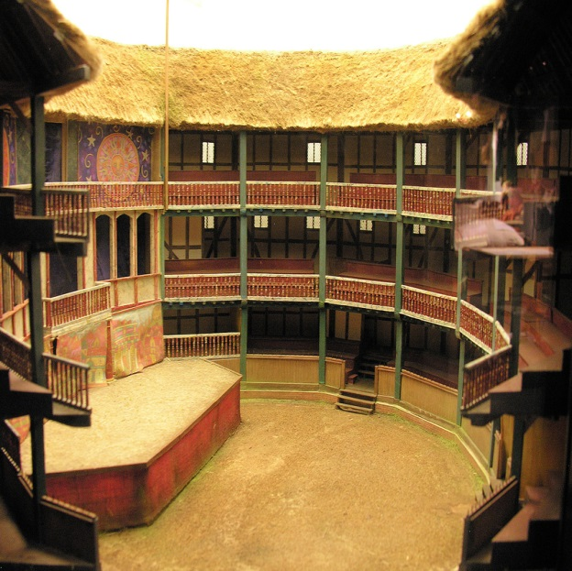
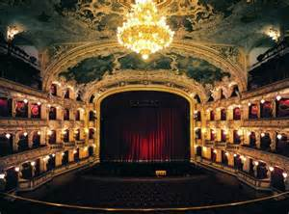
What is a theater?
The architecture of the theater has evolved greatly over time beginning with Classical theatre.
The State Opera, is an opera house in Prague, Czech Republic. It is part of the National Theatre of the Czech Republic, founded by Ministry of Culture of the Czech Republic in 1992. The theatre itself originally opened in 1888 as the New German Theatre and from 1949 to 1989 it was known as the Smetana Theatre. More recently it was renamed the Prague State Opera. Currently it is home to approximately 300 performances a year.
The Ancient Theatre of Epidaurus is situated within the archaeological site of the Sanctuary of Asklepios, in the Argolis prefecture of the Peloponnese. It is a half-hour drive from Nafplio and approximately two hours from Athens.
The Globe Theatre is a famous London theatre in which after 1599 the plays of William Shakespeare were performed.

Slide 4
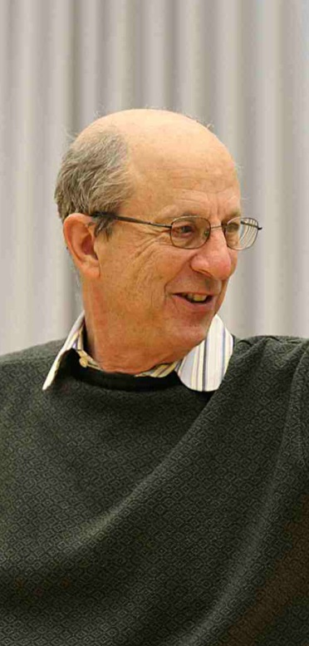
What is the difference between theatre and drama?
Theatre is the place of performance, such as the Richards Center of the Arts here in Palm Springs, or the performance of a theatrical work, such as the 2018 Broadway musical: Mean Girls.
A performance, according to Robert Cohen, is "an action, or series of actions, taken for the benefit of someone else. We call that 'someone else' the audience.”
Robert Cohen is an American university professor, theatre director, playwright, and drama critic.
He defines the theatre as "the live performance...of a scripted and rehearsed event.”
Obviously the three key words are:
Live
Performance
Scripted
Scripted means the work is repeatable
Robert Cohen

Slide 5
What is the difference between theatre and drama?
Drama is the script or the text of a play. As one writer put it: "drama is on the page and theatre is on the stage."
The original source language of these two terms, drama and theatre is Greek.
A rough English translation:
Theatre: To see
Drama: To do

Slide 6
Recap of Aristotle’s Ideas
Aristotle (384-322 BCE) was a Greek critic who in The Poetics (335 BCE), outlines the beginnings of drama
Aristotle develops a structured approach to dramatic analysis and presents a definition of drama.
What is his definition of drama?
Drama is "an imitation of men in action."
Three key words:
Imitation: It's not real, it's make believe.
Men: Drama deals with people, men and women.
Action: Something happens. There is movement; a beginning, middle and an end.

Slide 7
Recap on the meaning of the word Theatre
We now know that the word "theatre" derives from the ancient Greek word, theatron meaning literally "an instrument for (-tron) viewing (thea-)," which is problematical in and of itself.
By this definition, a theatron refers to only the audience's part of the theatre, where the seats are, the actual "instrument for viewing," that is, the place from which the viewers watched the drama.
That discounts the other parts of the Greek theatre where the performance, for the most part, takes place: the orchestra (dancing area), the skene (the tent behind the stage), and the parodoi (the side entrances into the orchestra).

Slide 8
Recap on the meaning of the word Theatre
Thus, theatron is too narrow a term to help us much in defining "theatre." After all, does theatre even require a specific "instrument for viewing?"
Street theatre, by definition, does not have a theatron, but few would say it is not theatre.
So, "theatre" is, in fact, harder to define. In reality, theatre offers a very wide range of possibilities in both theory and reality.
The American composer John Cage said that "theatre takes place all the time wherever one is."
The critic Bernard Beckerman claimed that theatre happens whenever "one or more human beings, isolated in time and/or space, present themselves to another or others..."
Neither constitutes a very restrictive definition. When it is not possible to tell theatre from a lecture, a tennis match, or astronauts on the moon, the search for a definitive definition is not over.

Slide 9
Recap on the meaning of the word Theatre
One modern theatre historian, Patti Gillespie, has referred to theatre as "performances by living actors that take place in the presence of living audiences," which is at least a more concrete definition. But it really only substitutes one abstract (theatre) for another (performance), which leaves open the question of what "performance" is.
The great theatre historian of the late twentieth century, Oscar Brockett, focused his studies in theatre history on theatre as an institution, or, as he puts it, an "autonomous activity" as opposed to merely "theatrical" elements in society at large.
But that assumes a society has some general recognition of theatre as a distinct art form and, inevitably, that means it must also have a representative word or way of referring to that institution, some sort of equivalent to our term "theatre."
And such a definition is circular: "theatre" is what a society calls "theatre.“

Slide 10
Recap on the meaning of the word Theatre
Moreover, associating vocabulary in different languages is a notoriously difficult enterprise.
When translating words from a foreign language into English, we are imposing our views of life on another society. If we decide that some foreign word is equivalent to "theatre," are we not the ones asserting that that society has the institution of theatre?
In ancient Egypt, there is no word exactly equivalent to our word "theatre," but there does appear to have been "theatrical" institutions
For example, festivals that had some sort of performance-based component.
The same difficulty exists in assessing whether Native American rituals, such as the buffalo dance, constitute "theatre."
So, while Brockett's view of "theatre as an institution" is helpful in defining theatre and almost certainly points us in the right direction, it presents its own problems and suggests that ultimately a fully satisfactory definition of theatre may not be possible.

Slide 11
Recap on the meaning of the word Theatre
If there is no clear definition, we can look at particular elements that are essential to theatre, perhaps we can gain, if nothing else, a sense of what theatre is:
LANGUAGE
To begin with, most theatre historians and critics would agree that language is fundamental to theatre. Whereas song predominates in opera and movement lies at the heart of ballet, the principal element in theatre is narrative language of some sort, which is not to say that song and dance cannot serve as elements of theatre, only that the spoken word tends to dominate even in musical theatre.
It must be admitted that the definition of "language" must be somewhat flexible in this case, because theatrical language can be sign language as in deaf theatre and the complex symbology of gesture found in some Asian theatre—much as with pantomime in Western theatre—but in all cases, language-based communication of some sort lies at the heart of the medium.

Slide 12
Recap on the meaning of the word Theatre
Impersonation
A second element fundamental to theatre is impersonation. In the same way that rules define a game or instruction underlies and shapes everything that happens in a classroom, impersonation is a formative component of theatre. A person or persons pretending to be people or things other than themselves is found in all forms of entertainment we call "theatre." The escape that such disguise provides to both performer and audience is, no doubt, one of the attractions of theatre. It opens the door to fantasy and all the enjoyments that unreality affords.
Audience
The third and last, but arguably the most important, element of theatre is the audience. Without an audience, without viewers viewing the viewed, how can there be theatre? It is curious, then, that we call those attending theatre the "audience," a word drawn from the Latin word for "hear" (audio), thereby attesting to the power of language, the first fundamental element of theatre listed above. But "spectators" is arguably a better term (from Latin specto, "watch").

Slide 13
Defining "Theatre History"
Such wide-open definitions of its component words complicate the process of creating a definition of "theatre history."
Given that "history" is "story" and "theatre" is "seeing," we might be led to assert that theatre history is a "narrative of the development of performances viewed by audiences across time."
In particular, employing synonyms like "performance" does little to advance our understanding, and surely it is important to recognize in any definition put forth theatre's focus on language and impersonation and, most of all, the centrality of the audience.
Thus, theatre history might be said to be the "reconstruction of the relationships between audience and language-oriented impersonation-based presentations in the past," but there are obvious problems with that definition as well.
Even if it were possible to recreate ancient performances in their costumes, sets and even language, it is still impossible to resurrect the ancient audience.

Slide 14
Defining "Theatre History"
This points to a fundamental difficulty in analyzing theatre in general:
All performance is history the second it is over.
The moment the word is said, the gesture is made, and the lights go down, the illusion is gone and, if no new illusion arises, the theatre in the strictest sense of the word is done.
The magic that arcs between viewer and viewed is a sequence of momentary flashes and that magic evaporates when either audience or play disappears.
Moreover, unlike art historians, theatre historians cannot retrieve or study the work itself, because the most crucial element is lost and unrecoverable—that is, the original audience, that collective of watchers listening as a group and reveling in the theatrical illusion and conventions prevalent in their day—all of which certainly makes "authentic" reproductions of past theatres appear rather pointless.

Slide 15
Defining "Theatre History"
Reconstructions of ancient performances more often than not result in mechanical, boring theatrical events that use "authenticity" as a screen to mask their creators' lackluster, uncourageous artistic choices.
So, where does that leave our attempt to define theatre history? Trapped somewhere between the play and the audience, the living and the dead, theatre history turns by default into a study of the records of performance in a society, a culture's collective memory of the evolution of its theatre and drama.
Imperfect as that definition is, it underscores an important point: theatre history involves the revival of past performances not necessarily on any real stage, but in the imaginary stage of the historian's mind. That makes it all the more important for historians to be aware of their own biases and cultural preferences since these may distort the picture unduly.

Slide 16
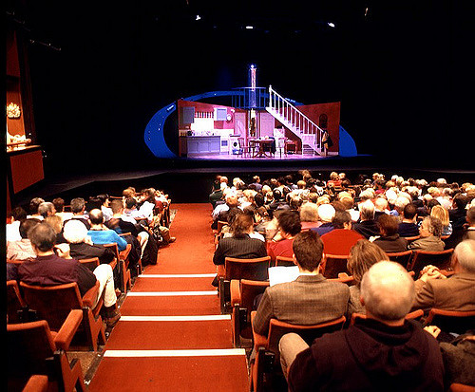
What are the six major elements of theatre?
Audience
Script
Actors
Director
The theatrical space (the theatre)
The technical elements of scenery, lights, costumes and sound

Slide 17
Top Ten Reasons Why Theatre is Still Important in the Twenty-First Century
Creativity
Theatre helps us to develop our creativity. As our education system increasingly puts an emphasis on science, technology, engineering, and math, we cannot forget the importance of art. Let’s put the “STE(A)M” back in “STEM!”
STEM stands for science, technology, engineering, and mathematics

Slide 18
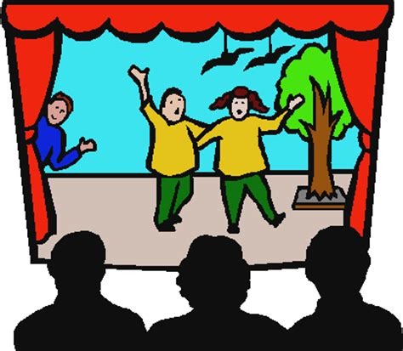
Top Ten Reasons Why Theatre is Still Important in the Twenty-First Century
2. Education
Theatre is a great way to learn. Going to the theatre teaches us about people, places, and ideas to which we would not otherwise be exposed. Learning in a theatrical setting makes learning fun.

Slide 19
Top Ten Reasons Why Theatre is Still Important in the Twenty-First Century
3. Social Change
Theatre is a cultural space where society examines itself in a mirror.
Theatre has long been looked at as a laboratory in which we can study the problems that confront society and attempt to solve those problems.

Slide 20
Top Ten Reasons Why Theatre is Still Important in the Twenty-First Century
4. Self-Empowerment
Performance permeates every aspect of our everyday lives.
Power relationships are constructed through performances.
Understanding how performances unfold around us can help us to recognize and take control of the power dynamics that affect us.

Slide 21
Top Ten Reasons Why Theatre is Still Important in the Twenty-First Century
5. Globalization
Theatre helps us understand people from cultures other than our own. We can learn a lot about people from cultures all around the world by studying their performance traditions. In doing so, we can learn to be less ethnocentric, and more accepting of others.
According to the Oxford dictionary, ethnocentric means to evaluate other people and cultures according to the standards of one's own culture.

Slide 22
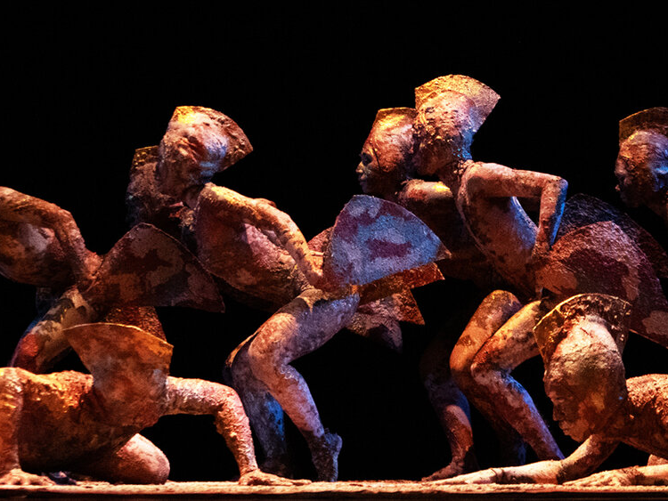
Top Ten Reasons Why Theatre is Still Important in the Twenty-First Century
6. The Body
Theatre reminds us that, even in this ever-changing digital age, there is a human body at the center of every digital transaction. Accounting for the body in the design of the future will help us make technology that works for us rather than us working for technology.

Slide 23
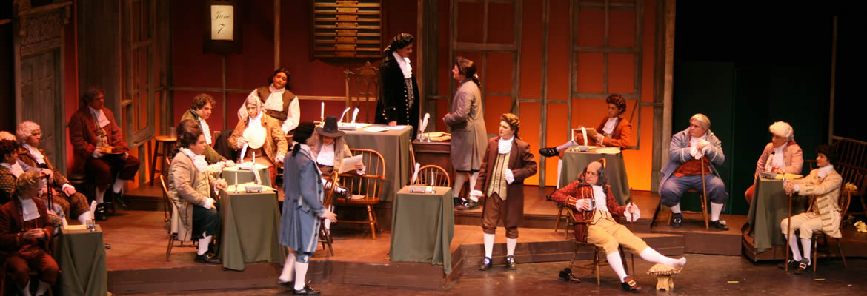
Top Ten Reasons Why Theatre is Still Important in the Twenty-First Century
7. History
Theatre is a great way to lean about history. Rather than learning history from reading it in a dusty textbook, theatre makes history come alive right before our eyes. Theatre makes learning about history fun.

Slide 24
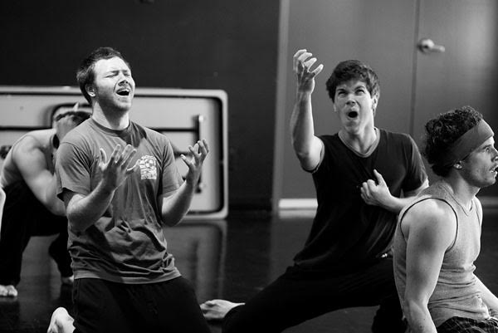
Top Ten Reasons Why Theatre is Still Important in the Twenty-First Century
8. Self-Knowledge
Theatre teaches us about ourselves. It helps us understand how our minds and the minds of others work. It helps us to see how the environments in which we live affect who we are and who we will become.

Slide 25
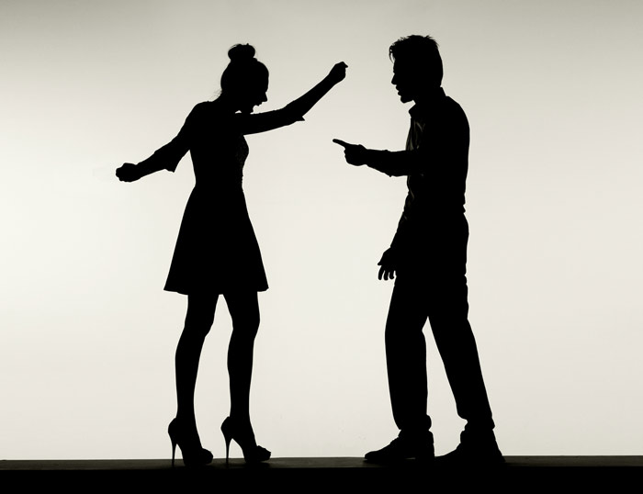
Top Ten Reasons Why Theatre is Still Important in the Twenty-First Century
9. Self-Expression
Theatre teaches us how to express ourselves more effectively. It develops our ability to communicate our thoughts and feelings to others, improving our relationships and improving the world around us.

Slide 26
Top Ten Reasons Why Theatre is Still Important in the Twenty-First Century
10. Human Beings
The performance of theatre is a universal cultural phenomenon that exists in every society around the world.
Human beings are the only animal species that creates theatre.
Understanding theatre helps us understand what it means to be human.

Slide 27
Why is learning about theatre important?
In the theatre we see men and women in action-what they do and why they do it – and we discover insight about our world by seeing through others' eyes.
Theatre is a major form of human expression, taking place in the present, but connecting us to other times and places.
Through characterization, design, and technology, theatre artists provide a window into the human condition.
Theatre is both visual and hearing medium, a shared experience between audience and performers.

Slide 28
Works Cited
Brown, Kevin. “The Top Ten Reasons Why Theatre is Still Important in the Twenty-First Century.” TCG Circle The Top Ten Reasons Why Theatre is Still Important in the Twenty-First Century Comments, Theatre Communications Group, www.tcgcircle.org/2014/06/the-top-ten-reasons-why-theatre-is-still-important-in-the-twenty-first-century/. Accessed 15 Aug. 2017.
Damen. (2012). Classical Drama and Society. Retrieved August 15, 2017, from http://www.usu.edu/markdamen/ClasDram/chapters/011intro.htm
Kantilaftis, H. (2015, November 24). Deeper Into The Method: 5 Contemporary Actors That Took Method Acting To The Limit. Retrieved August 15, 2018, from https://www.nyfa.edu/student-resources/deeper-into-the-method-5-contemporary-actors-that-took-method-acting-to-the-limit/
Mansfield University Office of Public Relations and Marketing. (n.d.). Opera & Musical Theatre. Retrieved August 15, 2018, from https://www.mansfield.edu/theatre/

